Slide 1
Digital Design & Computer Arch. Lab 8.1 Supplement: Full System Integration
Prof. Onur Mutlu
ETH Zürich
Spring 2022
3 May 2022

Slide 2
Lab 8 Overview
You will build a whole single-cycle processor and write assembly code that runs on the FPGA board.
Don’t worry! You have 2 sessions for the lab, and it will give you up to 14 points (+6 points from the reports).
You will learn how a processor is built.
Learn how the processor communicates with the outside world.
Implement the MIPS processor and demonstrate a simple “snake” program on the FPGA starter kit.

Slide 3
Lab 8 Sessions
Session I: The Crawling Snake
Session II: Speed Up the Snake

Slide 4
Lab 8 Session I: The MIPS Processor
Download the Vivado project from the course website
A lot of parts are already implemented for you!
What you will have to implement:
Compute the Instruction Memory address and read the instruction.
Connect the ALU.
Compute the Data Memory address and add the necessary wires.
Instantiate the Control Unit.

Slide 5
Lab 8 Session I: Memory-Mapped I/O
Your goal is to control the 7-segment display with your assembly program.
You will need to complete the I/O controller so the output of the processor will be correctly mapped to the display.

Slide 6
I/O in Assembly
How do we communicate with the display?
Memory Mapped I/O
We designate specific addresses for the I/O
We can read and write to those addresses.
Example
# write contents of $t0 into memory at address 0x7FF0
# so that the I/O controller can send it to the display
sw $t0, 0x7FF0($0)

Slide 7
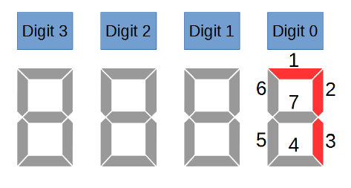
Lab 8 Session I : The Crawling Snake
You learned how to write assembly code in Lab 7
We provide you with the code for a crawling snake on the 7-segment display
We will run this program on the processor you build in this lab!

Slide 8
Lab 8 Session II: Speed Up The Snake
You will modify your assembly code to accept inputs.
The snake should crawl at different speeds for different inputs.
The inputs will be controlled by switches on the FPGA board.
Modify the I/O controller to accept the inputs.
Challenges
Change the direction of the snake.
Change the pattern of the snake.

Slide 9
Last Words
You will build a whole single-cycle processor and write assembly code that runs on the FPGA board.
You will learn how a processor is built.
Learn how the processor communicates with the outside world.
Implement the MIPS processor and demonstrate a simple “snake” program on the FPGA starter kit.
You will have some questions to answer in the report.

Slide 10
Report Deadline
23:59, 27 May 2022

Slide 11
Digital Design & Computer Arch. Lab 8.1 Supplement: Full System Integration
Prof. Onur Mutlu
ETH Zürich
Spring 2022
3 May 2022

