Slide 1
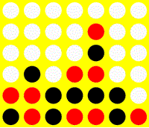
Neural Network Applications for Connect 4
Thomas Blight, Weiliang Chen, Gabriella Grandilli, Noah Sugarman

Slide 2
Problem
Create a competent and fast game AI that learns only from game states
Connect 4 was chosen because it is simple to learn but complex to master and has a limited number of game states
Notes:
Wei

Slide 3
Neural Network-based Solution
- Supervised Learning
- Back propagation
Input Space: 42 parameters
Motivation for neural networks:
- Easy to train on
- Fast decision-making
- Have multiple neural networks to encapsulate different game logic
Notes:
Wei

Slide 4
Training Data Generation
Heuristic AI: Play 100,000 games of Connect 4. When a game finishes, record each game state and whether it lead to victory, defeat or a draw
8-ply AI: Use predefined 8-ply database of game states where optimal play is assumed
Notes:
Noah

Slide 5
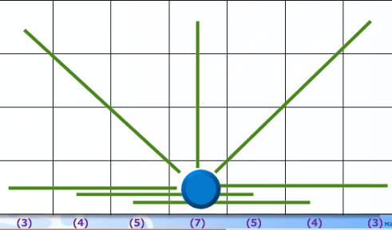
Game-Playing Algorithms
Used a line completeness heuristic with occasional random move selection to create a competitive semi-random Connect 4 AI .
Notes:
Noah

Slide 6
Results
Using the 8-ply ANN:
Beat random AI 87% of the time
Beat skilled human player 27% of the time
Beat heuristic game AI 50% of the time
Average of 0.15s to calculate next move
Notes:
Tom

Slide 7
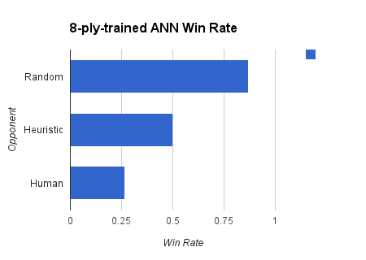
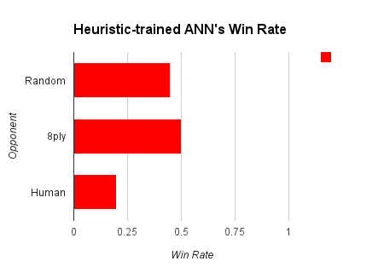
Results
Notes:
Tom

Slide 8
Conclusions
It's possible to create a competent Connect 4 AI by training only on game states
We beat a random AI 87% of the time and a competent human player 27% of the time
Easy to extend to other games with a finite number of game states (AI doesn't require knowledge of the rules of the game)
Notes:
Gabie

