Slide 1
Speechboard
Automatic Meeting Transcription on Tablet Devices
Fravic Fernando
Andrew Russell
Will Hughes
Noah Sugarman
Andrew Shapiro Munn
Customer: Extreme Venture Partners

Slide 2
Project Description
Problem: Taking meeting notes is hard, error-prone and distracting
Solution: An tablet app that automatically records meetings and helps pick out the important points

Slide 3
Iteration One Backlog
Competitor research
Front-End and UI
User environment design
Low-fidelity prototypes
Investigate audio capabilities of tablet devices
Back-End
Investigate open source solutions for speaker and speech recognition
Basic prototype of the cocktail party problem
Basic prototype of speech recognition

Slide 4
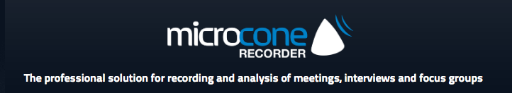
Competitor Research
Investigation complete ☺
Competitor: Microcone
High price
Requires custom hardware

Slide 5
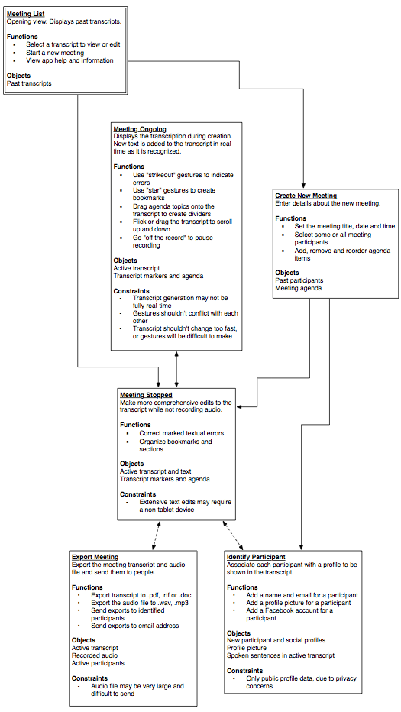
UED
Complete ☺
User Environment Design
Diagram of locations
Notes functions, constraints

Slide 6
Low-fidelity Prototypes
Not Complete ☹
Disagreement over how to implement UED
Not enough time
Must have unified vision of product

Slide 7
Audio Capabilities
Investigation complete ☺
Researched ability to stream input audio from iOS/Android

Slide 8
Open Source Solutions
Investigation complete ☺
Looked at numerous libraries

Slide 9
Cocktail Party Problem
Complete ☺
Implemented algorithm in Matlab

Slide 10
Basic Prototype of Speech Recognition
Not Complete ☹
It’s hard
Not enough time
More research and time for next iteration

Slide 11
Retrospective
We switched designs half-way through the iteration
Lost a lot of time and effort on the wrong idea
We need to have more time dedicated to the design project
We will hold regularly scheduled design project “workathons” in iteration 2

