Slide 1
Sean Koppenhafer, Jaime Rodriguez,
Chad Thueson, Noah Erickson, Rishal Dass
Weekly meeting, 2/11/2015
Digital Dash
Portland State University
Department of Electrical and Computer Engineering (ECE)

Slide 2
Weekly Progress Report
Updated Solutions in Proposal
Project schedule
  Extended to include Presentation & Poster
4D-System Display
  Ordered
Custom Board
  Create schematic
  Design power supply
Next Steps
  Test out program with electric car
  Start GUI design
Notes:
1/23/15, Thinking about Arduino Due for prototyping, in March send out CAD design for PCB manufacturing to cut down on real estate for the arduino due

Slide 3
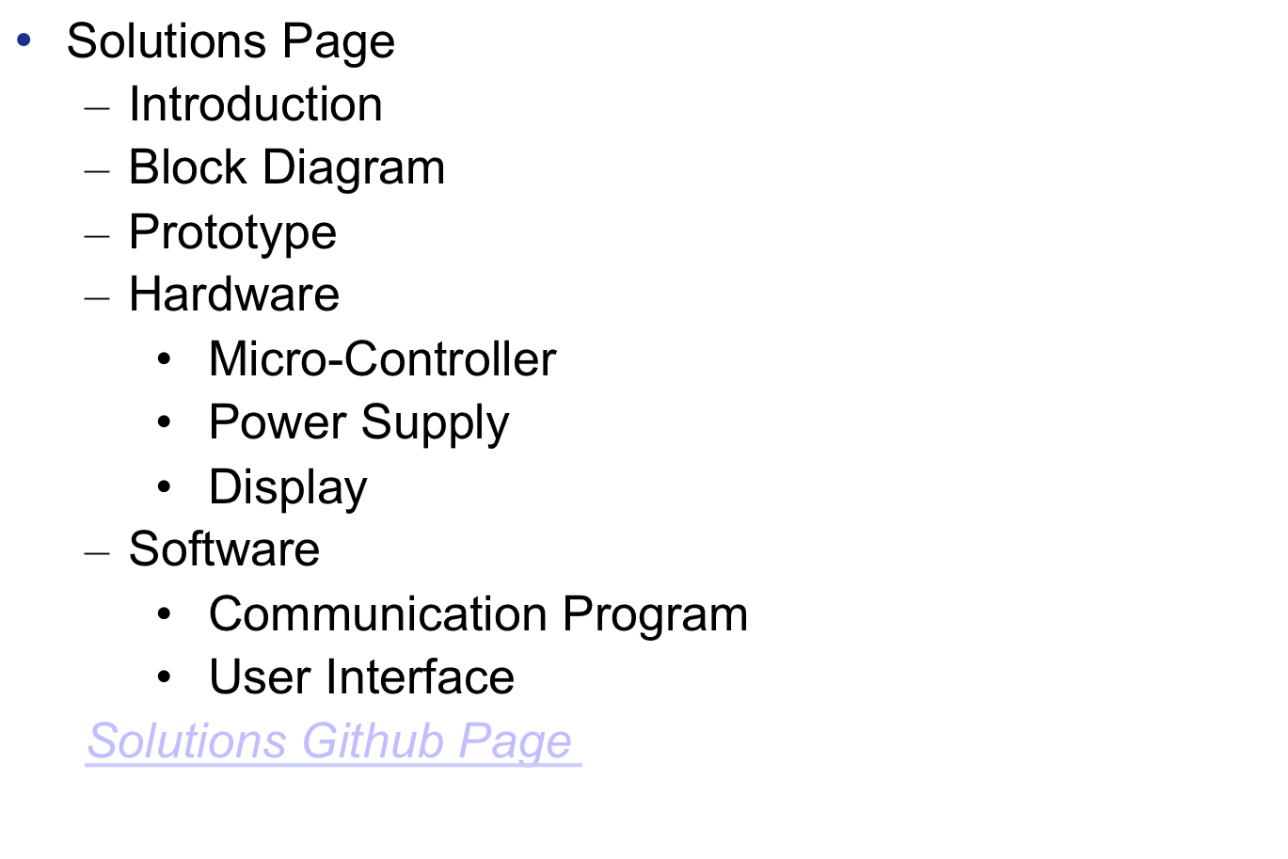
Updated Proposal

Slide 4
Project Schedule
Gantt Chart updated to include Presentation
  Schedule adjusted to include
    Presentation ( 6/12/15 )
    Poster ( 6/12/15 )
    Wrap up documentation

Slide 5
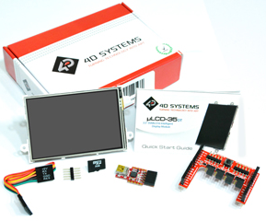
4D-Systems Display
Display Ordered
  uLCD-35DT
  3.5” screen
  Arduino Starter Kit
  $94.16

Slide 6
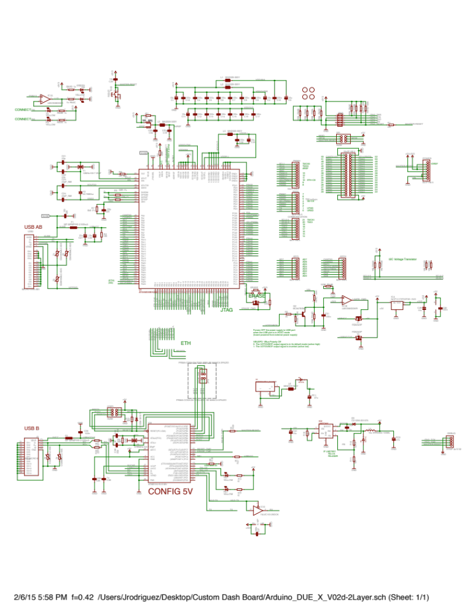
Arduino Due Schematic

Slide 7
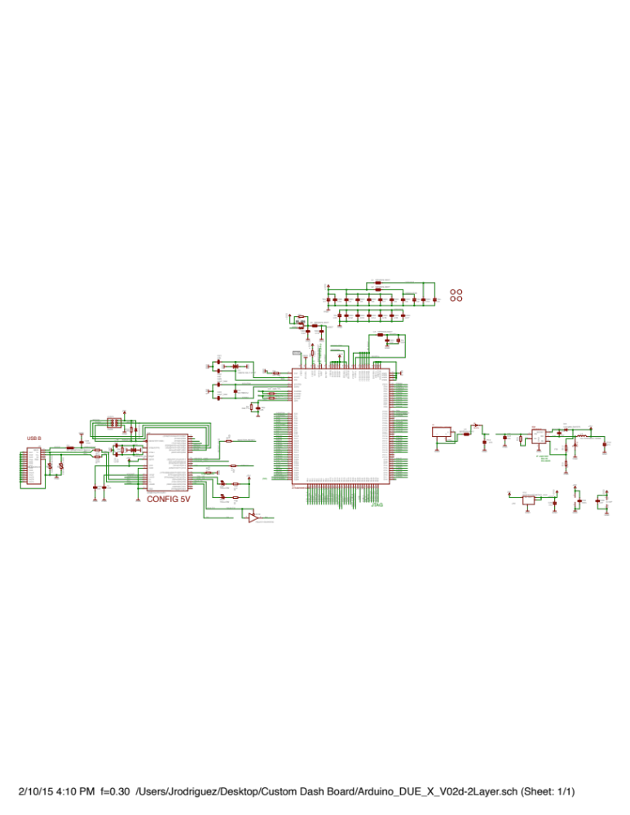
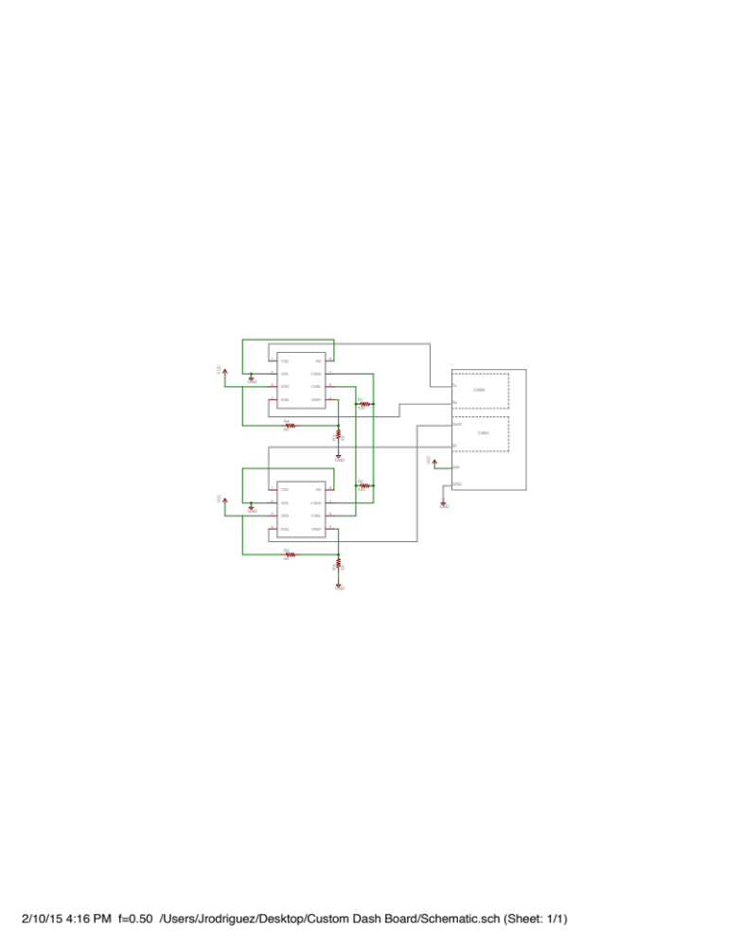
Custom Board Schematic
CAN Transceiver
Power Supply
MicroController
USB Programmer

Slide 8
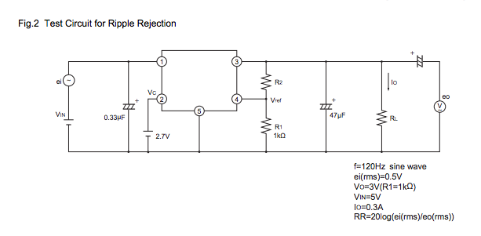
Power Supply
Current
  - LM2743
    Switching DC-DC Converter (Noise)
    Complicated
    $2.74 & up (Digi-Key)
Alternatives
  Fixed Voltage
    Specific voltages only
  Adjustable (Low Drop Out)
    Easy To Use
    Low Noise
    $1.50 & up
Sharp-070Xz1H

Slide 9
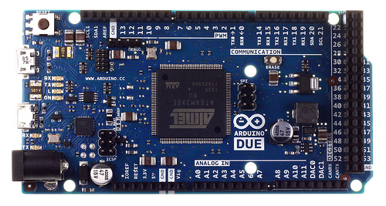
Prototyping Progress (update)
Arduino Due and MCP2551 Transceivers received
Were able to successfully send CAN messages between CAN0 and CAN1
Both polling and interrupt versions
Error codes defined
Interrupts setup for receiving messages
Prototype ready for testing with car.
Notes:
1/23/15, Thinking about Arduino Due for prototyping, in March send out CAD design for PCB manufacturing to cut down on real estate for the arduino due

Slide 10
Next Steps
The 4D systems screen
  Wait till it arrives
  Begin laying out GUI using systems IDE
Documentation
  - Continue both Hardware & Software
Debug Prototype
  Test Prototype with actual messages from the car’s CAN Buses
Custom Board
- Continue schematic capture for new board
- Begin new board layout

