Slide 1
Sean Koppenhafer, Jaime Rodriguez,
Chad Thueson, Noah Erickson, Rishal Dass
Weekly meeting, 12/17/2014
Digital Dash
Portland State University
Department of Electrical and Computer Engineering (ECE)

Slide 2
Weekly progress report
Project Overview
  Block Diagram
Research Main Components
  Micro Controller
  Communication Protocols
  Displays
Next Steps
  Select Components
  Designate tasks

Slide 3
Project Overview
eVCU
Communication
network
μ-Controller
LCD
Driver
LCD Display
Power
supply
Fig. 1 Block Diagram of Digital Dash system

Slide 4

Microcontroller
AT90CAN128
  8bit,128K flash
  16MHz
  CAN, EBI/EMI, I²C, SPI, UART/USART
Pros
  Cheap, $11
  Easy to use, and develop
  CAN Controller
Cons
  No Graphic LCD support (need graphics driver)

Slide 5
Microcontroller
AT328P/48/68/88
  8bit,32K flash
  20MHz
  I²C, SPI, UART/USART
Pros
  Cheap, $4
  Easy to use, and develop
Cons
  No Built in CAN Controller
  No Graphic LCD support (need graphics driver)

Slide 6
LCD Displays
Earth LCD
New Haven
Sun LCD
Sharp Microelectronics

Slide 7
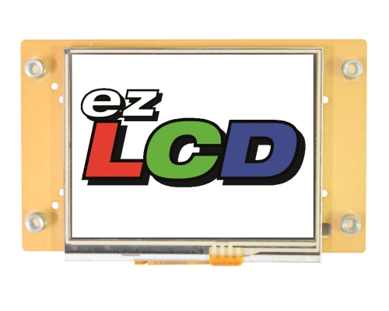
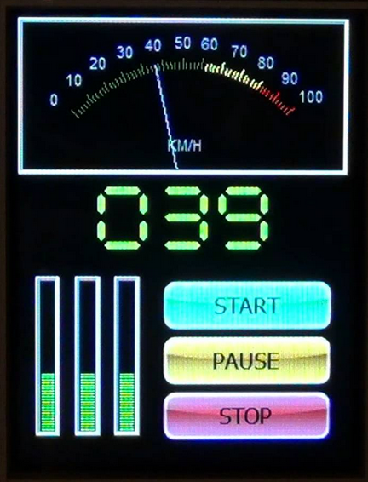
Earth LCD
ezLCD-313
Pros
  Indoor/Outdoor, Sun light Readable, 3.5" Smart LCD
  Transflective
  64K Colors
  Back light for night
  16 Bit Graphics Processor
  Sample macros and Widgets include analog meter,
  buttons, checkbox, dial, radio button, slider, and others.
  Arduino Compatible
Cons
  Expensive $219

Slide 8
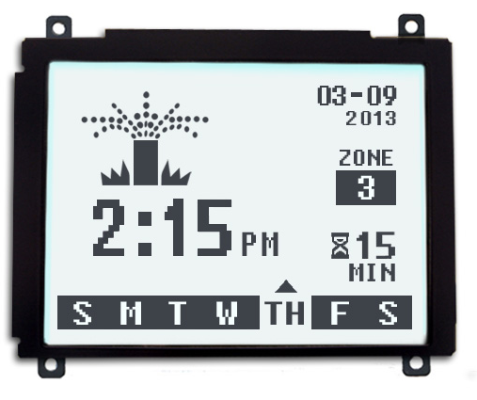
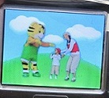
New Haven/ Sun LCD
NHD-320240WX-CoTFH-V#I041
Pros
  Transflective
  Size (3.7 x3.2)
  Cheap $59.99
  Graphic processor
Cons
  Black White
Sun-K3.5
Pros
  Transflective Color
  Size (3.5”)
  Graphic processor
  Bright 800 nits
Cons
  Cost ???

Slide 9
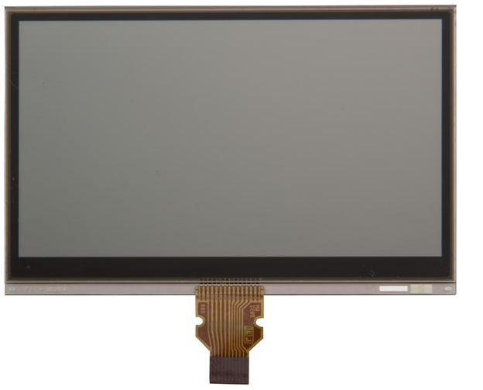
Sharp
P/N 852-LS027B7DH01
2.7” TFT display
Pros
  Memory LCD
  Low Power
  SPI interface
  Cheap $33
  Fast response
  High Resolution
Cons
  Mono Chrome black/white
  No Graphic Processor

Slide 10
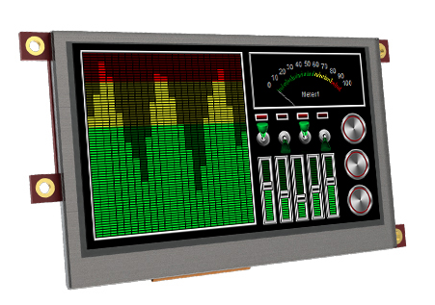
4D System
P/N 852-LS027B7DH01
4.3” LCD display
Pros
  Easy to connect to Arduino
  Resistive Touch
  Big Bright color display
  Moderate price $150
  Power Graphics processor
  Simple tools to create Gui
  High Resolution
Cons
  Regular LCD/ Not Transflective

Slide 11
Next steps
Select Components
  Choose LCD Display
Designate Tasks to be completed
  Who will do what
Create a project plan
  (GANTT chart).

