Slide 1
Sean Koppenhafer, Jaime Rodriguez,
Chad Thueson, Noah Erickson, Rishal Dass
Weekly meeting, 2/4/2015
Digital Dash
Portland State University
Department of Electrical and Computer Engineering (ECE)

Slide 2
Weekly Progress Report
Updated Project Proposal
Project schedule
  Completed
Arduino Due
  Received
CAN messages sending/receiving
Next Steps
  Program CAN message interrupts
  Work on documentation
  Source the screen
Notes:
1/23/15, Thinking about Arduino Due for prototyping, in March send out CAD design for PCB manufacturing to cut down on real estate for the arduino due

Slide 3
Project Proposal
Proposal now solely on the Github Wiki
Wiki now covers
  Objective
  Motivation
  Component choices and design
  Timeline
  Test plan
  Success Criteria
  Potential roadblocks

Slide 4
Project Schedule
Gantt Chart updated to reflect proper timeline
  Confusion with dates existed (prototype vs. final)
  First prototype (Arduino Due) to be complete by late March
  Final system to be complete by end of June

Slide 5
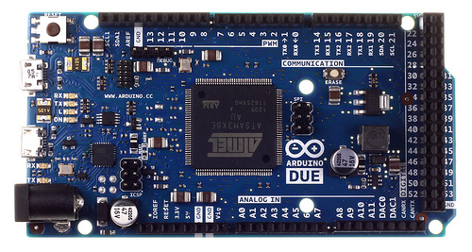
Prototyping Progress
Arduino Due and MCP2551 Transceivers received
Were able to successfully send CAN messages between CAN0 and CAN1
Both polling and interrupt versions
Skeleton code started
Notes:
1/23/15, Thinking about Arduino Due for prototyping, in March send out CAD design for PCB manufacturing to cut down on real estate for the arduino due

Slide 6
Next Steps
Source the 4D systems screen
  Either get a sample or buy it
Begin software documentation
Continue developing the prototype
  Receive word from Michal on the CAN messages that matter
  Begin to work on schematics
  Test receiving CAN messages from the car's CAN buses

