Slide 1
Sean Koppenhafer, Jaime Rodriguez,
Chad Thueson, Noah Erickson, Rishal Dass
Weekly meeting, 1/28/2015
Digital Dash
Portland State University
Department of Electrical and Computer Engineering (ECE)

Slide 2
Weekly progress report
Project Proposal
  Completed
Project schedule
  Schedule Updated to reflect actual dates
More Research Complete
  Microprocessors
Design Review
  Completed
Next Steps
  Purchase Components
  Start Prototyping
Notes:
1/23/15, Thinking about Arduino Due for prototyping, in March send out CAD design for PCB manufacturing to cut down on real estate for the arduino due

Slide 3
Project
eVCU
Communication
network
μ-Controller
LCD
Driver
LCD Display
Power
supply
Fig. 1 Block Diagram of Digital Dash system

Slide 4
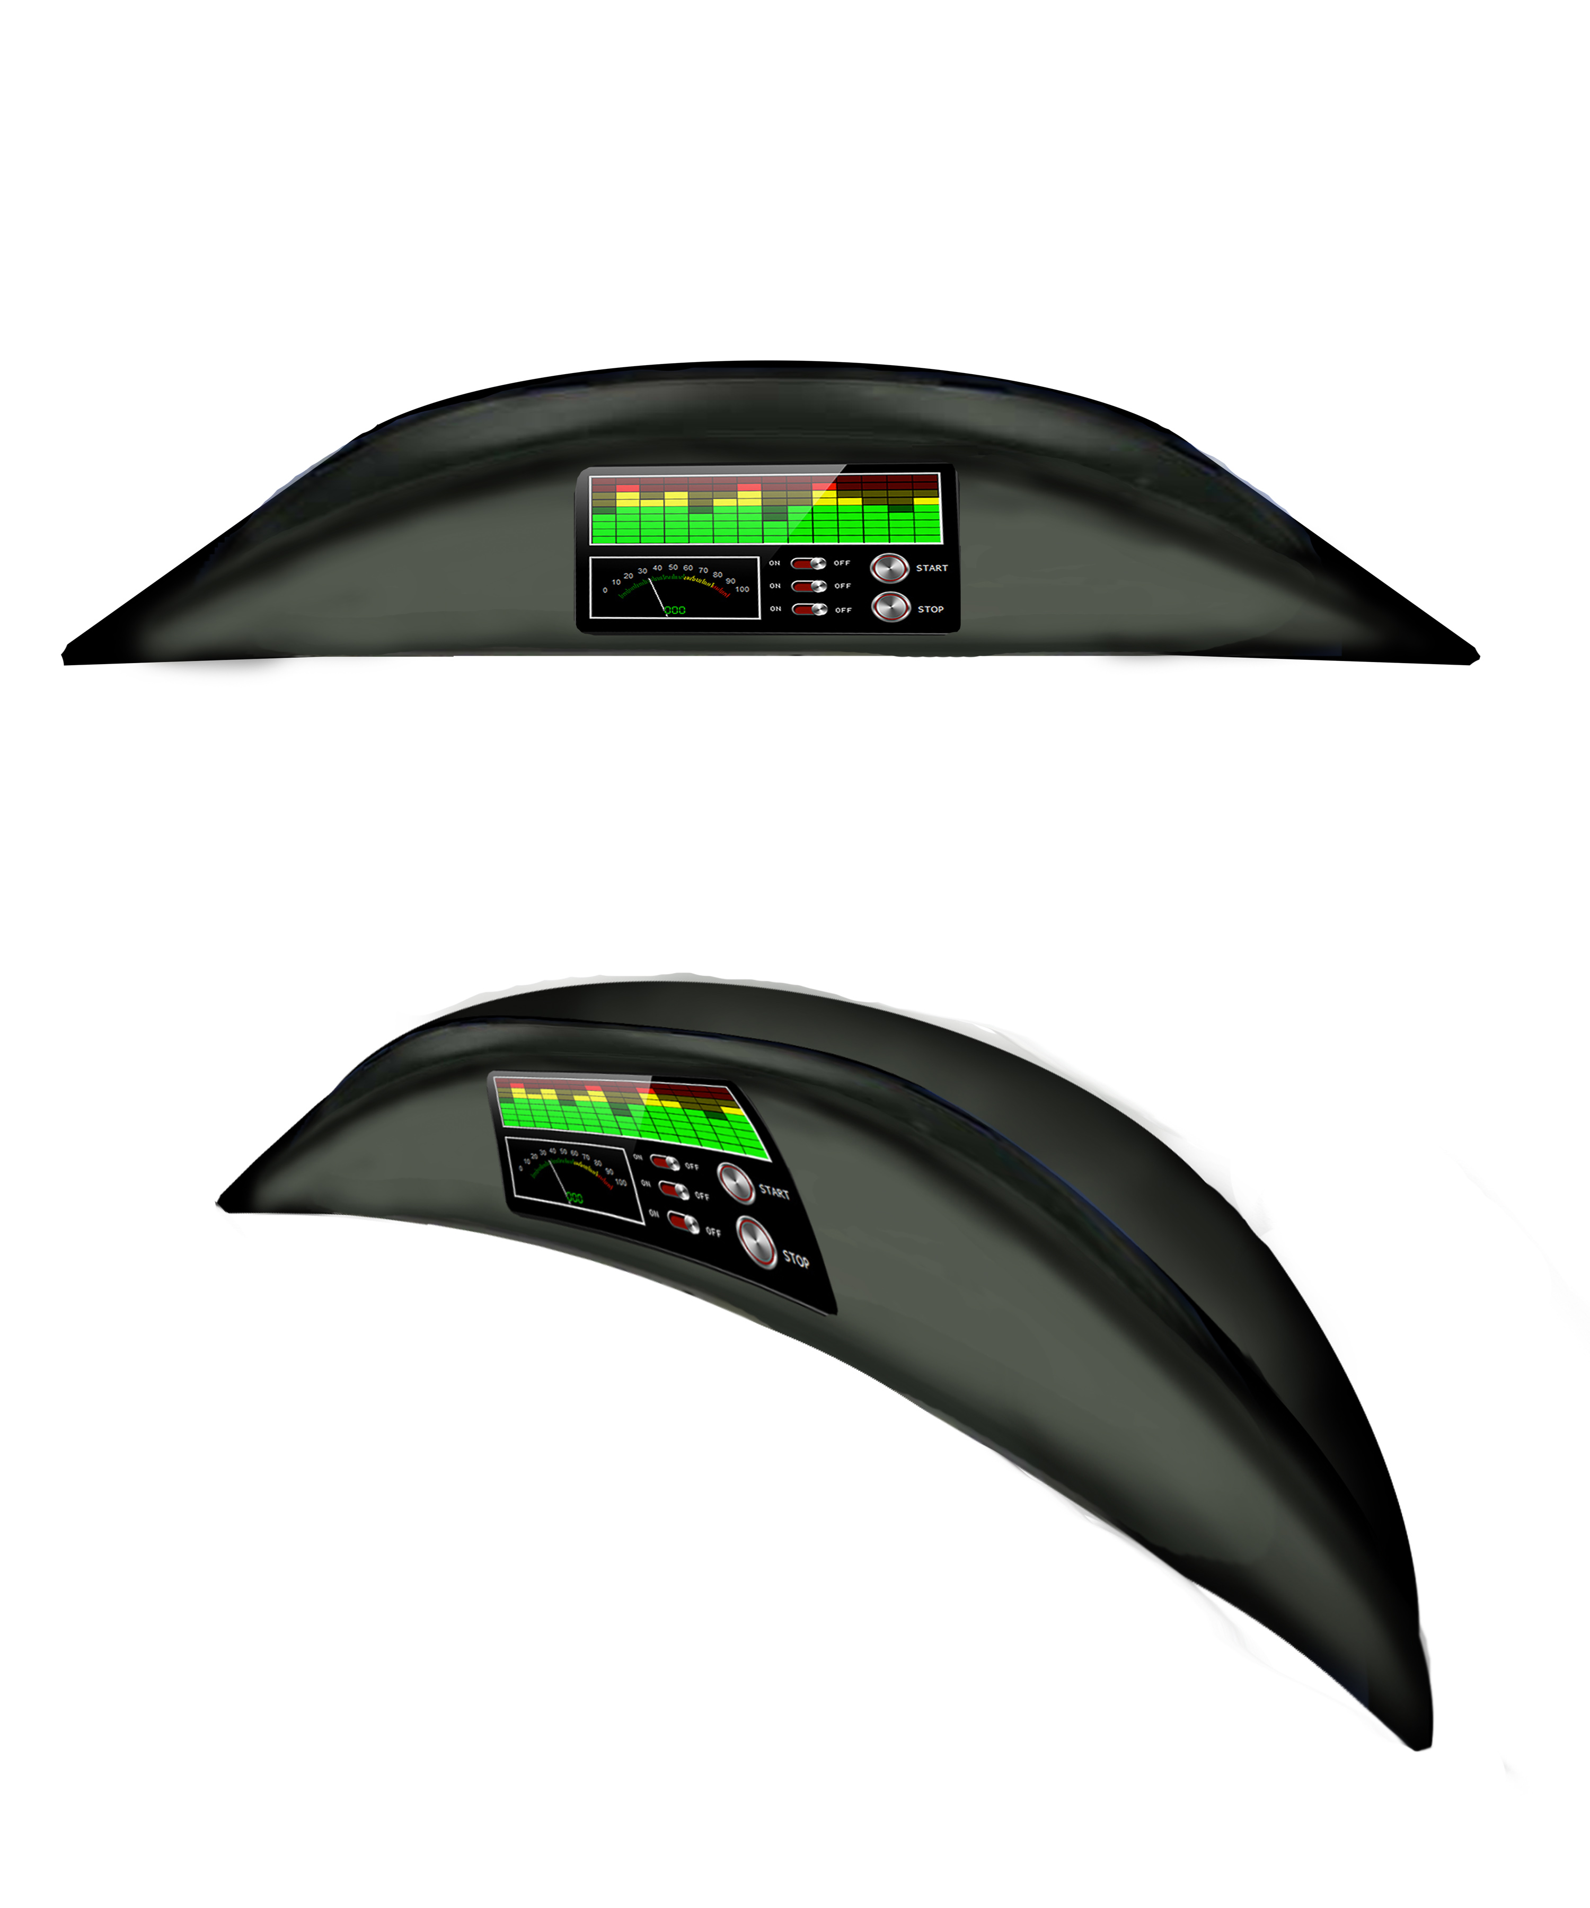
Project Proposal
CAN Protocol using serial to LCD
AT90CAN Atmel
AMS-42700 On Semiconductor
uLCD-35DT 4D systems

Slide 5

Microcontroller
AT90CAN128
  8bit,128K flash
  16MHz
  CAN, EBI/EMI, I²C, SPI, UART/USART
Pros
  Cheap, $11
  Easy to use, and develop
  CAN Controller

Slide 6

CAN Transceiver
AMIS-42700
  Especially designed to provide the link between a CAN controller (protocol IC) and two physical busses.
Pros
  Ideally suited for 12 V and 24 V industrial and automotive applications
  High speed (up to 1 Mbit/s in function of the bus topology)
  Fully compatible with the ISO 11898−2 standard

Slide 7

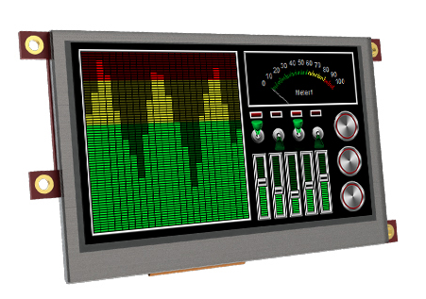
LCD Screen
P/N uLCD-35DT
3.5” LCD display
Pros
  Resistive Touch
  Color display
  Power Graphics processor
  Simple tools to create Gui
  High Resolution

Slide 8
Reasons for Choice
CAN is the standard for vehicle communication
Low message transfer latency
Simplicity to implement and expand
Other options
  Serial
  Wireless
  USB

Slide 9
Project Schedule
Time table and tasks have been laid out (Gantt chart)
Assign tasks

Slide 10
What is CAN
CAN Physical Properties
  Twisted pair wiring
  Deutsch connectors with 120 ohm resistors
CAN Transfer Properties
  Up to 1Mbit (determine what VMS is running at)
    Higher Baud rate lowers chance of communication errors
  Each node broadcasts message at specified time interval
  Each node has user set address
  Table look up to determine what message is being broadcast

Slide 11
Whats Next
Design Review
  Project requirements
Begin Prototyping
  Purchase main components
  Physical mock up of enclosure
  Reach out to VMS to determine software tools
  Skeleton code
Dry run of Design Review

