Slide 1
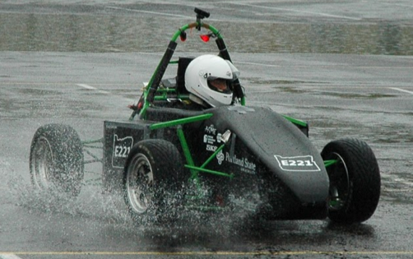
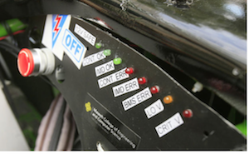
Project Overview
Electric systems add complexity and a traditional LED dash won't suffice
Drivers must be aware of system faults and warnings
An LCD Dashboard must be created to accommodate additional electrical systems
Formula SAE Electric Car
Current Traditional LED Dash

Slide 2
Project Requirements
Budget: $500
Timeline: March 2015
The display gather information from the CAN-bus and display it in a simple LCD GUI
Deliverables
  One functional Unit
  Well Documented Code
  Professional Documentation
  User Manual

Slide 3
Design Constraints
Choose most suitable LCD display
Design the communication interface with VCU
Develop GUI
Design waterproof casing for the display
Physical space on dash is limited

