Slide 1
확률과통계
Homework #1
2018000337 장호우

Slide 2
Content
Figure 1 with Poisson distribution
Figure 2 with Exponential distribution
Figure 3 with Erlang-2 distribution
Q & A
All Codes

Slide 3
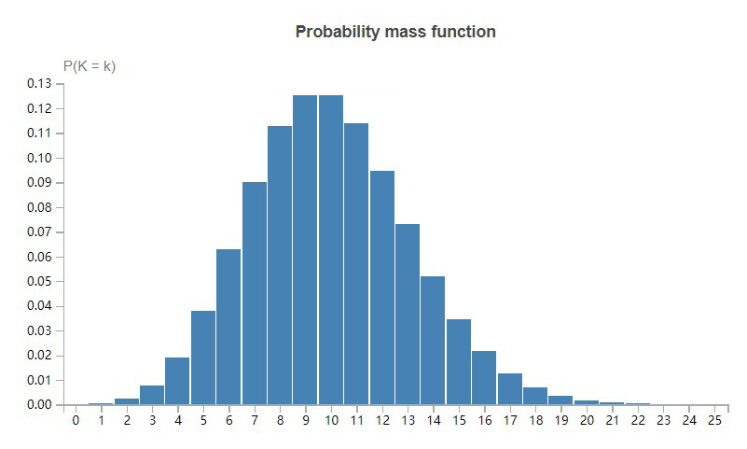
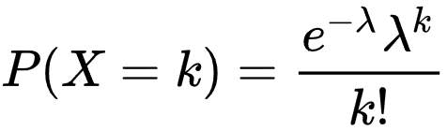
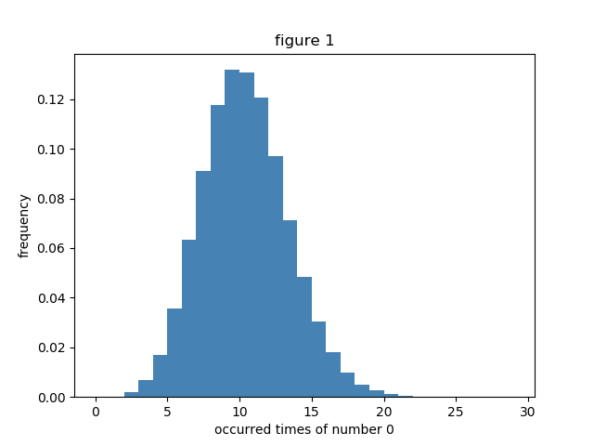
Figure 1
When the λ = 10, the figure of Poisson distribution was as same as the result of program.
The program generated 100 random numbers between 0 and 9 every time. So the occurred times of number Zero should be 10 times in average.

Slide 4
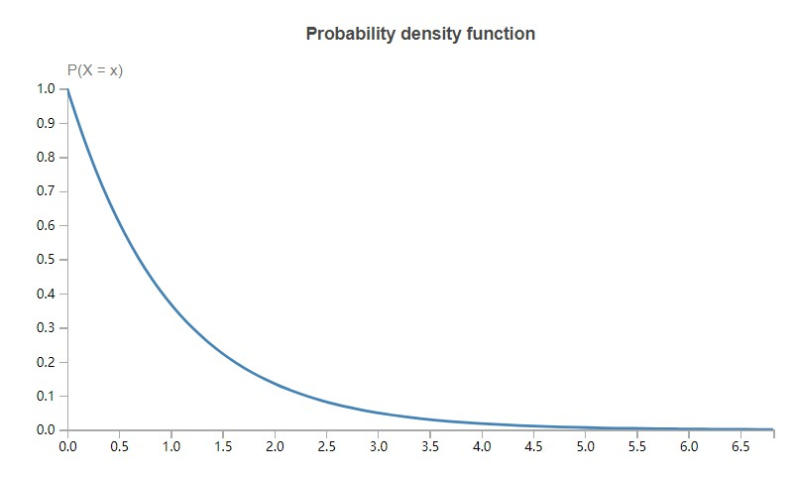
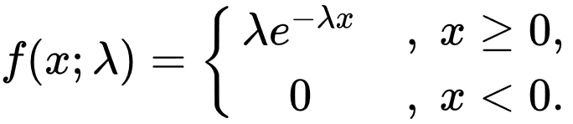
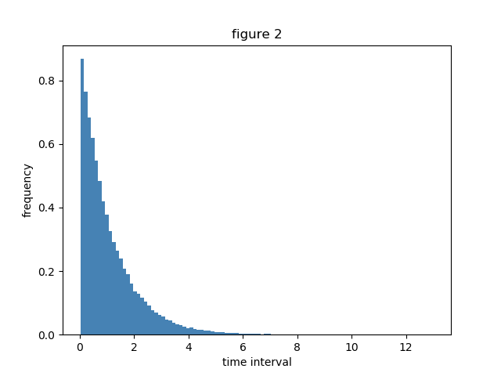
Figure 2
When the λ = 1, the figure of Exponential distribution was as same as the result of program.
The probability that two consecutive 0 generated is 1% and the program generated 100 random numbers each unit time. So the λ should be 1.

Slide 5
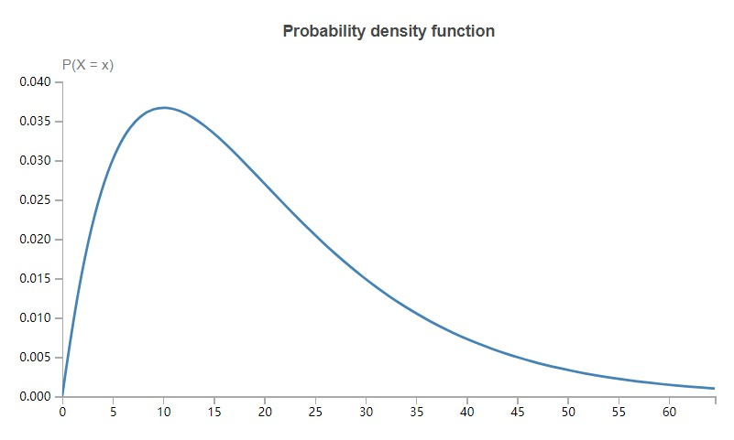
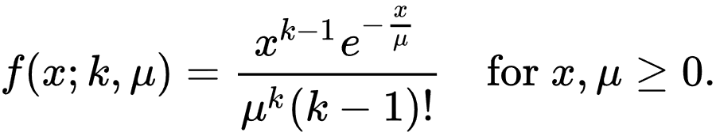
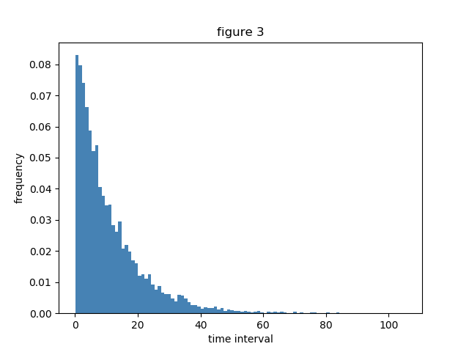
Figure 3
When the µ = 10, k = 2, the result of program seems like a part of figure of Erlang-2 distribution.
The probability that three consecutive 0 generated is 1‰ and the program generated 100 random numbers each unit time. So the µ should be 10.

Slide 6
Q & A
How many times and which method the random number occurred?
I used “numpy.random.randint()” to generate ten million random numbers in my Python program.
How to build the model for the time interval?
I generated ten million random numbers at first and read 100 numbers each unit time. So the time interval just means times of the program reads each 100 random numbers.

Slide 7
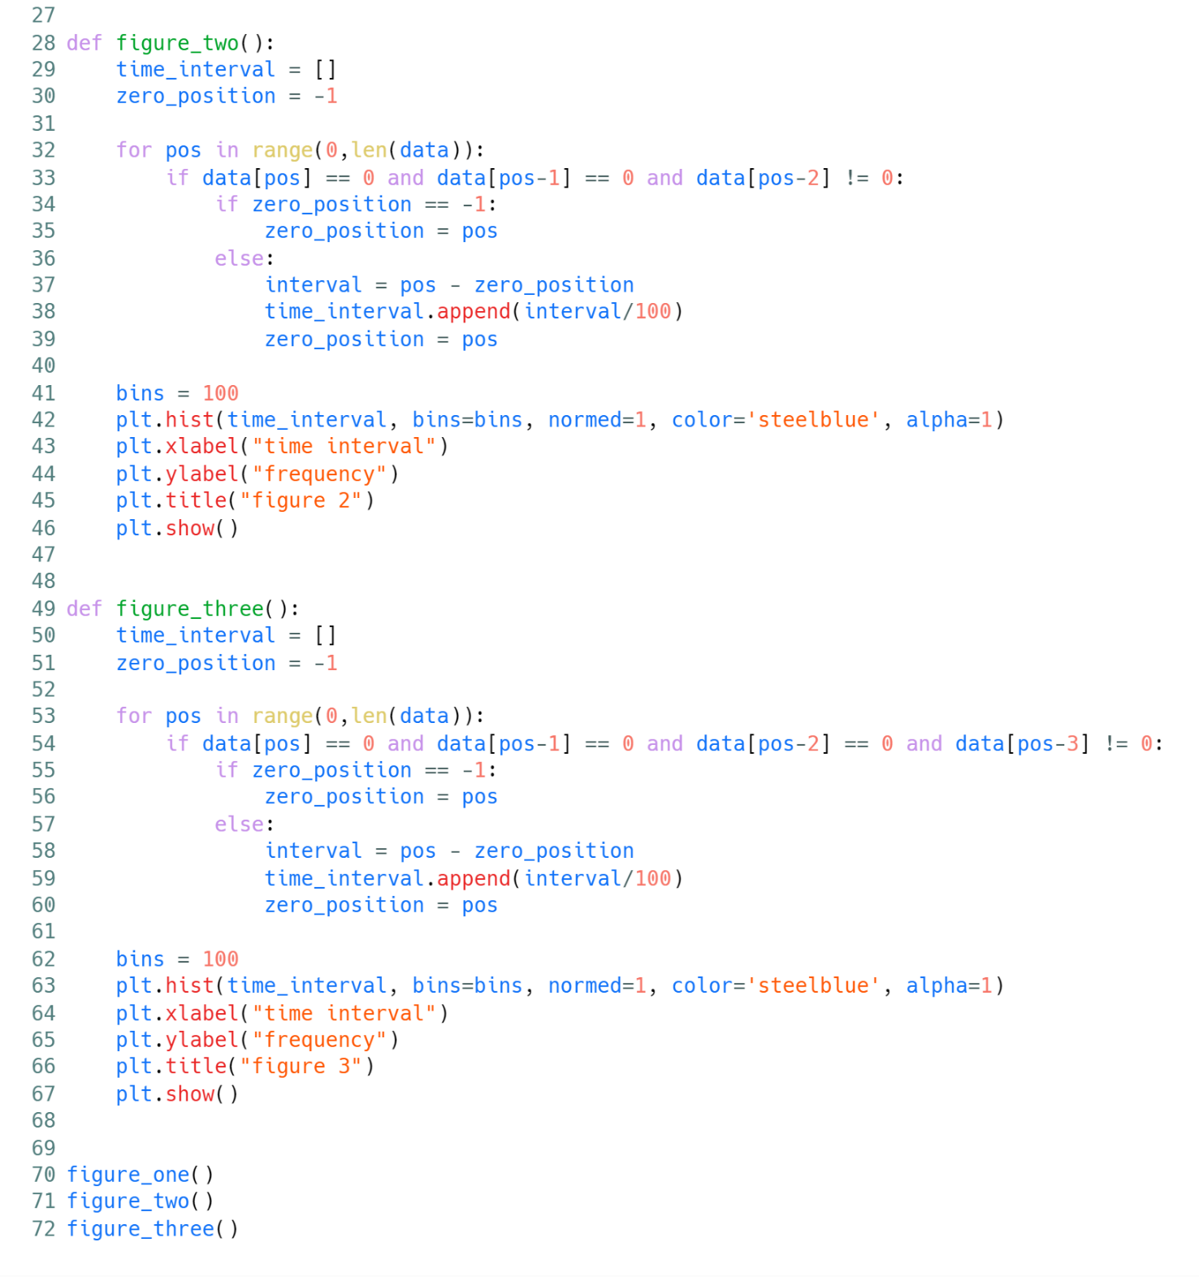
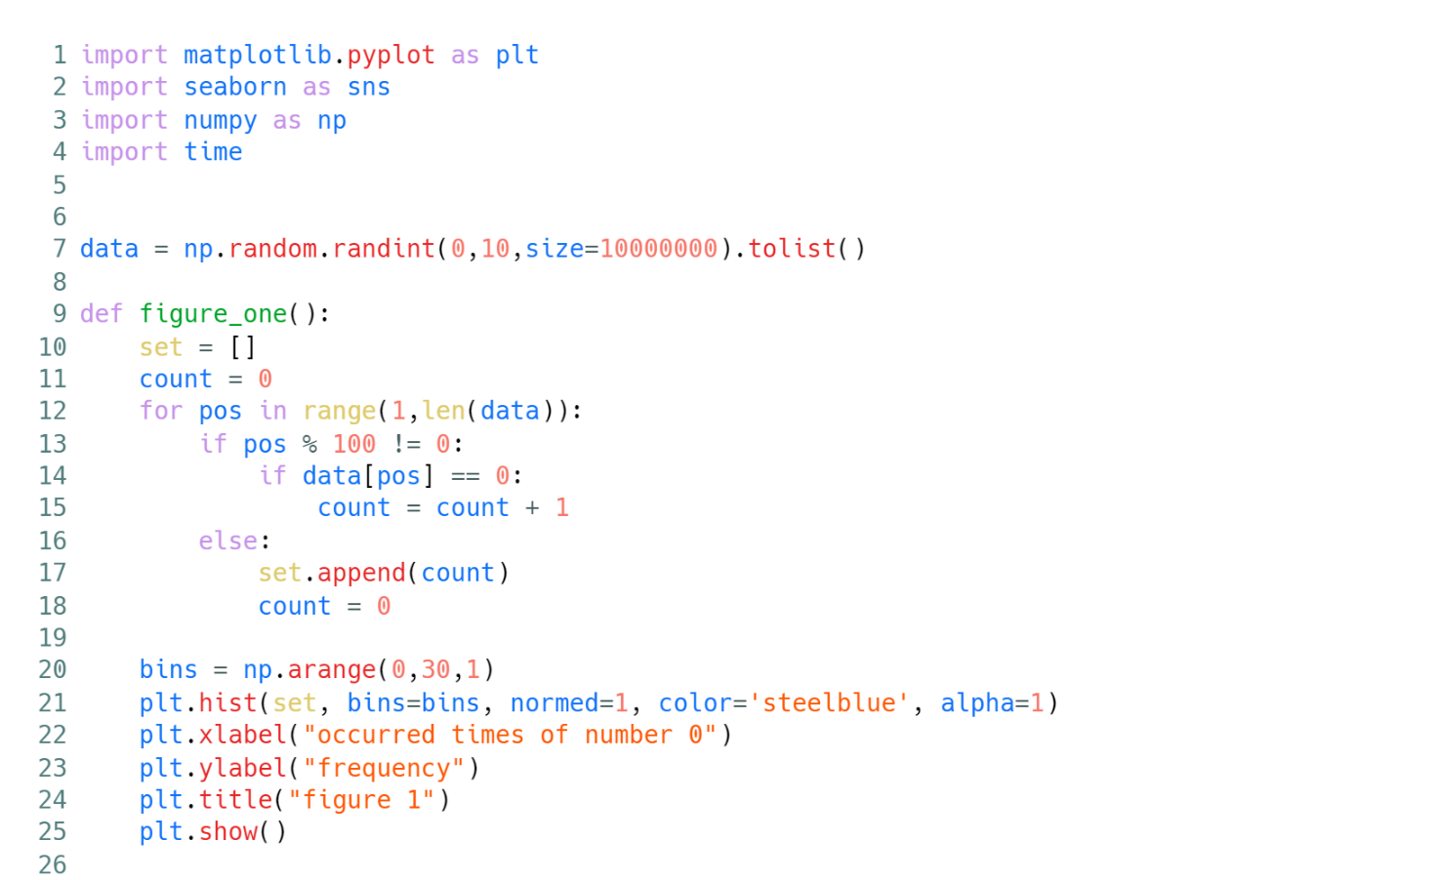
All Codes

