Slide 1
AI
Human vs
Ryu Suhyun 2017002197
Zhang Haoyu 2018000337

Slide 2
Contents
1
2
Introduction
Manufacture & Retail
3
4
AI apply in retail industry
Conclusion

Slide 3
1
Introduction

Slide 4
2
Manufacture & Retail

Slide 5


Manufacture vs Retail
VS
Manufacture
Product
Retail
?

Slide 6

What could the retail store do?
Efficiency

Slide 7
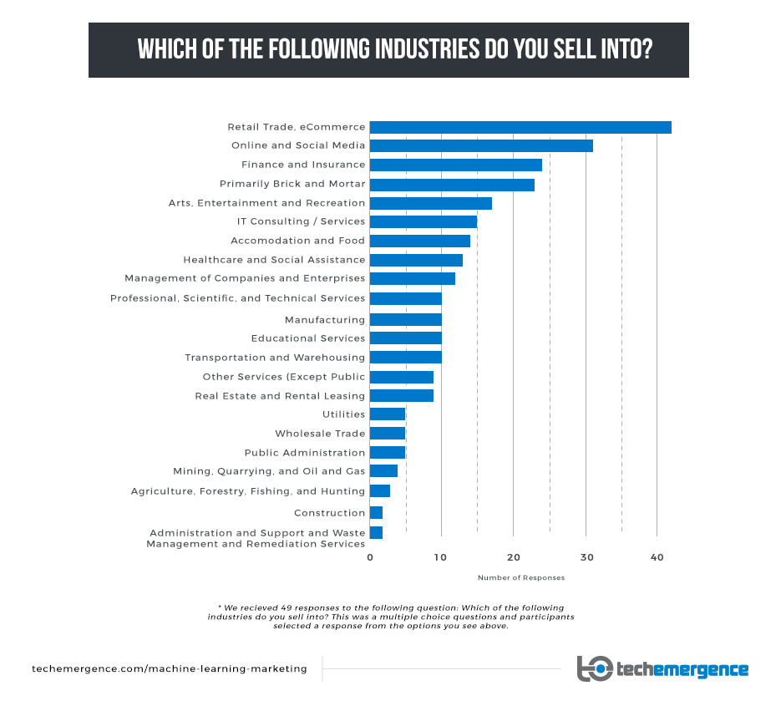
Which industry does AI company sell into?
Source:
https://www.techemergence.com/machine-learning-marketing/

Slide 8
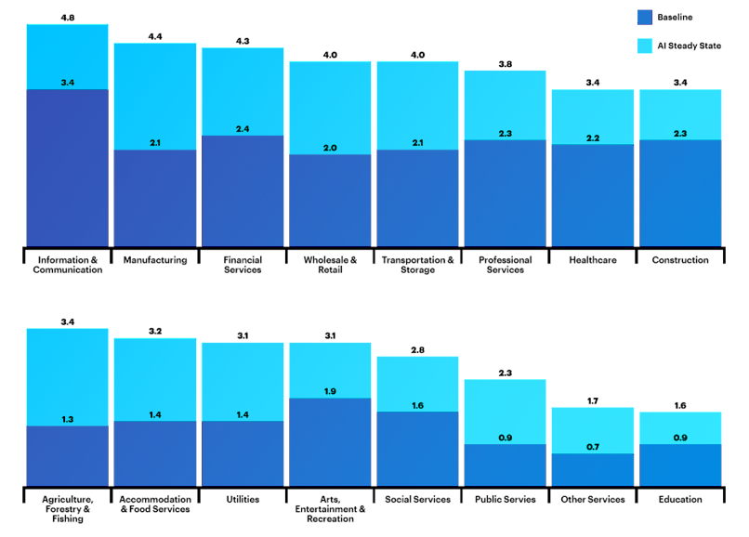

The GVA of AI apply in every industries
Source:
https://www.accenture.com/us-en/insight-ai-industry-growth
GVA
gross value added

Slide 9
3
AI apply in retail industry

Slide 10
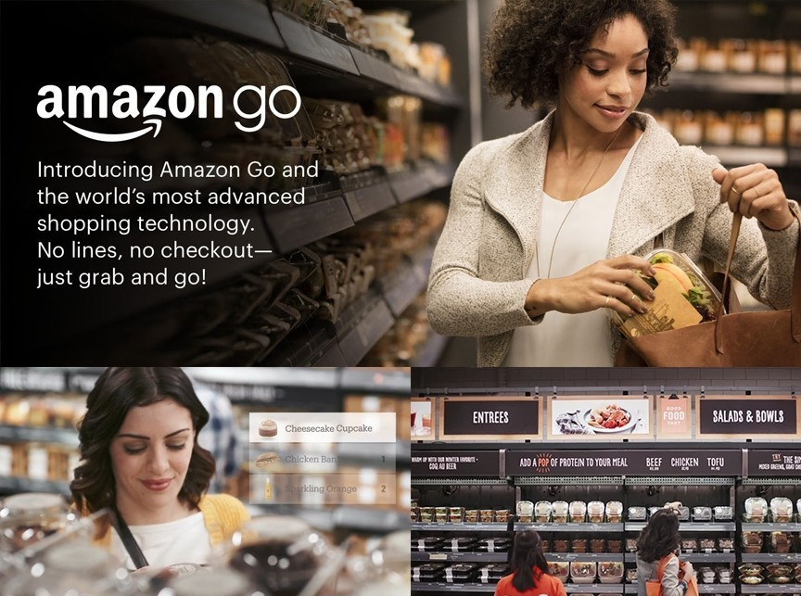
How Do Amazon Go Stores Work?
1. Set up the app
2. Scan app at the door
3. Shop
4. Place items in “virtual cart”
5. Just walk out

Slide 11
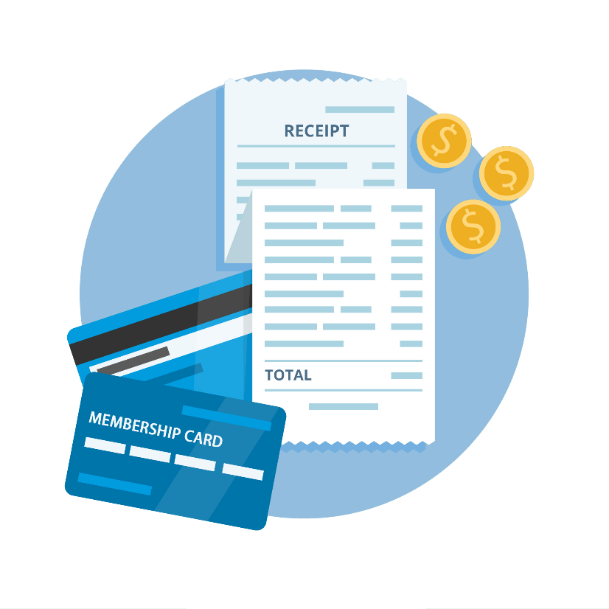

Unmanned store vs traditional store
VS
Shopping Behavior
Membership card data
& Purchase data

Slide 12


Intelligent recommendation
Recommendation
based on this behavior of the customer

Slide 13
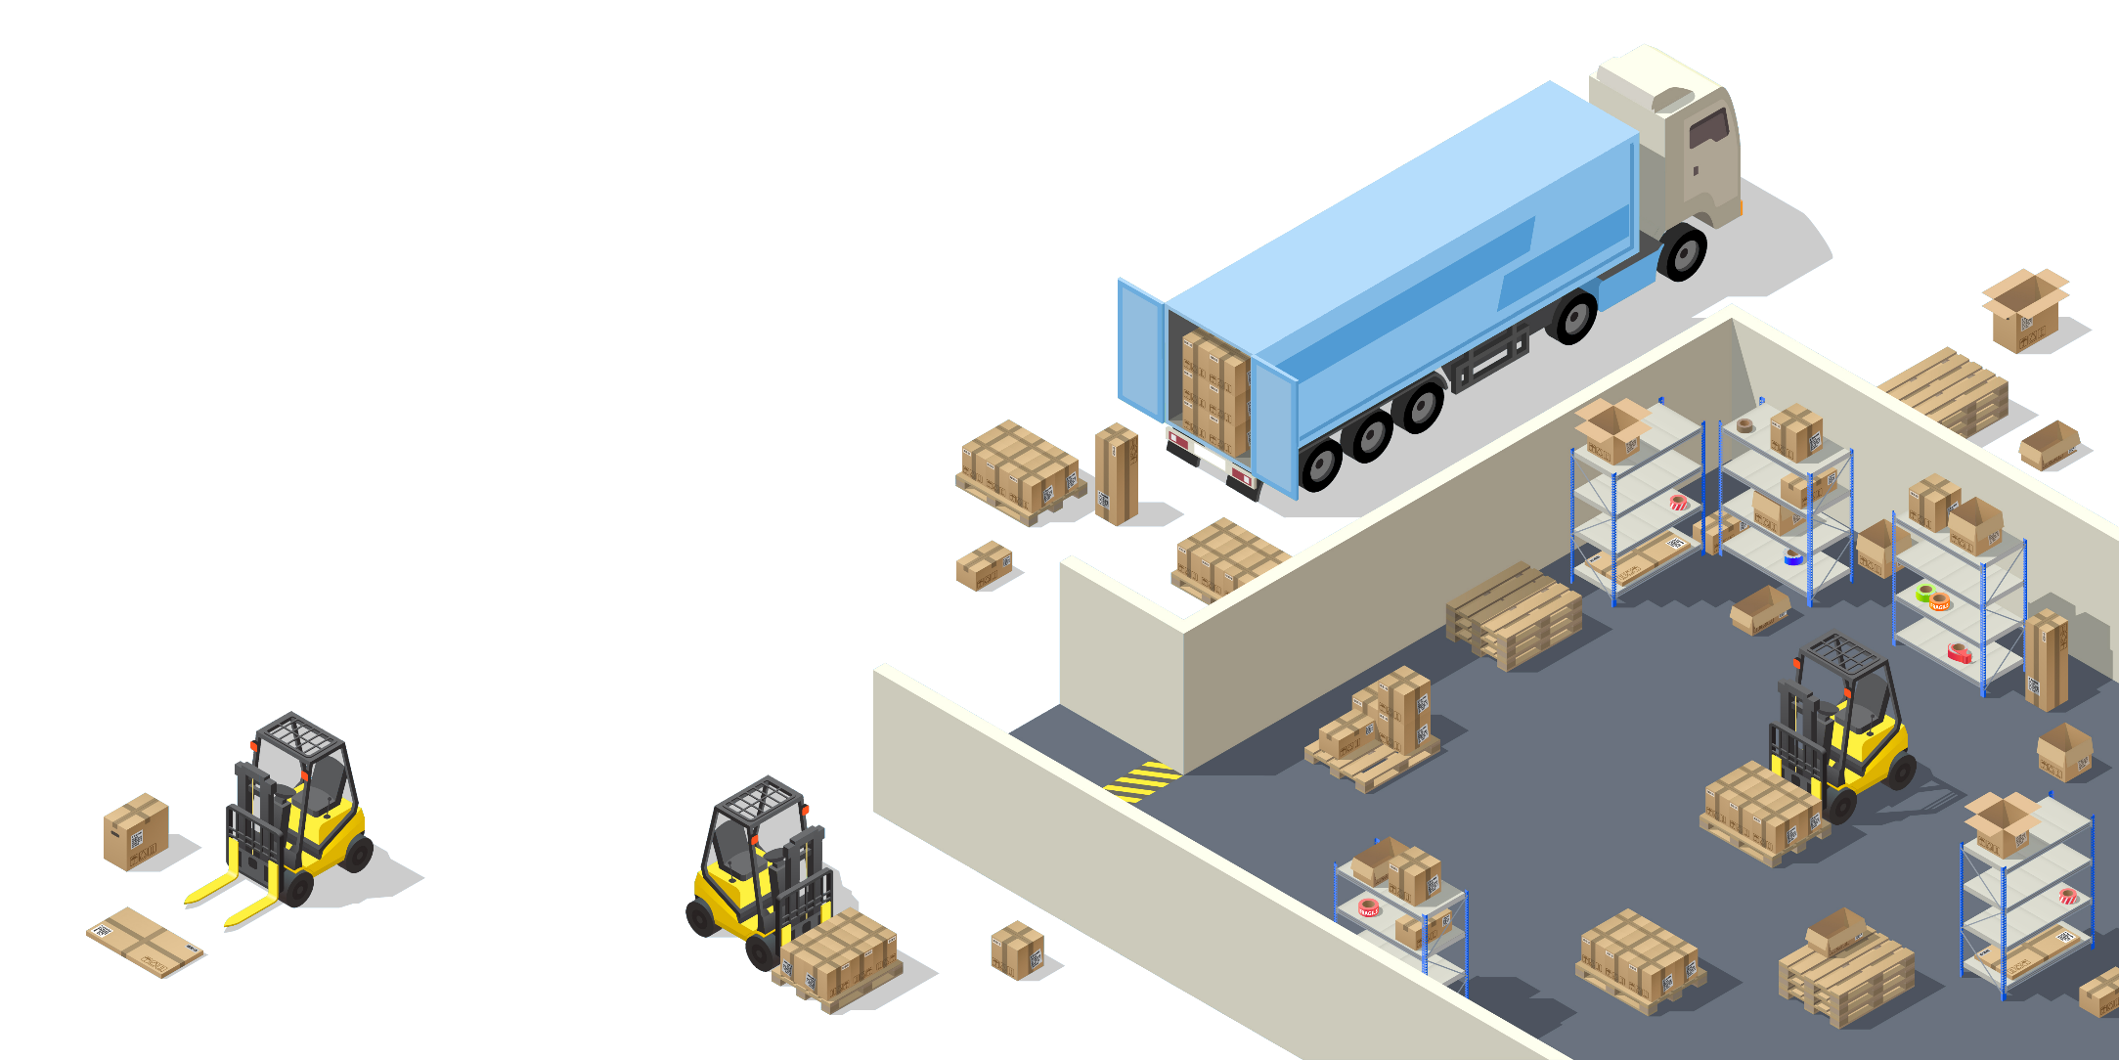

H&M intelligently adjust the inventory
Big data & AI
analyze returns, receipts and membership card data
Adjust inventory
adjust the inventory in each store Intelligently

Slide 14
4
Conclusion

Slide 15
THANKS!

