Slide 1
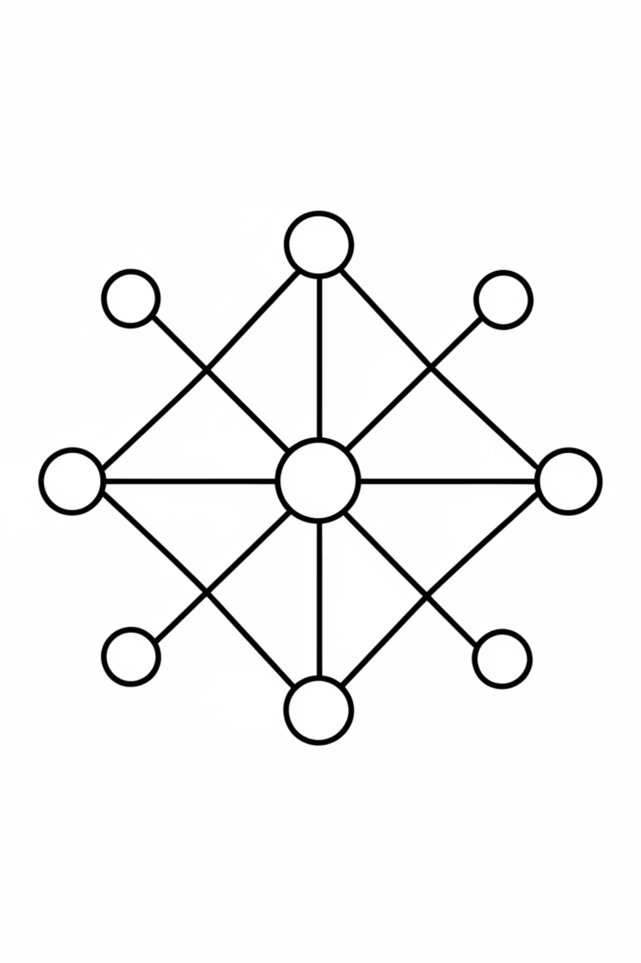
CNN Image Classification with PyTorch
Final Project – Deep Learning
John Doe, Jane Smith, Alex Johnson
Course: Introduction to Deep Learning, Fall 2024

Slide 2
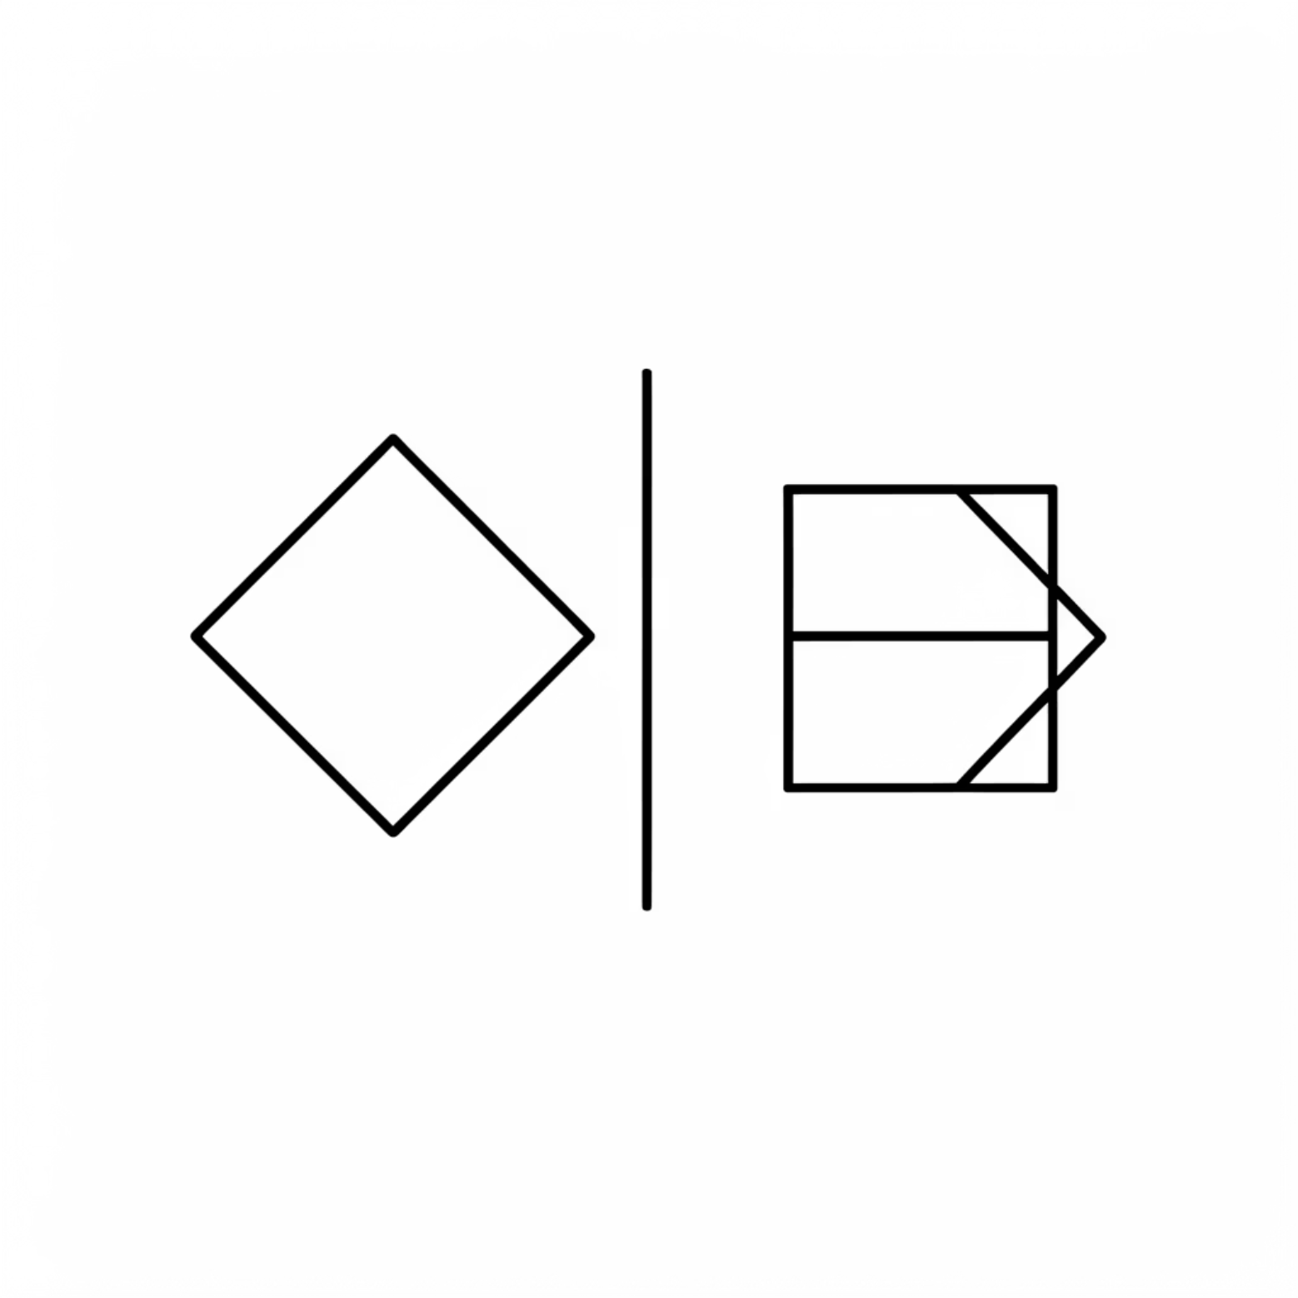
Problem & Dataset Overview
Binary image classification (2 classes)
Custom dataset: ~1000 images
Train / Validation / Test split: 70/15/15%
Goal: Compare architectures, regularization, and transfer learning effectiveness.

Slide 3
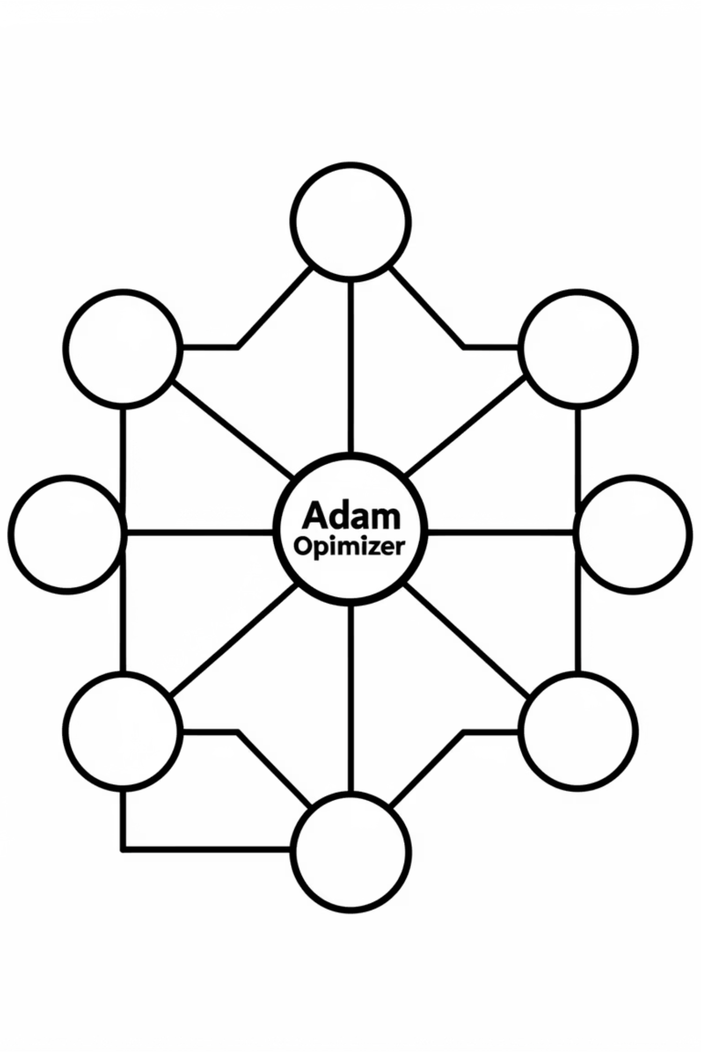
Baseline Model: Simple CNN
Architecture
Optimizer Comparison
Simple Convolutional Neural Network
Adam: Stable convergence, high accuracy
Minimal layers for initial evaluation
SGD: Highly sensitive to learning rate; unstable at sub-optimal LRs
ReLU activation functions
Baseline Selected
Architecture: Simple CNN
Optimizer: Adam
Learning Rate: 0.003

Slide 4
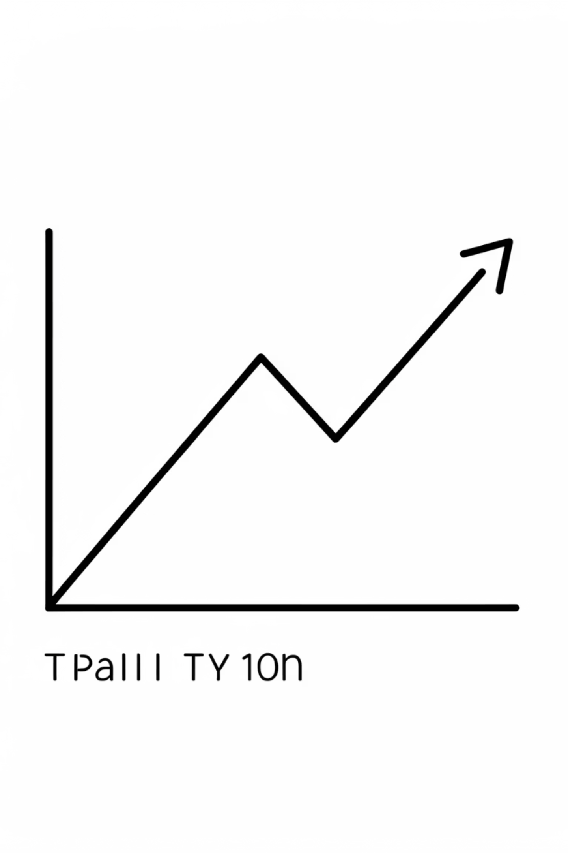
Enhancement with Batch Normalization
Experiment Design
Compared baseline model against an identical architecture incorporating Batch Normalization layers after each convolutional block.
Validation Accuracy
Both configurations achieved comparable best validation accuracy, suggesting BN didn't necessarily boost peak performance on the validation set.
Test Accuracy Improvement
Batch Normalization improved test accuracy to 1.0, indicating superior generalization capabilities on unseen data.
Interpretation
BN introduced initial training noise but resulted in a more robust model. This confirms its role in improving generalization, rather than just accelerating convergence.

Slide 5
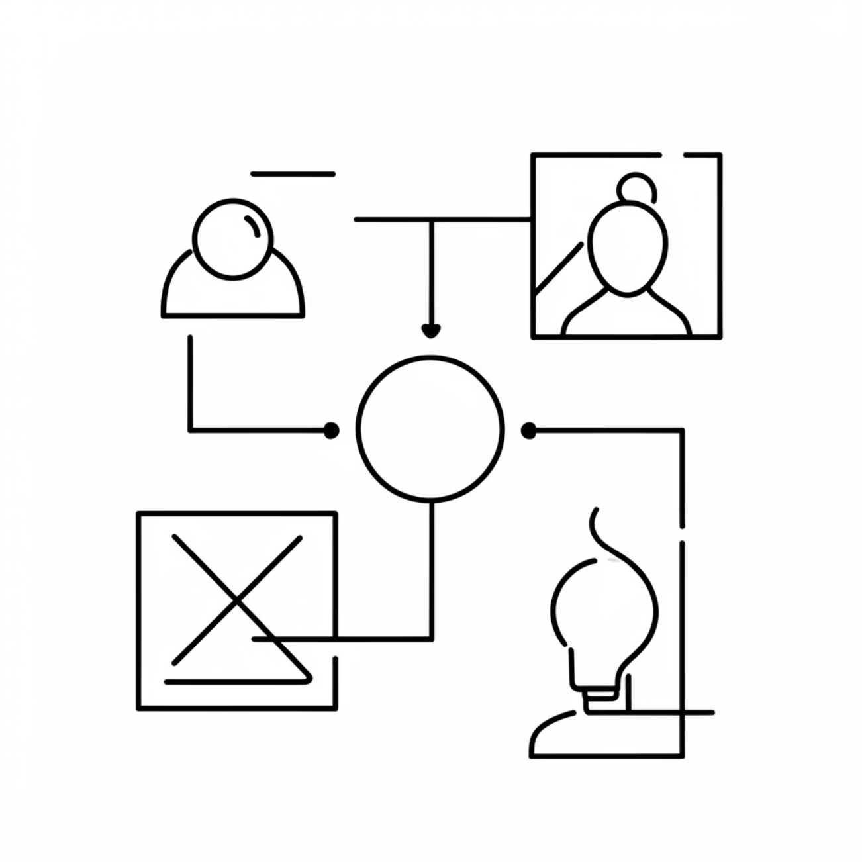
Regularization and Data Augmentation
Weight Decay (L2 Regularization)
No significant change in final accuracy.
Improved training stability across epochs.
Selected optimal value: wd=1e-4.
Dropout
Probability p=0.2 enhanced training stability.
Mitigated overfitting without accuracy degradation.
Data Augmentation
Strong augmentation: slowed convergence considerably.
Slightly detrimental to overall test accuracy.
Conclusion
Mild regularization (Weight Decay, Dropout) proved beneficial for stability and generalization. Strong data augmentation was not advantageous for this dataset and task.

Slide 6

Transfer Learning: Pretraining on CIFAR-10
Custom CNN architecture pretrained on CIFAR-10 dataset.
Objective: Enable learning of generic visual features (edges, textures, simple shapes).
Achieved ~59% validation accuracy on CIFAR-10.
This pretrained model served as an initialization point for subsequent fine-tuning on our custom dataset.

Slide 7
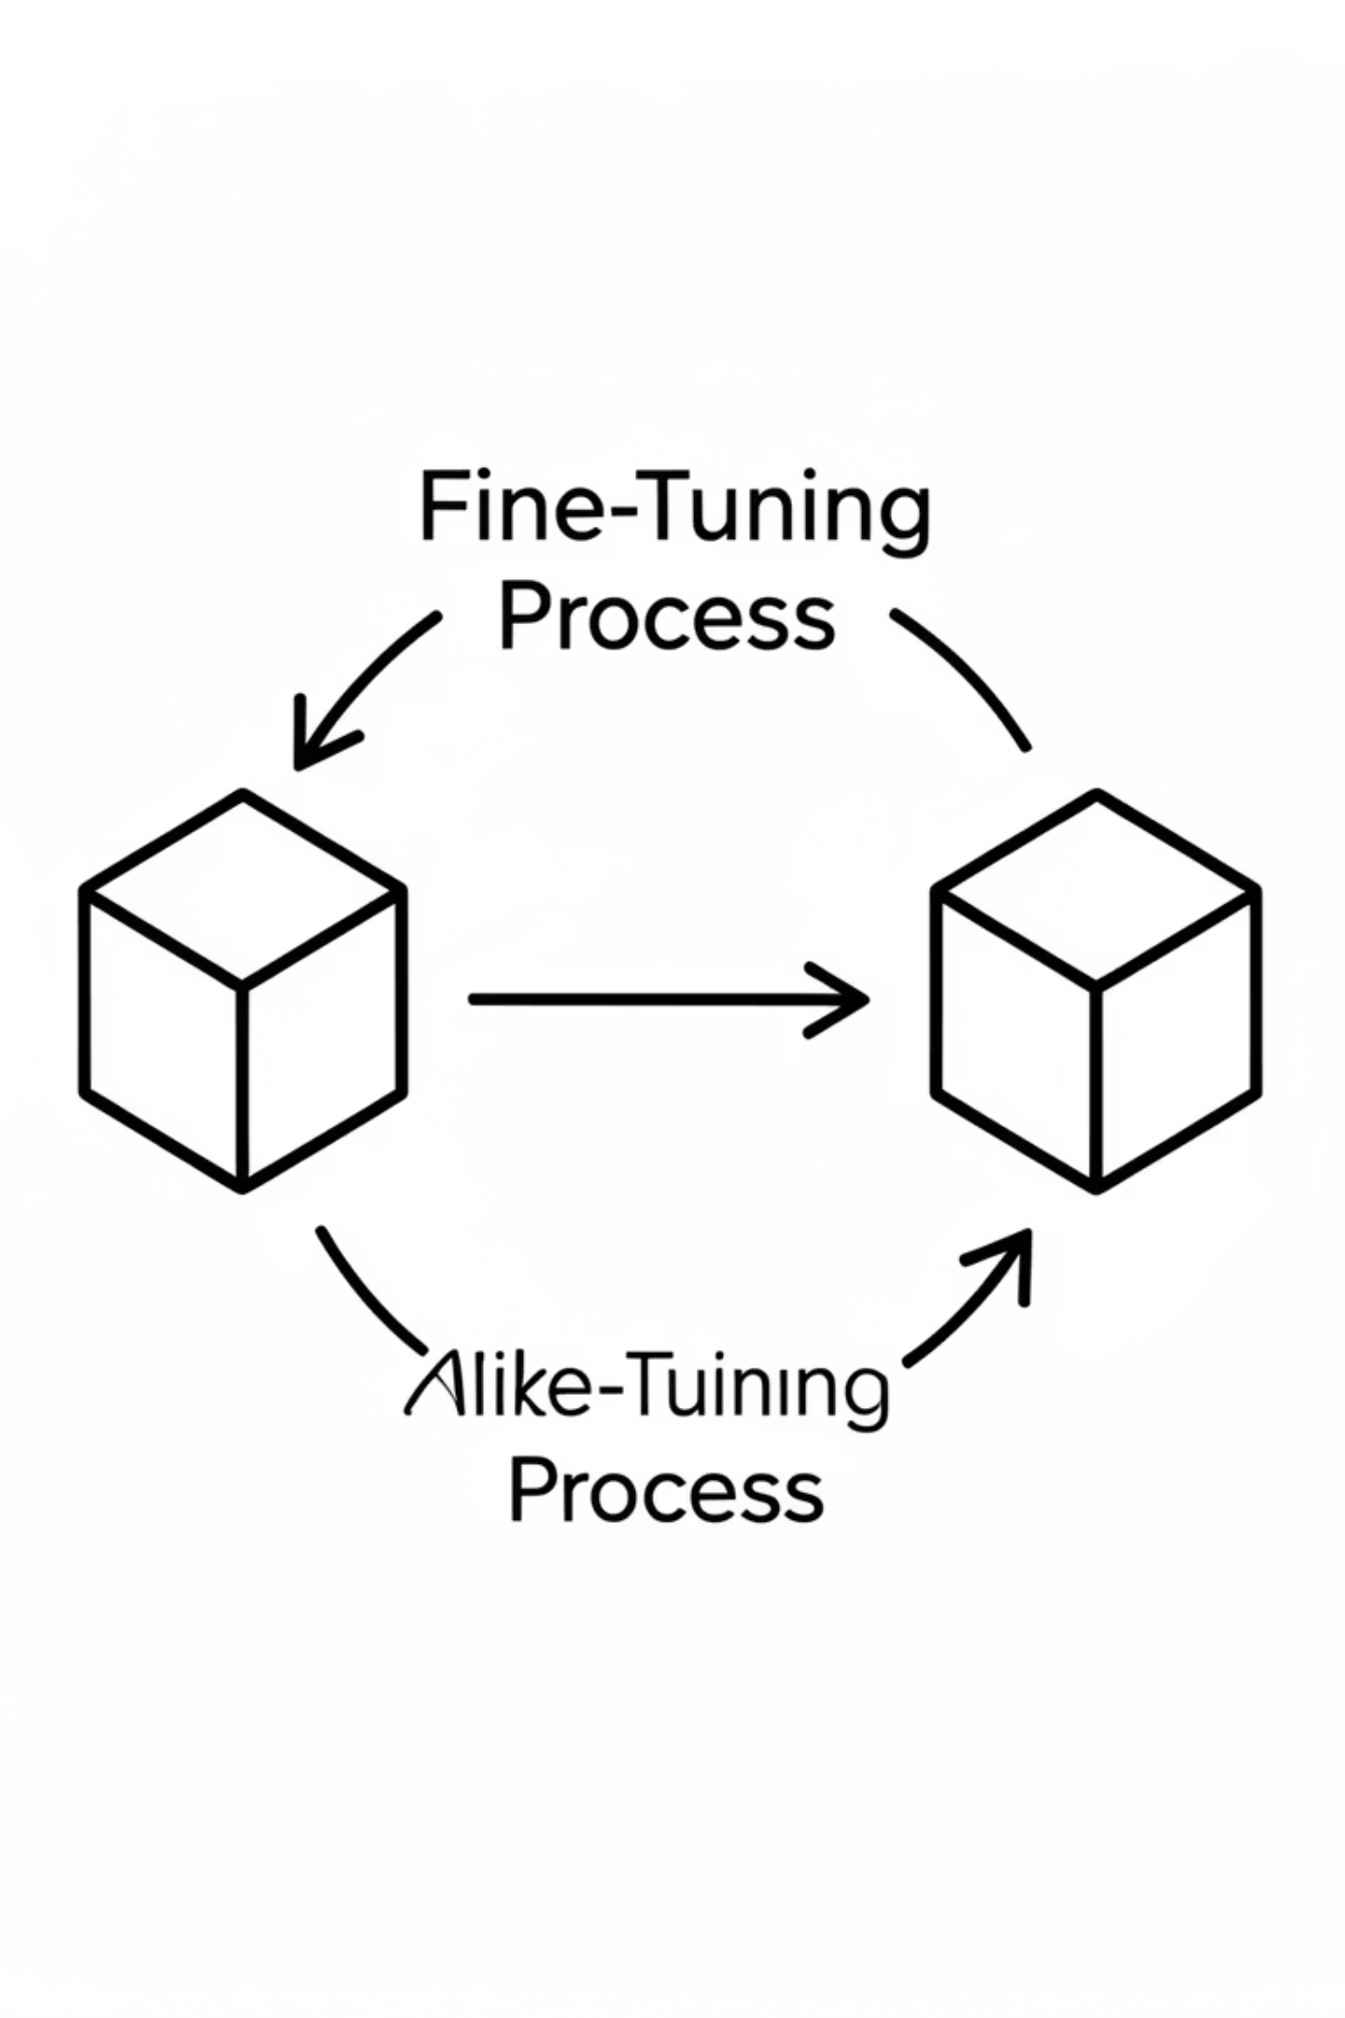
Fine-tuning the CIFAR-10 Model
Initialization
1
The CIFAR-10 pretrained CNN was used as the starting weight configuration for training on our custom dataset.
Convergence Speed
2
Demonstrated significantly faster convergence rates compared to training models from scratch, indicating effective transfer of learned features.
Final Accuracy
3
Achieved a final test accuracy of approximately 0.90.
Limitation
4
The overall accuracy improvement was limited by the relatively small size and simplicity of our custom dataset, capping the benefit of comprehensive feature learning.

Slide 8
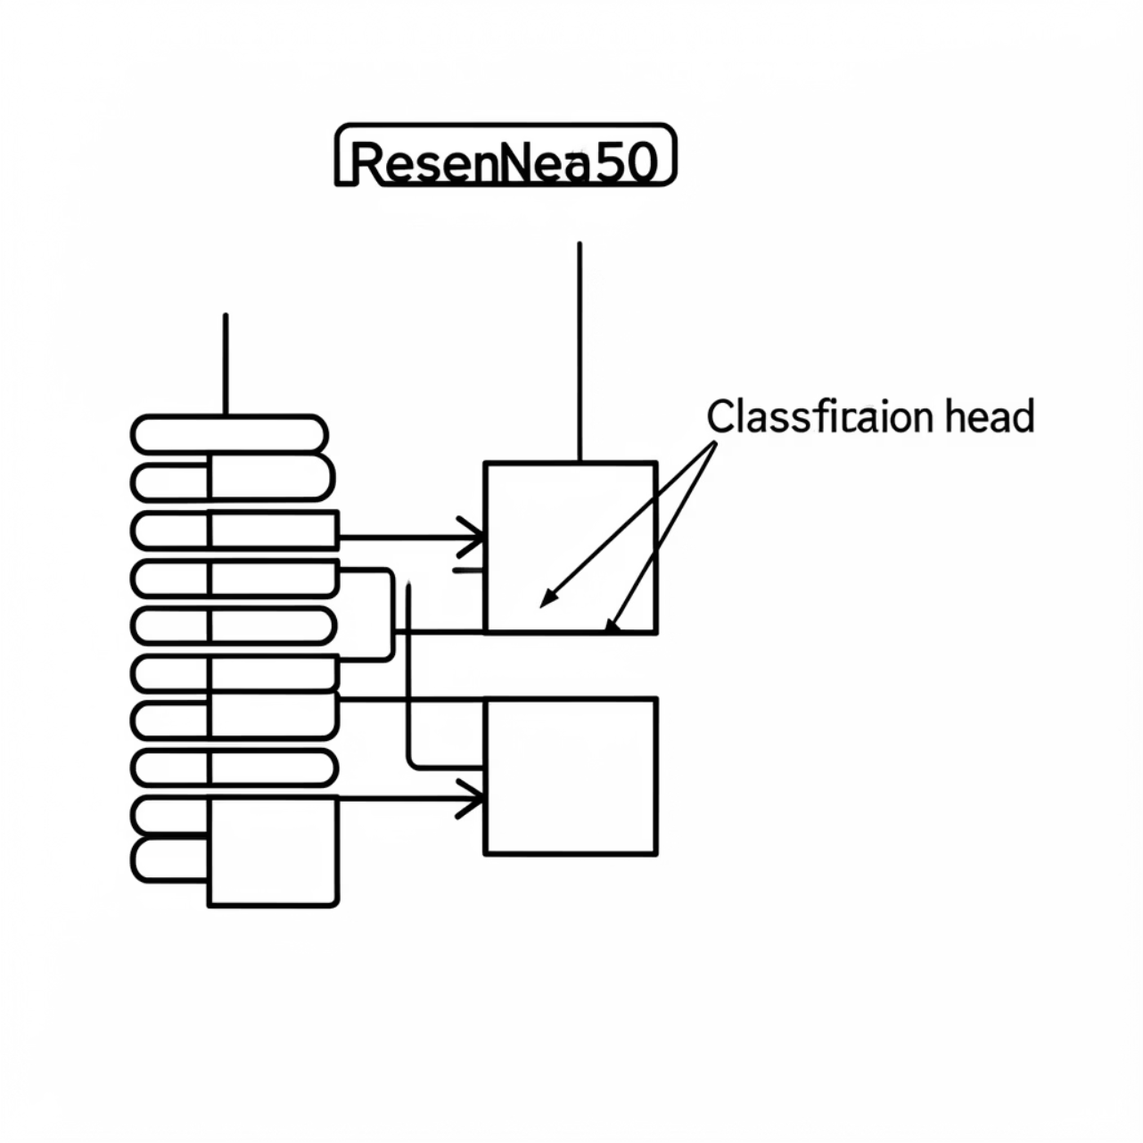
ResNet50 with Frozen Backbone
Pretrained ResNet50 model loaded from ImageNet weights.
Feature extraction layers (backbone) were frozen to prevent weight updates during training.
Only the final classification head (fully connected layers) was trained on our custom dataset.
Standard ImageNet normalization and 224x224 input resolution applied.
Achieved perfect validation and test accuracy of 1.0, demonstrating strong high-level feature transfer.

Slide 9
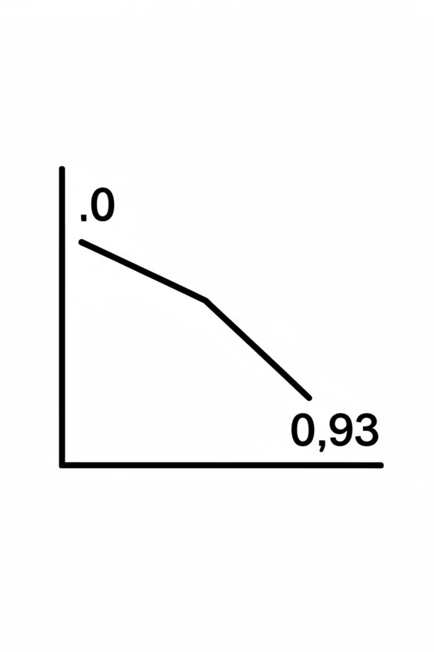
Fine-tuning ResNet50: Unfrozen Layers
1
Unfreezing Layers
Experiment involved unfreezing layer4 and the final fully connected layer (FC) of the ResNet50 model.
2
Discriminative Learning Rates
Applied lower learning rates to earlier, unfrozen layers and higher rates to the newly trained classification head, adapting to feature abstraction levels.
3
Performance (No Augmentation)
Without data augmentation, the model achieved a test accuracy of 1.0, indicating precise adaptation to the dataset without introduced variance.
4
Performance (Strong Augmentation)
With strong data augmentation, test accuracy dropped to approximately 0.93, suggesting that aggressive augmentation hurt generalization for this specific dataset and model combination.

Slide 10
Conclusions & Limitations
CNN Efficacy
Transfer Learning Impact
Augmentation Caution
Convolutional Neural Networks exhibit exceptional performance on the custom binary classification task.
Transfer learning significantly accelerates model convergence and boosts overall performance, particularly with robust pretrained models like ResNet50.
Strong data augmentation is not universally beneficial; for small, relatively simple datasets, it can hinder generalization.
Limitations
Future Work
The project's scope was limited by small validation/test sets and the potential simplicity of the task for highly complex models.
Exploring larger, more diverse datasets and implementing cross-validation techniques are critical next steps for robust evaluation.

