Slide 1
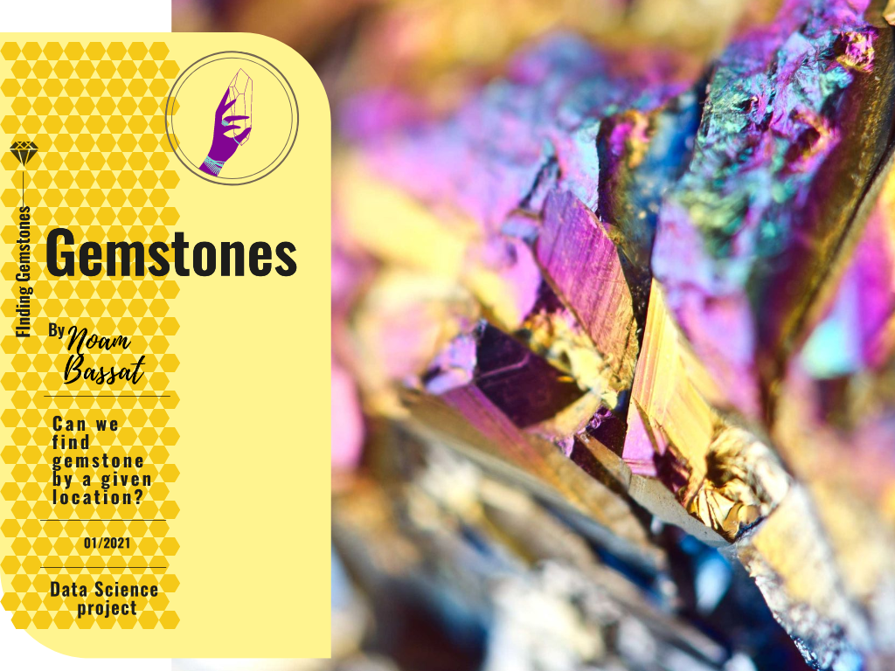

Slide 2
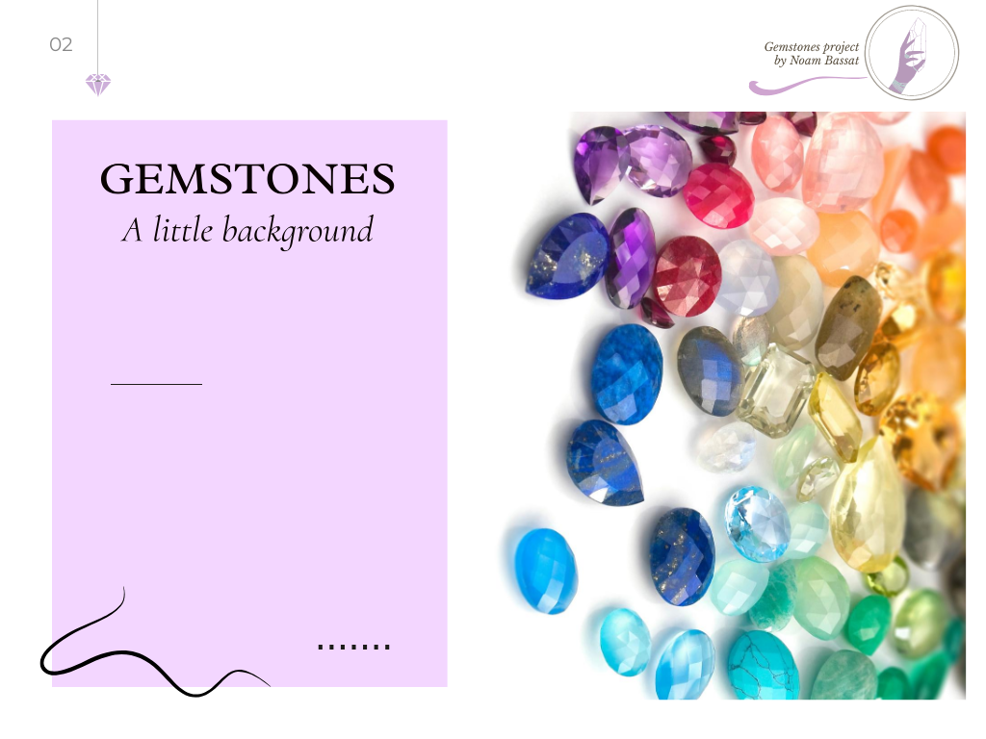

Slide 3
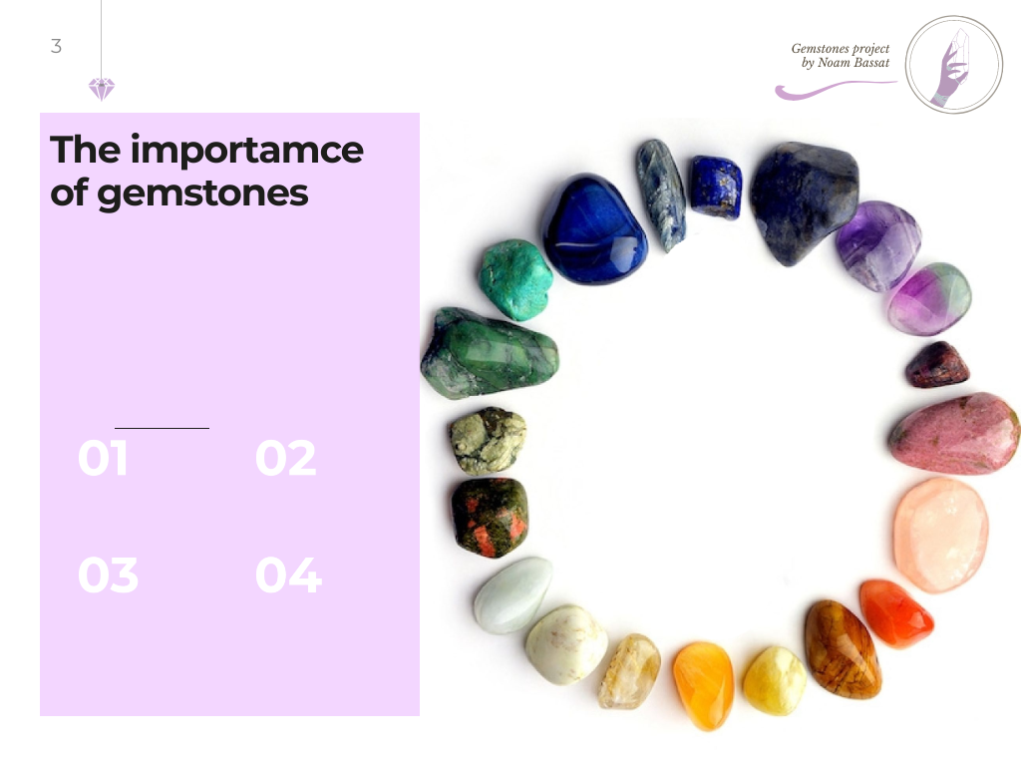

Slide 4
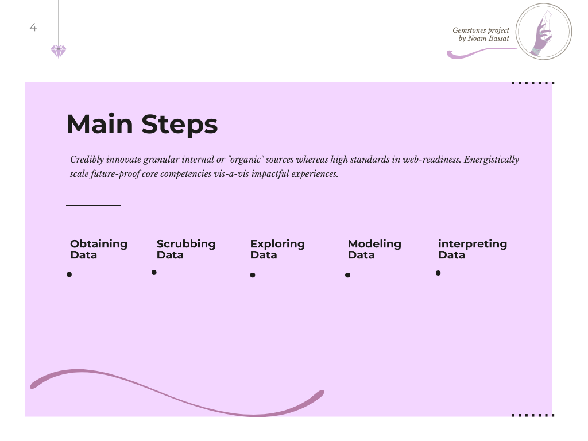

Slide 5
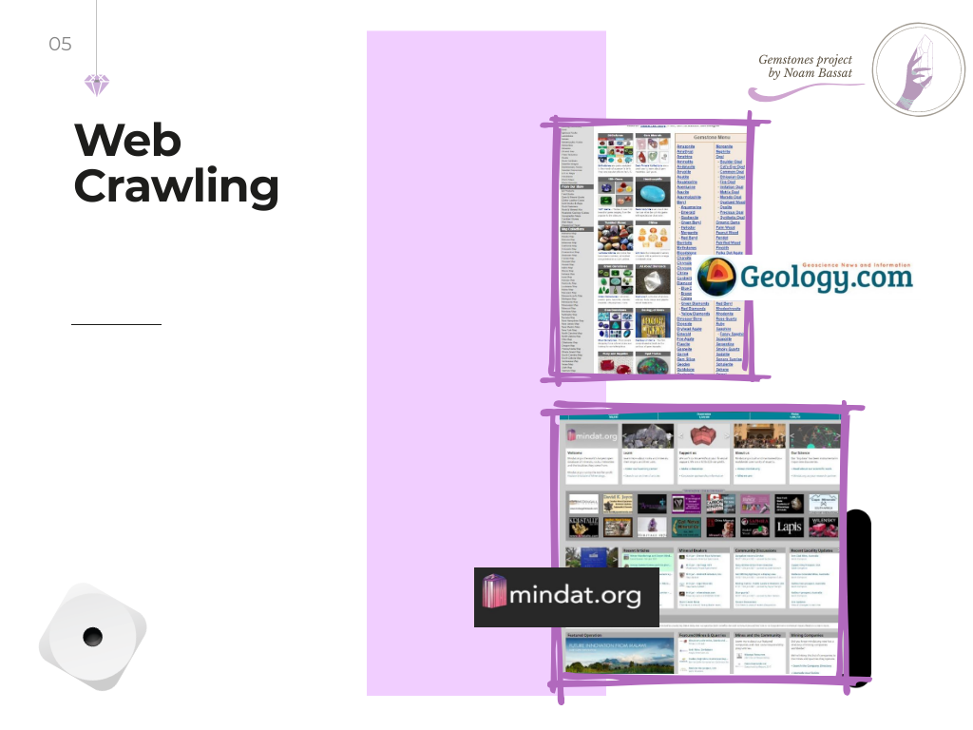

Slide 6


Slide 7


Slide 8


Slide 9


Slide 10


Slide 11

Cluster 7 | Cluster 6 | Cluster 5 | Cluster 4 | Cluster 3 | Cluster 2 | Cluster 1 | Cluster 0
53 | 125 | 261 | 102 | 104 | 216 | 68 | 679 | Number of locations
42.901839 75.451651- | 19.690474-, 29.756632 | 30.223338, 82.134699 | 39.803252, 123.978676 | 29.315328-, 143.127625 | 39.069659, 112.783420- | 48.719148, 11.227510 | 48.719148, 11.227510 | Average coordinates
19.639860, 94.661670- | 72.000000-, 0.083330 | 4.650000-, 45.083330 | 16.262780, 101.270000 | 75.283330-, 107.731640 | 16.883330, 166.854170- | 7.495260 14.492780- , | 7.495260, 14.492780- | Min Coordinates
67.399170, 44.152500- | 14.000000 72.500000 | 66.916670, 107.200000 | 70.880000, 164.733330 | 2.330250-, 179.958330 | 67.061940, 93.736110- | 79.799840, 51.061020 | 79.799840, 51.061020 | Max Coordinates
1 Dfb : Warm-summer humid continental climate | 7 BSh : Hot semi-arid (steppe) climate | 3 Cwa : Monsoon-influenced humid subtropical climate | 5 Cfa : Humid subtropical climate | 2 Cfb : Temperate oceanic climate | 13 BSk : Cold semi-arid (steppe) climate | 2 Cfb : Temperate oceanic climate | 2 Cfb : Temperate oceanic climate | Most frequent Climate
Ag Al As Au B Ba | Ag Al As Au B Ba Be | Ag Al As Au B | Ag Al As Au B Ba Be | Ag Al As Au B Ba Be Bi | Ag Al As Au B Ba Be | Ag Al As Au B Ba Be Bi Br C Ca Cd Ce | Ag Al As Au B Ba Be Bi | Most significant minerals

Slide 12
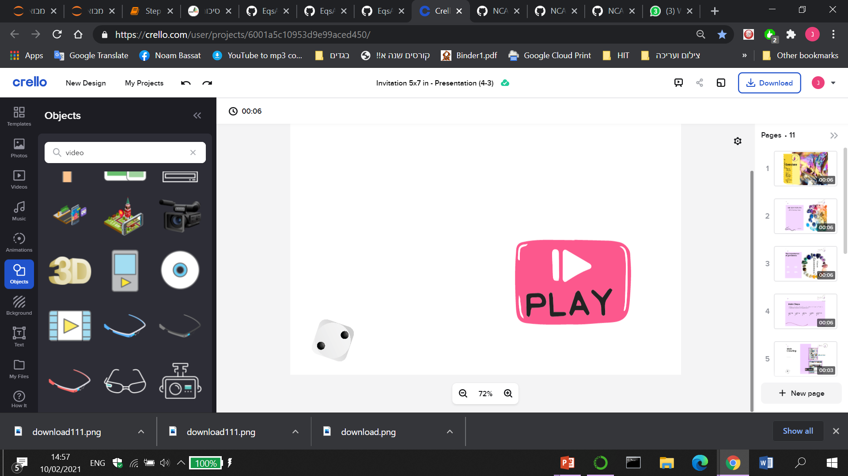
My Machine

