Slide 1
Can a recipe be personalized by a digital agent?
Noam Domovich

Slide 2
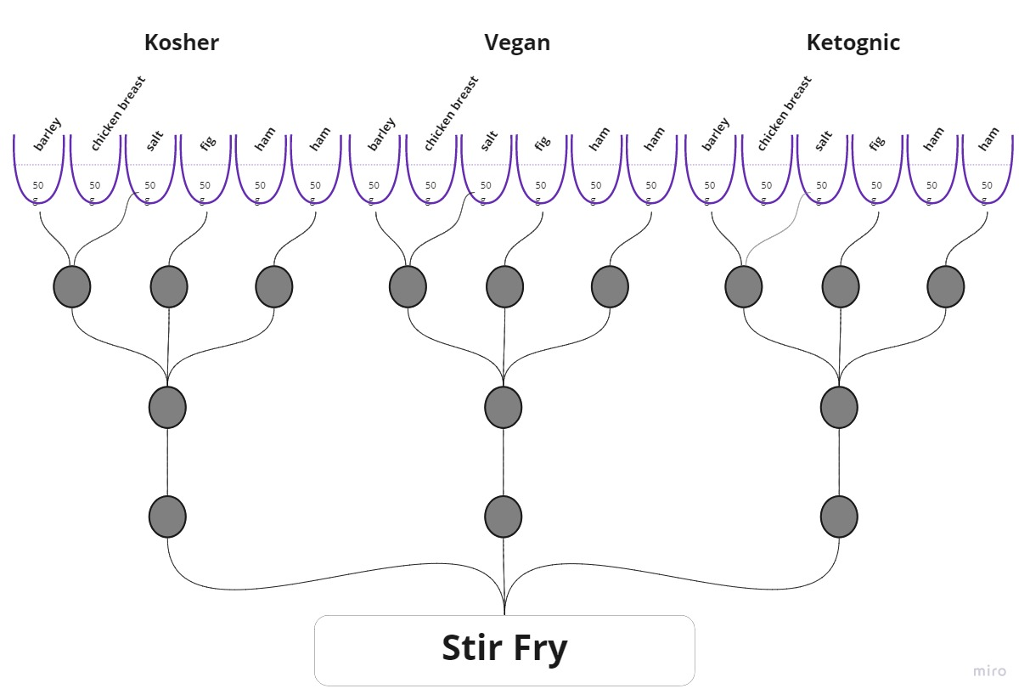
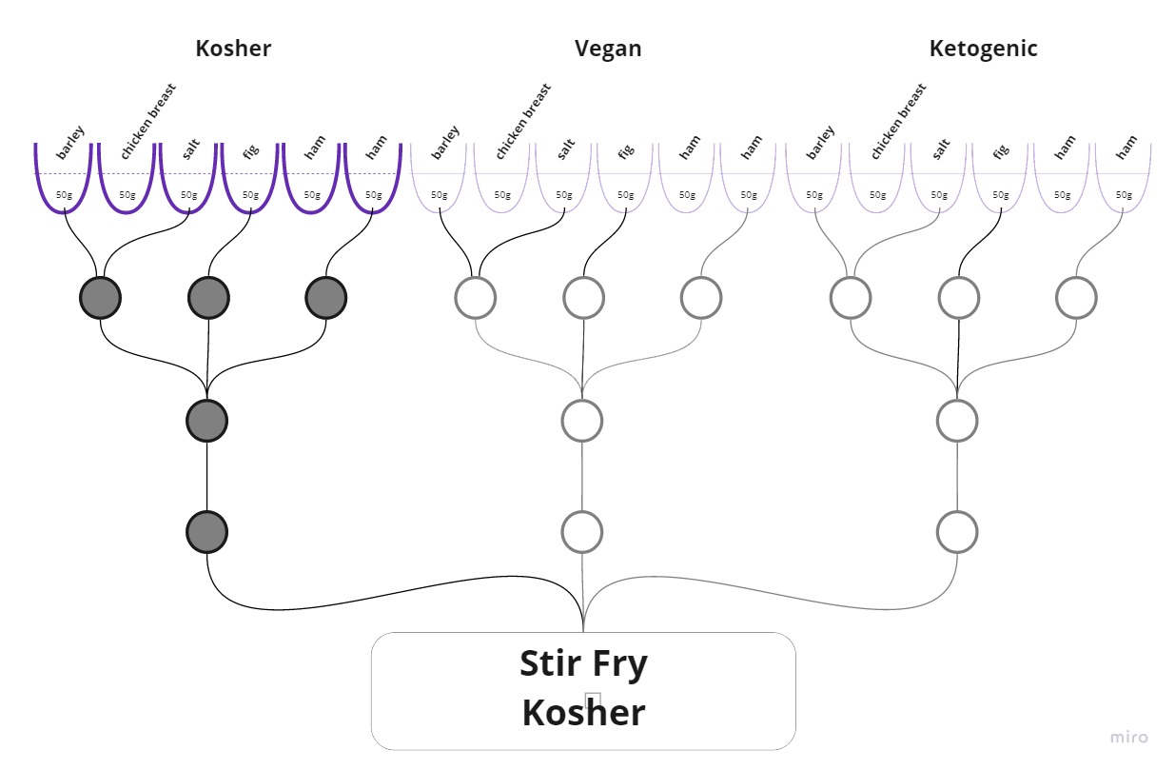
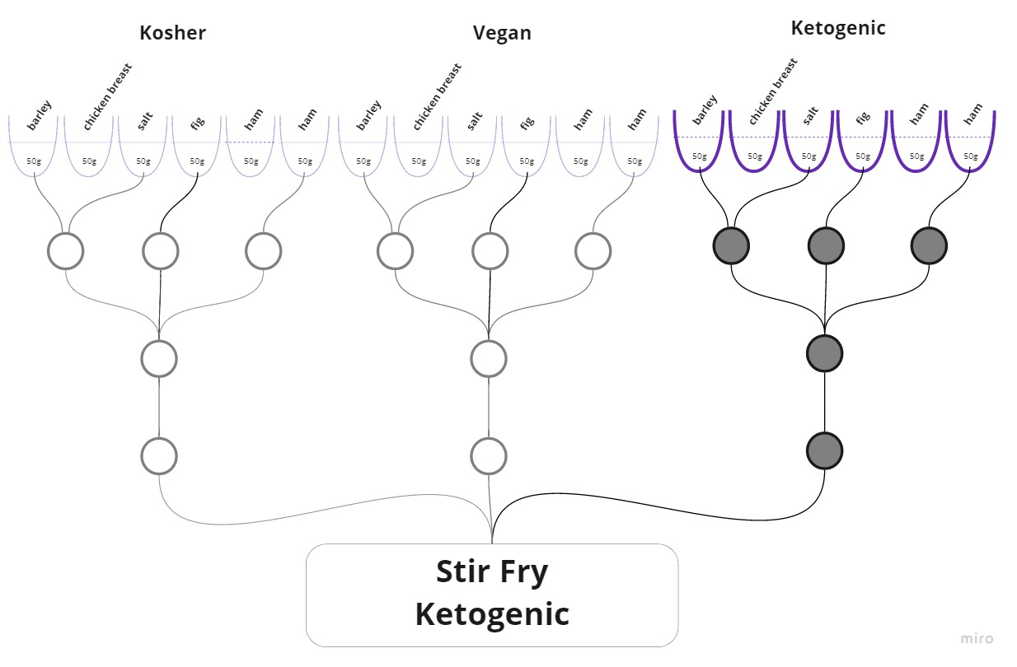
What Is Meta-recipe?
A meta-recipe could generate several different recipe variants based on the user restriction and preferences.
Restrictions examples: kosher, vegan, ketogenic etc.
Preferences examples: taste, aroma, environmental impact, macronutrient distribution.

Slide 3
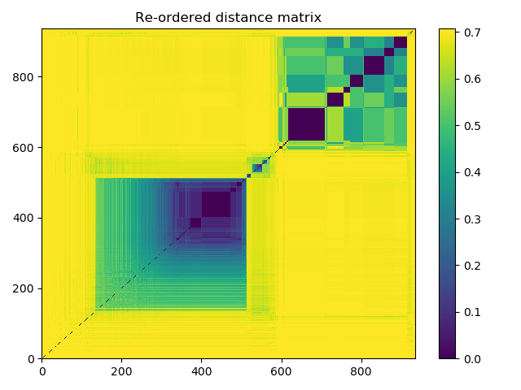
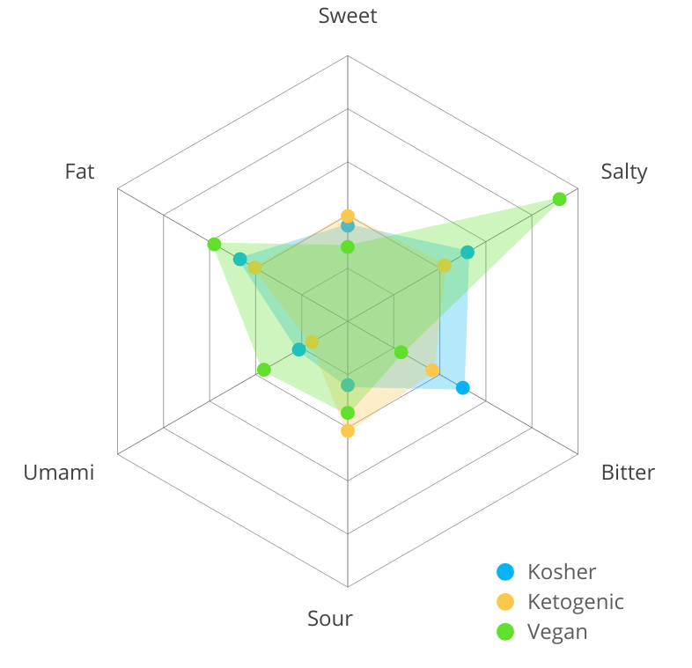
Recipes coring
Ingredient’s Aroma Analysis
Recipes Stir Fry Taste Comparison
Each ingredient was given a score based on some categories i.e.: aroma, taste, environmental impact etc.
For each recipe, a total score was calculated base on the ingredient score and the ingredient’s amount.

Slide 4
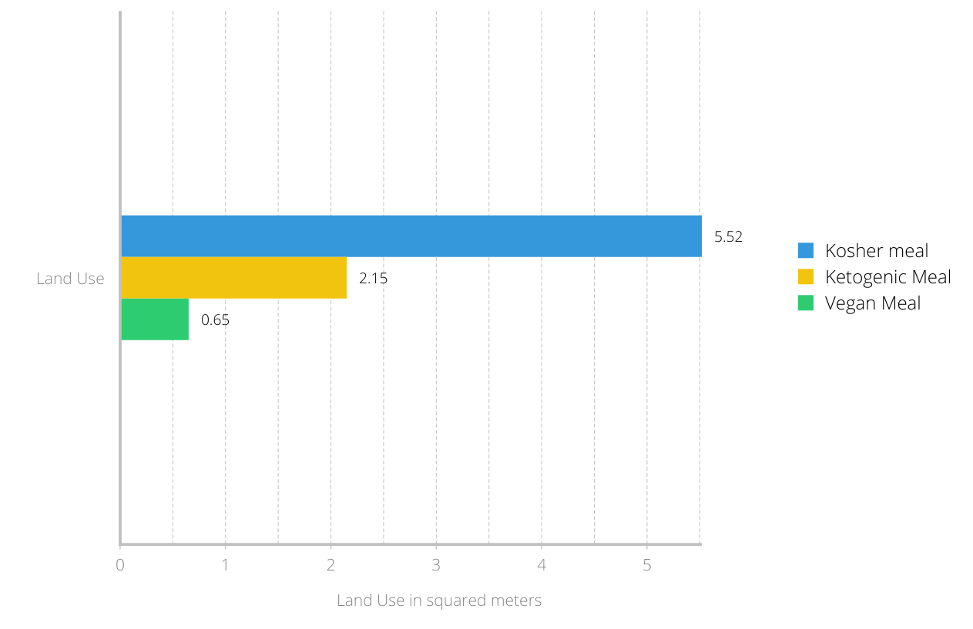
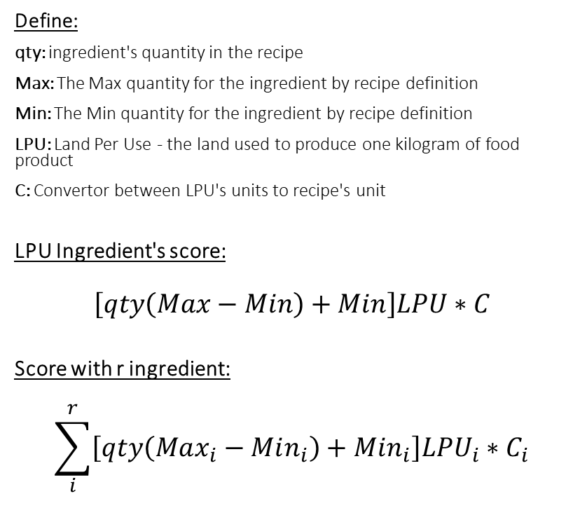
Land Use Footprint Score Calculation
Define:
qty: ingredient's quantity in the recipe
Max: The Max quantity for the ingredient by recipe definition
Min: The Min quantity for the ingredient by recipe definition
LPU: Land Per Use - the land used to produce one kilogram of food product
C: Convertor between LPU's units to recipe's unit
LPU Ingredient's score:
$$\left[qty\left(Max−Min\right)+Min\right]LPU∗C$$
Score with r ingredient:
$$\sum_{i}^{r}{\left[qty\left(Max_{i}−Min_{i}\right)+Min_{i}\right]LPU_{i}∗C_{i}}$$
Land use in squared meters for each lettuce wrap

Slide 5
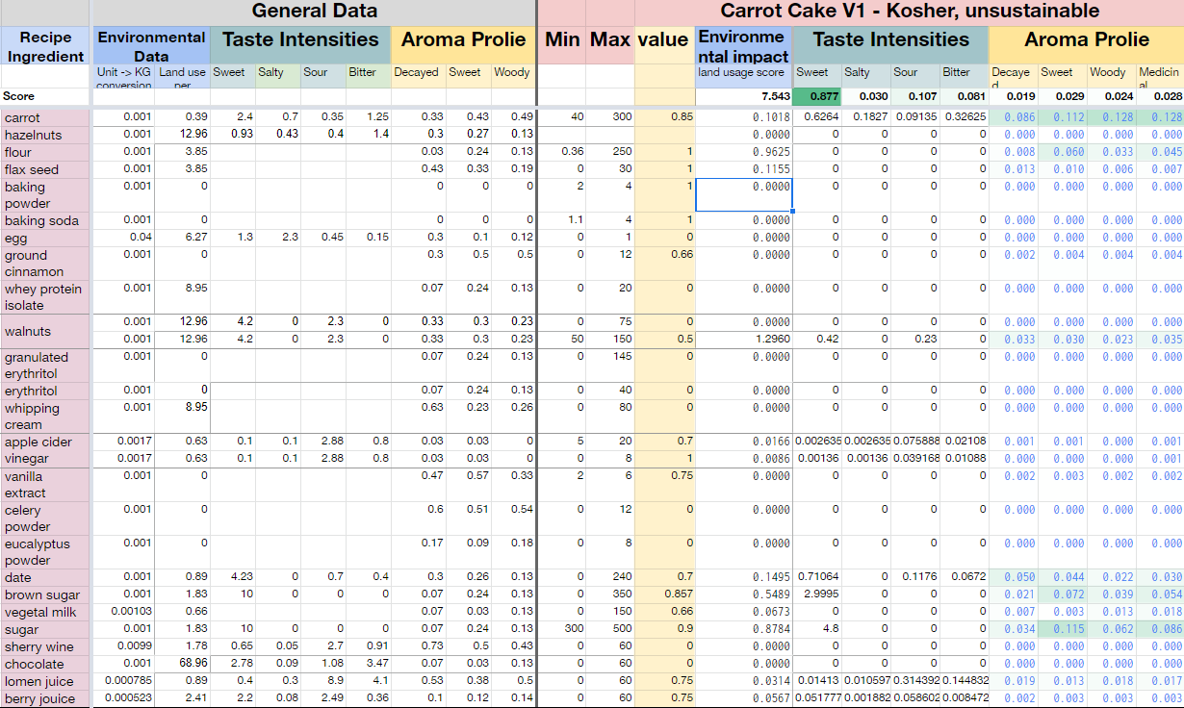
Score representation of recipe variant

Slide 6
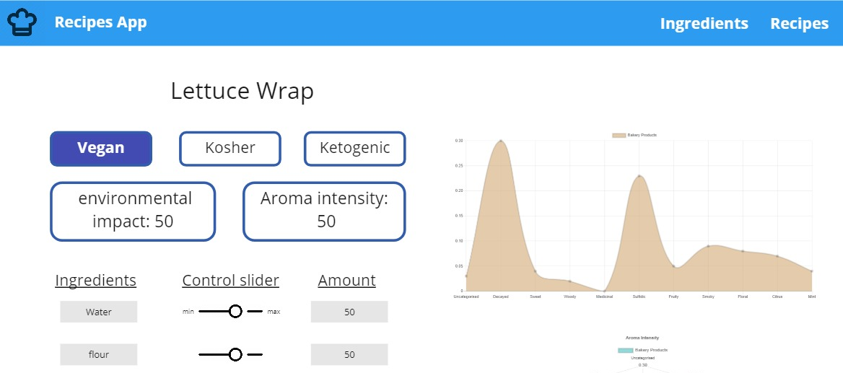
Recipes App – control your recipe

