Slide 1

Can a recipe be personalized by a digital agent?
Noam Domovich

Slide 2
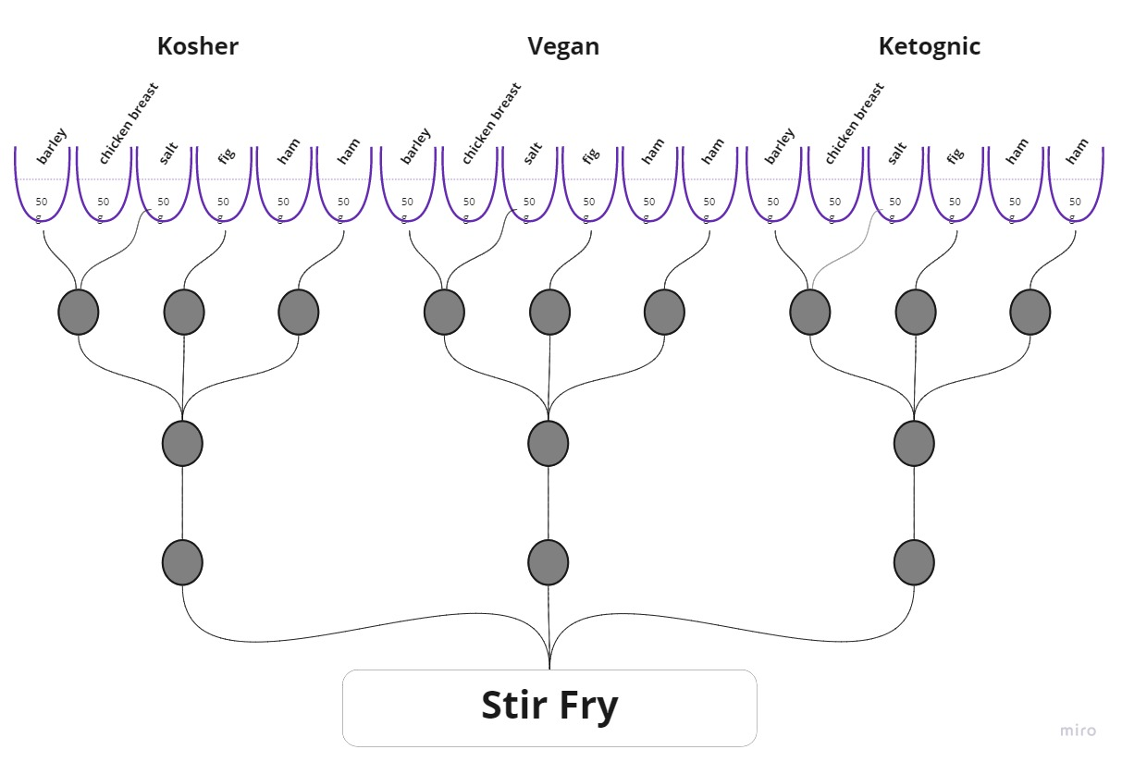
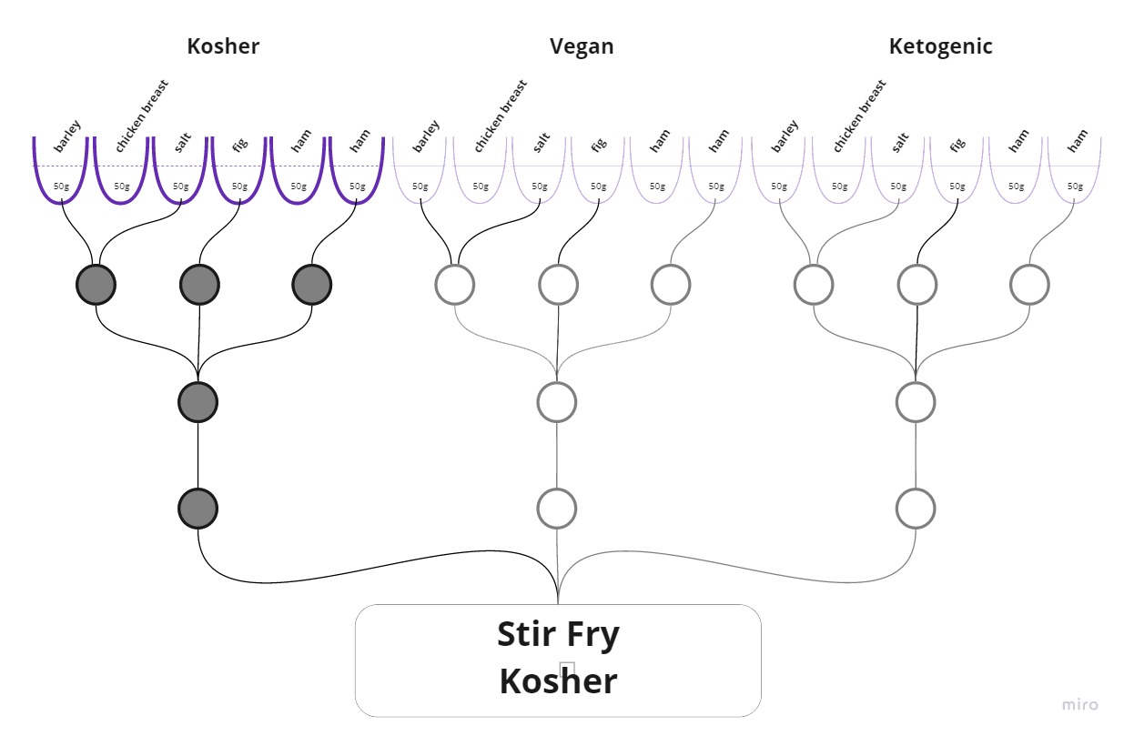
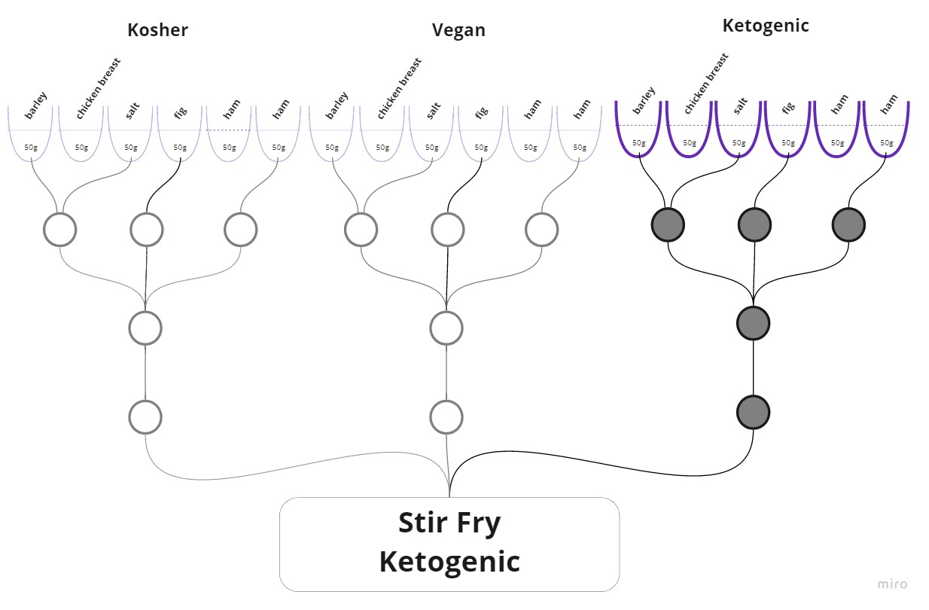
What Is Meta-recipe?
A meta-recipe could generate several different recipe variants based on the user restriction and preferences.
Restrictions examples: kosher, vegan, ketogenic etc.
Preferences examples: taste, aroma, environmental impact, macronutrient distribution.

Slide 3
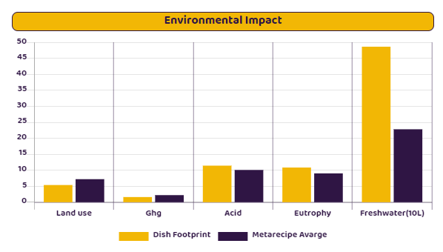
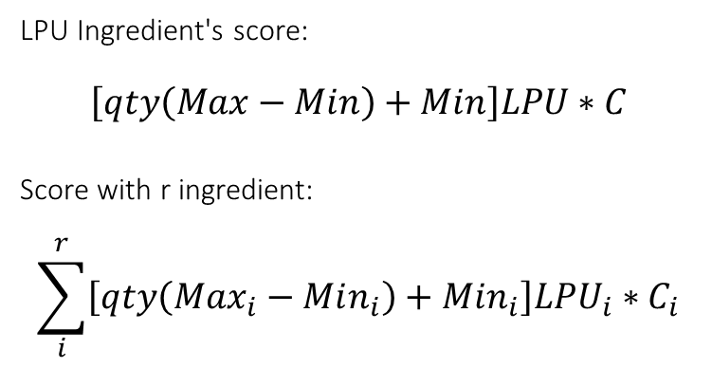
Recipes scoring
Each ingredient was given a score based on some categories i.e.: aroma, taste, environmental impact etc.
For each recipe, a total score was calculated base on the ingredient score and the ingredient’s amount.
LPU Ingredient's score:
$$\left[qty\left(Max−Min\right)+Min\right]LPU∗C$$
Score with r ingredient:
$$\sum_{i}^{r}{\left[qty\left(Max_{i}−Min_{i}\right)+Min_{i}\right]LPU_{i}∗C_{i}}$$
Lettuce wrap & Vegan

Slide 4
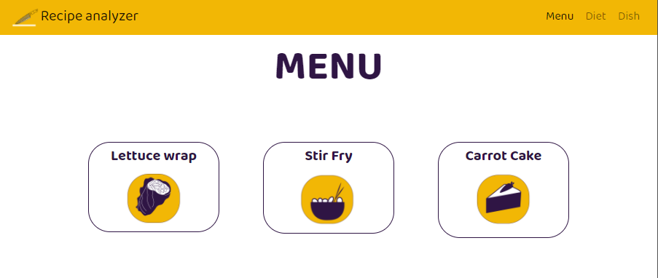
Recipes Analyzer – control your recipe

Slide 5
Project design
Insights
The project has two parts : backend and frontend
Backend
Using Django framework to create RESTful API (python)
Frontend
Using React framework to create flexible UI (js)
It’s can be done
The environmental impact of our food
Web development skills

Slide 6
Sources
Thanks
Application
Online app in netlify
View the data schema in Heroku
Github
The backend code you can find here
The frontend code you can find here
The documents : VISION & SDD & SRS etc. you can find here
Shimon Heimowitz , Prof. Amit Zoran - Advisers
Emiliano Arencibia Gonzalez - Culinary consultant
Vered Domovich & Eilam Sklar - UI design

