Slide 1
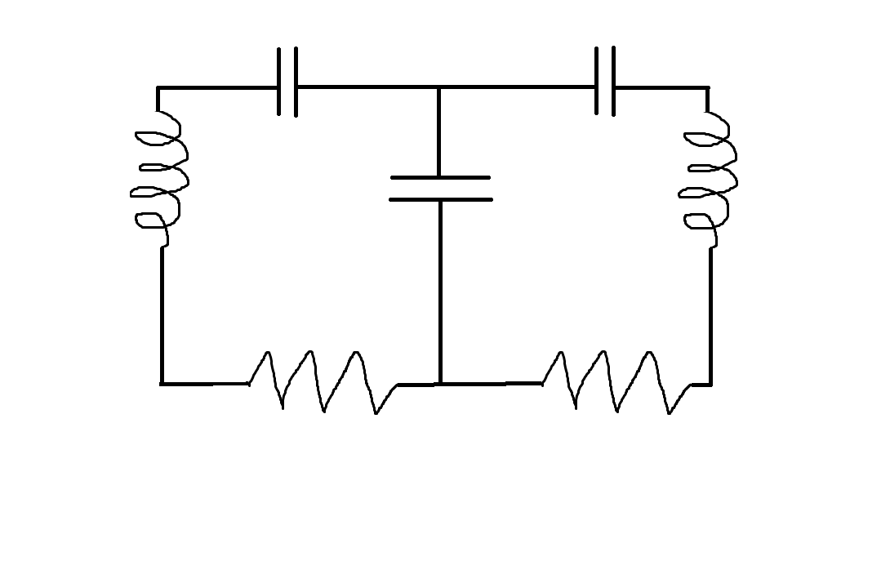




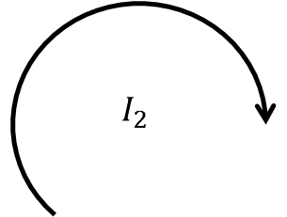



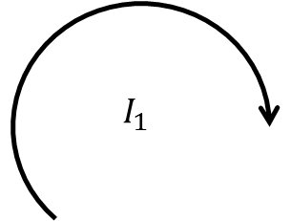






$$C_{1}$$
$$C_{2}$$
$$I_{1}$$
$$I_{2}$$
$$L_{1}$$
$$L_{2}$$
$$C′$$
~
$$R_{3}$$
$$V$$
$$R_{1}$$
$$R_{2}$$
$$gnd$$
$$Ch1$$
$$Scope$$
$$Ch2$$

