Slide 1
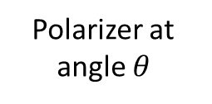
Polarizer at angle $θ$
Plane wave
vertical polarization
source
Sensor

Slide 2
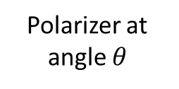
Polarizer at angle $θ$
Horizontal Polarizer
Plane wave
vertical polarization
source
Sensor

Slide 3




Wave
guide
transmitter
sensor
w
$$\hat{Z}$$
$$λ$$
$$L_{1}$$
$$L_{2}$$

