Slide 1
MATRISONG
Rom Sahaf
Igal Rochkes
Eyal Lustig
Noam Kanonich

Slide 2



create face to your music

Slide 3
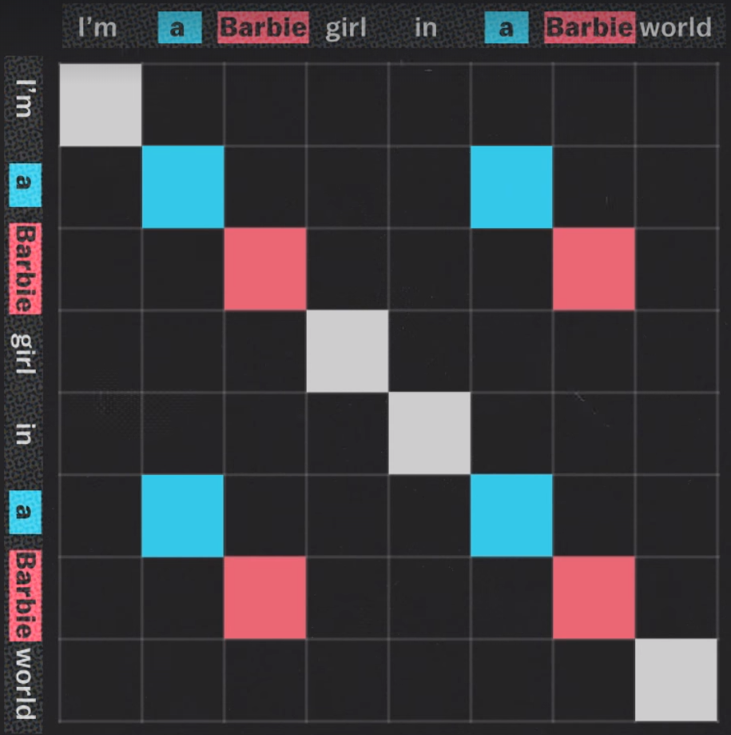
MatriSong
A program that creates a picture of a song, which we could than study, and learn things about it structure and repetitive nature
link

Slide 4
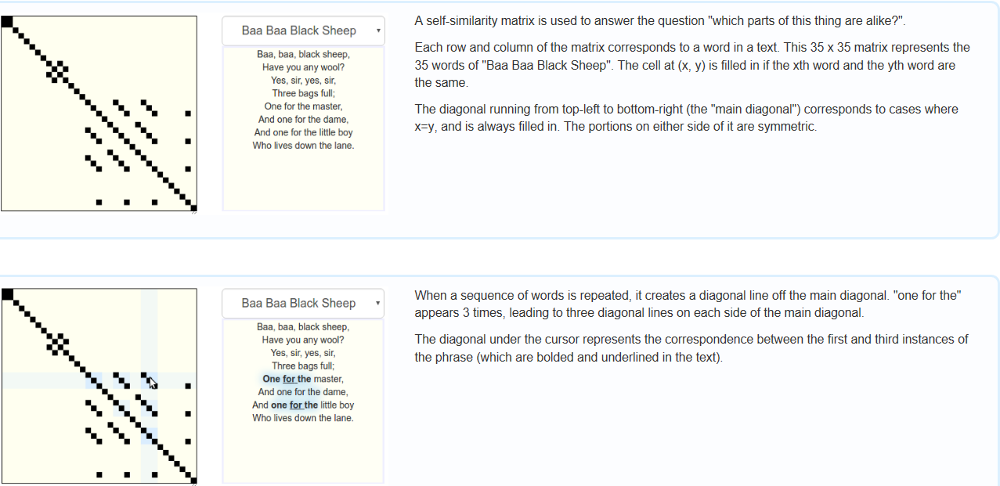
Past projects
We’re based on a project called “Songsim” – the project produces a similarity matrix from a song’s lyrics. That way, each song gets a visual identity, a fingerprint.
The major drawback of this project, is that it only visually represents the song’s lyrics and not the melody.
Our project will take a step forward, dealing with both the lyrics and the melody, combining them into a single visual structure.

Slide 5
Solution
A software program that gets a song as an input and produces full visual identity – A Picture of a song.
*Will be implemented in JAVA, using it’s visual libraries and JDK*

Slide 6
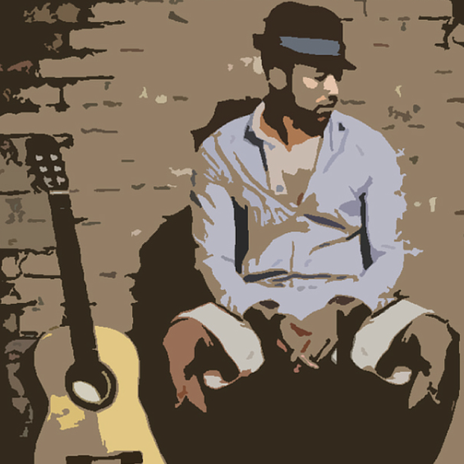
solution
In past projects, only the lyrics' repetition was analyzed, thus, losing a lot of information about the song's structure.
We will analyze repetitions in both lyrics and melody, and combine them together to create a visual "picture" that would represent the song structure profoundly.
The user will be able to learn much more about the song's structure, patterns and repetitive nature.

Slide 7




Lyrics sim-matrix
Lyrics file
User’s song
The song’s face
MatriSong algorithm
melody file
Melody sim-matrix

Slide 8
Work stages
Stage 1
Stage 2
Stage 3
A program that takes few words as input (a file or a string) and prints a basic similarity matrix (perhaps to the console). After that, we'll want the program to take a small midi file (or maybe just a series of numbers) and print a basic similarity matrix (perhaps to the console)
The program gets a song file as an input and splits it into a lyrics file and a melody file, then produces two visually-beautiful and colorful matrices (using JDK). From there, we can start thinking about how to combine them to a single visual structure; probably as a multi-layer structure.
improving visualization, choose visually suitable songs for demo, wrap the program in a user-friendly interface with several options of activation.

Slide 9
Bibliography
A Facebook clip that describe original project: link
The SongSim project's website: link

