Slide 1
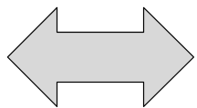
Tensor Factorization
Shallow Non-Linear CNN
(sum of components)
input
conv
pool
output
Hierarchical Tensor Factorization
Deep Non-Linear CNN
local tensor factorization
(sum of local components)
input
conv
pool
conv
pool
output

