Slide 1

Data Versioning for Reproducibility with R and Dolt
Dr. Noam Ross
@noamross
#nyhackr, 2022-05-19
This work is licensed under a Creative Commons Attribution 4.0 International License.

Slide 2


@EcoHealthNYC
@rOpenSci

Slide 3
The Plan
Some musings on versioning data
An introduction to dolt, a git-like SQL database
{doltr}, an R client for dolt, with a live demo 😬
Some workflows with dolt and R and other stuff
The ✨ future✨ and Q & A with special guests!

Slide 4
Why Version Control Data?
Lots of data is “live”
New and updated values tracking real-processes
Revision, curation, and schema changes due to changing goals and QA processes
Reproducibility and auditability
Collaboration in database development and curation

Slide 5
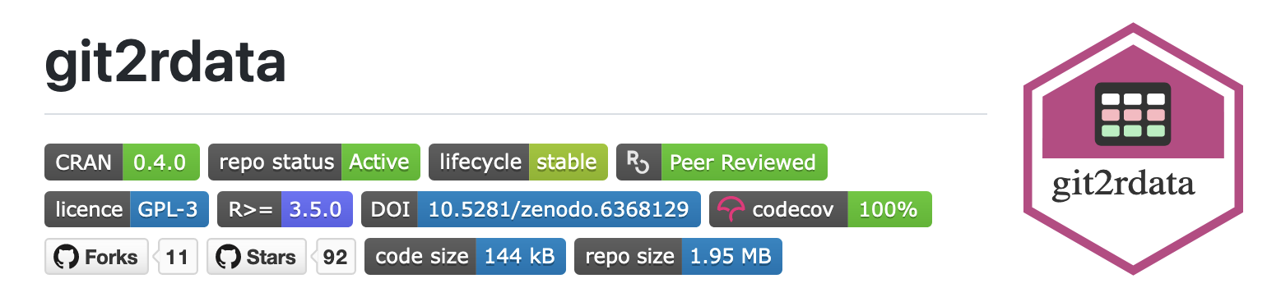
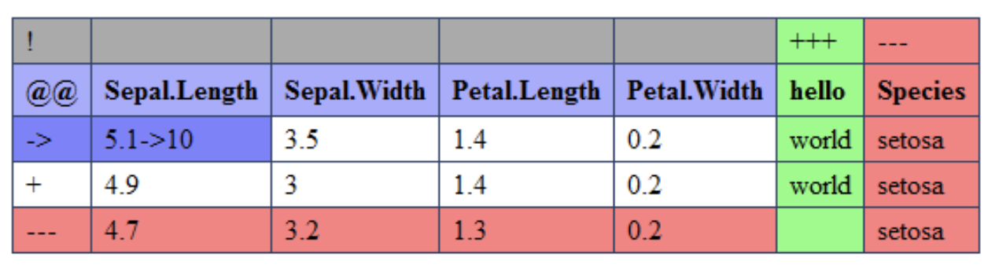
Storing Data with Git
Not always a bad idea!
Couple code + data with same versioning (good? bad?)
Inefficient for lots of data structures
Git tools are built around lines, not fields
Some tools can help: 📦{git2rdata}, 📦{diffObj}, 📦{daff}
docs.ropensci.org/git2rdata
github.com/edwindj/daff

Slide 6
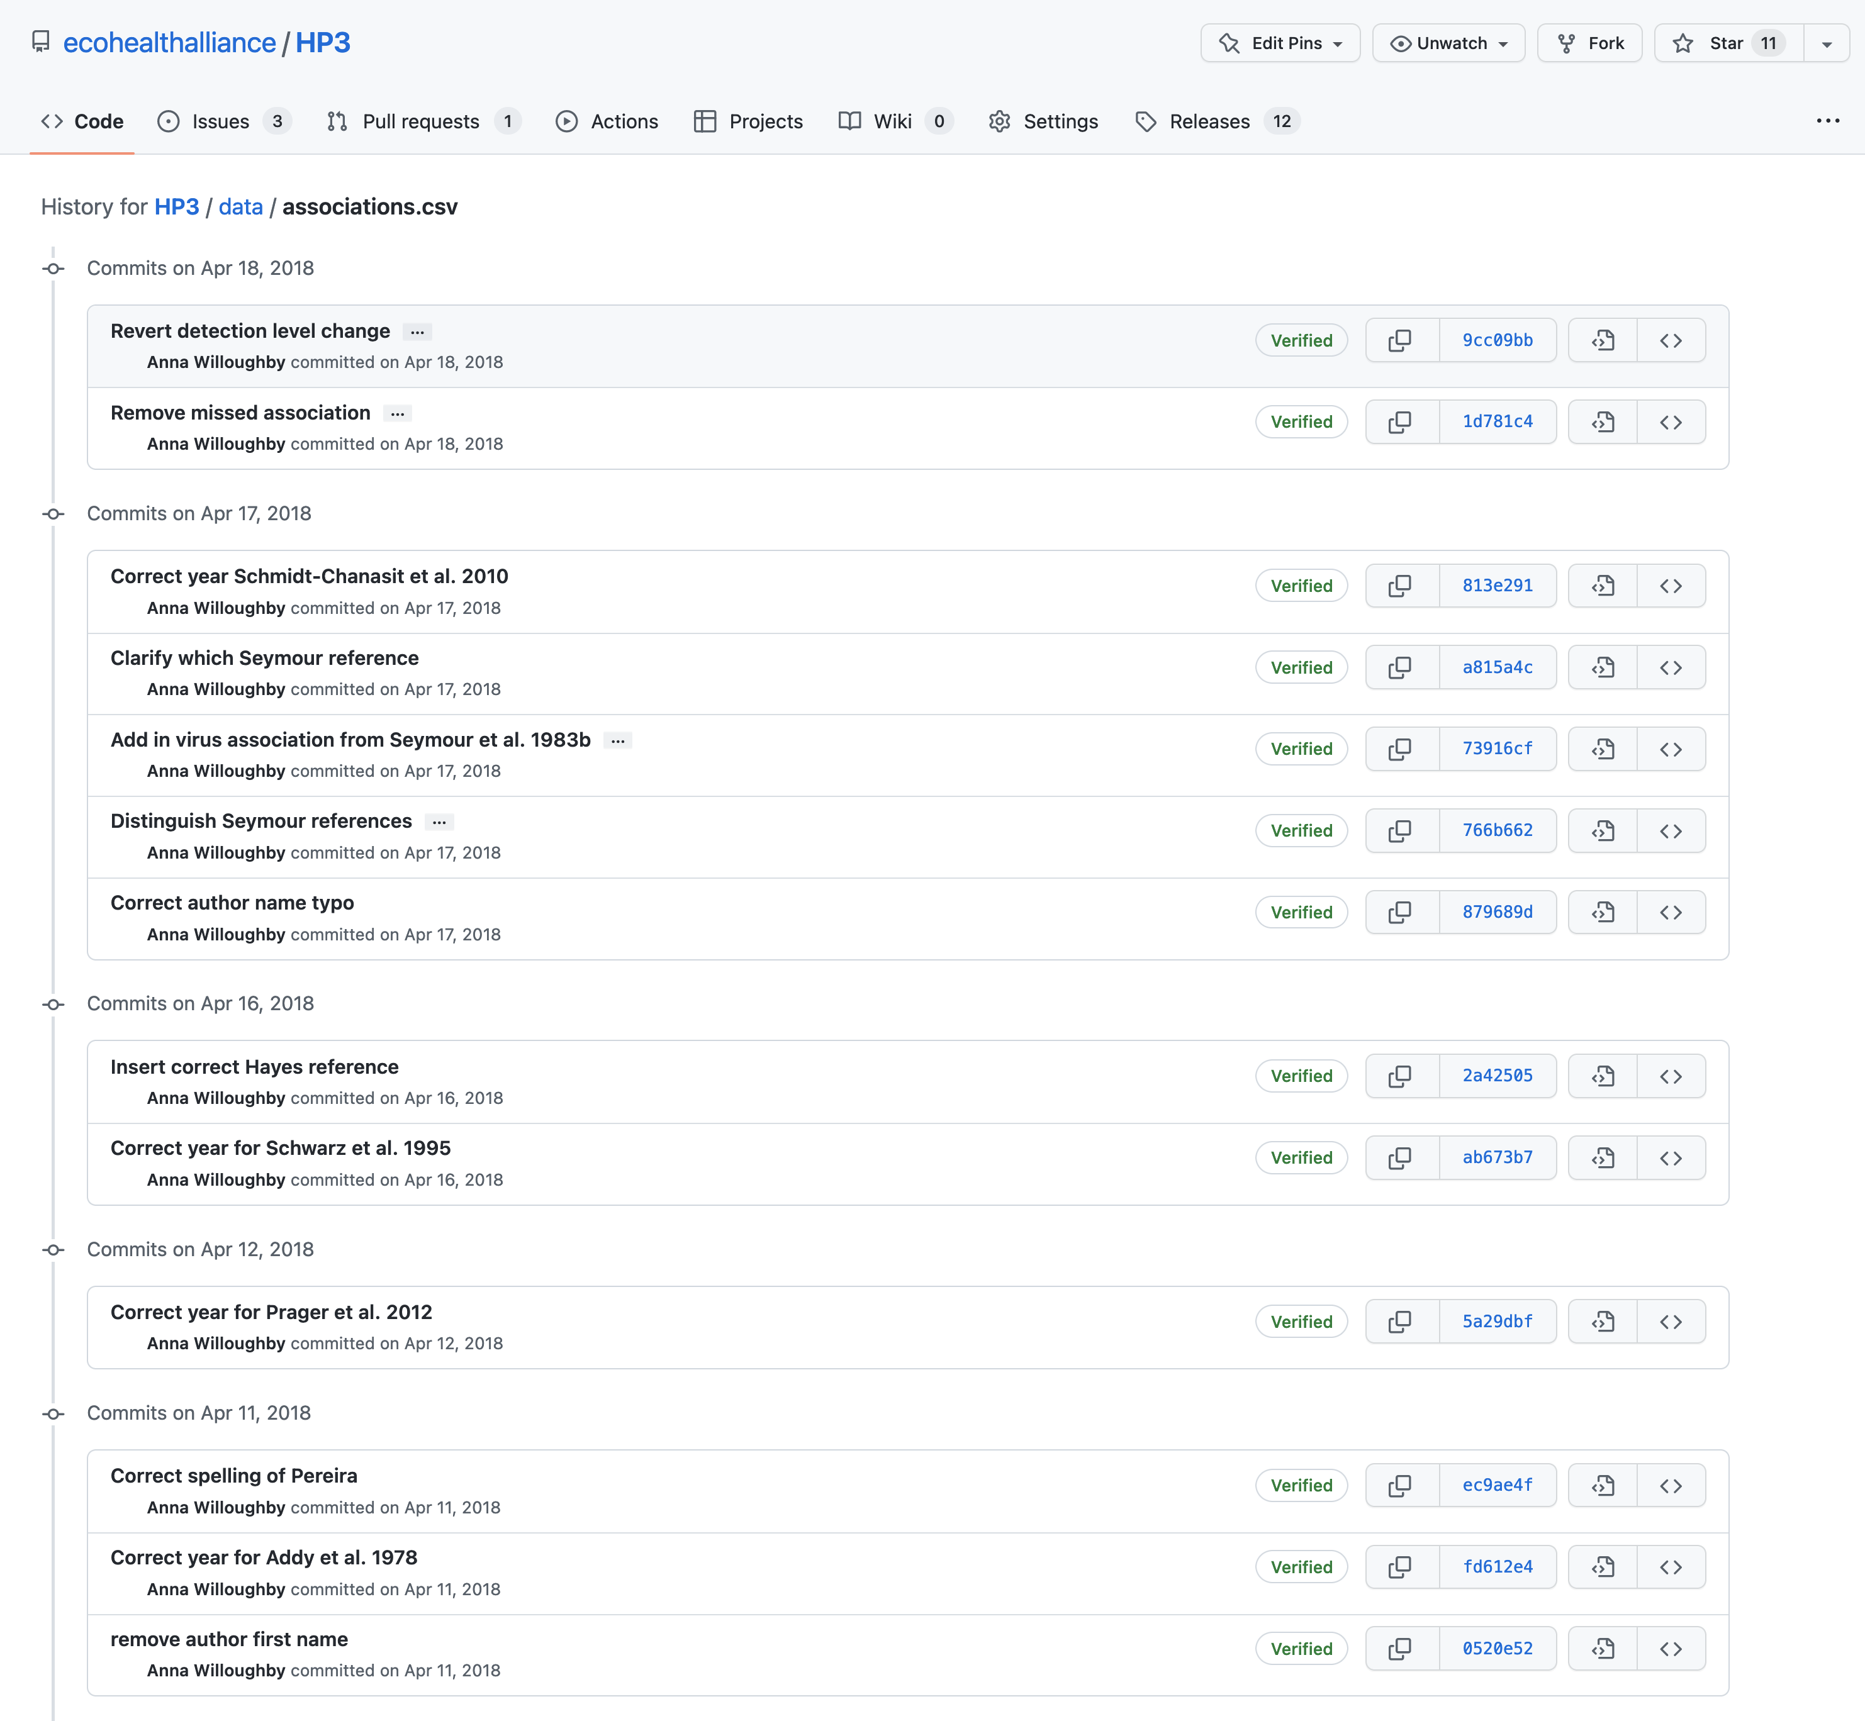
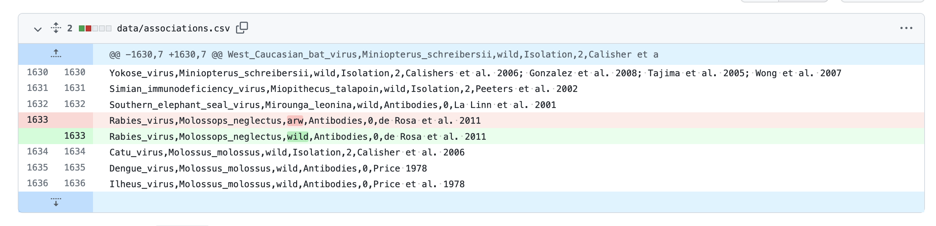
This versions the data format, not contents
Data types and interrelationships are not preserved

Slide 7

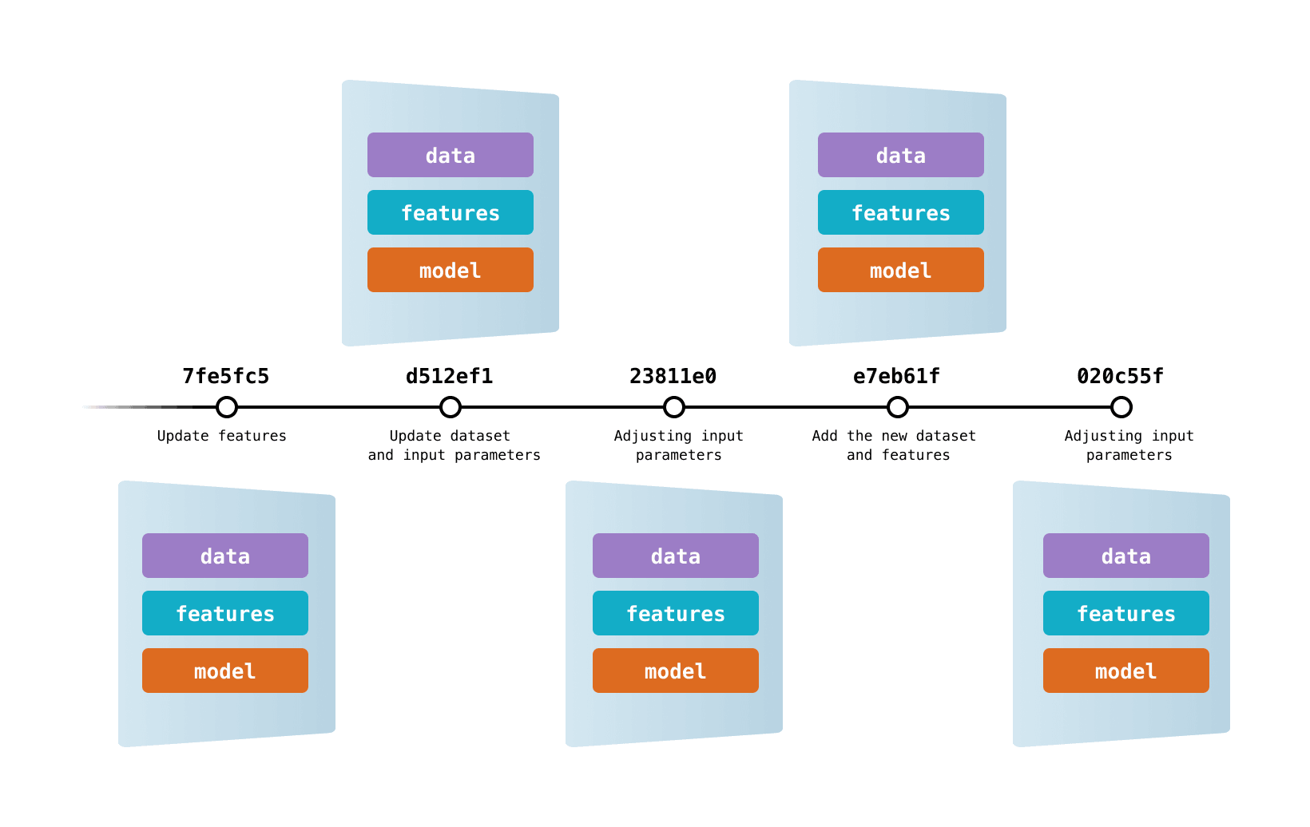
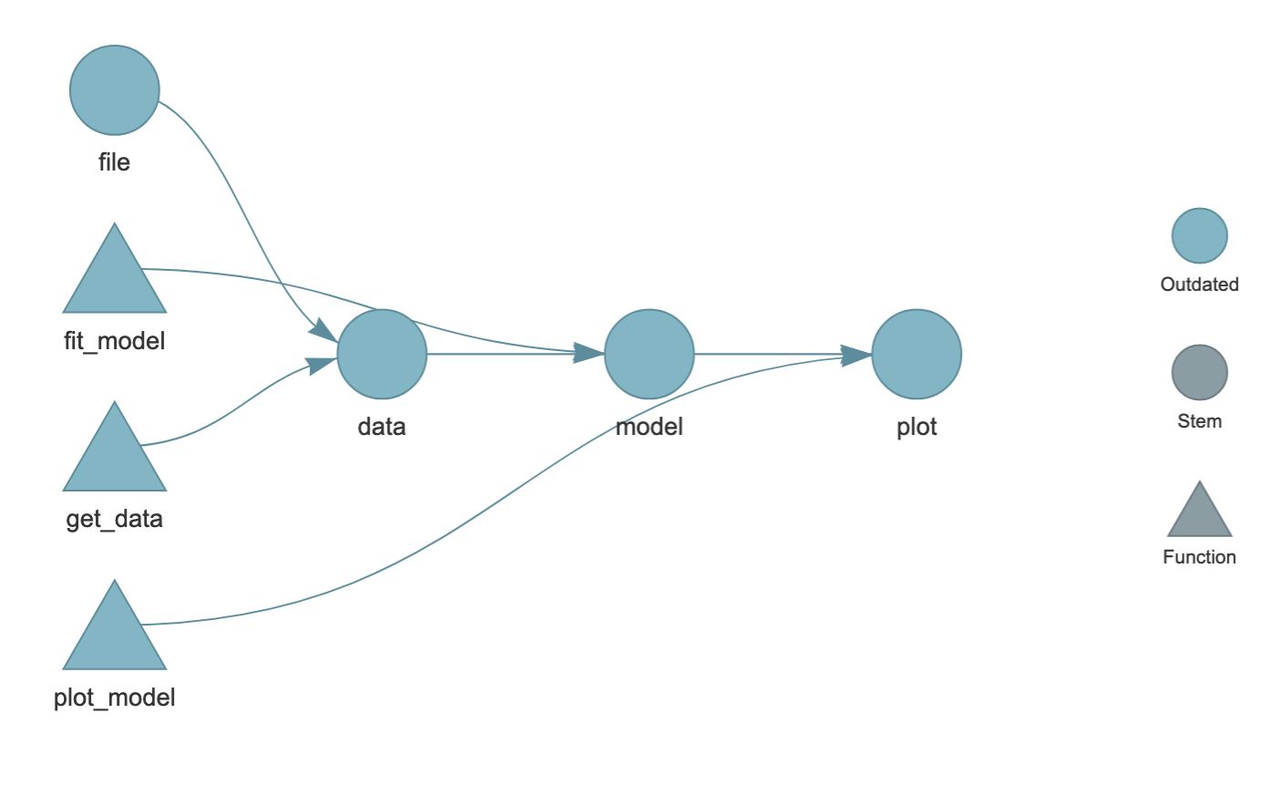


Versioning in a Build System
Data versions tightly linked to model
Good for arbitrary or binary data in ML pipelines
Good for build efficiency (caching), auditability
Generally no diff, merge tools or structure/schema awareness
In R 📦 {targets} can take advantage of S3 or git binary versioning
General tools like DVC and Pacyderm store arbitrary data as files
dvc.org
books.ropensci.org/targets

Slide 8
Versioning in the Database
”Temporal Tables” can provide version-like capabilities for tightly-controlled databases with fixed fields
TerminusDB: git-like versioning for graph-like databases
dolt: git-like versioning for SQL (relational) databases

Slide 9

What is Dolt?
A relational (SQL) database with git-like versioning
Single binary program (written in Go)
On-disk storage
MySQL / MariaDB compatible
CLI and server-client SQL interfaces
@DoltHub

Slide 10
What is “Git-Like”?
Change, Add, Commit workflow
Branch, Diff, and Merge
Push-pull database against remotes
Patch/Pull Request contribution across distributed repositories
Web Interface via DoltHub/DoltLab

Slide 11
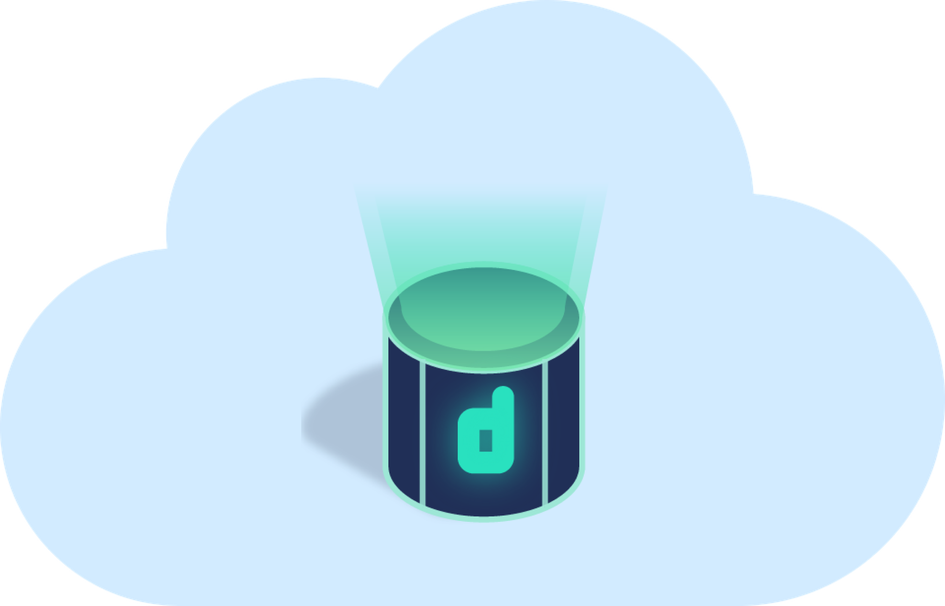
What is DoltHub?
A central hosting service for Dolt repositories
Also serves data via REST API, CSV and ZIP exports
Some web-based editing capabilities
Self-Hostable as DoltLab
dolthub.com

Slide 12
Dolt is not
Your fastest option for data I/O
A “Big Data” product
Stable for critical systems

Slide 13

{doltr} in a nutshell
A {DBI}-style wrapper for dolt databases
A manager for dolt server processes
A {gert}/{git2r}-style interface for dolt versioning
An RStudio plugin
ecohealthalliance.github.io/doltr

Slide 14
SQL workflows with R
Commonly, R users interface with SQL databases
To pull data for analysis from an upstream/central hosted source
As internal storage or caches for data packages or Shiny apps
SQL reading tooling is very well developed (e.g., {dbplyr})
SQL writing tooling and workflows are less well supported, but…
📦 {DBI}, dbWriteTable(), dbDropTable()
📦 {dbx}, built on DBI, has dbInsert(),dbUpsert()
📦 {dbplyr} in dev has rows_insert(), rows_append(), rows_update(), rows_patch(), rows_upsert(), and rows_delete()

Slide 15





Workflow: ML on a Moving Target
Building models against data that are updated and scraped from possibly mutating upstream sources
Regularly changing our own schema to better organize data for model structure
Fix schema as upstream data source changes
Scheduled job updates data + commits
DATA:
Dolt(Hub) Repo
Develop model against fixed database state
CI job checks model against latest data
CODE:
Git(Hub) Repo
Emma Mendelsohn
Nathan Layman

Slide 16




Workflow: Ongoing Field/Lab Projects
Database and schema and GUI updates as scope of data collection evolves
Field teams collect/enter data via GUIs with their own data storage
Collecting field data across teams in a database serving multiple / changing goals
Running reproducible analyses for scientific publication and archival
DATA:
Dolt(Hub) Repo
Auto-commit new data to Dolt
CSV Export!
Create Dolt Releases (tags) at time of publication
Run analyses against data state at fixed dates/states
Scientific Publication and Archives
Create Git Releases (tags) at time of publication
CODE:
Git(Hub) Repo

Slide 17
Stuff to Come in {doltr}
A DoltHub API interface
Support for spatial data
New dolt versioning functions
Database writing convenience functions? dbAddCol() dbAddData()
More at https://github.com/ecohealthalliance/doltr/issues

Slide 18
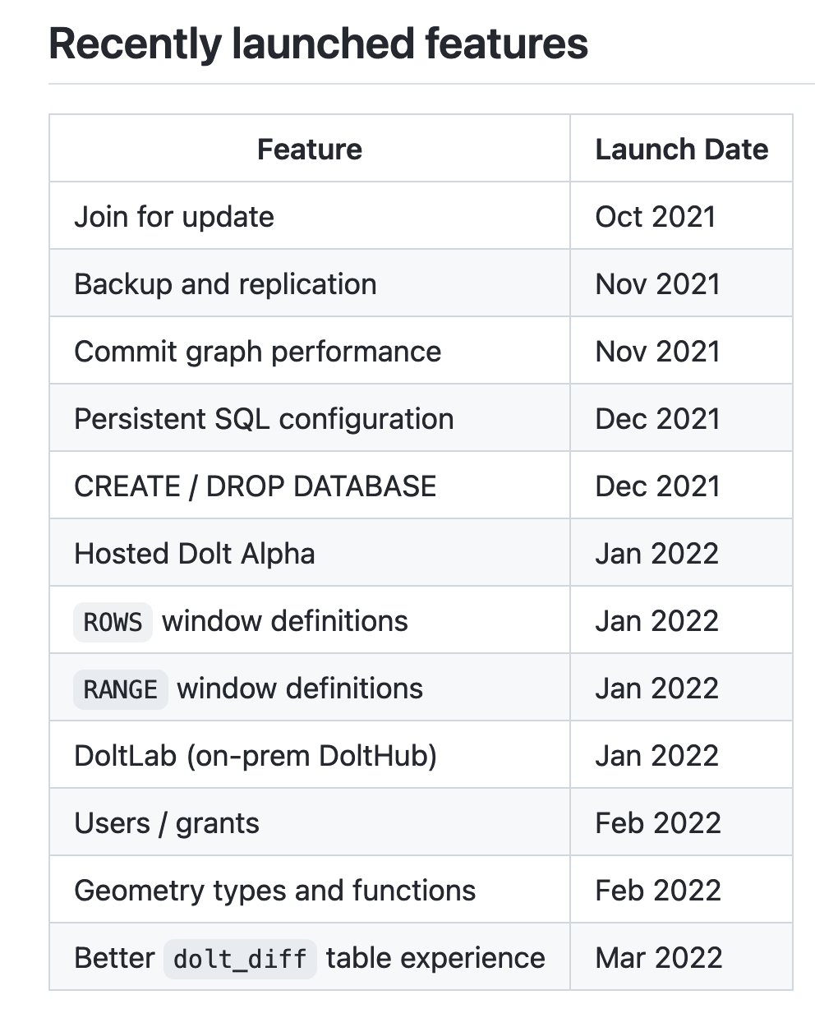
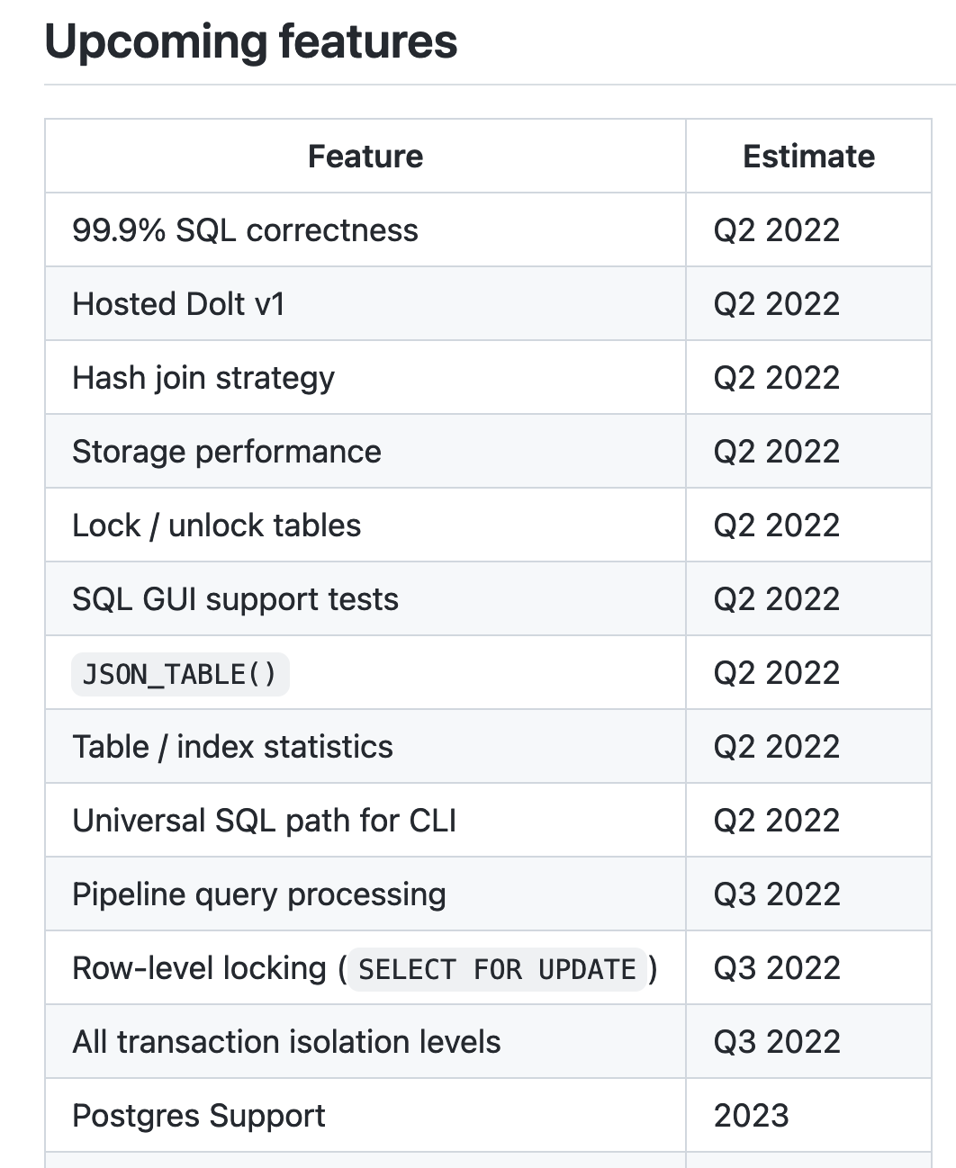
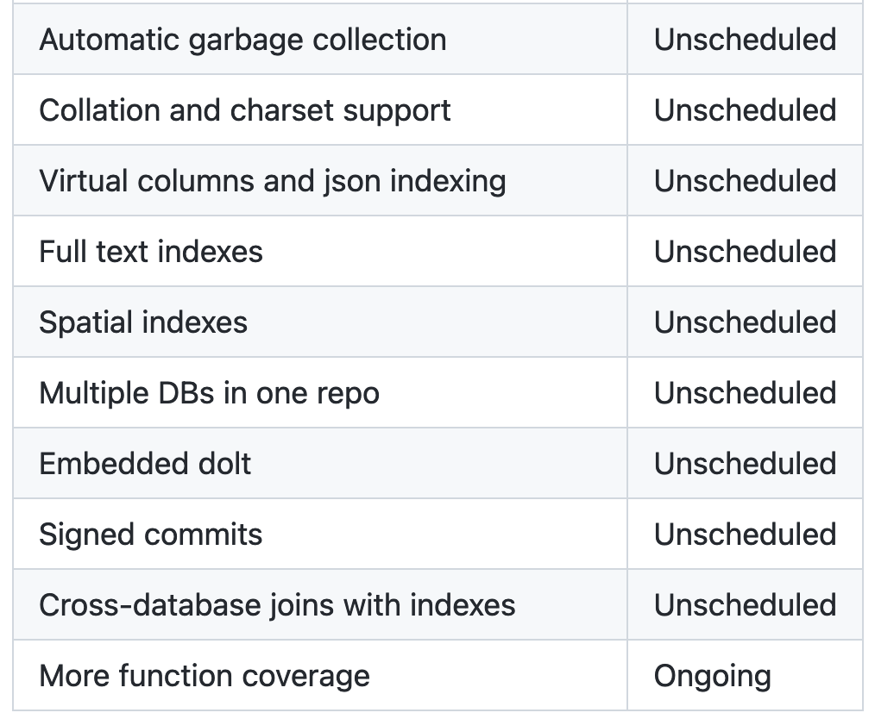
Stuff to Come in dolt
https://github.com/dolthub/dolt/blob/main/docs/roadmap.md

Slide 19
Thank You!
Check out dolt (and join the Discord):
www.dolthub.com
Install and kick the tires on {doltr}:
ecohealthalliance.github.io/doltr
@noamross
@DoltHub

