Slide 1
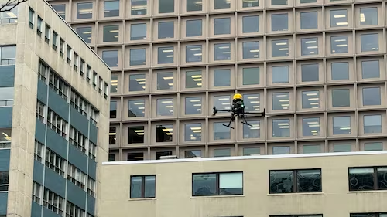
AirDepth
Monocular Drone Distance Estimation
Recovering useful metric scale from one RGB image
single RGB frame
->
distance in meters
6.01m
3.28m
RGB only
synthetic MAE
real MAE after calibration
no LiDAR / stereo / GPS
01

Slide 2
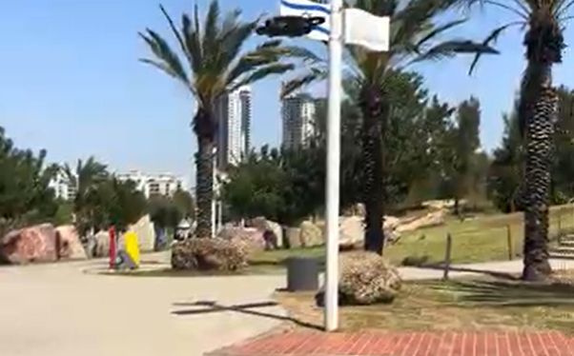
PROBLEM
Detection is not enough; the system needs distance.
For tracking, avoidance, and counter-UAV response, a 2D box is only half the answer.
01
What the camera gives
RGB pixels and a 2D target location.
02
What the system needs
Metric Z-distance from the observer.
03
Why it matters
Distance supports response timing and 3D localization.
02

Slide 3
CHALLENGE
Scale ambiguity is the core monocular obstacle.
The image projection loses absolute metric scale.
Small + near
Large + far
Similar image footprint
AirDepth learns the mapping to meters from labeled examples.
03

Slide 4
GAP
Hardware depth is accurate, but not lightweight.
AirDepth targets the low-cost RGB-only path.
Traditional depth
RGB-only target
01
LiDAR
01
Low payload
High accuracy
Fits lighter platforms
02
Radar
->
02
Low cost
Range sensing
No special depth sensor
03
Stereo
03
Single camera
Triangulation
Simpler field setup
04
RGB-D
04
Needs learning
Dedicated depth
Metric scale is inferred
04

Slide 5
METHOD
AirDepth separates perception from metric conversion.
The depth model supplies relative structure; the regressor and calibration recover usable scale.
BOX
F
CAL
Z
ML
->
->
->
->
Detect
Features
Calibrate
find target box
Depth
box + local depth
Regress
adapt to real
relative map
predict meters
05

Slide 6
DATA STRATEGY
Synthetic data teaches scale; real data tests transfer.
The two datasets play different roles in the evidence chain.
15,064
20-150m
489
transfer
synthetic Unreal images
known ground-truth range
real Nenrus images
calibration evaluation
Training + controlled benchmark
Real-domain bias + calibration
06

Slide 7
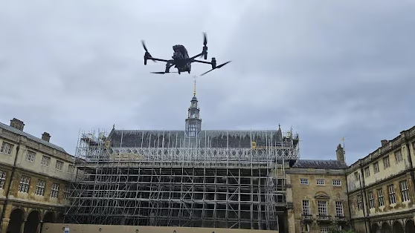
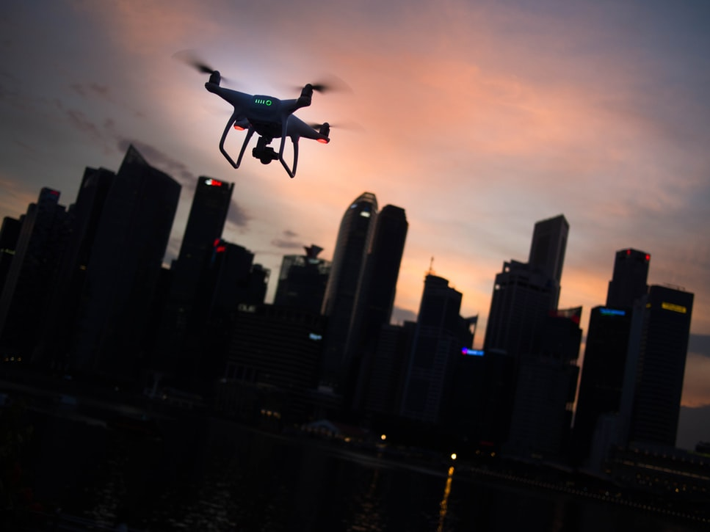
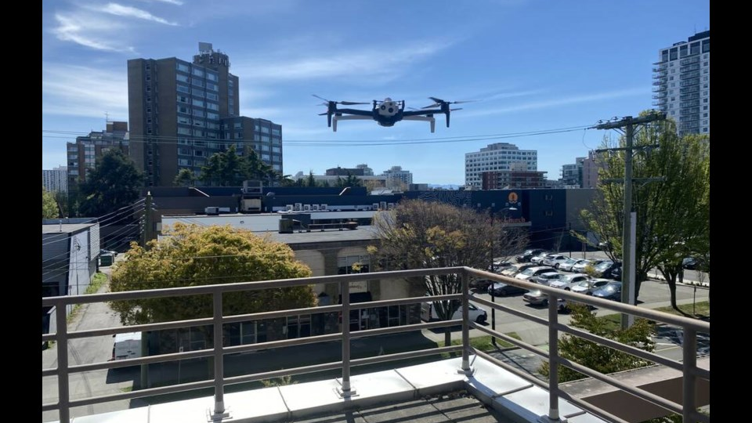
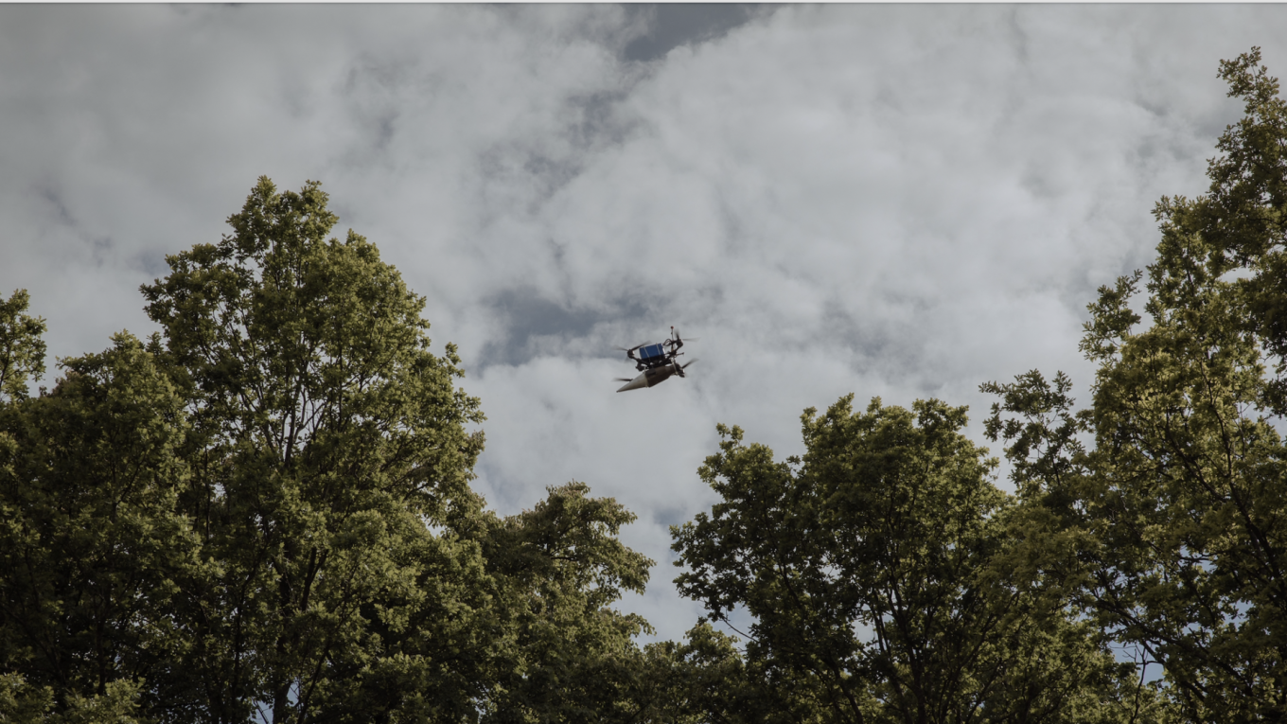
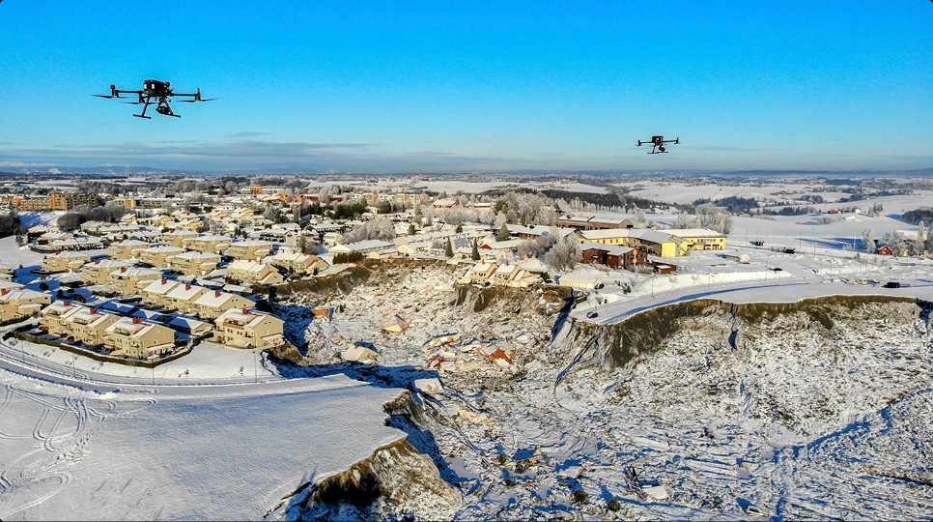
SYNTHETIC DATASET
Controlled images made metric supervision possible.
Each frame carries known distance and environment labels.
01
Distance
20, 30, ... 150m
02
Weather
clear sky / light rain
03
Time
10AM / 8PM
04
Ground truth
controlled Unreal setup
07

Slide 8
FEATURE DESIGN
The bounding box became a distance sensor.
Geometry was not just an intermediate detector output.
01
Width / height
apparent scale
02
Area ratio
target footprint
03
Aspect ratio
viewing shape
04
Center position
image location
08

Slide 9
DEPTH FEATURES
Local depth worked better than global scene context.
Relative depth was useful as a cue, not as the final metric answer.
01
Run depth model
dense relative map
02
Crop around drone
target-centered signal
03
Summarize robustly
midpoint / median / context
04
Jitter the box
stable features under detector noise
Relative depth alone is not meters
09

Slide 10
MODEL EVOLUTION
Ablations turned a weak depth cue into a 6m system.
Each step added one kind of missing scale information.
47.70m
MAE lower is better
32.29m
13.20m
7.19m
6.39m
6.01m
Scale only
Depth linear
Linear + box
Random Forest
RF + jitter
RF-XGB ensemble
10

Slide 11
SYNTHETIC RESULT
The final ensemble was strongest and stable on holdout.
Held-out synthetic test set: 2,260 rows.
Scale only
47.70m
6.01m
Depth linear
32.29m
test MAE
Linear + box
13.20m
Random Forest
7.19m
0.949
R2
RF + jitter
6.39m
Final ensemble
6.01m
81%
within 10m
11

Slide 12
DISTANCE BREAKDOWN
Farther drones remain the hardest regime.
The final model degrades gracefully, but target size still matters.
Near
Mid
Far
≤60m
60-100m
>100m
3.37m
6.96m
9.18m
Less pixels -> less stable boxes and depth cues
12

Slide 13
SIM-TO-REAL
The raw synthetic model overpredicted real drones.
This exposed systematic domain shift, not just random error.
23.80m
99.8%
raw real MAE
->
overprediction rate
different camera, drone scale, annotation behavior, and image statistics
13

Slide 14
CALIBRATION
A lightweight real-domain mapping fixed most of the bias.
20% real calibration data; remaining rows used for evaluation.
33.86m
Before calibration
After calibration
23.80m
16.65m
96.4%
within 10m after calibration
3.28m
2.78m
3.54m
Overall
Kongsberg
Vestfold
14

Slide 15
CONTRIBUTIONS
The project proved the path, and named the limits.
A judge should hear both the result and the deployment boundary.
01
02
03
Method
Experiments
Transfer
Hybrid monocular metric-distance framework.
Ablations from scale-only to final ensemble.
Real-domain calibration reduced systematic bias.
Limits: detector quality, real calibration need, runtime still to benchmark, far range remains hardest.
15

Slide 16
Questions?
Monocular depth alone is not enough. AirDepth combines relative depth, bounding-box geometry, supervised regression, and calibration to recover useful metric scale.
RGB only
meters
single camera input
calibrated output
16

