Slide 1
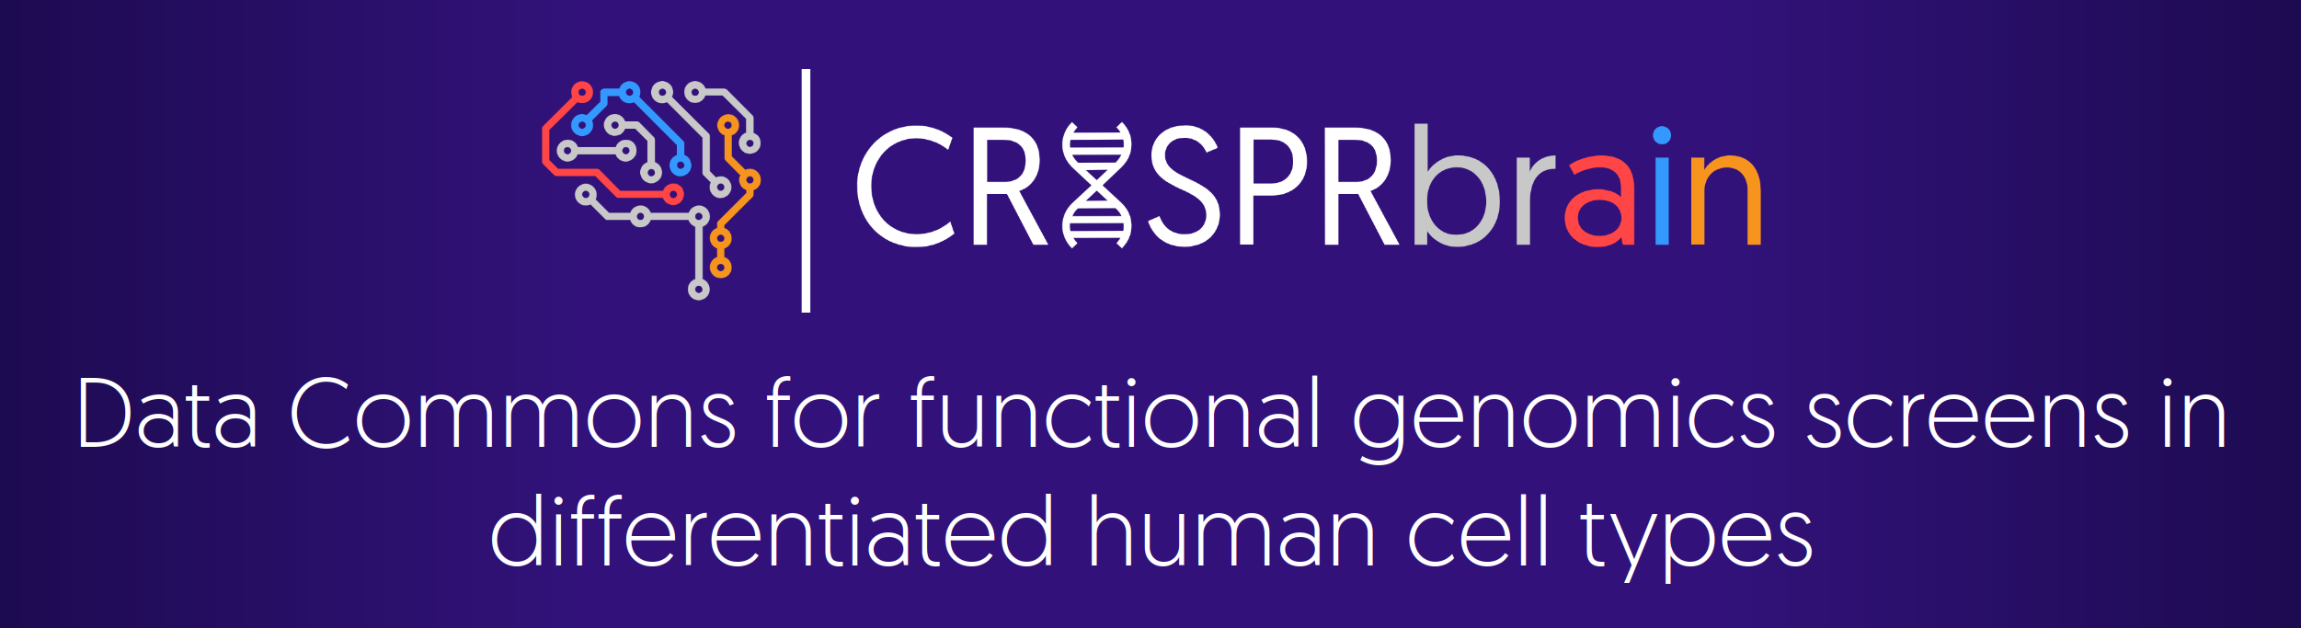
CZI
NDCN
Noam Teyssier @noamteyssier
2023-06-07

Slide 2




Agenda
Background and Motivation
Features and Utilities
New and Upcoming Features
Updated Screen Pipeline

Slide 3
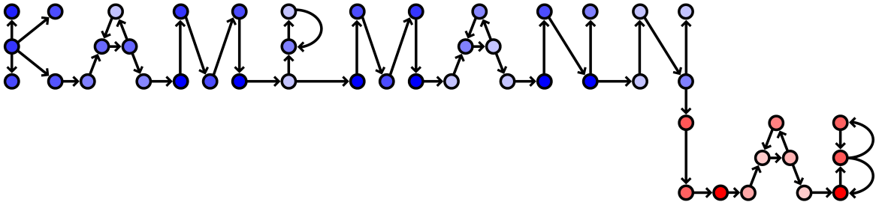

CRISPRBrain is a public data commons of functional genomics screens
It provides a public database to organize those screens and a graphical
user interface to explore the results of functional screens
in human cell types
Focused on standardization, interactivity, and public access of data
Partnership between the Kampmann Lab and Data Tecnica International

Slide 4
Anatomy of a Functional Genomics Screen
Survival
Phagocytosis
Fluorescence
Carrying 1 sgRNA
Phenotype
Depleted Gene
Knockdowns
Enriched Gene
Knockdowns
RELL2
KMT5A
GEN1
AP2S1
NFIX
LDB1
ZXDA
RFX3
GBX1
NSD1
Inactive
Non-Targeting

Slide 5
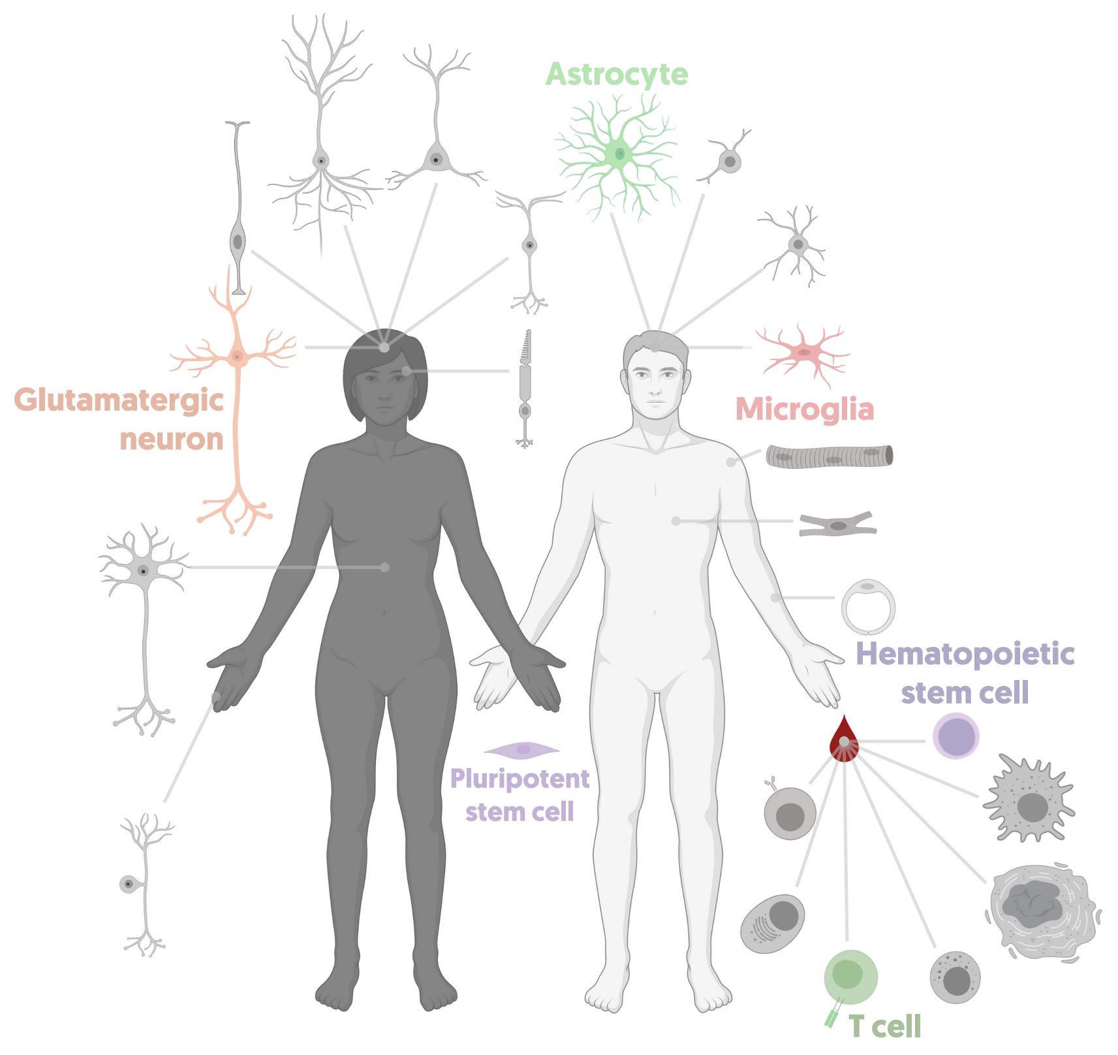
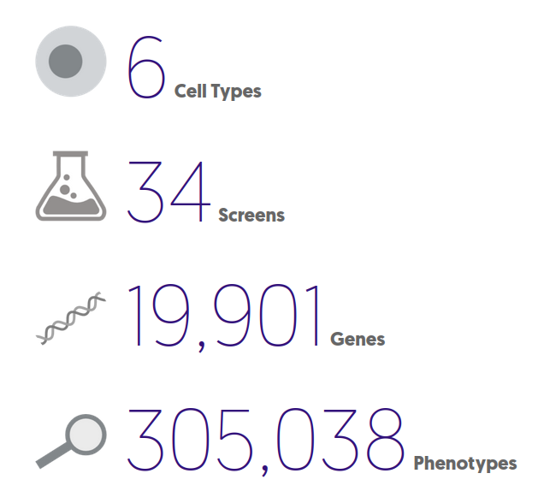
Current Screening Data
iPSCs
Diff.

Slide 6
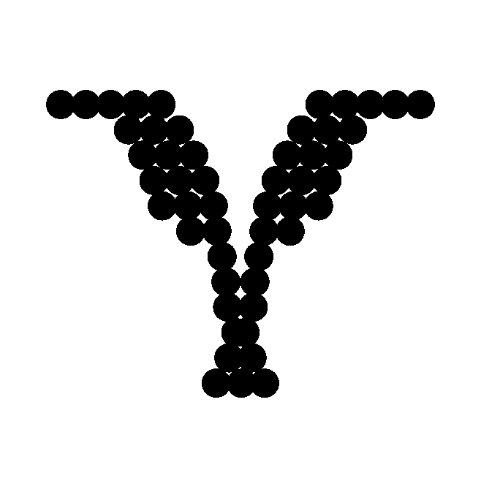

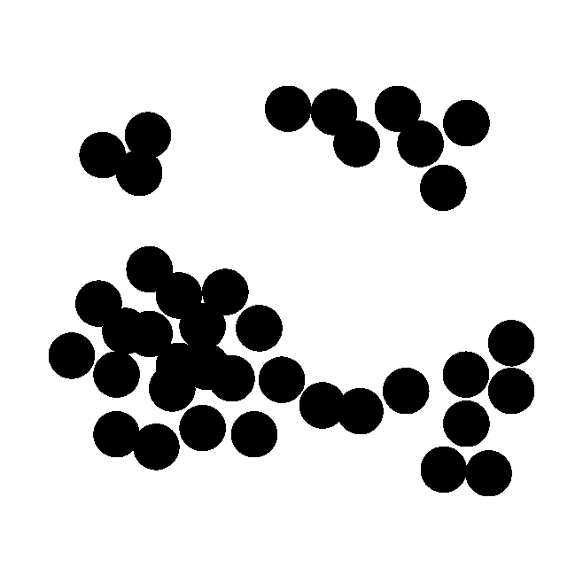
Resolution of Functional Genomics Screens
Simple Screens
Bulk
Single-Cell
One-Dimensional Phenotype
High-Dimensional Phenotype
Low-Throughput
High-Dimensional Phenotype
High Throughput

Slide 7
Exploring a Simple Screen

Slide 8
Comparing Two Screens

Slide 9
Exploring a Transcriptomic Screen

Slide 10
Exploring a CROP-seq

Slide 11
Exploring a CROP-Seq

Slide 12
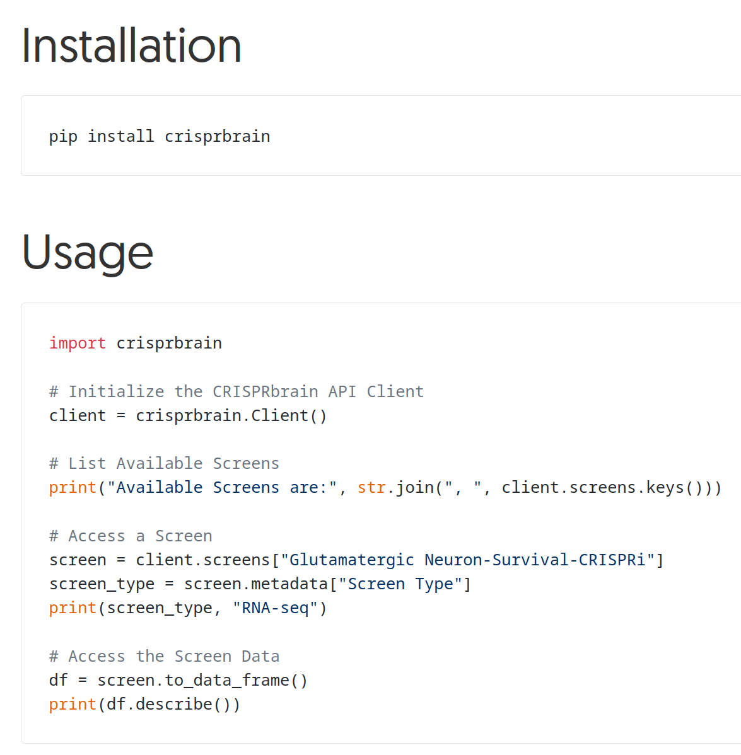
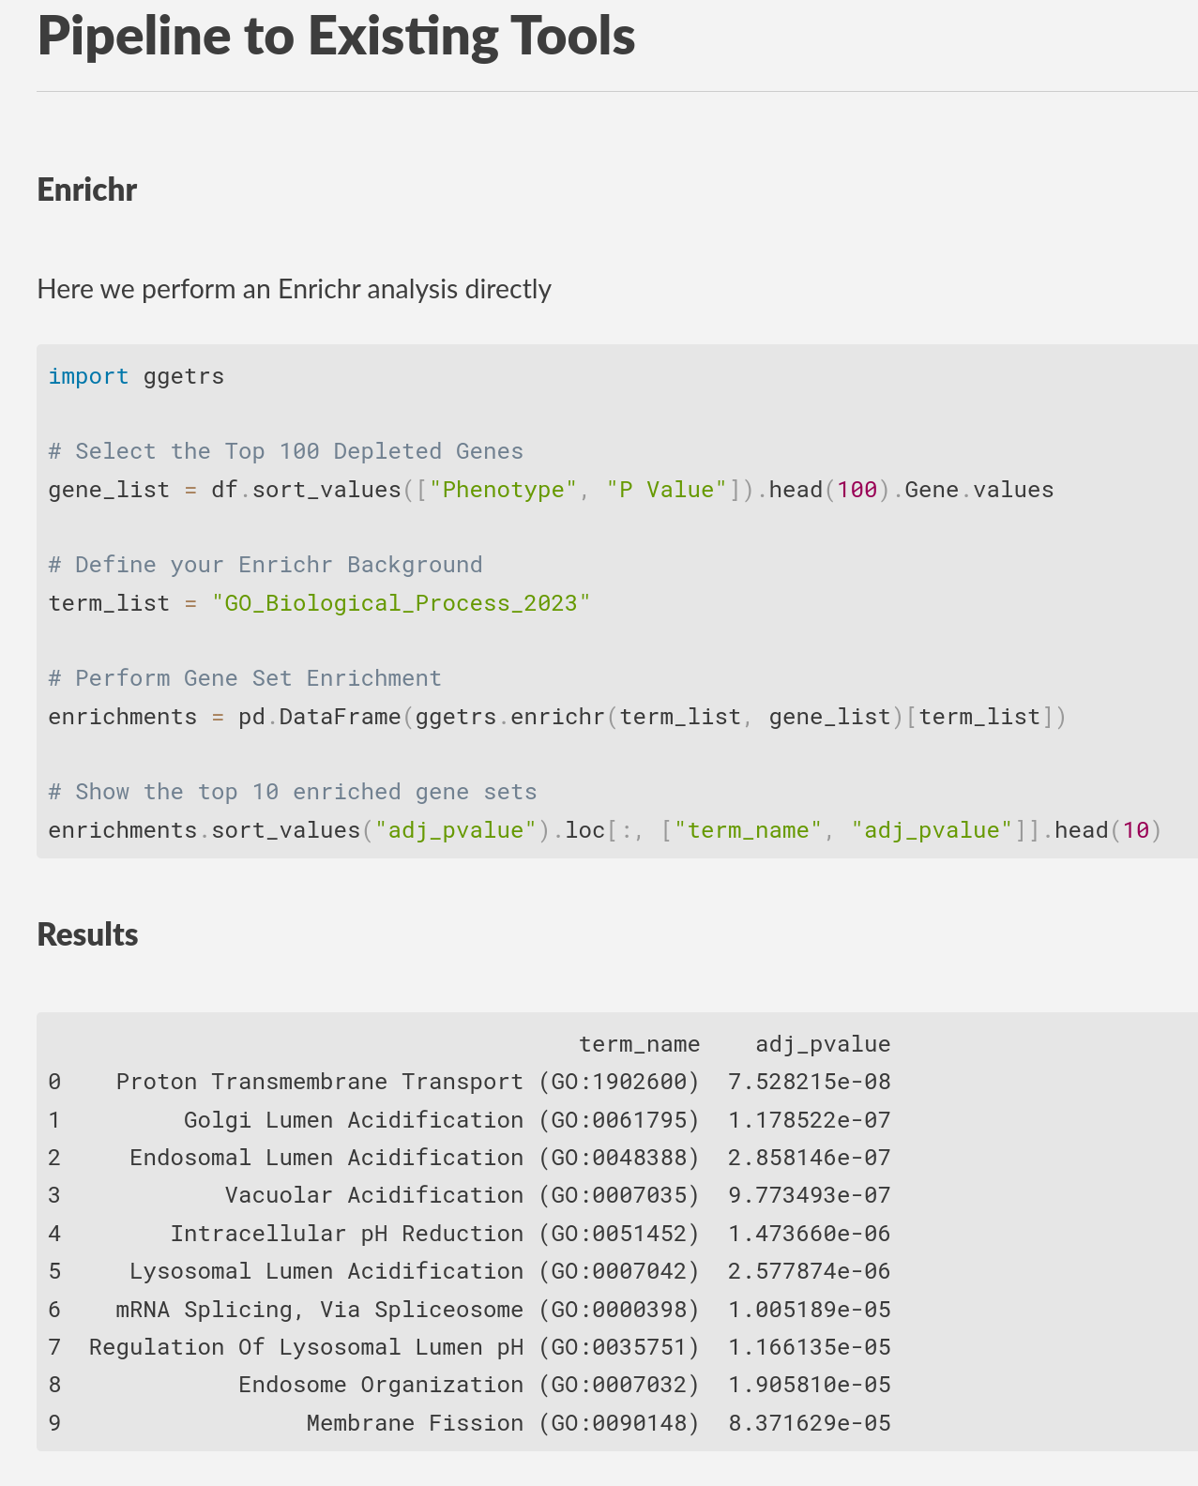
Public API
https://noamteyssier.github.io/ggetrs

Slide 13
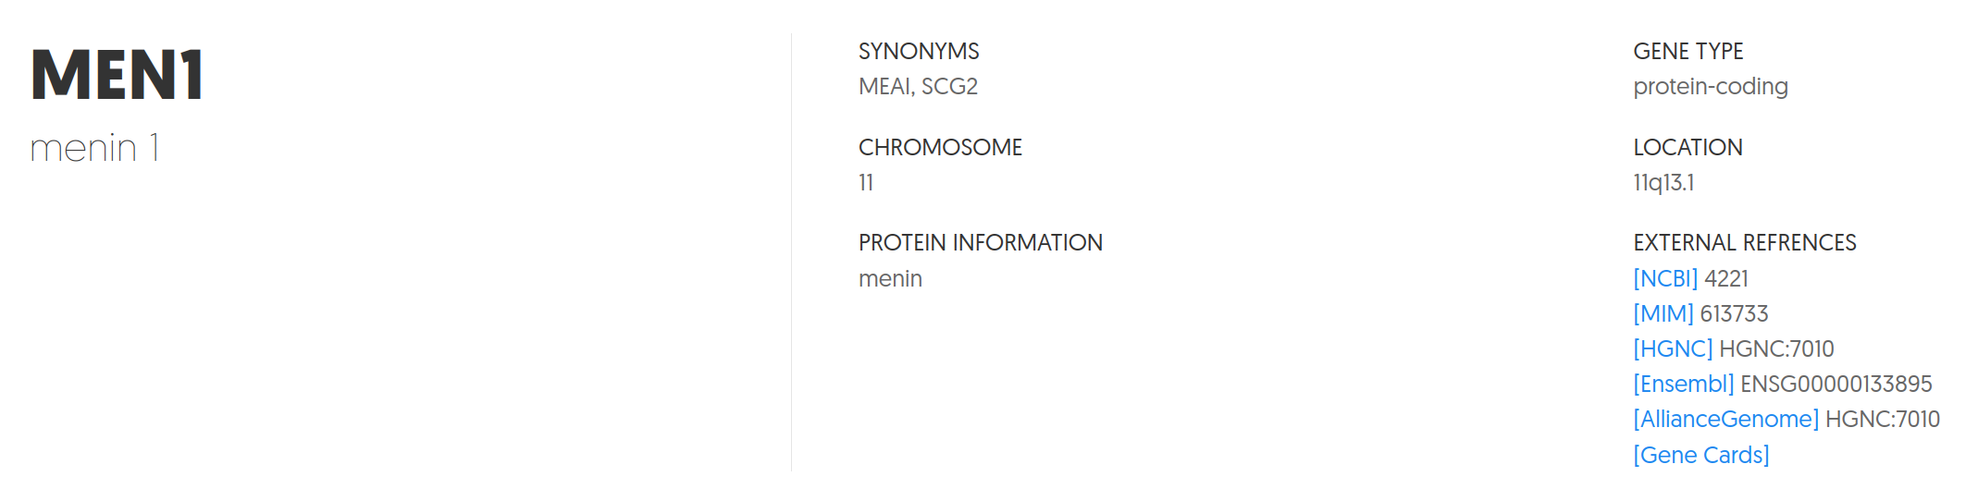
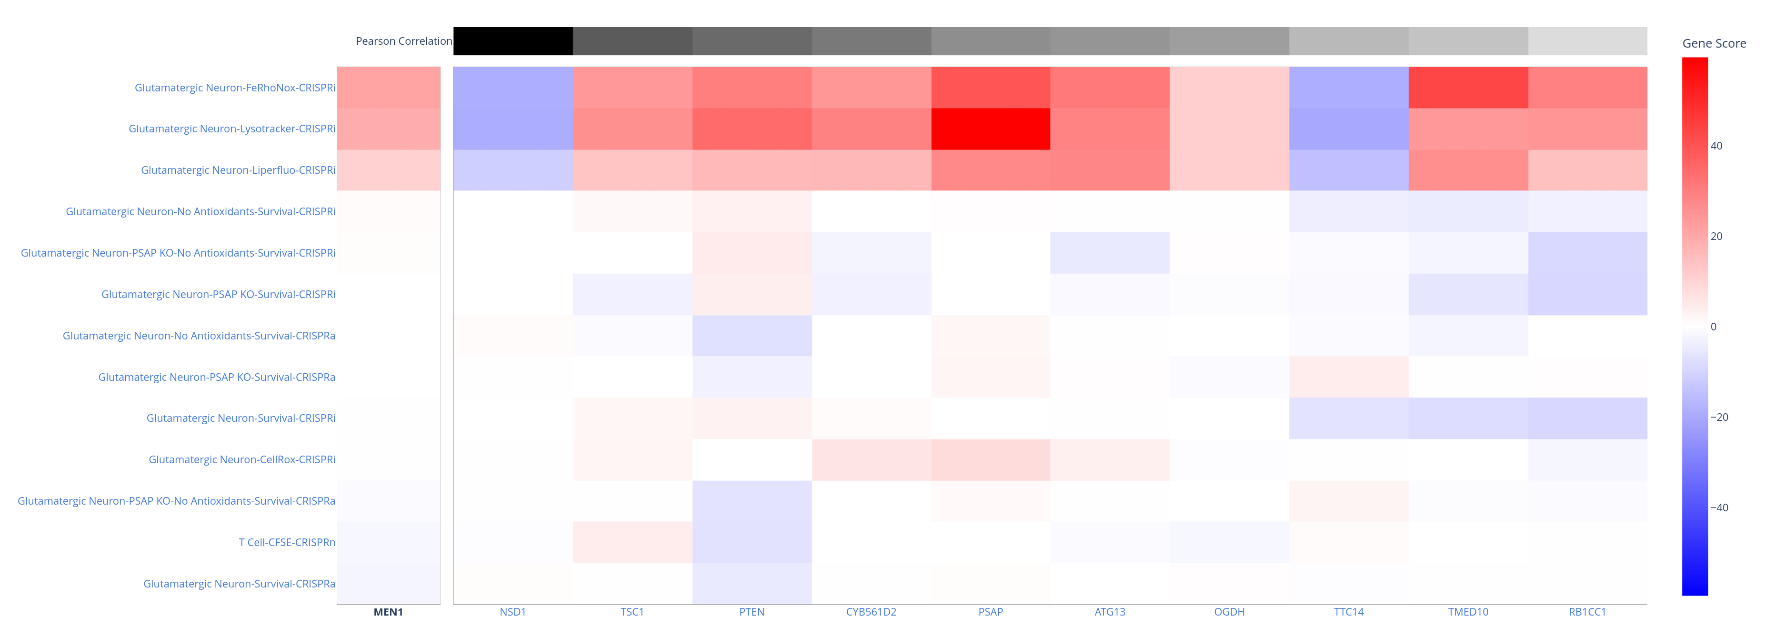
New Features:
Gene Views

Slide 14
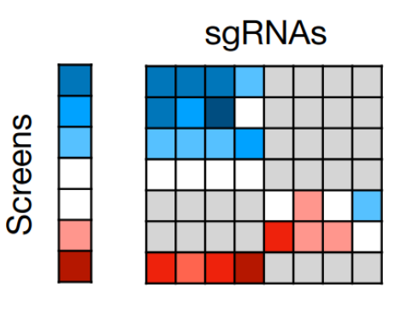
Upcoming Features
Gene-Guide Level Analysis
Identify all sgRNAs for a specific guide
that had a phenotype in a screen
Quickly filter for active sgRNAs

Slide 15
Standardizing Analysis
FASTQ
Counts
Matrix
sgRNA
Enrichment
Gene
Enrichment
sgcount
crispr_screen

Slide 16
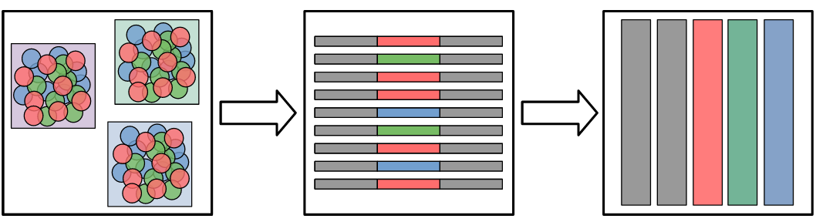
Mapping sgRNA Counts
FASTQ
sgcount
Much faster than full or pseudoalignment
Sample-Level Parallelization
Easy modification for one-off mismatches
or positional mismatches
Easy to use command-line interface
(soon to be GUI)
Counts
Matrix
https://noamteyssier.github.io/sgcount

Slide 17
Counts
Matrix
crispr_screen
sgRNA / Gene Enrichment
Fast differential abundance testing between control
and treatment groups
Control over prior distribution in sgRNA differential
abundance test (negative binomial / normal)
Selection of gene aggregation method (aRRA / INC)
Declarative design – if it works now it will work later.
sgRNA
Results
Gene
Results
https://noamteyssier.github.io/crispr_screen

Slide 18

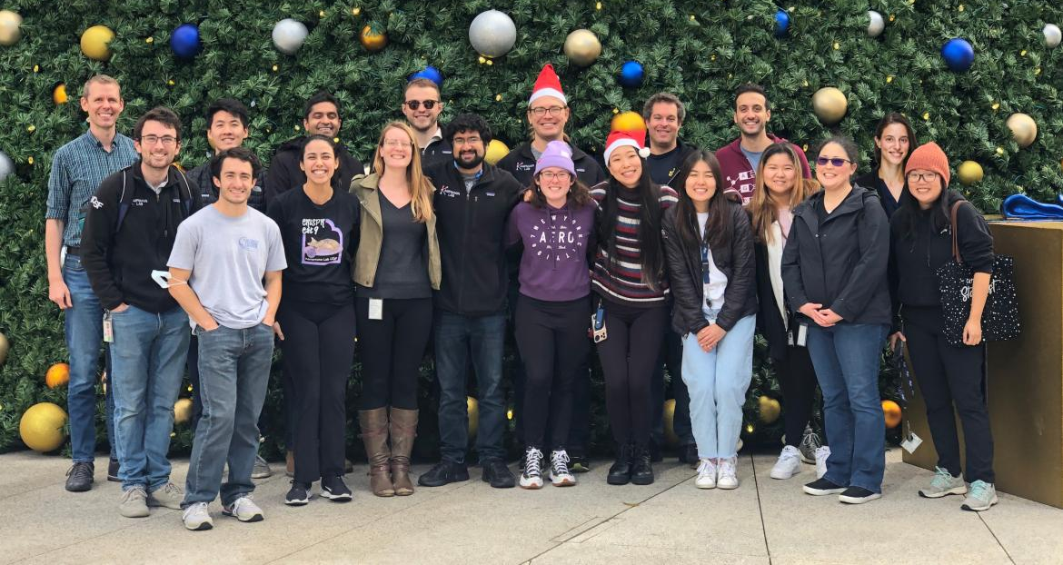


Acknowledgements
Links
Kampmann Lab
Martin Kampmann
Ruilin Tian
Kun Leng
Nina Draeger
Syd Sattler
DTI
Faraz Faghri
Sayed Hadi Hashemi
Mike A Nalls
Andrew B Singleton
https://github.com/noamteyssier/czi_ndcn_2023

