Slide 1
duplicate classification
Identifying duplicate questions with neural nets
Noah Murphy

Slide 2
Preprocessing
1.
Drop NA ( 3 out of 404290 rows )
2.
Split: training : validation : test
80 : 10 : 10
3.
Convert DataFrame to Dataset:
Making the data more ‘digestible’
4. Singled out “question1”

Slide 3
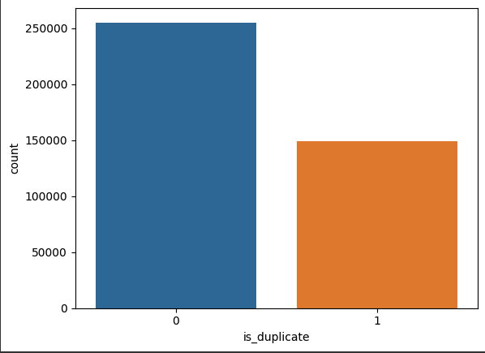
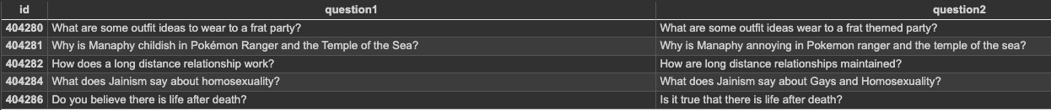
Check label balance -> unbalanced
63% class 0 (non-duplicates)
Investigate what duplicates look like:

Slide 4
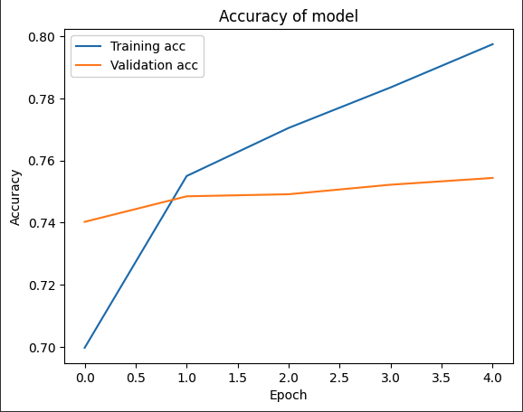
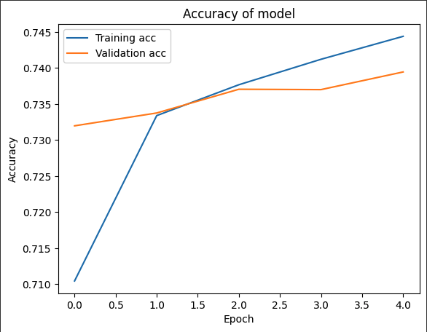
Accuracy
Feedforward Neural Net
LSTM
Note: y-axis scales are not the same

Slide 5
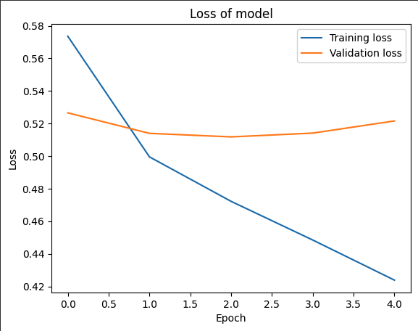
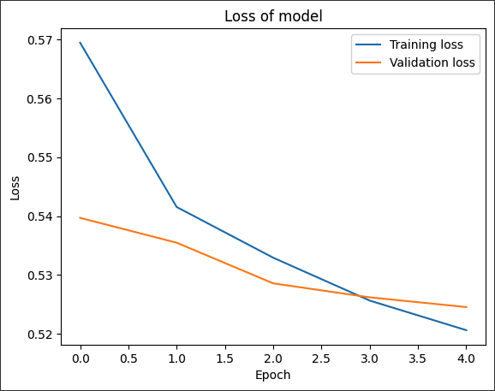
Loss
Feedforward Neural Net
LSTM
Note: y-axis scales are not the same

Slide 6
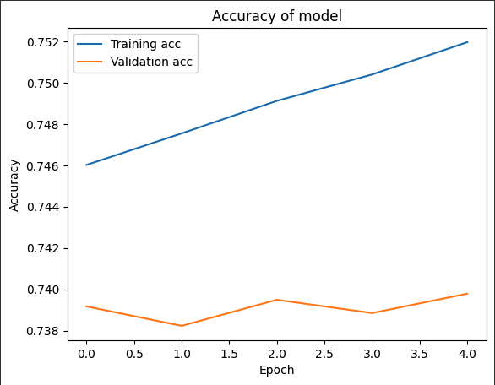
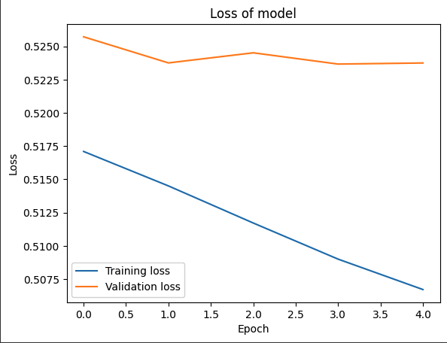
LSTM
10 epochs

Slide 7
Models
Feedforward Neural Net
LSTM
accuracy = 0.75
accuracy = 0.74
Layer 1: Imported NNLM (Hub Layer)
Token based embedding trained on English Google News 7 billion document corpus
Layer 2: Dense layer (16 nodes, ReLU)
Layer 3: Dense layer (16 nodes, ReLU)
Layer 4: Dense layer (1 node, sigmoid)
Layer 1: Embedding layer (TextVectorization)
Layer 2: LSTM (32 nodes)
Layer 3: Dense (32 nodes, ReLU)
Layer 4: Dropout (40%)
Layer 5: Dense (1 node, sigmoid)

