Slide 1

SAFE TRAVELS POPULATION HEALTH DOMAIN
TEAM ROCKSTARS: CS-6400-O01
EDDIE FLAISLER, NOA NADLER, JOHN GADBOIS,
FORREST BRAZEAL, RAVI RAINA

Slide 2
OVERVIEW
Introduction
Project Description
Research
Business Case
Project Plan
Conclusion

Slide 3
INTRODUCTION
Project Motivation
Almost by definition, traveling abroad increases exposure to infectious diseases
Risk for such exposure is even greater for travelers in underdeveloped countries, which lack public hygiene infrastructure
These diseases may be viral or bacterial, foodborne or waterborne, dangerous only to certain people or to every traveler.
Specific Example
The Zika virus is currently much in the news. This virus causes birth defects, so it is of particular concern to pregnant women. The virus is spreading rapidly throughout a number of countries by transmission methods that are still being discovered. Travelers need to know what geographical areas are at risk, what kind of human contact transmits the virus and the status of potential vaccines or treatments.

Slide 4
INTRODUCTION
Options
There are at least three possible ways to deal with travel-related health dangers:
Don’t travel anywhere! (Let’s agree that this is not the best solution)
Travel blindly and hope for the best. ( doesn’t seem like a great idea either)
Take necessary precautions to ensure a safe trip. The last option is clearly superior, but with so many potential dangers, how can a traveler stay informed and prepared?
Project Scope
Push region-specific known conditions or outbreaks to the end user
Make customized recommendations about preventing and possibly treating these diseases

Slide 5
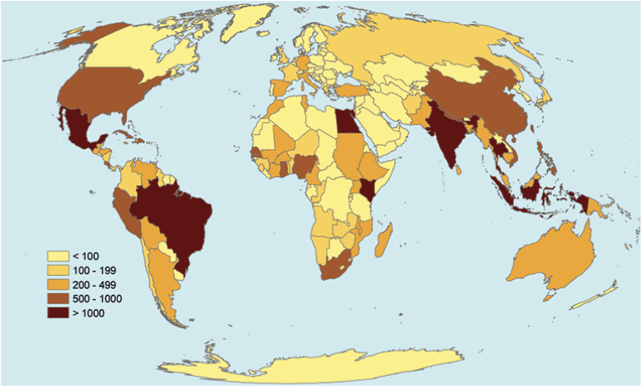
EXAMPLE
Diphtheria is a serious disease caused by bacteria. There are four combination vaccines used to prevent diphtheria.
According to GeoSentinel, the number of travelers with likely exposure to Diphtheria ranged from less than 100 to over 1000 people in places like Mexico, South America, India, and parts of Southeast Asia.

Slide 6
PROJECT DESCRIPTION
Proposed Solution
"SafeTravels", our proposed web application project, attempts to address the previously raised population health concerns by harnessing the power of health informatics. By integrating with existing data standards like FHIR and outbreak information from organizations like the CDC, we will provide customized recommendations for prospective travelers seeking to ensure a safe and healthy trip.

Slide 7
PROJECT DESCRIPTION
Salient Features
Provide destination-based info regarding vaccines to take prior to arrival
Recommended off-the-shelf medicine that travelers should pack
Tips and recommended aids to prevent infections
Tips for self-treatment in case of an infection
Real time location based push notifications ( through email or another asynchronous device ) with outbreak information

Slide 8
RESEARCH
Market Context
Studies show that 50%-75% of travelers in tropical and subtropical regions develop some type of health problem. Though medical attention is not required in all cases, it can cause significant suffering to the traveler and incur non-negligible medical costs for treating the developed condition.
With American travelers the most prevalent infectious conditions are Malaria, Hepatitis A, Typhoid Fever and Traveler’s Diarrhea with or without complications. All of the above may be prevented by properly preparing for the trip.

Slide 9
RESEARCH
Needs
There is a need for a destination based and comprehensive source of information that travelers can turn to in a fast and efficient manner. –
Since travelers might have a cultural or a language barrier they should take proactive steps in making sure they are aware of health hazards in their destination

Slide 10
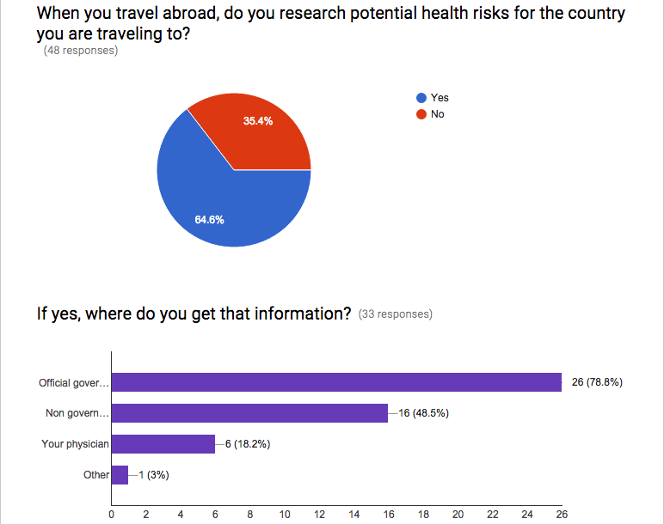
RESEARCH – SURVEY RESULTS
Survey: http://goo.gl/forms/LLjb84tBuA

Slide 11
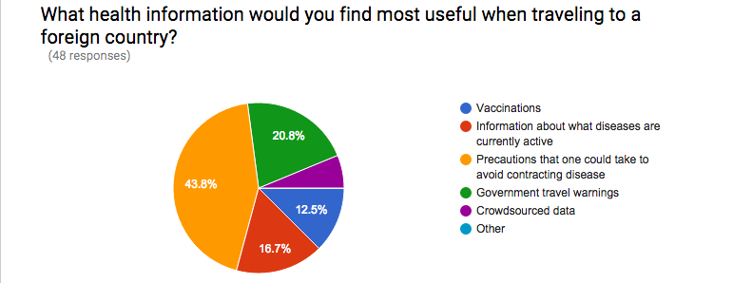
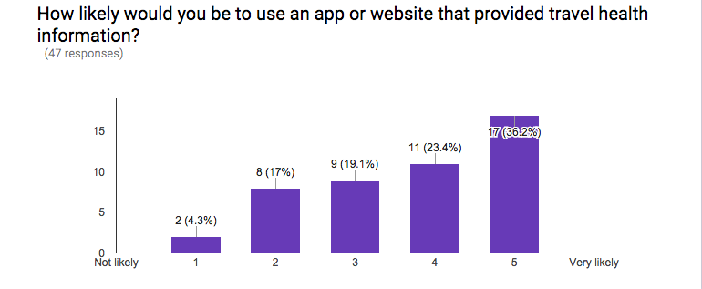
RESEARCH – SURVEY RESULTS

Slide 12
RESEARCH
Research Databases
CDC's Traveler Health database - Primary source for our vaccination list
Data.gov - Provides a wide variety of datasets of open government data
FHIR – Will be used to pull the current vaccinations for a patient
WHO – Provides country health profiles including statistics of key infectious diseases
CIA Factbook - Provides a breakdown of the currently active infectious diseases
NORS - Considering the use of NORS to provide information on active outbreaks in the USA particularly food and water born diseases

Slide 13
BUSINESS CASE
Problem Description
Travelers that look for health information about their destination have to reach out to different sources and spend a lot of time researching
Travelers often have cultural and/or language barriers and therefore are not aware of health hazards around them
Intended Users
Travelers, either for business or leisure
Travel/Tourist Agencies
Government Bodies ( e.g. Dept. of Tourism/Travel)
Civic Institutions ( e.g. Town municipal corporations)

Slide 14
BUSINESS CASE
Benefits to Users
Concise vaccination information makes sure the users are getting just what they need
One-stop shop for all of the user's location-specific health needs. No "homework" needed
Online check list helps the user organize his\her health-related preparation before the trip
Simple and clear guidelines help the user protect his\her health while on the trip
Users get real time warnings about health hazards around them

Slide 15
BUSINESS CASE
Benefits to Non Users
Travelers that are informed of an outbreak in a certain area and avoid visiting this area help in not spreading the disease in their future destinations.
Mitigating chances of infection in travelers also means mitigating these chances for the people who come in contact with these tourists, especially after they return home.
Healthier returning travelers save treatment time and money to health organizations.

Slide 16
PROJECT PLAN
Team members key responsibilities
Project Manager - Eddie Flaisler
Development Lead – John Gadbois
Documentation Lead – Ravi Raina
QA Manager – Noa Nadler
Principal Architect – Forrest Brazeal
Developers - All
Testers - All

Slide 17
PROJECT PLAN
Tools Required
External Resources Required

Slide 18
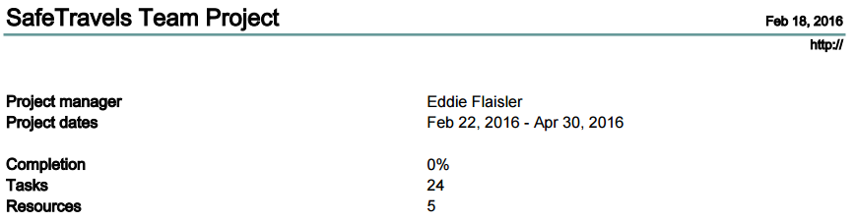
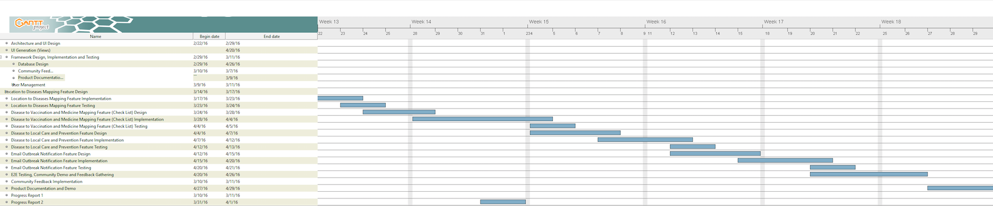
GANTT CHART

Slide 19
CONCLUSION

