Slide 1
SAFE TRAVELS POPULATION HEALTH DOMAIN
TEAM ROCKSTARS: CS-6400-O01
EDDIE FLAISLER, NOA NADLER, JOHN GADBOIS,
FORREST BRAZZEAL, RAVI RAINA

Slide 2
OVERVIEW
Project Goals and Overview
Overall Project Status
Project Success, Unique and Outstanding Elements
Project Demonstrations
Future Opportunities
Team Member Introduction and Contributions
Next Steps

Slide 3
PROJECT OVERVIEW – EXECUTIVE SUMMARY
It is with great pleasure that team Rock Stars presents Safe Travels 1.0, your home for healthy and aware traveling.
Our vision was to provide a user-friendly, lightweight web interface allowing users to learn about and manage risks involved in their travel plans.
We wanted to provide a customized experience where each traveler can setup their own account in the app and use it to better organize the health-related preparation for their trip.

Slide 4
PROJECT OVERVIEW – EXECUTIVE SUMMARY
We used integration with FHIR to leverage the way we monitor user vaccinations.
We also provided an enterprise-level email notification feature: A scalable solution allowing users to register for daily email notifications related to only current health risks in their destinations, thus keeping them better informed at a no effort at all.
Did we succeed? We will let you be the judge of that.

Slide 5
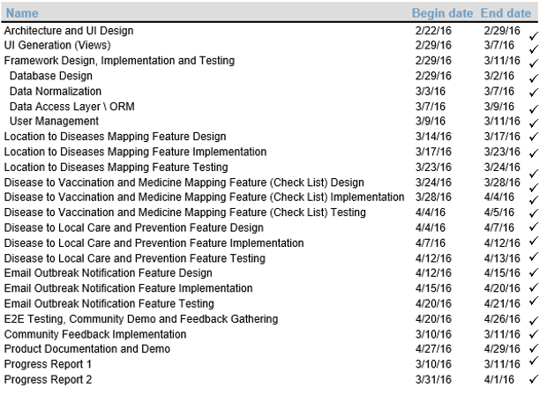
GANTT CHART

Slide 6
UNIQUE ELEMENTS
Provided customized travel health recommendations in terms of vaccinations and packing list based on the user selection of countries.
Provided an email alerts subscription service for travel hazards. The service send a daily email aggregating CDC information about health hazards in all countries the user currently has selected.
Integrated users’ planned trips with FHIR vaccine data
Provided the option to combine travel recommendations for trips involving multiple countries
Please see our design documents for further information.
After signing in, the “Plan Trip” screen shows up. The user can select single or multiple countries that he/she is travelling to. There’s also option to receive email notification about health hazards. Then click on the Plan My Trip Button

Slide 7
PROJECT SUCCESSES
Harvested pertinent data from the CDC website on a scheduled basis
Created a 2-tier application giving users health information about planned trips
Implemented a robust user authentication scheme to protect access to our application and FHIR data
Integrated Patient and Immunization resource references (both select and create) with the MiHIN FHIR server
After signing in, the “Plan Trip” screen shows up. The user can select single or multiple countries that he/she is travelling to. There’s also option to receive email notification about health hazards. Then click on the Plan My Trip Button

Slide 8
OUTSTANDING ELEMENTS
Due to the limitations of the public MiHIN FHIR server, we were not able to save our Patient and Immunization resources there.
Workaround: We saved our resources in our application’s database as well as on FHIR so they would not disappear when the MiHIN server gets wiped.
Due to the limitations of our free Heroku account, we did not have enough worker threads to run our scheduler jobs automatically.
Workaround: we demonstrated a proof of concept by manually allocating threads within the Heroku application to run our alerting and notification processes.
After signing in, the “Plan Trip” screen shows up. The user can select single or multiple countries that he/she is travelling to. There’s also option to receive email notification about health hazards. Then click on the Plan My Trip Button

Slide 9
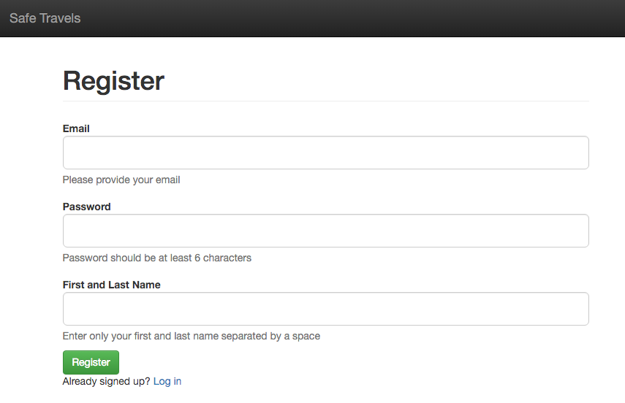
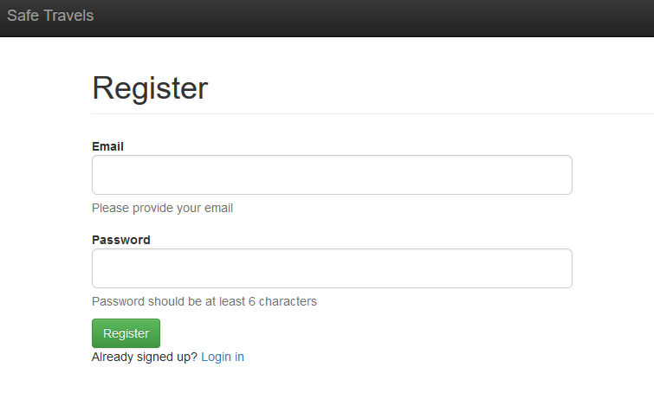
PROJECT DEMONSTRATION
Go the website: https://safe-travels-app.herokuapp.com/signup
The following screen shows up. A new user can either register on the site, or existing users can login

Slide 10
PROJECT DEMONSTRATION

Slide 11
FUTURE OPPORTUNITIES
Location based alerts based on mobile device location
Mobile push notifications
Trip management (archiving and planning multiple trips)

Slide 12
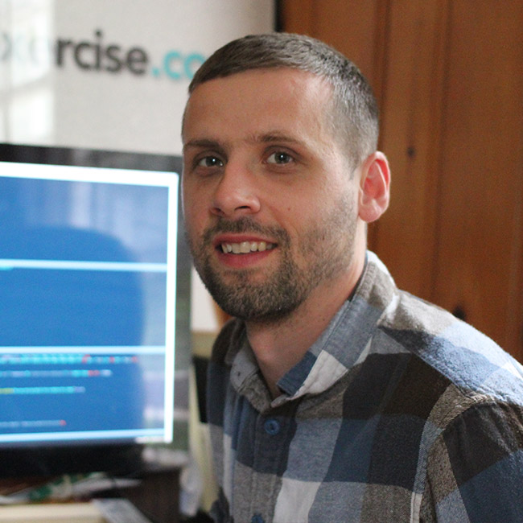
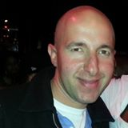
TEAM INTRODUCTION AND CONTRIBUTIONS
Eddie Flaisler, Project Manager and Technical Lead for Email Notification
Eddie is the mastermind behind the successful underground food tour business "eddieble". It is his life mission to make people emotionally stable through carbs. Though accomplished in talking about food, growing it is not a strength of Eddie's: He is associated with the only case in history of an "Early Girl" tomato plant blooming 4 months late.
John Gadbois, Technical Lead and Front End Expert John understands computational complexity well, fathering an exponentially increasing number of children. A Connecticut man through and through and an avid Francophile, John could have gone to Yale but felt that the location for his grad school had to be on the classy side. So definitely Atlanta.
Assuming an existing user ( someone already signed up), the following screen shows up. Enter the email address and password

Slide 13
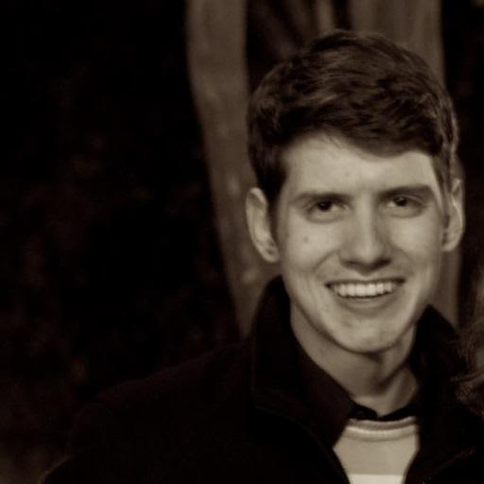
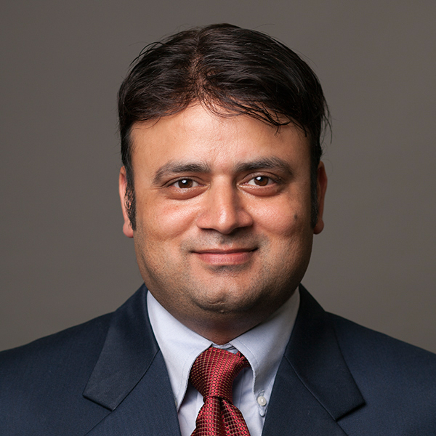
TEAM INTRODUCTION AND CONTRIBUTIONS
Forrest Brazeal, System Architect and Back End Expert
Forrest loves his drumsticks, and coming from South Carolina this does not only indicate he's into music. The tallest of the team, Forrest views the world from a high level. This, along with his track record as a National Spelling Bee finalist who was able to perfectly spell "decoupling and dependency injection", made him a perfect fit for our Architect role.
Assuming an existing user ( someone already signed up), the following screen shows up. Enter the email address and password
Ravi Raina, Documentation Lead and IC
Formerly known as "Star of Kashmir", Ravi fulfilled the dream of every Jewish mother and married a doctor. A world-renowned expert in interpersonal communication, Ravi has friends in 40 countries, pursues a successful gardening career by talking to plants, and speaks five languages. This makes him a polyglot - another word only Forrest can spell.
Assuming an existing user ( someone already signed up), the following screen shows up. Enter the email address and password

Slide 14
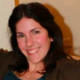
TEAM INTRODUCTION AND CONTRIBUTIONS
Noa Nadler, QA Lead and IC Noa is part student, part mom and part motorcyclist. Living the bustling city life in San Jose, CA, where being on the street after 7 pm is considered loitering, she enjoys going to bed early, day-time hikes and reading. Noa was unanimously elected our QA lead, once we finalized the profile for the position as someone who should always tell us we are wrong and is always right, and realized we needed a..well..girl.
Assuming an existing user ( someone already signed up), the following screen shows up. Enter the email address and password

Slide 15
THE END

