Slide 1

SAFE TRAVELS POPULATION HEALTH DOMAIN
TEAM ROCKSTARS: CS-6400-O01
EDDIE FLAISLER, NOA NADLER, JOHN GADBOIS,
FORREST BRAZEAL, RAVI RAINA

Slide 2
OVERVIEW
Introduction
Project Description
Research
Business Case
Project Plan
Conclusion

Slide 3
INTRODUCTION
Project Motivation
Almost by definition, traveling abroad increases exposure to infectious diseases
Risk for such exposure is even greater for travelers in underdeveloped countries, which lack public hygiene infrastructure
Project Scope
Push region-specific known conditions or outbreaks to the end user
Make customized recommendations about preventing and possibly treating these diseases

Slide 4
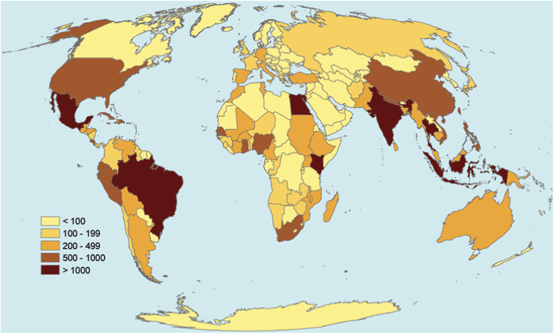
EXAMPLE
Diphtheria is a serious disease caused by bacteria. There are four combination vaccines used to prevent diphtheria.
According to GeoSentinel, the number of travelers with likely exposure to Diphtheria ranged from less than 100 to over 1000 people in places like Mexico, South America, India, and parts of Southeast Asia.

Slide 5
PROJECT DESCRIPTION
Proposed Solution
Create a user-friendly web-based interface (SafeTravels)
Technical Details

Slide 6
PROJECT DESCRIPTION
Salient Features
Provide destination-based info regarding vaccines to take prior to arrival
Recommended off-the-shelf medicine that travelers should pack
Tips and recommended aids to prevent infections
Tips for self-treatment in case of an infection
Real time location based push notifications ( through email or another asynchronous device ) with outbreak information

Slide 7
RESEARCH
Market Context
Studies show that 50%-75% of travelers in tropical and subtropical regions develop some type of health problem. Though medical attention is not required in all cases, it can cause significant suffering to the traveler and incur non-negligible medical costs for treating the developed condition.
With American travelers the most prevalent infectious conditions are Malaria, Hepatitis A, Typhoid Fever and Traveler’s Diarrhea with or without complications. All of the above may be prevented by properly preparing for the trip.

Slide 8
RESEARCH
Needs
Need for a destination based, comprehensive source of information that travelers can turn to in a fast and efficient manner
Since travelers might have cultural or language barriers they should take proactive steps to ensure they are aware of health hazards

Slide 9
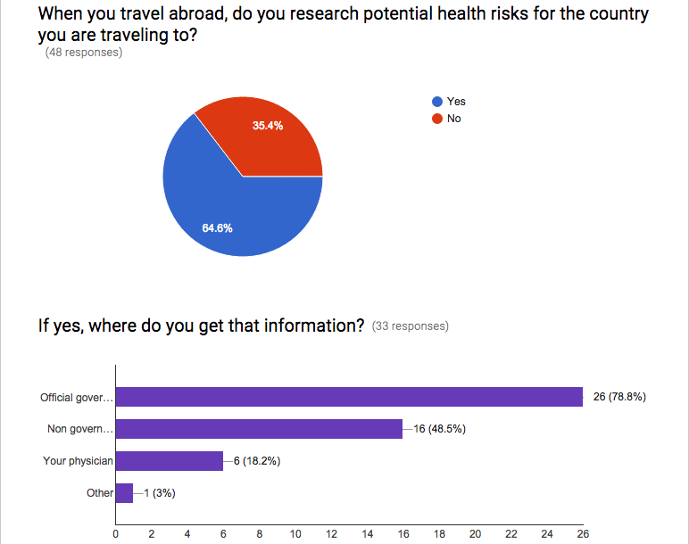
RESEARCH – SURVEY RESULTS
Survey: http://goo.gl/forms/LLjb84tBuA

Slide 10
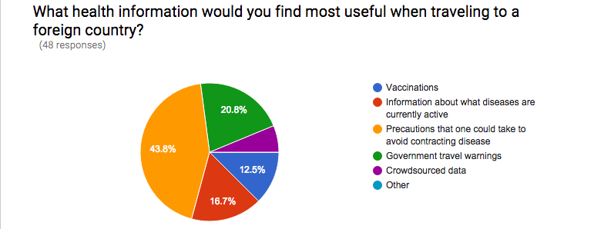
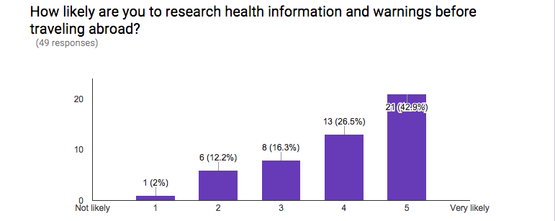
RESEARCH – SURVEY RESULTS

Slide 11
RESEARCH
Research Databases
CDC's Traveler Health database - Primary source for our vaccination list
Data.gov - Provides a wide variety of datasets of open government data
FHIR – Will be used to pull the current vaccinations for a patient
WHO – Provides country health profiles including statistics of key infectious diseases
CIA Factbook - Provides a breakdown of the currently active infectious diseases
NORS - Considering the use of NORS to provide information on active outbreaks in the USA particularly food and water born diseases

Slide 12
BUSINESS CASE
Problem Description
Travelers that look for health information about their destination have to reach out to different sources and spend a lot of time researching
Travelers often have cultural and/or language barriers and therefore are not aware of health hazards around them
Intended Users
Travelers, either for business or leisure
Travel/Tourist Agencies
Government Bodies ( e.g. Dept. of Tourism/Travel)
Civic Institutions ( e.g. Town municipal corporations)

Slide 13
BUSINESS CASE
Benefits to Users
Concise vaccination information makes sure the users are getting just what they need
One-stop shop for all of the user's location-specific health needs. No "homework" needed
Online check list helps the user organize his\her health-related preparation before the trip
Simple and clear guidelines help the user protect his\her health while on the trip
Users get real time warnings about health hazards around them

Slide 14
BUSINESS CASE
Benefits to Non Users
Travelers that are informed of an outbreak in a certain area and avoid visiting this area help in not spreading the disease in their future destinations.
Mitigating chances of infection in travelers also means mitigating these chances for the people who come in contact with these tourists, especially after they return home.
Healthier returning travelers save treatment time and money to health organizations.

Slide 15
PROJECT PLAN
Team members key responsibilities
Project Manager - Eddie Flaisler
Development Lead – John Gadbois
Documentation Lead – Ravi Raina
QA Manager – Noa Nadler
Principal Architect – Forrest Brazeal
Developers - All
Testers - All

Slide 16
PROJECT PLAN
Tools Required
External Resources Required

Slide 17
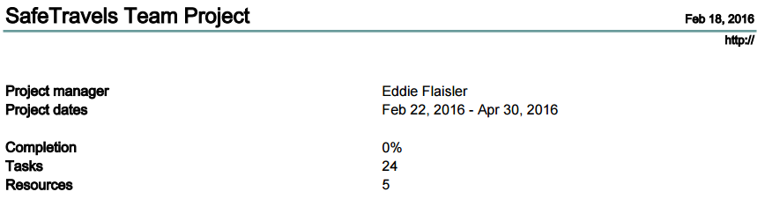
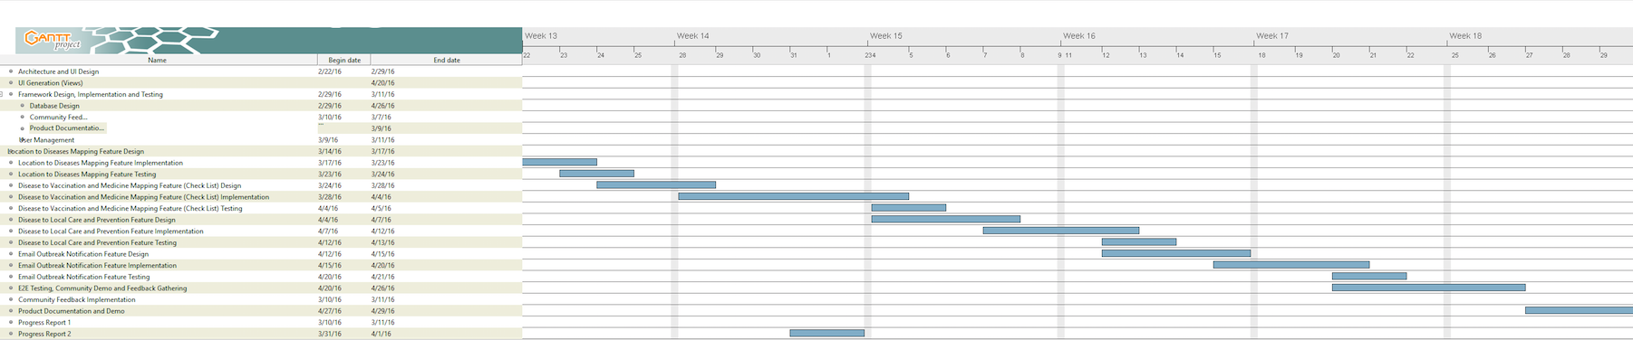
GANTT CHART

Slide 18
CONCLUSION

