Slide 1

SAFE TRAVEL POPULATION HEALTH DOMAIN
TEAM ROCKSTARS: CS-6400-O01
EDDIE FLAISLER, NOA NADLER, JOHN GADBOIS, FORREST BRAZZEAL, RAVI RAINA

Slide 2
OVERVIEW
Introduction
Project Description
Research
Business Case
Project Plan
Conclusion

Slide 3
INTRODUCTION
Project Motivation
Almost by definition, traveling abroad increases exposure to infectious diseases
Risk for such exposure is even greater for travelers in underdeveloped countries, which lack public hygiene infrastructure
Project Scope
Push region-specific known conditions or outbreaks to the end user
Make customized recommendations about preventing and possibly treating these diseases

Slide 4
PROJECT DESCRIPTION
Proposed Solution
Create a user-friendly web-based interface (SafeTravel)
Downloadable app on smart phone (Android ? )
Technical Details

Slide 5
PROJECT DESCRIPTION
Salient Features
Provide destination-based info regarding vaccines to take prior to arrival
Recommended off-the-shelf medicine
Tips and recommended aids to prevent infections
Tips for self-treatment in case of an infection
Real time location based push notifications with outbreak information

Slide 6
RESEARCH
Market Context
Needs
Survey
Interview
Email

Slide 7
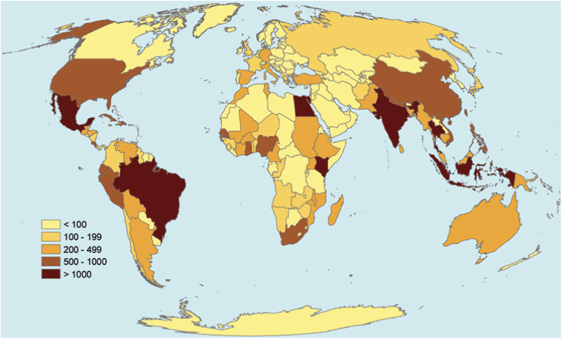
RESEARCH - EXAMPLE
Diphtheria is a serious disease caused by bacteria. There are four combination vaccines used to prevent diphtheria.
According to GeoSentinel, the number of travelers with likely exposure to Diphtheria ranged from less than 100 to over 1000 people in places like Mexico, South America, India, and parts of Southeast Asia.

Slide 8
BUSINESS CASE
Problem Description
Travelers that look for health information about their destination have to reach out to different sources and spend a lot of time researching
Travelers often have cultural and/or language barriers and therefore are not aware of health hazards around them
Intended Users
Travelers, either for business or leisure
Travel/Tourist Agencies
Government Bodies
Civic Institutions Benefits to Users

Slide 9
BUSINESS CASE
Benefits to Users
Users save valuable research time by getting access to a singular and comprehensive source of information about the health conditions in their destination
Users get a list of necessary vaccines and off-the-shelf medicine they should pack based on their destination
Users get real time warnings about health hazards around them
Benefits to Non Users
Travelers that are informed of an outbreak and avoid visiting the infected area help in limit the spread of the disease
Travelers using SafeTravel are able to warn locals about approaching diseases and share tips they learn from the app about treatment and how to prevent contagion

Slide 10
BUSINESS CASE
Solution
Revenue Stream

Slide 11
PROJECT PLAN
Team members key responsibilities
Project Manager - Eddie Flaisler
Development Lead -
Documentation Lead -
QA Manager -
Developers - All
Testers - All

Slide 12
PROJECT PLAN
Tools Required
External Resources Required

Slide 13
GANTT CHART

Slide 14
CONCLUSION

