Slide 1
SAFE TRAVEL POPULATION HEALTH DOMAIN
TEAM ROCKSTARS: CS-6400-O01
EDDIE FLAISLER, NOA NADLER, JOHN GADBOIS,
FORREST BRAZZEAL, RAVI RAINA

Slide 2
OVERVIEW
Project Update
High Level Project Architecture
Tools and languages used
Screen Prototypes
Concerns
Next Steps

Slide 3
PROJECT UPDATE
It’s been quite the two weeks for team “Rock Stars”. We exceeded our initial goals for this time period. We stuck to our plan, with the only change being the replacement of “User Management Design” with “Email Notification Design”. We are still deciding the best way to address user management. We did design our framework to accommodate any decision we will make.

Slide 4
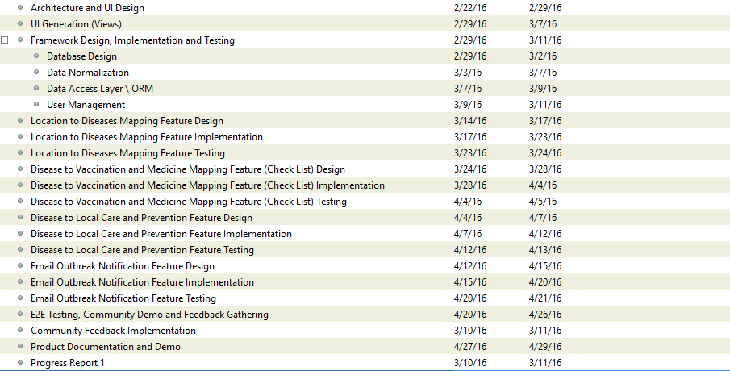
PROJECT UPDATE
✓
✓
✓
✓
✓
✗
✓
✓

Slide 5
GANTT CHART

Slide 6
TOOLS AND LANGUAGES USED
Backend: http://sparkjava.com/
User Authentication: https://github.com/pac4j/play-pac4j?
Database Access: SQL2o -https://sparktutorials.github.io/2015/04/29/spark-and-sql2o.html
Database: PostgreSQL
Front End CSS/HTML: Bootstrap http://getbootstrap.com/
Javascript Framework: EmberJS http://emberjs.com/
Hosting: Heroku

Slide 7
HIGH LEVEL PROJECT ARCHITECTURE

Slide 8
HIGH LEVEL PROJECT ARCHITECTURE
FHIR REST API
A Java REST client will be used to interact with the FHIR REST API. Our web client will interact with FHIR via our application REST API.
PostgreSQL Database
We will be storing and accessing data in a PostgreSQL database that is hosted in Heroku. Our web application will communicate with the API via the Java application using SQL libraries that wrap JDBC SQL queries.
REST API/User Authentication
Our web client will communicate with our backend exclusively through our REST API. The REST API will send and receive JSON formatted data. Requests that require user authentication will be accessed via authenticated requests.

Slide 9
HIGH LEVEL PROJECT ARCHITECTURE
JavaScript Web Application/EmberJS
Our client application will be a web-based single-page application (SPA). We are using the EmberJS MVC framework to handle all the client side logic, including routing, rendering, and communicating with the API.

Slide 10
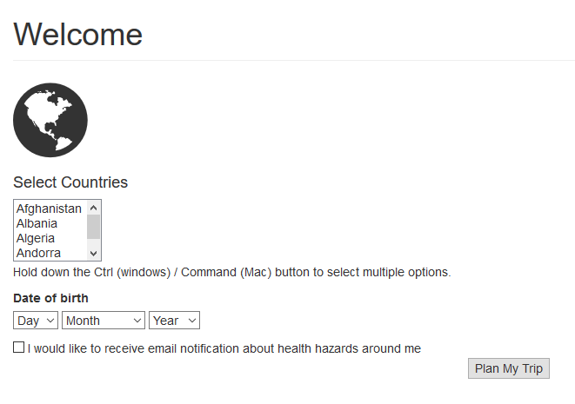
SCREEN PROTOTYPES
This is the Welcome screen and the user can select the countries where she is travelling and also enter her D.O.B and select email notifications and then hit “Plan My Trip”

Slide 11
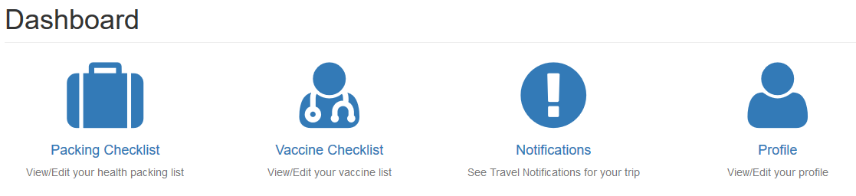
SCREEN PROTOTYPES
When the user hits “Plan My Trip”, the dashboard shows up with following options
Packing Checklist - List of items to pack for the trip
Vaccine Checklist – List of vaccines necessary or required for this trip
Notifications – Set travel notifications for this trip
Profile – View/Edit the user profile

Slide 12
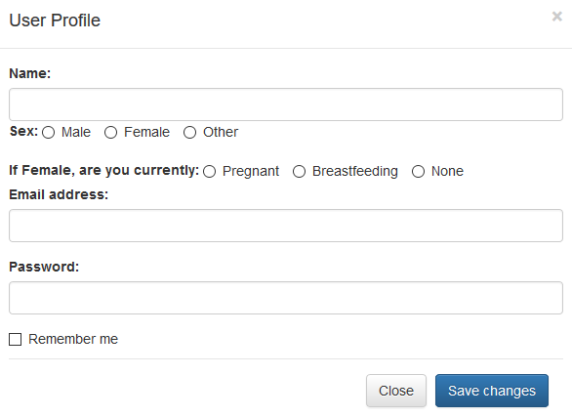
SCREEN PROTOTYPES
After clicking the Profile, the following screen shows up. The user can enter/edit her user profile info, including Name, Sex, email address and password. If user is female, we have also provided options for entering whether she is pregnant or breastfeeding.

Slide 13
CONCERNS
We reached out to people in CDC and local government bodies for an interview but were unsuccessful. Not a major concern since we got good response and useful data from the survey we conducted
Another concern we have is lack of sample data in FHIR server. We are hoping it will be available in time so we can continue development and validation activities for our project.

Slide 14
NEXT STEPS
Work on refining the Markups and User Interface
Framework, Design, Implementation and testing of the following features
User Management
Disease Mapping feature
Disease to Vaccination and Medicine

