Slide 1
SAFE TRAVELS POPULATION HEALTH DOMAIN
TEAM ROCKSTARS: CS-6400-O01
EDDIE FLAISLER, NOA NADLER, JOHN GADBOIS,
FORREST BRAZZEAL, RAVI RAINA

Slide 2
OVERVIEW
Project Update
Screen Prototypes/Demonstrations
Outstanding Elements
Concerns
Next Steps

Slide 3
PROJECT UPDATE – EXECUTIVE SUMMARY
These are very exciting times for us here at SafeTravels. Our product is starting to take its final form and things are actually working. We made immense progress in finalizing our UI, user management, user registration and notification process, data extraction from our online resources and its analysis and utilization. Our current major challenge is FHIR integration for our user vaccinations feature. This effort is lead by Forrest and John.
Brace yourselves. SafeTravels is coming.

Slide 4
PROJECT UPDATE - FEATURES
Completed Framework, Design, Implementation and Testing of the following features
User Management
Location to Disease Mapping
Disease to Local care and prevention
Completed Design and implementation of
Email Outbreak and Notification feature
Completed Design of Disease to Medical Mapping

Slide 5
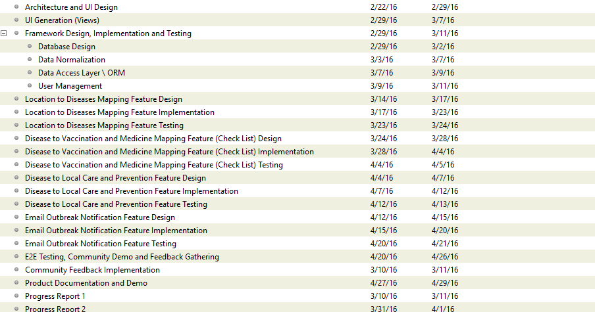

GANTT CHART
✓
✓
✓
✓
✓
✓
✓
✓
✓
✓
✓
✓
✗
✓
✓
✓
✓
✗
✗
✓
✓
✓
✓
✓
✓
✓

Slide 6
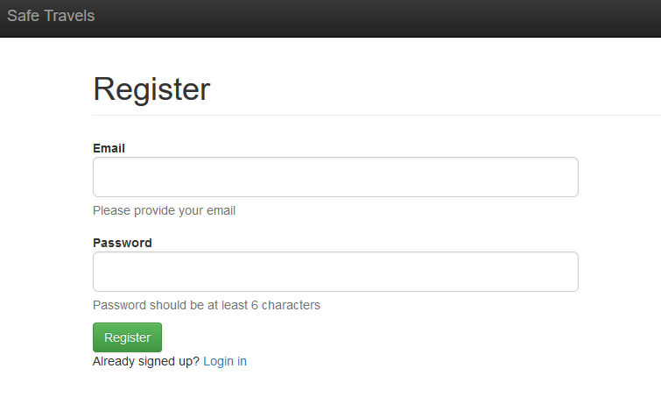
SCREEN PROTOTYPES
Go the website: https://safe-travels-app.herokuapp.com/signup
The following screen shows up. A new user can either register on the site, or existing users can login

Slide 7
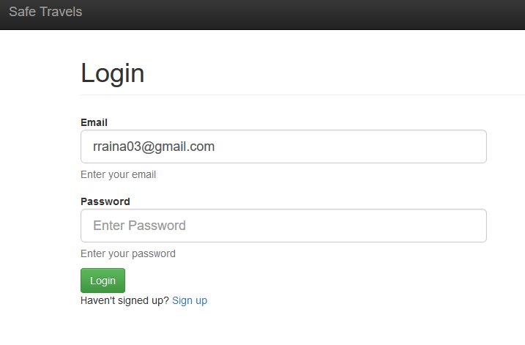
SCREEN PROTOTYPES
Assuming an existing user ( someone already signed up), the following screen shows up. Enter the email address and password

Slide 8
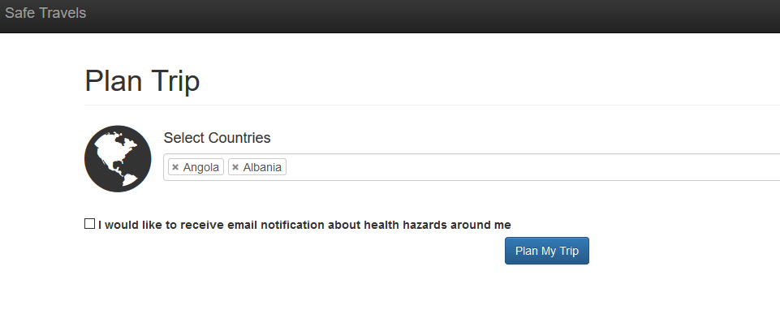
SCREEN PROTOTYPES
After signing in, the “Plan Trip” screen shows up. The user can select single or multiple countries that he/she is travelling to. There’s also option to receive email notification about health hazards. Then click on the Plan My Trip Button

Slide 9
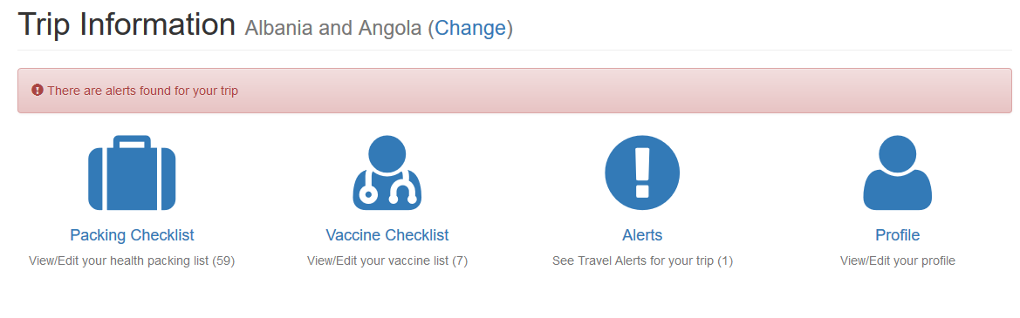
SCREEN PROTOTYPES
The following screen shows up.
Packing Checklist - List of items to pack for the trip
Vaccine Checklist – List of vaccines necessary or required for this trip
Notifications – Set travel notifications for this trip
Profile – View/Edit the user profile
The user can click on any of the following options. First, lets click on Packing Checklist option.

Slide 10
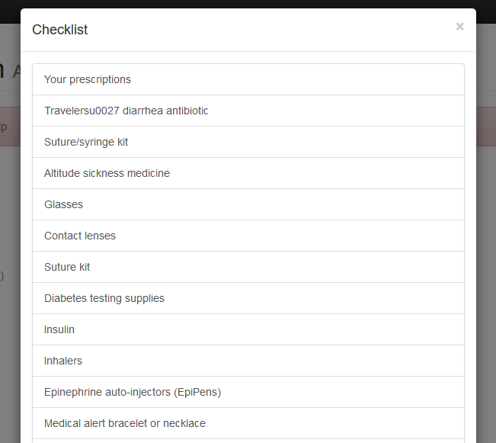
SCREEN PROTOTYPES
The following screen shows up. For the countries selected, the checklist is 59 items long. Lets go back to the previous screen and click on Vaccine Checklist

Slide 11
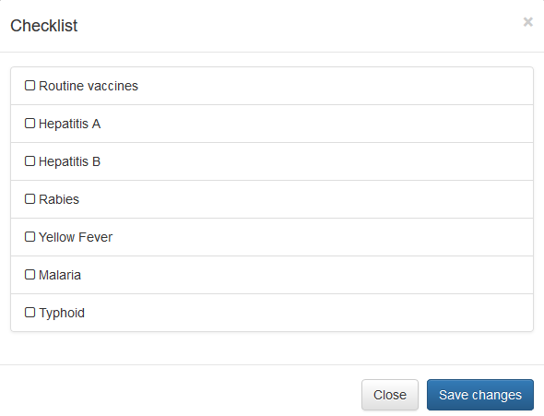
SCREEN PROTOTYPES
The checklist with the list of relevant vaccines gets displayed. Go back to previous screen and now click on alerts.

Slide 12
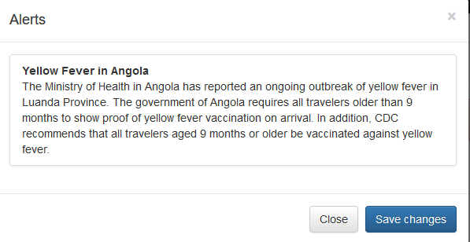
SCREEN PROTOTYPES
The Alerts screen shows up. This has warning about Yellow Fever in Angola. Now go back to the last screen and click on User Profile.

Slide 13
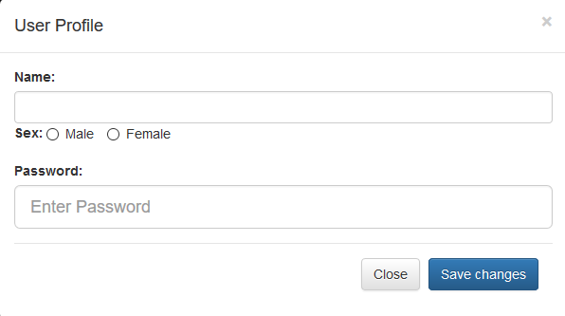
SCREEN PROTOTYPES
After clicking the Profile, the following screen shows up. The user can enter/edit her user profile info, including Name, Sex, email address and password.

Slide 14
OUTSTANDING ELEMENTS OF APPLICATION
FHIR integration for our user vaccinations feature
Implementation and Testing of Disease to vaccination and medical mapping feature.
Testing of email notification feature
End to End Testing, community demo and feedback gathering.

Slide 15
CHALLENGES
Integrating and authenticating with the FHIR server: We ultimately decided to create new FHIR users when a user account is created on safe-travels. We then can sync vaccine data from our application with FHIR. We also had to map all our CDC vaccine names to vaccine codes that are usable with FHIR.
Email Integration: We had some difficulty finding an email provider to integrate our application with. After hitting some dead ends, we decided to go with SendGrid which provided an easy-to-use Java API.

Slide 16
CHALLENGES
UI Challenges: We had various UI challenges, specifically figuring out how to display CDC alerts and how to allow users to mark off vaccinations as current.

Slide 17
NEXT STEPS
FHIR integration for our user vaccinations feature
Integration and Testing of the remaining features
End to End Testing, community demo and feedback gathering

Slide 18
BACKUP

Slide 19
HIGH LEVEL PROJECT ARCHITECTURE

