Slide 1
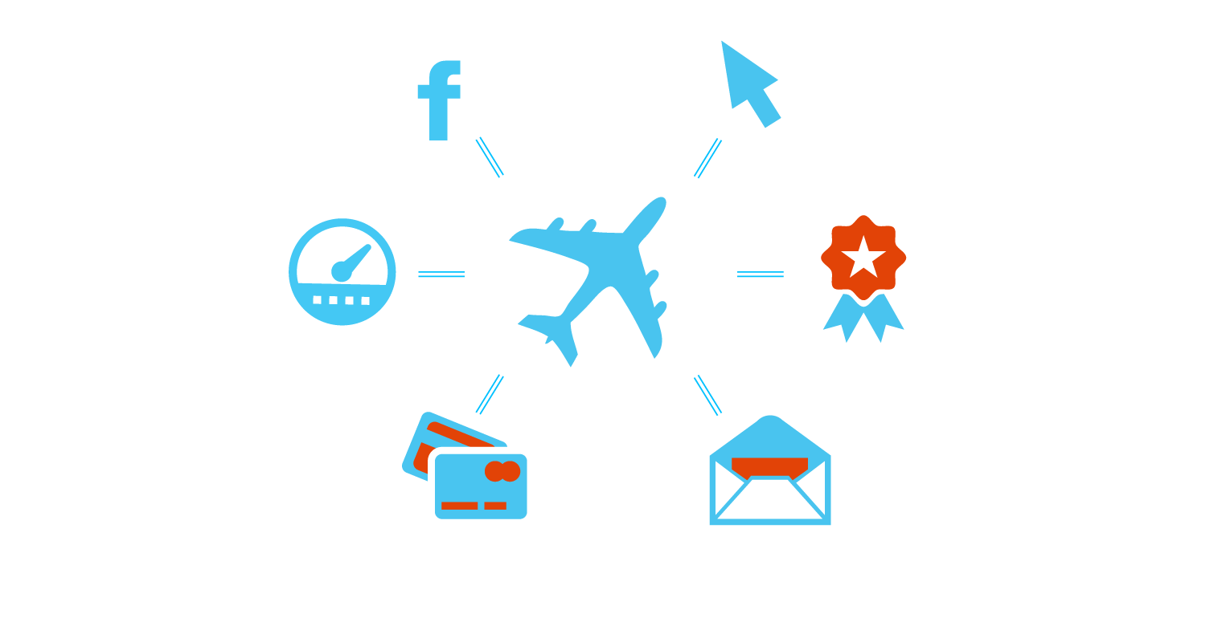
Results Across Multiple Initiatives
+
Sojern generates lift across multiple objectives
Social Media Engagement
Bookings (CPM, CPB)
Mileage Incentives
MileagePlus Initiatives
Credit Card
Offers
eNewsletter Opt-ins

