Slide 1



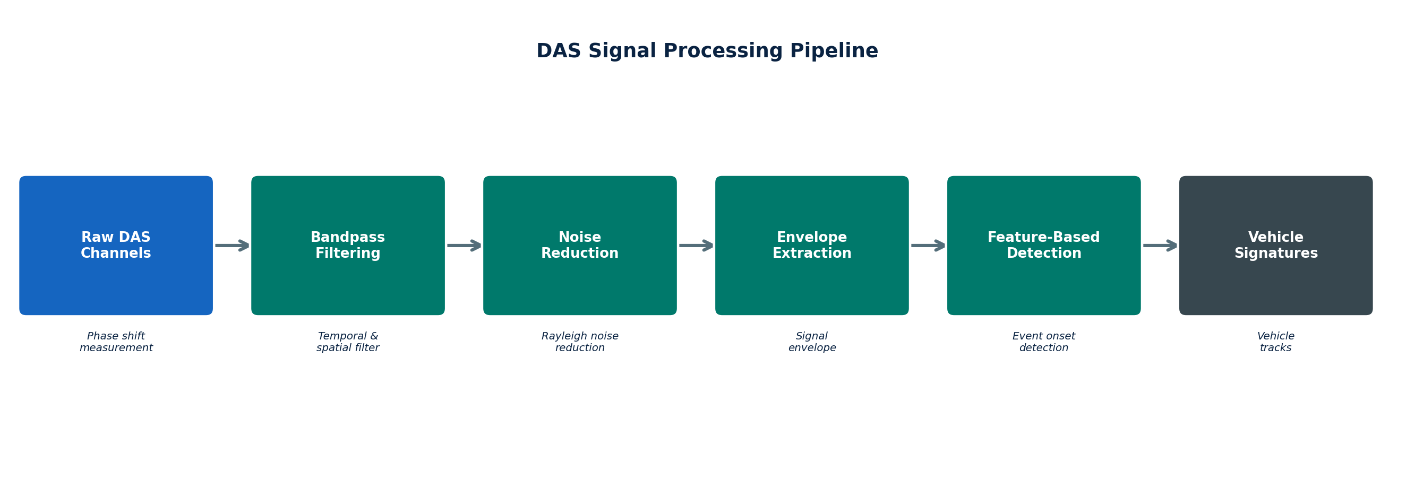
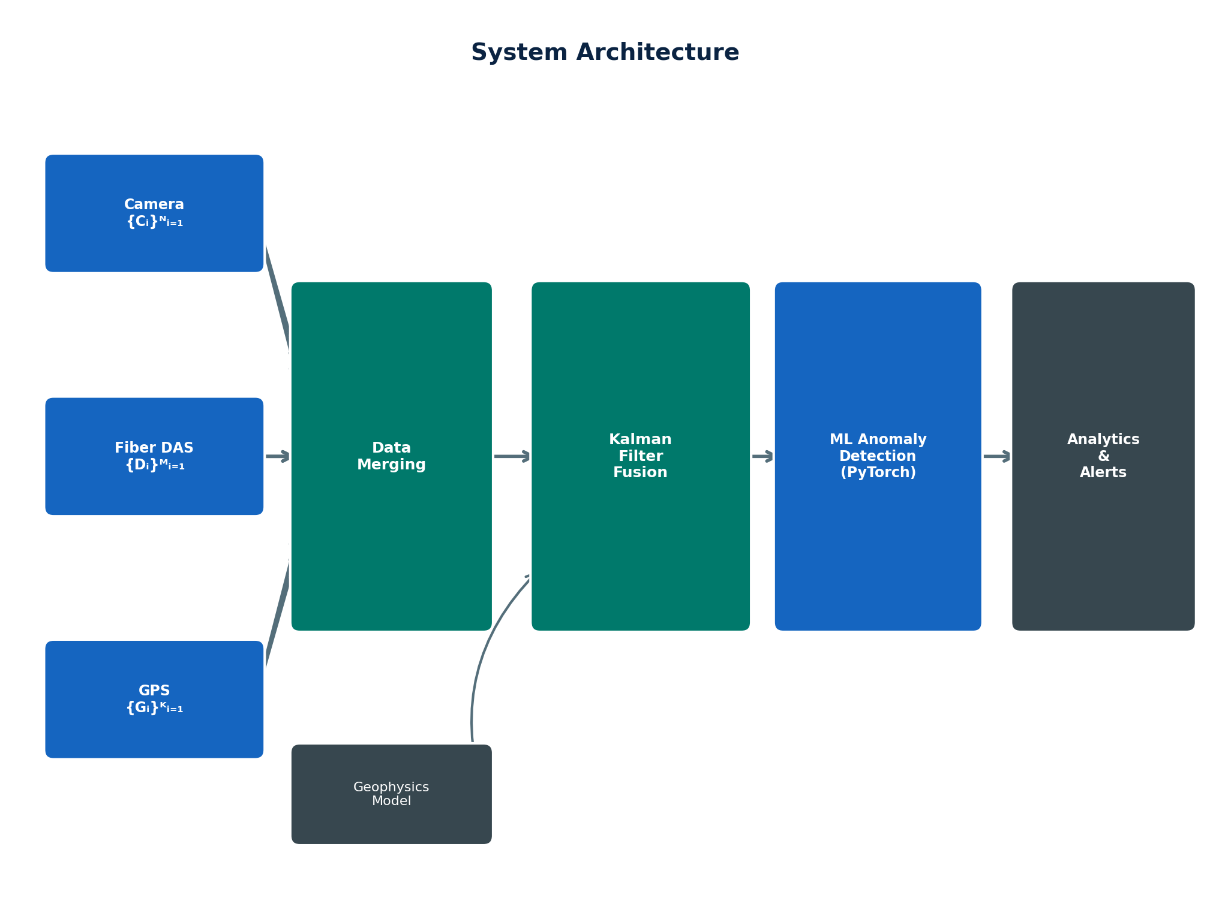
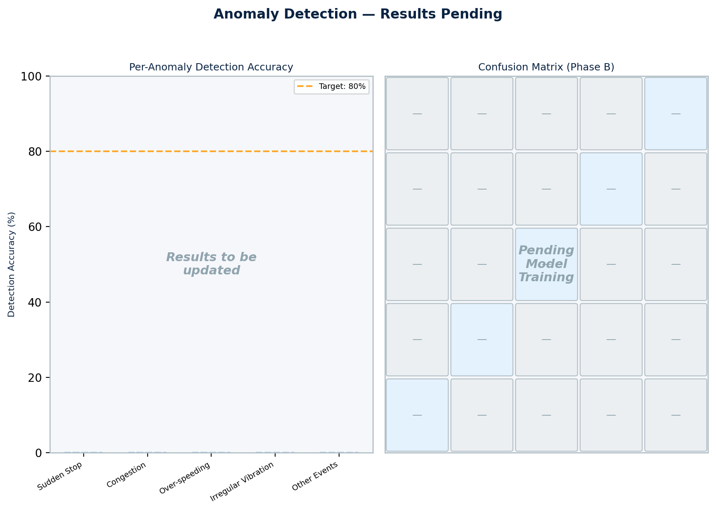
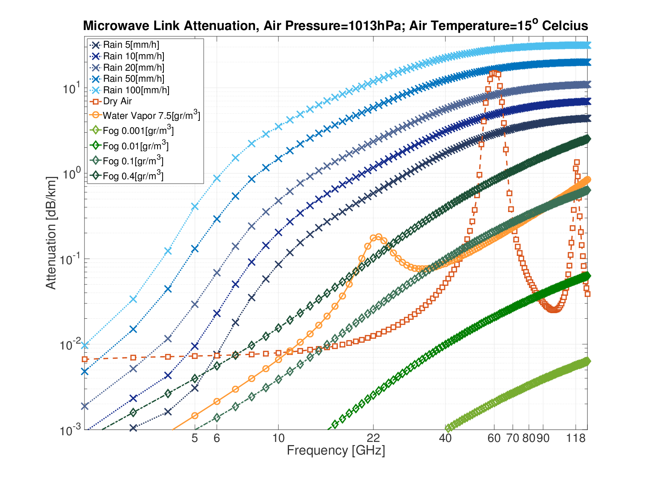
Smart City Traffic Monitoring: Fiber DAS & Sensor Fusion
[Student Name 1], [Student Name 2]
Advisor: Prof. Moshe Tur, Prof. Yair Moshe
Project Number: XX-X-X-XXXX
Abstract
A fiber optic-based traffic monitoring system for smart cities — combining Distributed Acoustic Sensing (DAS), computer vision cameras, and GPS to track vehicles across road segments, estimate speed, and detect anomalies in real time using existing underground “dark fiber” infrastructure.
Enables scalable, all-weather, city-wide coverage with no new roadside hardware required.
Goals
Performance targets, validated through simulation:
≥90% Cross-Street Tracking Accuracy (DAS + Camera + GPS fused)
≤5 km/h Speed Estimation Error (GPS-calibrated DAS delays)
<60 s Full Pipeline Latency (≤3 s per-event processing)
≥80% Anomaly Detection Accuracy (Phase B, 5/10 types in Phase A)
Methods & Implementation
Traffic Simulation: Python-based configurable multi-street environment generating synchronized DAS signals, camera detections, and GPS traces.
DAS Signal Processing Pipeline — raw optical data to vehicle signatures:
Initial
Conditions
Introduction & Motivation
Conventional monitoring approaches have critical limitations:
Cameras — degrade in fog/rain/night; intersection-only coverage
GPS probes — sparse, user-dependent; no continuous spatial data
Single-sensor DAS — high false alarms in dense urban environments
Our system fuses all three modalities via a Kalman filter. Vehicle vibrations travel through road structure and are sensed as Rayleigh backscattering phase shifts in the buried fiber:
ε̇(t,z) ≈ ∂/∂t [(u(t,z+L)−u(t,z))/L]
Dark fibers: unused telecom cables already deployed underground, repurposed as distributed sensor arrays at near-zero marginal cost.
vs. Commercial Alternatives
OptaSense — DAS only; single modality; high false alarm rates
Miovision — Cameras only; intersection-limited; weather-sensitive
Our System — DAS + Camera + GPS; all-weather; continuous coverage
Strapdown
Solution
Kalman
Filter
GPS
IMU
Sensor Fusion & Results
Kalman Filter integrates asynchronous DAS, camera, and GPS into a unified state estimate enabling cross-street tracking and trajectory reconstruction.
Completed milestones (May 2026):
Multi-street simulation: ✓ Operational
DAS processing pipeline: ✓ Validated on synthetic data
Kalman filter fusion: ✓ Implemented and tested
Speed estimation ≤5 km/h: ✓ Achieved in simulation
Anomaly detection results — pending model training completion:
System Architecture
Camera frames provide visual ground-truth; fiber DAS gives continuous vibration signatures; GPS supplies precise timing for speed calibration. Streams are fused via Kalman Filter into a unified vehicle state estimate, then classified by a PyTorch neural network for anomaly detection and real-time alerts.
Integrated
Solution
Conclusions
City-scale monitoring demonstrated using existing fiber infrastructure
Kalman fusion of DAS + Camera + GPS achieves consistent cross-street tracking
Scalable architecture — dark fiber needs no new hardware
Anomaly detection (PyTorch NN) under training; results in final submission
References
[1] DAS research, Tel Aviv University — fiber sensing for urban traffic.
[2] G. Welch & G. Bishop, “Kalman Filter,” UNC Chapel Hill, 2006.

