Slide 1




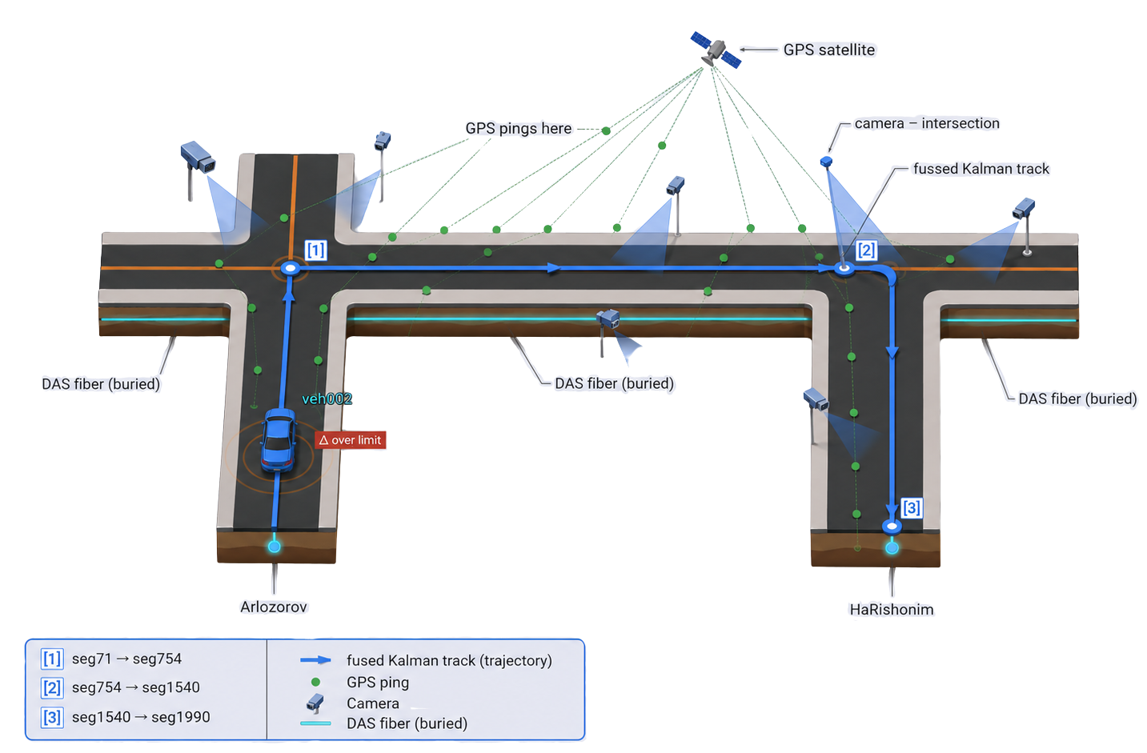
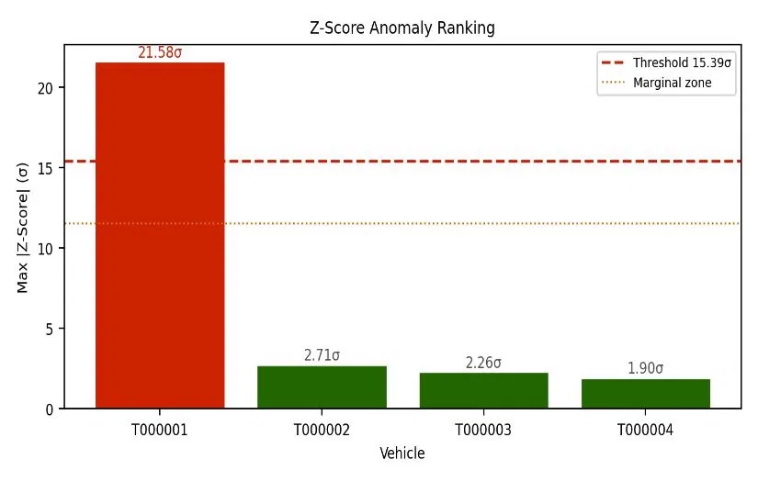
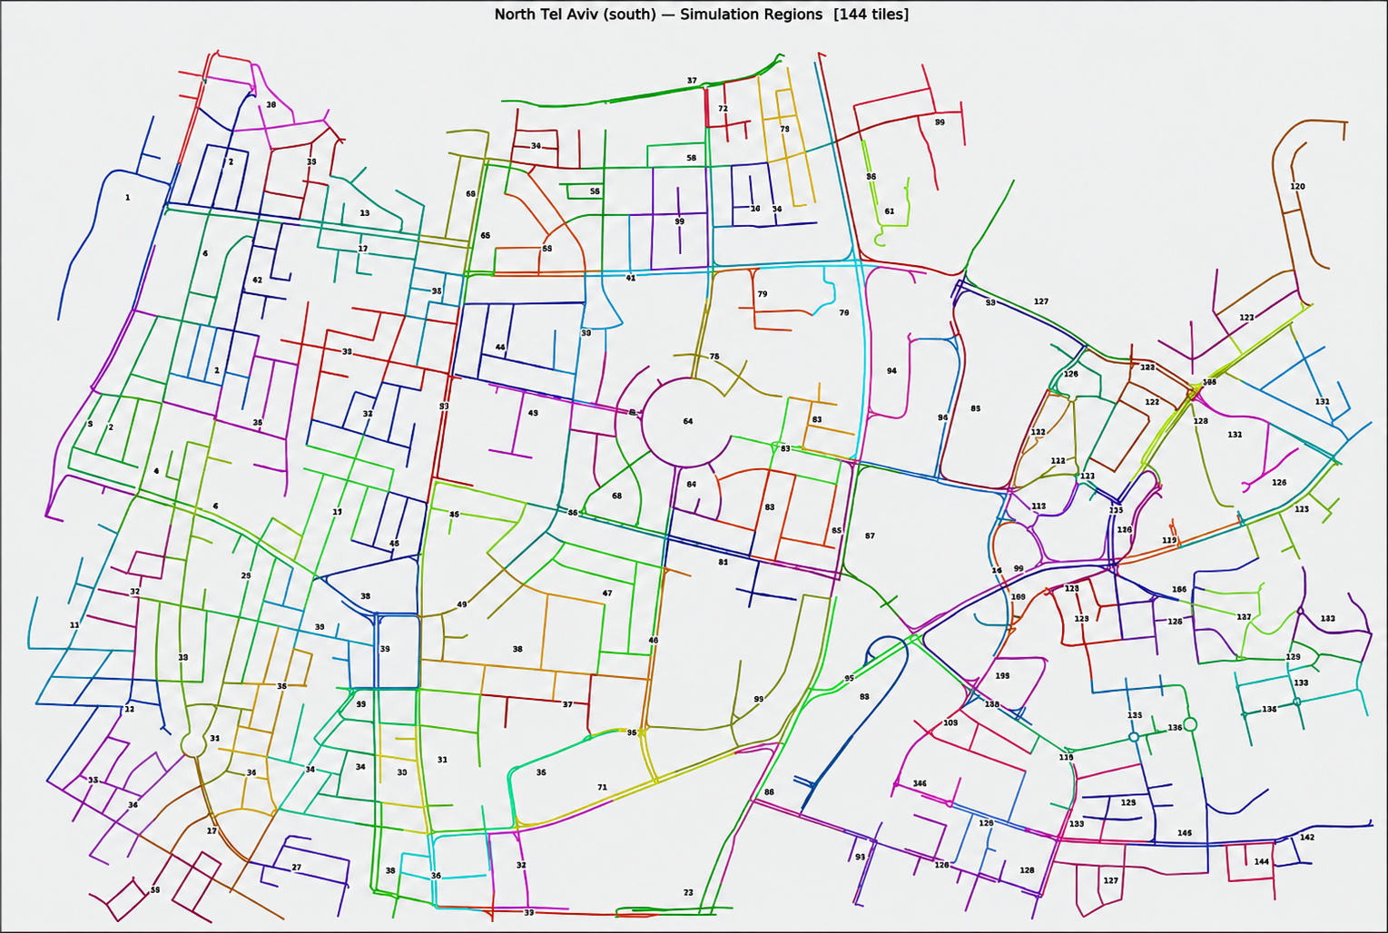
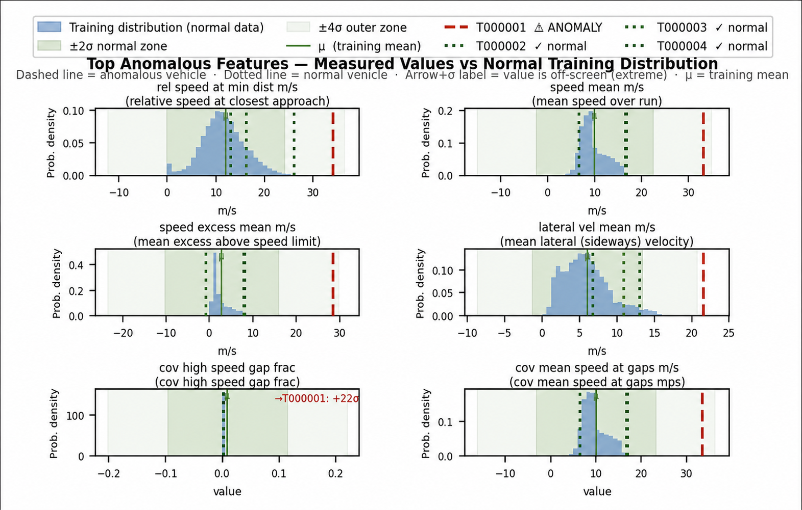
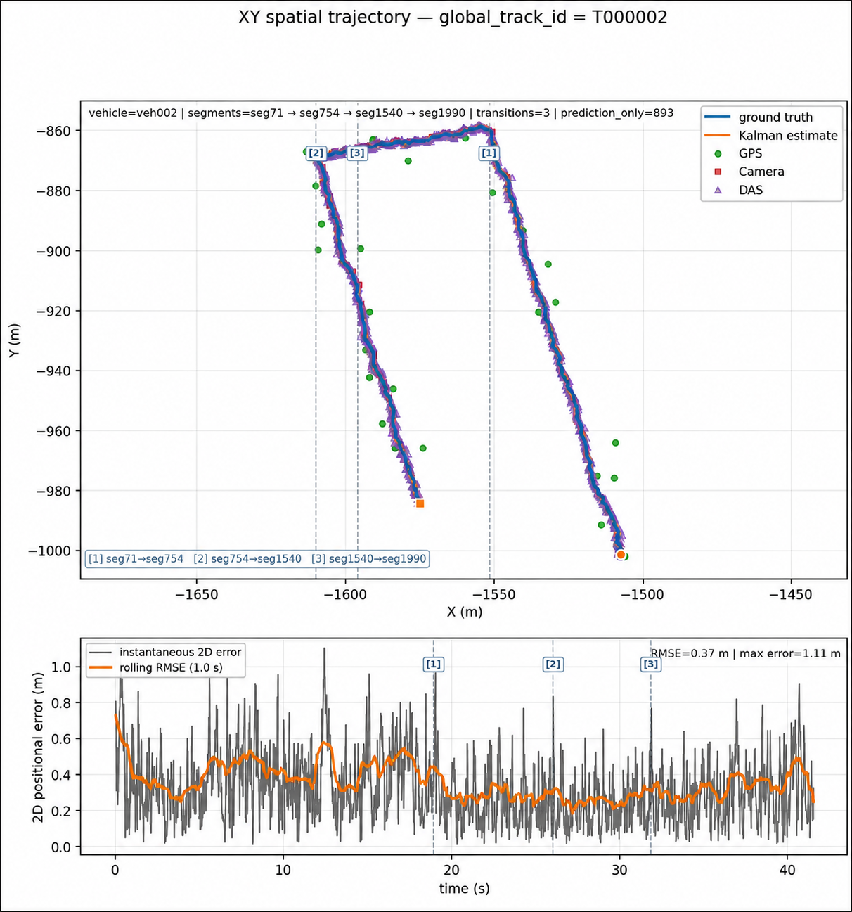
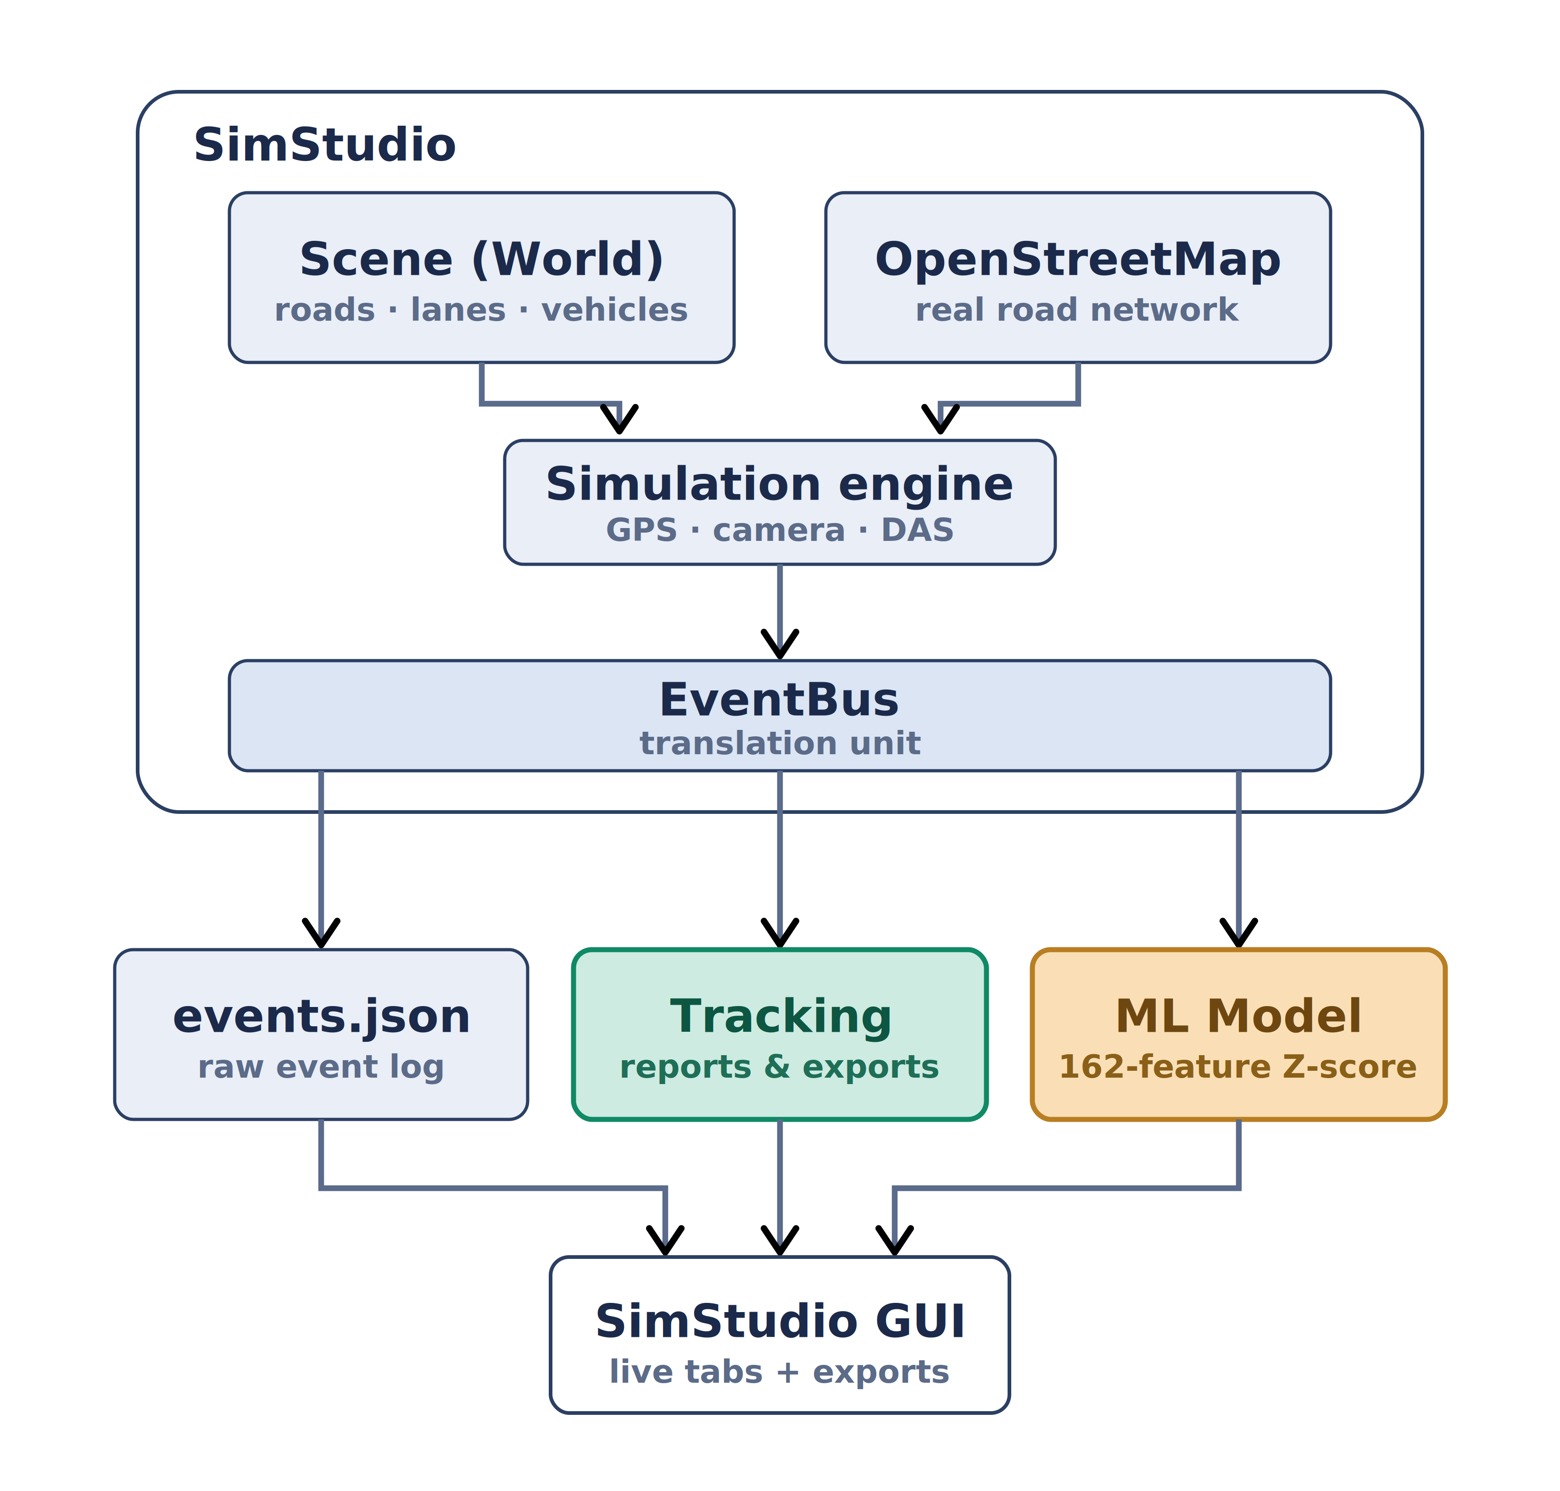
Optical Fibers for Smart Cities
Noa Sapir, Nitai Dobrecki
Advisor: Khen Cohen
SCAN ME
FOR A DEMO!
Project Number: 25-1-1-3221
Intro & Motivation
SimStudio combines DAS, camera, and GPS data to track vehicles and detect abnormal traffic events.
Since cameras and GPS can be limited by weather, lighting, or coverage, DAS adds continuous road sensing through existing fiber-optic infrastructure.
Results - Region 120, over speeding
CROSS SEGMENT TRACKING
Kalman filter with 0.37 m RMSE of ground truth.
Achieving over 90% accurecy and less than 5 km/h speed estimation error.
Same vehicle re identified across 3 segment from motion + sensors alone, one unbroken track.
ANOMALY DETECTION
Over limit speeder flagged at 21.58σ
Achiving more than 80% detection accurecy
Over limit speeder is elevated across the entire speed feature block and extreme on high speed gap behaviour
its measured speed aspects and lateral velocity values fall outside the training distribution
Across all anomaly types, and different regions, results were consistent, achieving Less than 60s pipeline latency (less than 3s per event)
Methods & Implementation
Using SimStudio, we import true street geometry across North Tel Aviv, divided into 144 regions, and generate many anomaly free traffic scenes that set the baseline of normal behavior
We defined
anomalies:
- sudden braking
- Collision
- Speeding
- Stalled Vehicle
- Tailgating
- Heavy Vehicle
- Weaving
and generate multiple scenes to each region. From the resulting.
we developed a ML
moudle to identify
anomalies.
The moudle learns
162 behavior features
for each scene, then
scores each vehicle in
the scene by how far
it deviates - Z score,
flagging anything
past 15.8σ.
Conclusions
Proven here in simulation.Every street could become a city wide nervous system, sensing the roads everywhere, with no new hardware.

