Slide 1
Image Classification
Faces vs Non-Faces
Noa Tal, 31/03/2024

Slide 2
Introduction & Data Overview
In this task, our objective is to develop an image classifier capable of accurately distinguishing between faces and non-faces.
We will train the classifier using the MIT faces & non-faces dataset. The dataset comprises separate training and test sets, each containing grayscale images labeled as either faces or non-faces.
Train Dataset:
Total Images: 6,977
Image Shape: [1, 19, 19]
Class Distribution:
Non-Faces: 4,548 images
Faces: 2,429 images
Test Dataset:
Total Images: 24,045
Image Shape: [1, 19, 19]
Class Distribution:
Non-Faces: 23,573 images
Faces: 472 images

Slide 3
Model Architecture
Our image classifier model architecture is designed using convolutional neural networks (CNNs) to effectively capture spatial patterns and features in the input images.
Conv1 Input: 1 Output: 32 Kernel size: 3X3 Padding: 1
Conv2 Input: 32 Output: 64 Kernel size: 3X3 Padding: 1
Conv3 Input: 64 Output: 128 Kernel size: 3X3 Padding: 1
FC1
FC2
sigmoid
Relu
Max pool
Relu
Max pool
Relu
Max pool
Reshape
Relu

Slide 4
Training & Hyperparameter Tuning
Training Process: The model underwent training using the training dataset and was subsequently evaluated using the separate test dataset to assess its generalization performance.
Hyperparameter Tuning with Wandb: Utilizing Wandb, we engaged in hyperparameter tuning, systematically exploring various combinations to optimize the model's accuracy.
Hyperparameters Explored:
Learning Rate (lr): Explored values of 0.00001, 0.0001, and 0.001.
Number of Epochs: Investigated training epochs of 10, 20, and 30.
Batch Size: Tested batch sizes of 16, 32, and 64. Among the hyperparameters explored, the learning rate emerged as the most influential factor based on the tuning results.
Notes:
Best Lr = 0.001 no change in shape and in the CNN architecture

Slide 5
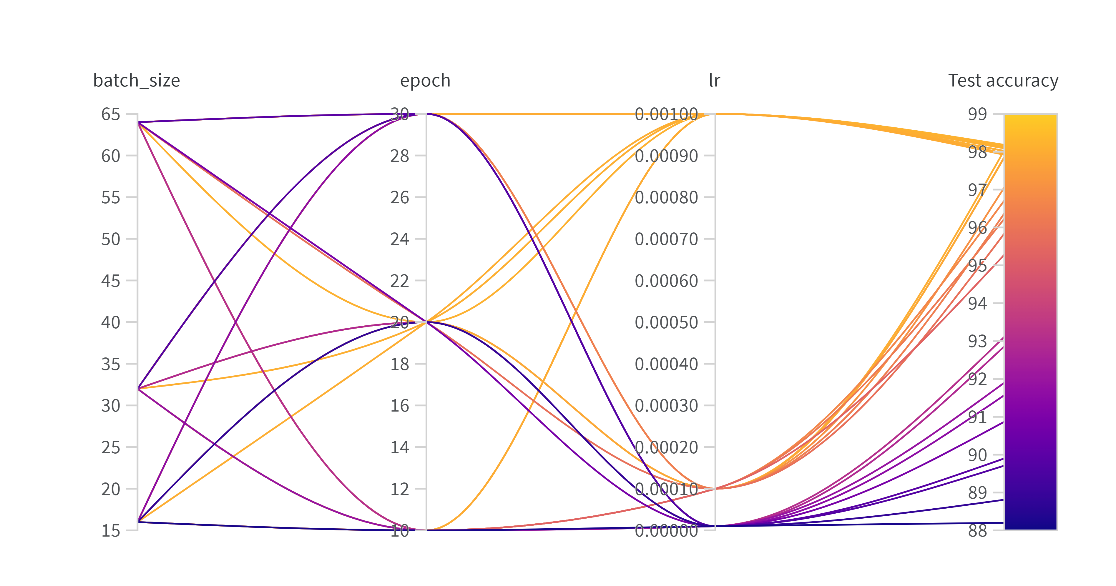
Results and Performance
The highest test accuracy achieved was ~98.4%, attained with a learning rate of 0.001, batch size of 32 and 20 epochs
Notes:
CSV attached to the project

Slide 6
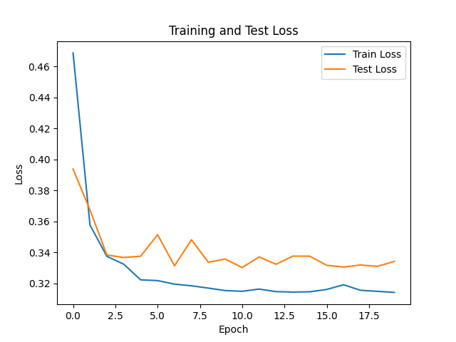
Results
num | batch_size | epoch | lr | Test accuracy
1 | 32 | 10 | 0.001 | 98.18
2 | 16 | 10 | 0.001 | 98.17
3 | 64 | 20 | 0.001 | 98.14
4 | 32 | 30 | 0.001 | 98.12
5 | 32 | 20 | 0.001 | 98.09
6 | 16 | 30 | 0.0001 | 98.04
7 | 16 | 30 | 0.001 | 98.02
8 | 16 | 20 | 0.001 | 98.02
9 | 64 | 10 | 0.001 | 97.96
10 | 64 | 30 | 0.001 | 97.92

Slide 7
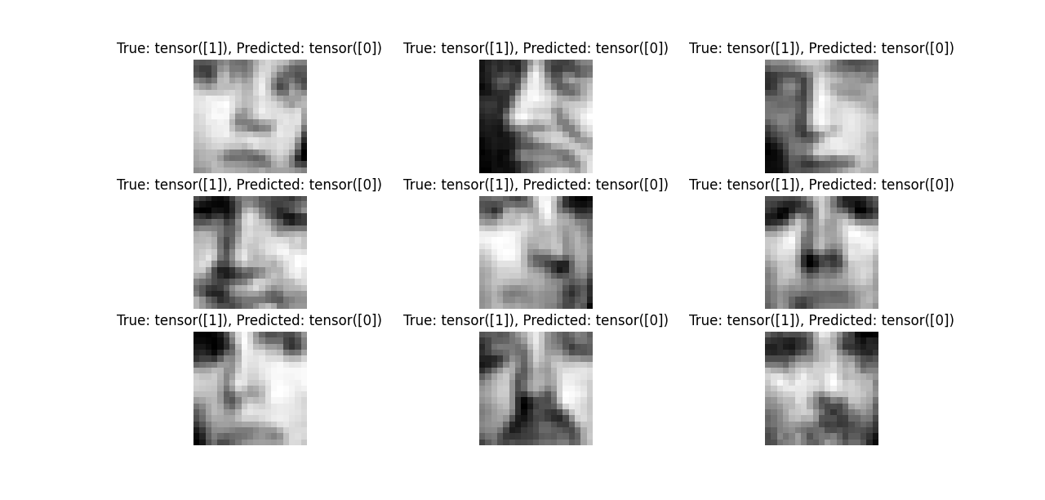
Mis-classifications
Notes:
Example of the first 9 mismatches

Slide 8
Visualization of Features

Slide 9
Next
Different CNN architectures/layers
Reshaping before entering the model
Data cleaning
Notes:
Data
Shape
cuda

Slide 10
Questions

