Slide 1
Image Classification
Faces vs Non-Faces
Noa Tal, 01/04/2024

Slide 2
Introduction & Data Overview
In this task, our objective is to develop an image classifier capable of accurately distinguishing between faces and non-faces.
We will train the classifier using the MIT faces & non-faces dataset. The dataset comprises separate training and test sets, each containing grayscale images labeled as either faces or non-faces.
Train Dataset:
Total Images: 6,977
Image Shape: [1, 19, 19]
Class Distribution:
Non-Faces: 4,548 images
Faces: 2,429 images
Test Dataset:
Total Images: 24,045
Image Shape: [1, 19, 19]
Class Distribution:
Non-Faces: 23,573 images
Faces: 472 images
Notes:
Dataset overview
Class imbalance:
Train Data: 65% non-face, 35% face
Test Data: 98% non-face, 2% face The class imbalance (more non-face images) can bias the model towards the majority class.
The images in the dataset are grayscale and of a small size, 19x19 pixels.

Slide 3
Model Architecture
Our image classifier model architecture is designed using a convolutional neural network (CNN) to effectively capture spatial patterns and features in the input images.
Conv1 Input: 1 Output: 32 Kernel size: 3X3 Padding: 1
Conv2 Input: 32 Output: 64 Kernel size: 3X3 Padding: 1
Conv3 Input: 64 Output: 128 Kernel size: 3X3 Padding: 1
FC1
FC2
sigmoid
ReLU
Max pool
ReLU
Max pool
ReLU
Max pool
Reshape
RelU
Notes:
Model architecture self.conv1 = nn.Conv2d(1, 32, kernel_size=3, padding=1) self.conv2 = nn.Conv2d(32, 64, kernel_size=3, padding=1) self.conv3 = nn.Conv2d(64, 128, kernel_size=3, padding=1) self.pool = nn.MaxPool2d(2, 2) self.fc1 = nn.Linear(128 * 2 * 2, 256) self.fc2 = nn.Linear(256, 2) # 2 output classes: face or non-face
Input layer –single channel since the image is greyscale.
Convolutional Neural Networks (CNNs) are particularly well-suited for image classification tasks.
CNNs can automatically learn the relevant features from the images themselves during training.
CNNs are designed to capture the spatial relationships between pixels in an image. This is achieved through convolutional layers that use filters to scan the image, identifying patterns like edges, textures, and shapes.
These lower-level features are then combined in subsequent layers to form more complex features, allowing the CNN to gradually recognize objects within the image.
Parameter sharing - where a small set of learnable filters is applied across the entire input image. This significantly reduces the number of parameters compared to fully connected networks, making CNNs more efficient
Kernel 3X3 + padding 1 – feature maps remain the same
Pooling helps in reducing the spatial dimensions of the feature maps while retaining the most important information.
The use of non-linear activation functions like ReLU after each convolutional layer introduces non-linearity into the network, enabling it to learn complex patterns and relationships within the data.
ReLU(x) = MAX(0,x)
Leaky ReLU(x) = x if x>0, a*x otherwise
The fully connected layers (or linear layers) at the end of the network are responsible for combining the extracted features and making the final classification decision.
Sigmoid activation function squashes the output of the last layer to values between 0 and 1, which can be interpreted as probabilities.(softmax is typically used in multi-class classification problems)
Input
(32, 1, 19, 19)
- (No parameters)
Conv1
(32, 32, 19, 19)
(3 * 3 * 1 + 1) * 32 = 320
ReLU1
(32, 32, 19, 19)
- (No additional parameters)
Pool1
(32, 32, 9, 9)
- (No parameters)
Conv2
(32, 64, 9, 9)
(3 * 3 * 32 + 1) * 64 = 18496
ReLU2
(32, 64, 9, 9)
- (No additional parameters)
Pool2
(32, 64, 4, 4)
- (No parameters)
Conv3
(32, 128, 4, 4)
(3 * 3 * 64 + 1) * 128 = 73728
ReLU3
(32, 128, 4, 4)
- (No additional parameters)
Pool3
(32, 128, 2, 2)
- (No parameters)
Flatten
(32, 128 * 2 * 2)
- (No parameters)
FC1
(32, 256)
(128 * 2 * 2 + 1) * 256 = 81920
ReLU4
(32, 256)
- (No additional parameters)
FC2
(32, 2)
(256 + 1) * 2 = 512
Sigmoid
(32, 2)
- (No parameters)

Slide 4
Training & Hyperparameter Tuning
Training Process: The model underwent training using the training dataset and was subsequently evaluated using the separate test dataset to assess its generalization performance.
Hyperparameter Tuning with Wandb: Utilizing Wandb, we engaged in hyperparameter tuning, systematically exploring various combinations to optimize the model's accuracy.
Hyperparameters Explored:
Learning Rate (lr): Explored values of 0.00001, 0.0001, 0.001 and 0.01.
Number of Epochs: Investigated training epochs of 10, 20, and 30.
Batch Size: Tested batch sizes of 16, 32, and 64. Among the hyperparameters explored, the learning rate emerged as the most influential factor based on the tuning results.
Notes:
Best Lr = 0.001 no change in the image shape and the CNN architecture

Slide 5
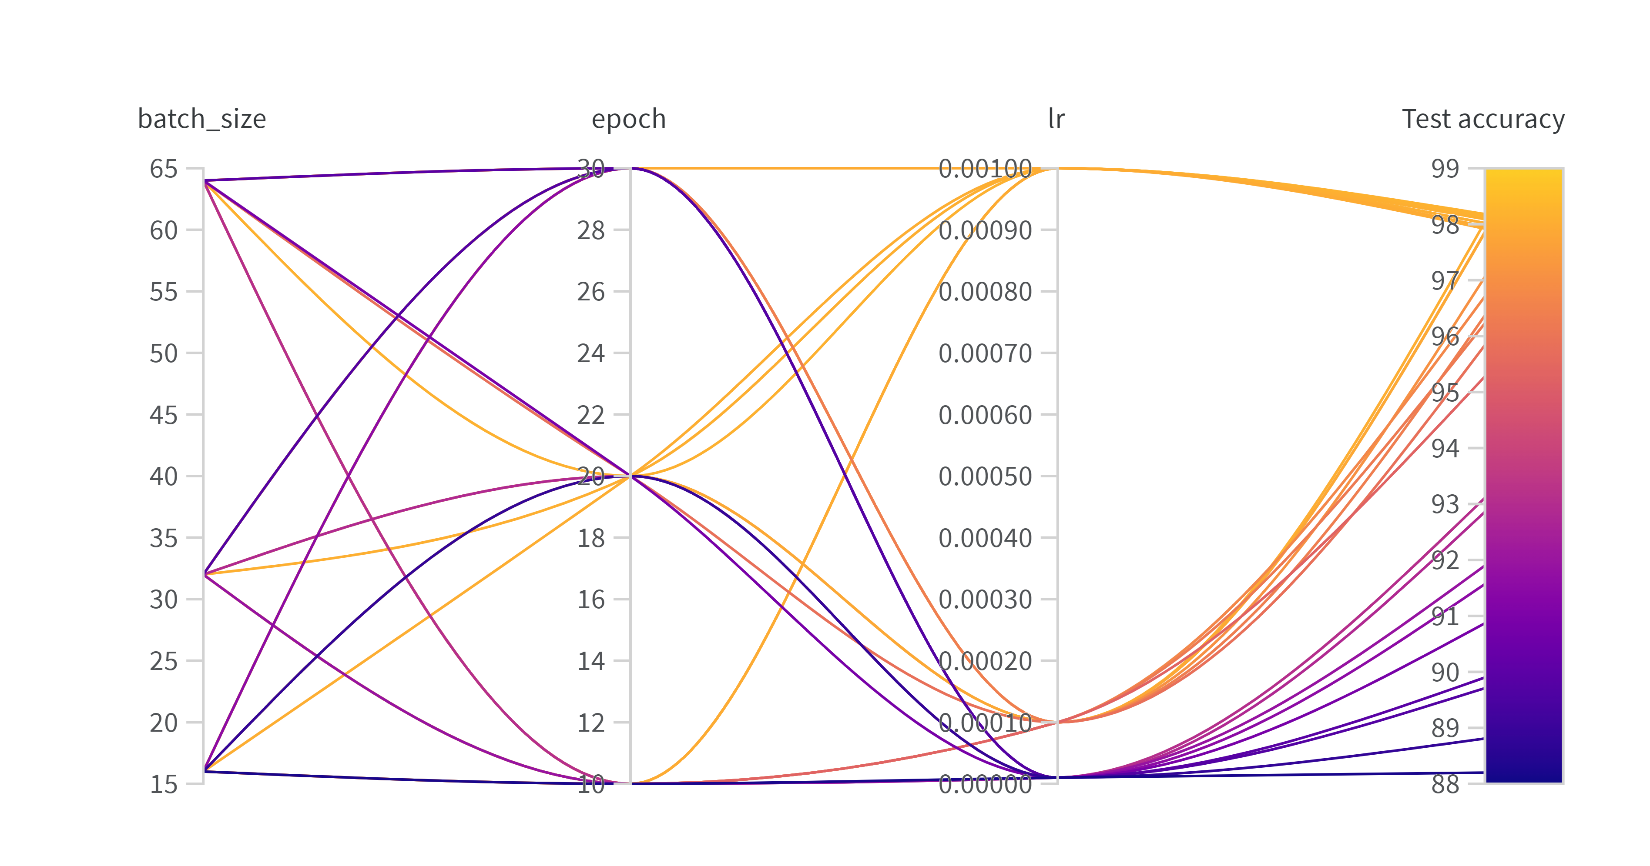
Results and Performance
The highest test accuracy achieved was ~98.4%, attained with a learning rate of 0.001, batch size of 32 and 20 epochs
Notes:
CSV attached to the project results directory

Slide 6
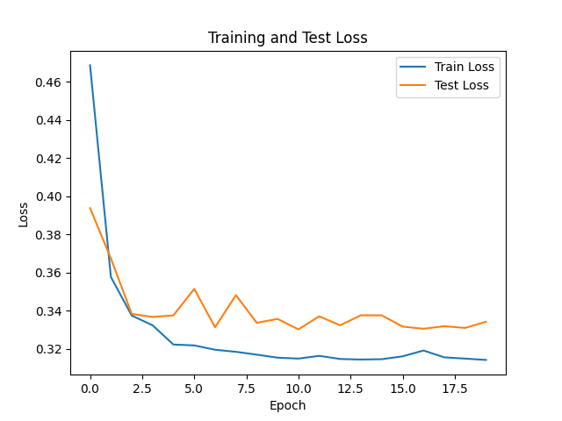
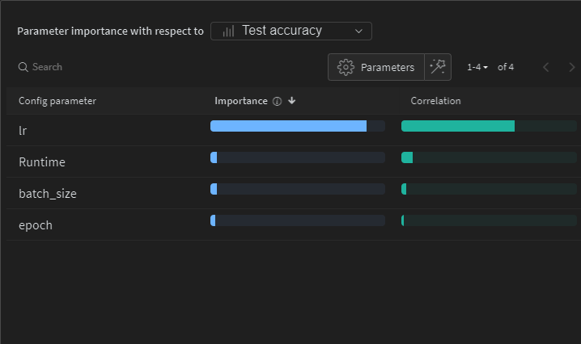
Results
num | batch_size | epoch | lr | Test accuracy
1 | 16 | 10 | 0.001 | 98.27
2 | 64 | 10 | 0.001 | 98.24
3 | 32 | 20 | 0.001 | 98.24
4 | 64 | 20 | 0.001 | 98.1
5 | 32 | 30 | 0.001 | 98.06
6 | 16 | 30 | 0.01 | 98.02
7 | 16 | 30 | 0.001 | 98.02
8 | 16 | 20 | 0.01 | 98.02
9 | 16 | 10 | 0.01 | 98.02
10 | 16 | 20 | 0.001 | 98.01
Notes:
CSV Result from wandb example
Overfitting check example
Importance of the lr

Slide 7
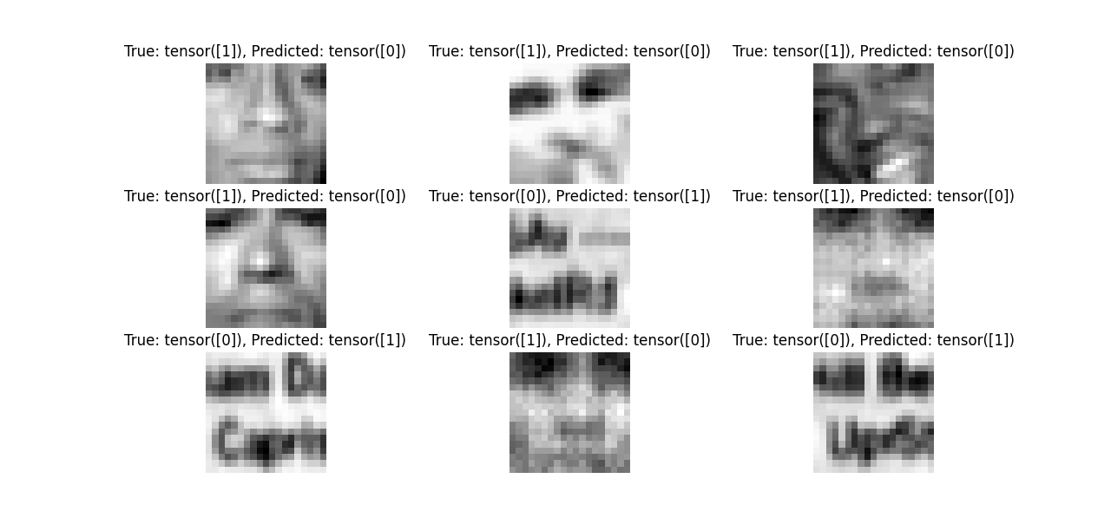
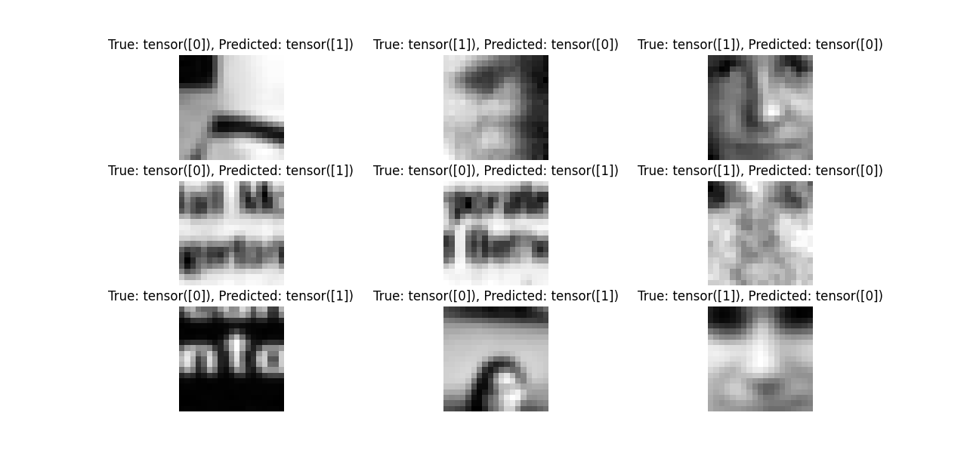
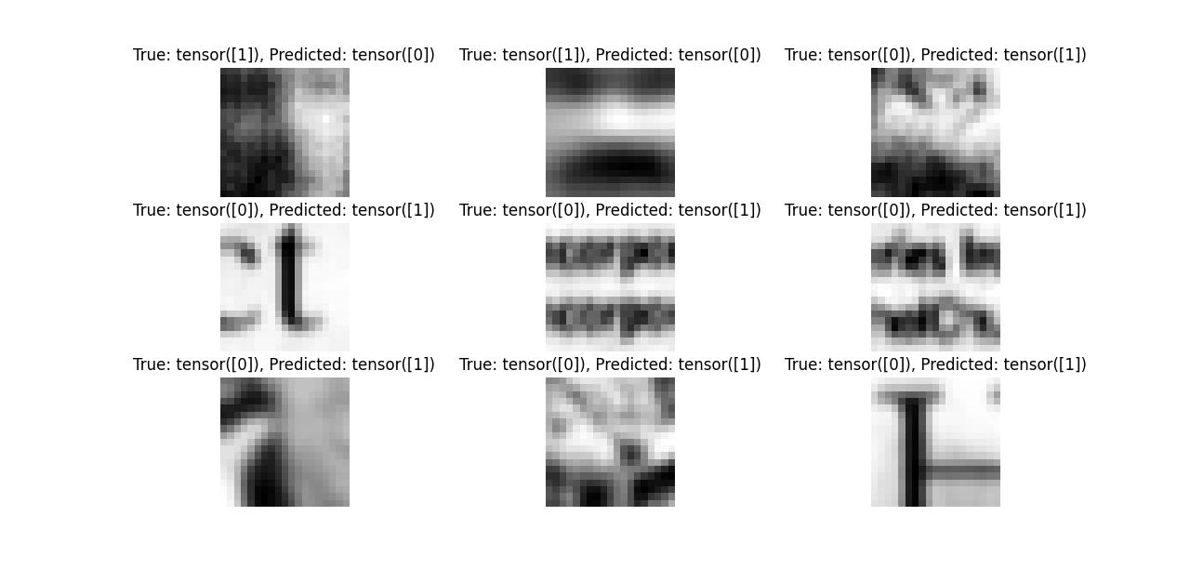
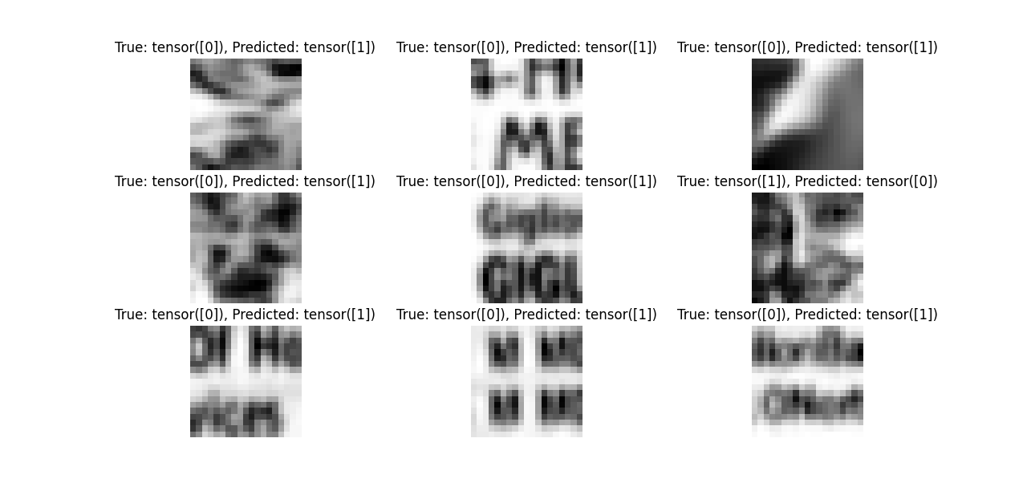
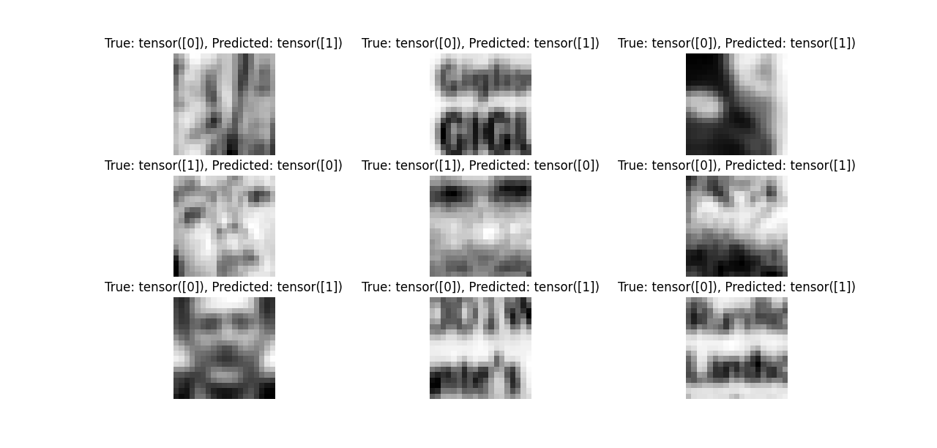
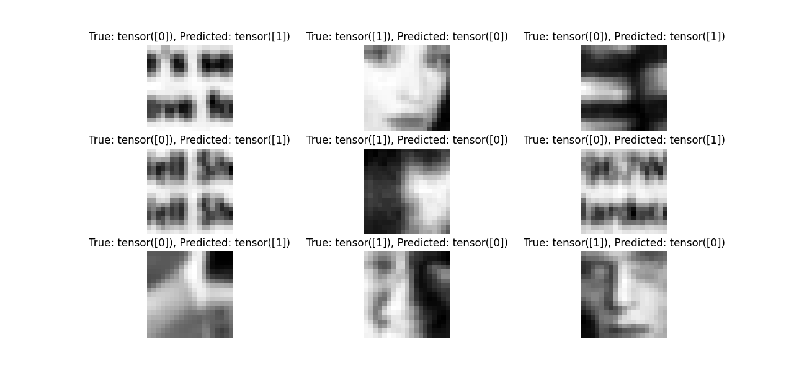
Mis-classifications
Average number of misclassified samples:
False Positive - Classified as face when the true label is non-face: ~50
False Negative - Classified as non-face when the true label is face: ~360
Class imbalance, where one class significantly outweighs the other in the dataset, can contribute to model misclassification. This imbalance may lead the model to become biased towards the majority class during training, affecting its ability to properly distinguish between classes.
Notes:
10 test runs for the example, the first 9 random mis-matches images
Avg of 10 runs:
Classified as non-face(true label face) = FN (most of the miss-matches)
Classified as face(true label non-face) = FP
In binary classification tasks, accuracy measures the overall correctness of the model's predictions, regardless of class.
If one class (non-faces) dominates the dataset, the model may achieve high accuracy by correctly classifying the majority class while still struggling with the minority class.
The model achieves high accuracy, but it struggles with recall, suggesting that it misses a significant portion of the positive class.
This discrepancy could be due to various factors, such as class imbalance(65-53), model complexity, or insufficient training data for the positive class. Test Accuracy: The model consistently achieves high accuracy, ranging from 98.1% to 98.19%, indicating that it correctly classifies the majority of samples in the test set.
Precision: The precision values range from 0.616 to 0.786, with an average precision of approximately 0.669. Precision represents the proportion of correctly predicted positive instances among all instances predicted as positive by the model.
Recall: The recall values range from 0.131 to 0.239, with an average recall of approximately 0.189. Recall, also known as sensitivity, measures the proportion of actual positive instances that the model correctly identifies.
(Run with batch norm)
Test accuracy: 98.08
Average Precision: 0.6956928138455083
Average Recall: 0.22521186440677968
(More even data distribution in the train)
Average Precision and Recall over 10 runs:
Average Precision: 0.9331463614096582
Average Recall: 0.2942796610169492
(20 epochs + normalization)
Average Precision: 0.9325678323048292
Average Recall: 0.32521186440677974
The high test accuracy indicates that the model performs well overall.
However, the relatively low recall values suggest that the model might miss a considerable portion of positive instances.

Slide 8
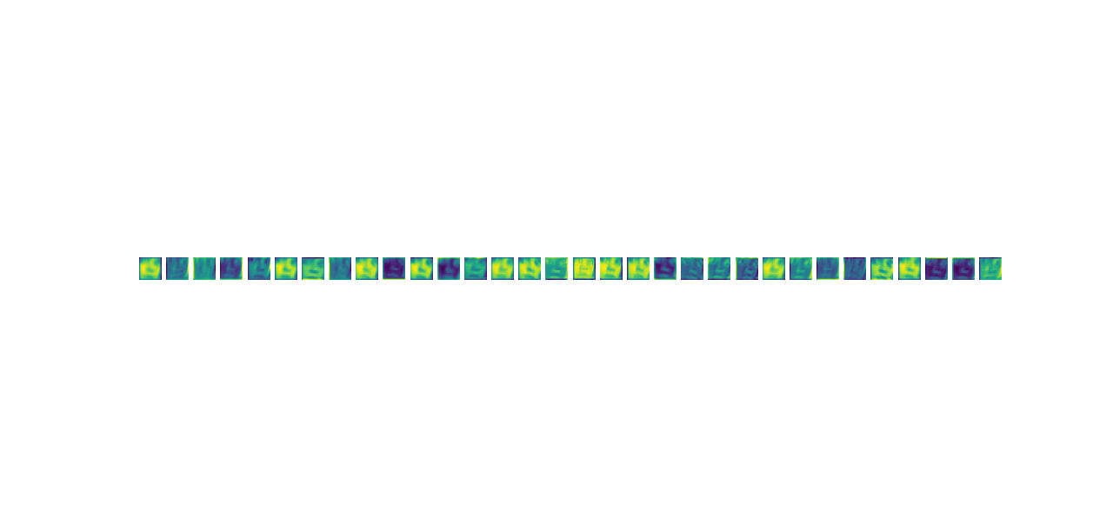
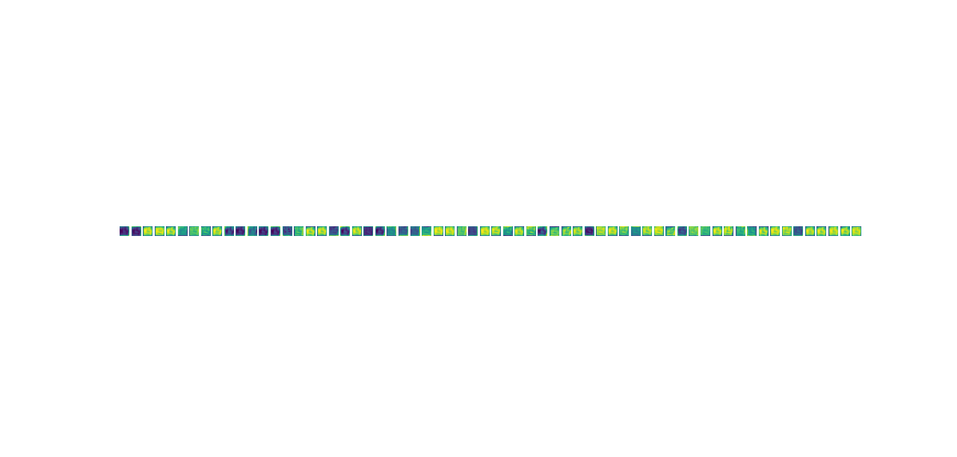
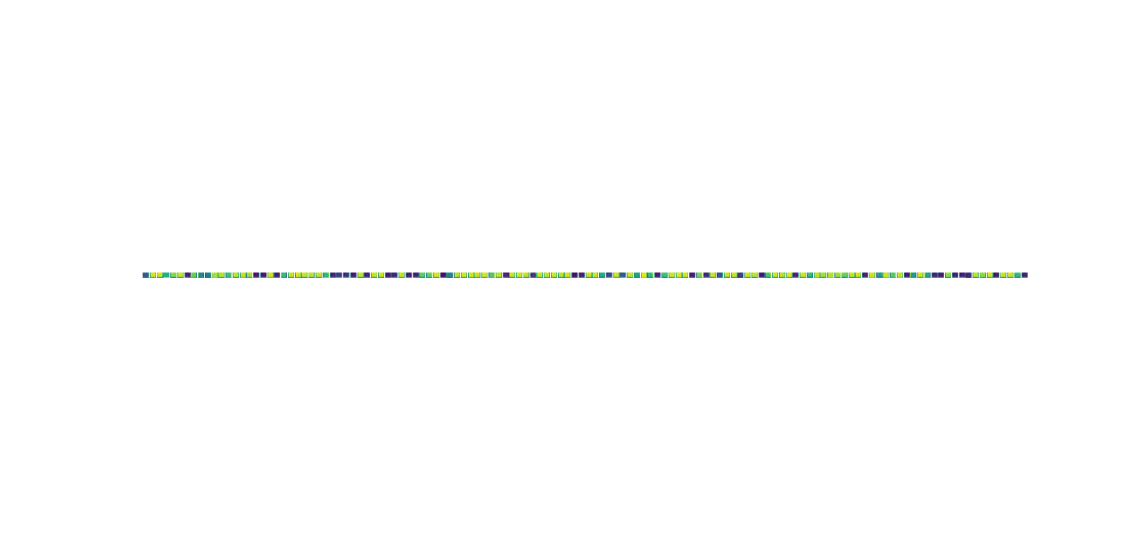
Visualization of Computed Features
Conv1(32 filters)
Conv2(64 filters)
Conv3(128 filters)
Notes:
Feature maps
Activation Maps/Feature Maps: These are visualizations of the output of individual neurons in a convolutional neural network (CNN).
Activation maps show which parts of the input image or data are being activated or emphasized by specific neurons.
The different colors represent the strength or intensity of the activations at different spatial locations within the feature map.
Brighter Colors (Yellow/Green): These indicate higher activations or stronger responses from the neurons in the corresponding locations of the feature map. (These areas might correspond to edges, corners, or other distinctive facial features.)
Darker Colors (Purple/Blue): Conversely, these indicate lower activations or weaker responses from the neurons. Darker regions might correspond to areas where the CNN has not detected significant features or where the features are less prominent.
Conv1: The activations in the first convolutional layer often capture low-level features such as edges, textures, and color gradients.
Conv2: As you move deeper into the network, the activations in subsequent convolutional layers tend to capture increasingly complex and abstract features.
Conv3: The activations in deeper layers like Conv3 may represent even higher-level features, such as parts of objects or entire object shapes.

Slide 9
Next
Implement data augmentation techniques such as rotation, translation, and scaling to increase the diversity of the training dataset and improve model robustness.
Architectural Modifications: Experiment with different neural network architectures.
Transfer Learning: Explore the use of pre-trained models.
Regularization: Apply regularization techniques such as dropout to prevent overfitting and improve generalization performance.
Data cleaning
Use Cloud/CUDA GPU to explore more hyperparameters
Notes:
Data augmentation involves generating new training samples by applying various transformations to existing data, such as rotation, translation, scaling, flipping, cropping, and adjusting brightness or contrast.
The goal of data augmentation is to increase the diversity and variability of the training dataset, which helps the model learn more robust and invariant features.
Translation: This simply means shifting the image a small distance horizontally or vertically. Imagine moving an object in the picture slightly to the left or right. By training the model on these translated versions, it learns to recognize the object regardless of its minor position within the image.
Scaling: This involves resizing the image slightly larger or smaller. In the real world, objects can be closer or farther away, so the model needs to be able to handle variations in size. Data augmentation with scaling helps the model achieve this.
Architectural Modifications CNN and ResNets

Slide 10
Questions

