Slide 1
Image Classification
Faces vs Non-Faces
Noa Tal, 01/04/2024

Slide 2
Introduction & Data Overview
In this task, our objective is to develop an image classifier capable of accurately distinguishing between faces and non-faces.
We will train the classifier using the MIT faces & non-faces dataset. The dataset comprises separate training and test sets, each containing grayscale images labeled as either faces or non-faces.
Train Dataset:
Total Images: 6,977
Image Shape: [1, 19, 19]
Class Distribution:
Non-Faces: 4,548 images
Faces: 2,429 images
Test Dataset:
Total Images: 24,045
Image Shape: [1, 19, 19]
Class Distribution:
Non-Faces: 23,573 images
Faces: 472 images

Slide 3
Model Architecture
Our image classifier model architecture is designed using a convolutional neural network (CNN) to effectively capture spatial patterns and features in the input images.
Conv1 Input: 1 Output: 32 Kernel size: 3X3 Padding: 1
Conv2 Input: 32 Output: 64 Kernel size: 3X3 Padding: 1
Conv3 Input: 64 Output: 128 Kernel size: 3X3 Padding: 1
FC1
FC2
sigmoid
Relu
Max pool
Relu
Max pool
Relu
Max pool
Reshape
Relu
Notes:
Model architecture

Slide 4
Training & Hyperparameter Tuning
Training Process: The model underwent training using the training dataset and was subsequently evaluated using the separate test dataset to assess its generalization performance.
Hyperparameter Tuning with Wandb: Utilizing Wandb, we engaged in hyperparameter tuning, systematically exploring various combinations to optimize the model's accuracy.
Hyperparameters Explored:
Learning Rate (lr): Explored values of 0.00001, 0.0001, 0.001 and 0.01.
Number of Epochs: Investigated training epochs of 10, 20, and 30.
Batch Size: Tested batch sizes of 16, 32, and 64. Among the hyperparameters explored, the learning rate emerged as the most influential factor based on the tuning results.
Notes:
Best Lr = 0.001 no change in the image shape and the CNN architecture

Slide 5
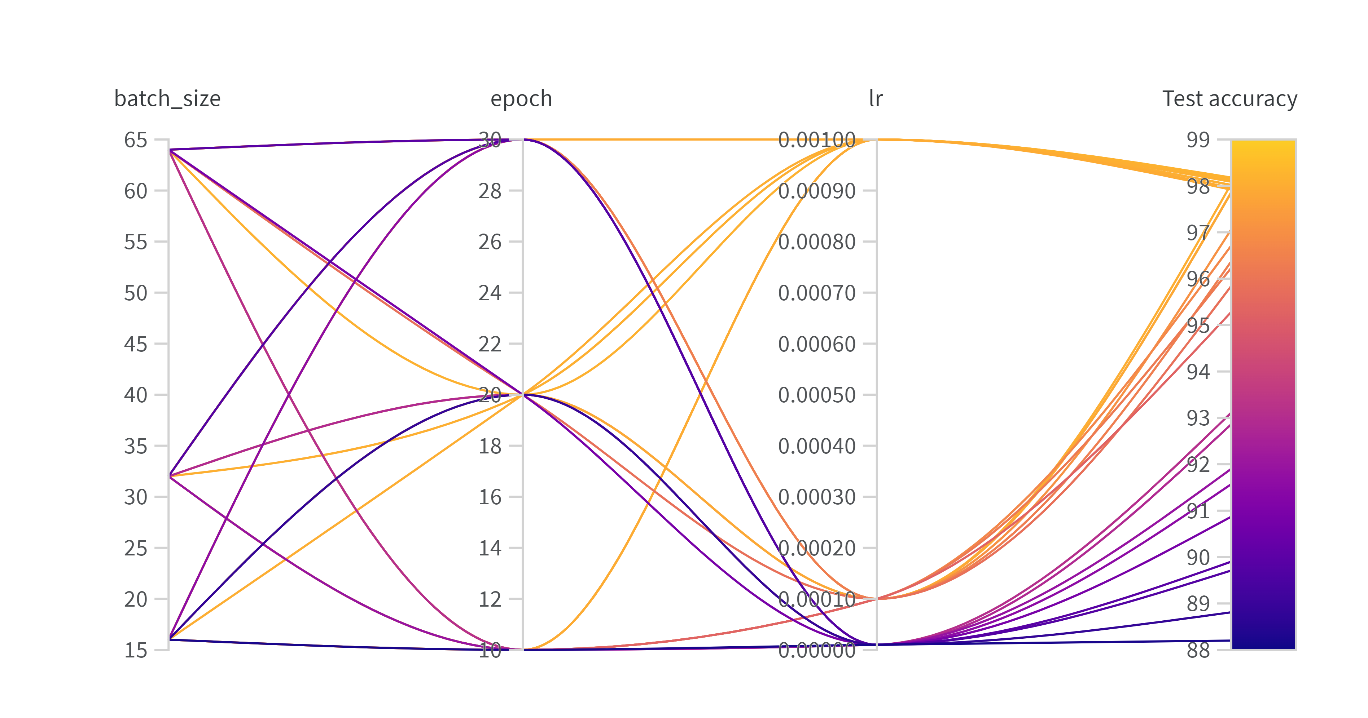
Results and Performance
The highest test accuracy achieved was ~98.4%, attained with a learning rate of 0.001, batch size of 32 and 20 epochs
Notes:
CSV attached to the project

Slide 6
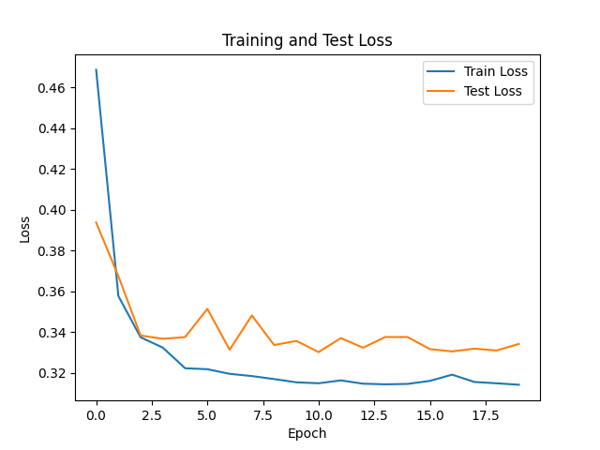
Results
num | batch_size | epoch | lr | Test accuracy
1 | 16 | 10 | 0.001 | 98.27
2 | 64 | 10 | 0.001 | 98.24
3 | 32 | 20 | 0.001 | 98.24
4 | 64 | 20 | 0.001 | 98.1
5 | 32 | 30 | 0.001 | 98.06
6 | 16 | 30 | 0.01 | 98.02
7 | 16 | 30 | 0.001 | 98.02
8 | 16 | 20 | 0.01 | 98.02
9 | 16 | 10 | 0.01 | 98.02
10 | 16 | 20 | 0.001 | 98.01
Notes:
Result from wandb example
Overfitting check

Slide 7
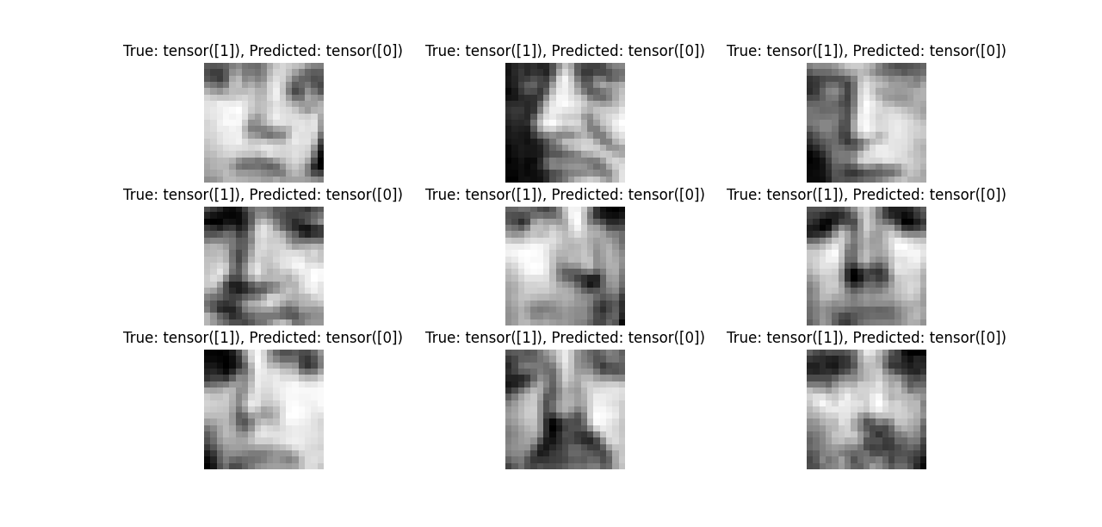
Mis-classifications
We can see that most of the misclassification images are cropped which could be the reason the model is having trouble classifying them correctly.
Notes:
Example of the first 9 mismatches

Slide 8
Visualization of Features

Slide 9
Next
Implement data augmentation techniques such as rotation, translation, and scaling to increase the diversity of the training dataset and improve model robustness.
Architectural Modifications, Experiment with different neural network architectures.
Transfer Learning, Explore the use of pre-trained models.
Regularization Techniques: Apply regularization techniques such as dropout to prevent overfitting and improve generalization performance.
Data cleaning
Notes:
Data augmentation involves generating new training samples by applying various transformations to existing data, such as rotation, translation, scaling, flipping, cropping, and adjusting brightness or contrast.
The goal of data augmentation is to increase the diversity and variability of the training dataset, which helps the model learn more robust and invariant features.
CNN and ResNets

Slide 10
Questions

