Slide 1
Predicting DEFAULT CREDIT CARD CLIENT
Group project
UBC
Master of data science

Slide 2

OVERVIEW
Problem: Predicting whether a credit card client will default or not
Problem type: Classification ( Default Or Not)
Data set:
Credit transaction of credit card clients in Taiwan from Apr 2005 to September 2005
30,000 examples
23 explanatory variables

Slide 3

Data processing
Preliminary preprocessing: change feature names, NaN values
Split the data into train (70%) and test (30%) portions randomly
Perform exploratory data analysis on the train set
Perform preprocessing and transformations: Drop features, identify feature types then transform the features accordingly

Slide 4
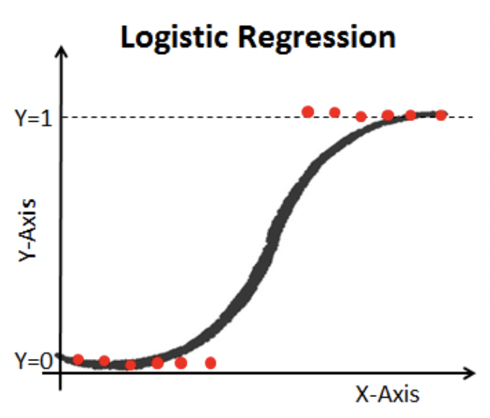
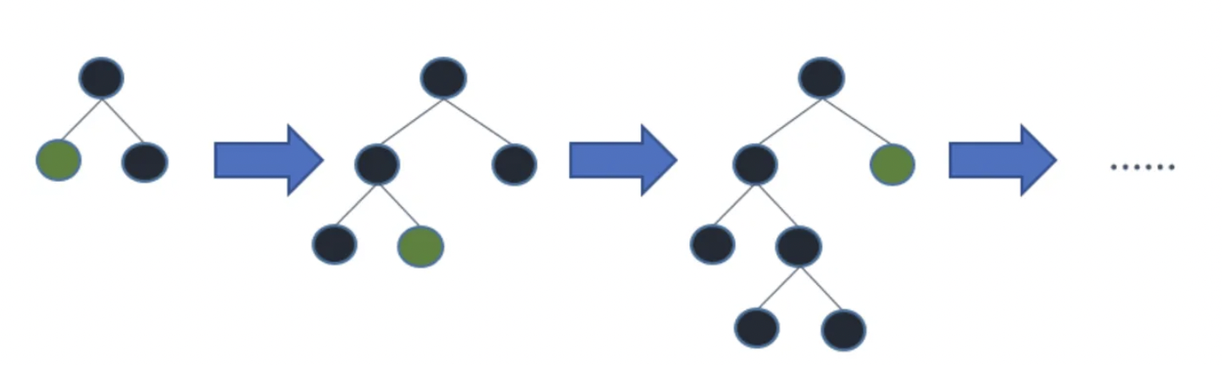
models
Choose metric: F1
Apply Baseline model, linear model (logistic regression), and tuned logistic regression
Try other model types, compare with above three models to find the best model:
LightGBM model
Find out the most important features: PAY_1 (Repayment status in Sep 2005, value = -1, 1, 2, 3,…, 9)
Apply the best performing model on test set and get the score of selected metric

Slide 5
ROLE PLAYED
The group includes 3 members
I was the one who pick the data, kick off the project, draft all answers
Other team members: check and revise the draft answers
Lessons learned:
Only use related and important features
Select suitable metric
Not all machine learning models can beat linear model.

