Slide 1
Positive Interval
Negative Interval
Positive Interval
Negative Interval

Slide 2
Positive Ray
Negative Ray

Slide 3
Positive Ray
Negative Ray
Positive Ray
Negative Ray
Positive Ray
Positive Ray

Slide 4
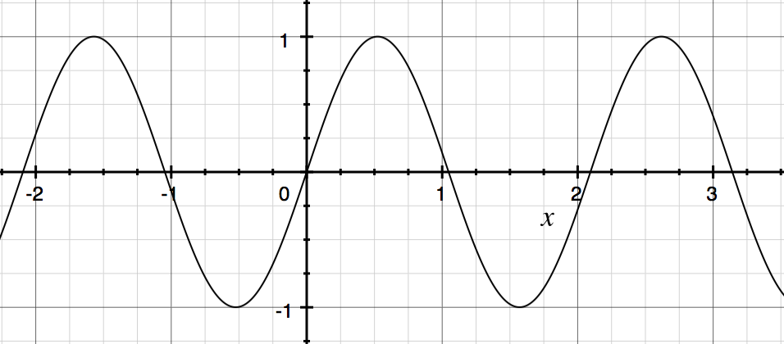
D degree polynomial

Slide 5


0
$$θ$$
-1
0.2
0.8
0.2
1
0
$$θ$$
-1
0.8
0.2
0.8
1
$$θ$$
0
-1
0.2
0.8
0.2
1
$$θ$$
0
-1
0.8
0.2
0.8
1

