Slide 1
Sequential logic
Sequential circuits
  simple circuits with feedback
  latches
  edge-triggered flip-flops
Timing methodologies
  cascading flip-flops for proper operation
  clock skew
Asynchronous inputs
  metastability and synchronization
Basic registers
  shift registers
  simple counters
Hardware description languages and sequential logic

Slide 2
Sequential circuits
Circuits with feedback
  outputs = f(inputs, past inputs, past outputs)
  basis for building "memory" into logic circuits
  door combination lock is an example of a sequential circuit
    state is memory
    state is an "output" and an "input" to combinational logic
    combination storage elements are also memory
new
equal
reset
value
C1
C2
C3
mux
control
multiplexer
comb. logic
comparator
state
clock
equal
open/closed

Slide 3
Circuits with feedback
How to control feedback?
  what stops values from cycling around endlessly
X1
X2
•
•
•
Xn
Z1
Z2
•
•
•
Zn
switching
network

Slide 4


Simplest circuits with feedback
Two inverters form a static memory cell
  will hold value as long as it has power applied
How to get a new value into the memory cell?
  selectively break feedback path
  load new value into cell
"1"
"stored value"
"0"
"remember"
"load"
"stored value"
"data"

Slide 5




Memory with cross-coupled gates
Cross-coupled NOR gates
  similar to inverter pair, with capability to force output to 0 (reset=1) or 1 (set=1)
Cross-coupled NAND gates
  similar to inverter pair, with capability to force output to 0 (reset=0) or 1 (set=0)
R
Q
Q
R
S
S
Q'
S'
Q
Q
S'
R'
Q'
R'

Slide 6
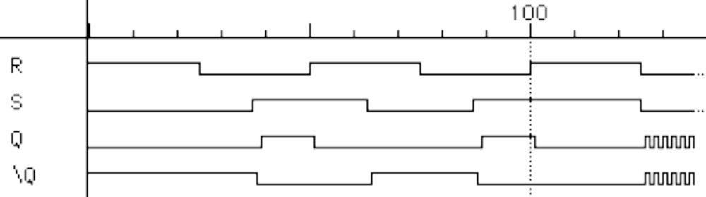
Timing behavior
R
Q
S
Q'
Reset
Hold
Set
Reset
Set
100
Race
R
S
Q
\Q

Slide 7
State behavior or R-S latch
R
Q
S
Q'
Truth table of R-S latch behavior
Q Q'
0 1
Q Q'
1 0
S R Q
0 0 hold
0 1 0
1 0 1
1 1 unstable
Q Q'
0 0
Q Q'
1 1

Slide 8
Theoretical R-S latch behavior
R
Q
S
Q'
SR=10
SR=00
SR=01
SR=00
SR=10
Q Q'
0 1
SR=01
Q Q'
1 0
SR=01
SR=10
SR=11
State diagram
  states: possible values
  transitions: changes
  based on inputs
Q Q'
0 0
SR=11
SR=11
SR=00
SR=11
SR=00
SR=01
SR=10
possible oscillation
between states 00 and 11
Q Q'
1 1

Slide 9
Observed R-S latch behavior
R
Q
S
Q'
Very difficult to observe R-S latch in the 1-1 state
  one of R or S usually changes first
Ambiguously returns to state 0-1 or 1-0
  a so-called "race condition"
  or non-deterministic transition
SR=10
SR=00
SR=01
SR=00
SR=10
Q Q'
0 1
SR=01
Q Q'
1 0
SR=01
SR=10
SR=11
Q Q'
0 0
SR=11
SR=11
SR=00
SR=00

Slide 10

R-S latch analysis
Break feedback path
R
Q
Q(t)
S
Q(t+Δ)
S
Q'
R
S R Q(t) Q(t+Δ)
0 0 0 0
0 0 1 1
0 1 0 0
0 1 1 0
1 0 0 1
1 0 1 1
1 1 0 X
1 1 1 X
hold
S
0 0
1 0
X 1
X 1
reset
Q(t)
set
R
not allowed
characteristic equation
Q(t+Δ) = S + R’ Q(t)

Slide 11


Activity: R-S latch using NAND gates
R’
Q'
Q(t)
Q
R’
S’
S’
S R S’ R’ Q(t) Q(t+Δ)
0 0 1 1 0 0
0 0 1 1 1 1
0 1 1 0 0 0
0 1 1 0 1 0
1 0 0 1 0 1
1 0 0 1 1 1
1 1 0 0 0 X
1 1 0 0 1 X
hold
S
0 0
1 0
X 1
X 1
reset
Q(t)
set
R
not allowed
characteristic equation
Q(t+Δ) = S + R’ Q(t)

Slide 12

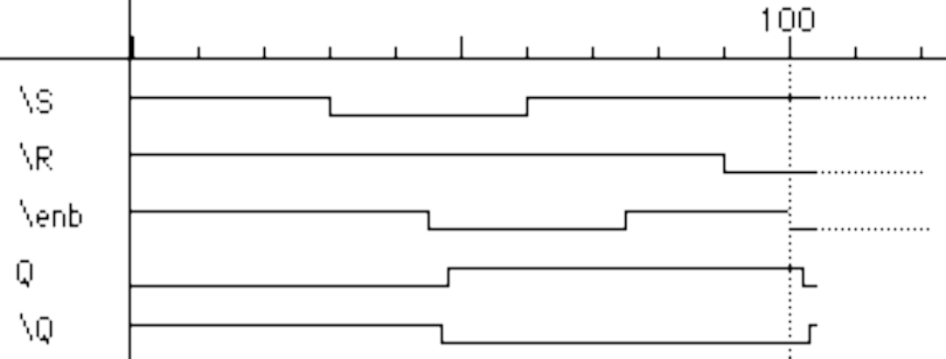
Gated R-S latch
Control when R and S inputs matter
  otherwise, the slightest glitch on R or S while enable is low could cause
  change in value stored
R'
R
Q
enable'
Q'
S'
S
Set
Reset
100
S'
R'
enable'
Q
Q'

Slide 13
Clocks
Used to keep time
  wait long enough for inputs (R' and S') to settle
  then allow to have effect on value stored
Clocks are regular periodic signals
  period (time between ticks)
  duty-cycle (time clock is high between ticks - expressed as % of period)
duty cycle (in this case, 50%)
period

Slide 14
Clocks (cont’d)
Controlling an R-S latch with a clock
  can't let R and S change while clock is active (allowing R and S to pass)
  only have half of clock period for signal changes to propagate
  signals must be stable for the other half of clock period
R’
R
Q
clock’
Q’
S’
S
stable
changing
stable
changing
stable
R’ and S’
clock’

Slide 15
Cascading latches
Connect output of one latch to input of another
How to stop changes from racing through chain?
  need to be able to control flow of data from one latch to the next
  move one latch per clock period
  have to worry about logic between latches (arrows) that is too fast
R
R
Q’
R
Q’
S
S
Q
S
Q
clock

Slide 16
Master-slave structure
Break flow by alternating clocks (like an air-lock)
  use positive clock to latch inputs into one R-S latch
  use negative clock to change outputs with another R-S latch
View pair as one basic unit
  master-slave flip-flop
  twice as much logic
  output changes a few gate delays after the falling edge of clock but does not affect any cascaded flip-flops
master stage
slave stage
R
P’
R
Q’
R
Q’
S
S
Q
S
Q
P
CLK

Slide 17
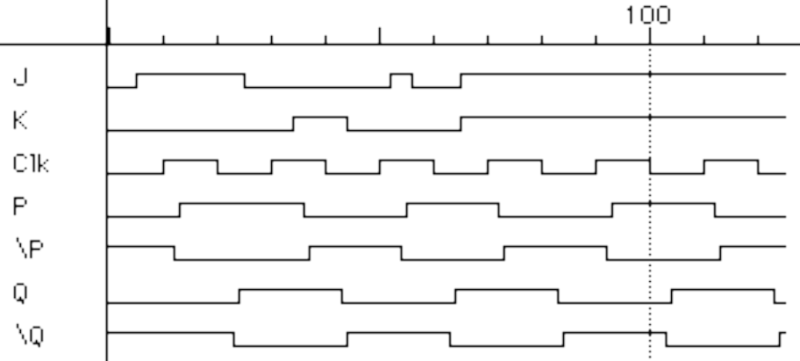
The 1s catching problem
In first R-S stage of master-slave FF
  0-1-0 glitch on R or S while clock is high is "caught" by master stage
  leads to constraints on logic to be hazard-free
master stage
slave stage
R
R
Q’
P’
R
Q’
S
S
Q
P
S
Q
1s
catch
Set
Reset
CLK
S
R
CLK
P
P’
Q
Q’
Master
Outputs
Slave
Outputs

Slide 18
D flip-flop
Make S and R complements of each other
  eliminates 1s catching problem
  can't just hold previous value
  (must have new value ready every clock period)
  value of D just before clock goes low is what is stored in flip-flop
  can make R-S flip-flop by adding logic to make D = S + R’ Q
master stage
slave stage
P’
Q’
R
Q’
R
Q’
D
S
Q
S
Q
Q
P
CLK
10 gates

Slide 19
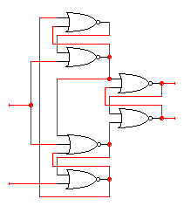

Edge-triggered flip-flops
More efficient solution: only 6 gates
  sensitive to inputs only near edge of clock signal (not while high)
D’
D
holds D’ when
clock goes low
negative edge-triggered D
flip-flop (D-FF)
4-5 gate delays
must respect setup and hold time
constraints to successfully
capture input
0
R
Q
Clk=1
Q’
S
0
holds D when
clock goes low
characteristic equation
Q(t+1) = D
D
D’

Slide 20
Edge-triggered flip-flops (cont’d)
Step-by-step analysis
D’
D
D’
D
D’
D’
R
R
Q
Q
Clk=0
Clk=0
S
S
D
D
D
D’
new D
D’
new D ≠ old D
when clock goes high-to-low
data is latched
when clock is low
data is held

Slide 21
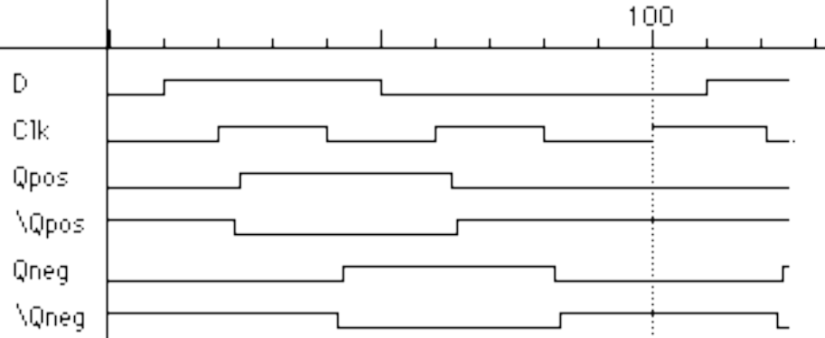
Edge-triggered flip-flops (cont’d)
Positive edge-triggered
  inputs sampled on rising edge; outputs change after rising edge
Negative edge-triggered flip-flops
  inputs sampled on falling edge; outputs change after falling edge
100
D
CLK
Qpos
Qpos’
Qneg
Qneg’
positive edge-triggered FF
negative edge-triggered FF

Slide 22
Timing methodologies
Rules for interconnecting components and clocks
  guarantee proper operation of system when strictly followed
Approach depends on building blocks used for memory elements
  we'll focus on systems with edge-triggered flip-flops
    found in programmable logic devices
  many custom integrated circuits focus on level-sensitive latches
Basic rules for correct timing:
  (1) correct inputs, with respect to time, are provided to the flip-flops
  (2) no flip-flop changes state more than once per clocking event

Slide 23
Timing methodologies (cont’d)
Definition of terms
  clock: periodic event, causes state of memory element to change
  can be rising edge or falling edge or high level or low level
  setup time: minimum time before the clocking event by which the
  input must be stable (Tsu)
  hold time: minimum time after the clocking event until which the
  input must remain stable (Th)
T_{su}
T_{h}
data
D
Q
D
Q
input
clock
clock
there is a timing "window"
around the clocking event
during which the input must
remain stable and unchanged
in order to be recognized
stable
changing
data
clock

Slide 24
Comparison of latches and flip-flops
D Q
CLK
D
CLK
Qedge
Qlatch
positive
edge-triggered
flip-flop
D Q
G
CLK
transparent
(level-sensitive)
latch
behavior is the same unless input changes
while the clock is high

Slide 25
Comparison of latches and flip-flops (cont’d)
Type When inputs are sampled When output is valid
unclocked always propagation delay from input change
latch
level-sensitive clock high propagation delay from input change
latch (Tsu/Th around falling or clock edge (whichever is later)
edge of clock)
master-slave clock high propagation delay from falling edge
flip-flop (Tsu/Th around falling of clock
edge of clock)
negative clock hi-to-lo transition propagation delay from falling edge
edge-triggered (Tsu/Th around falling of clock
flip-flop edge of clock)

Slide 26
Typical timing specifications
Positive edge-triggered D flip-flop
  setup and hold times
  minimum clock width
  propagation delays (low to high, high to low, max and typical)
T
su
T
h
T
T
1.8
0.5
su
h
ns
ns
1.8
0.5
D
ns
ns
T
w
T
w
3.3
3.3
Clk
ns
ns
T
pd
T
3.6 ns
Q
pd
1.1 ns
3.6 ns
1.1 ns
all measurements are made from the clocking event (the rising edge of the clock)

Slide 27
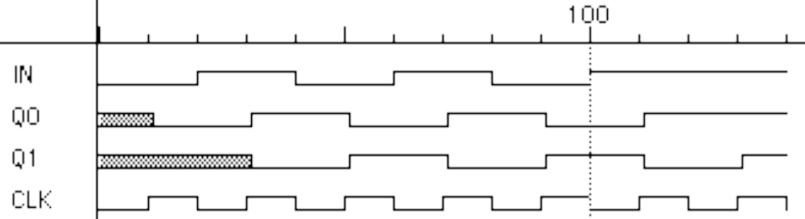
Cascading edge-triggered flip-flops
Shift register
  new value goes into first stage
  while previous value of first stage goes into second stage
  consider setup/hold/propagation delays (prop must be > hold)
Q0
Q1
IN
D
Q
D
Q
OUT
CLK
100
IN
Q0
Q1
CLK

Slide 28
Cascading edge-triggered flip-flops (cont’d)
Why this works
  propagation delays exceed hold times
  clock width constraint exceeds setup time
  this guarantees following stage will latch current value before it changes to new value
In
Q0
Q1
CLK
T_{su}
1.8ns
T_{su}
1.8ns
timing constraints
guarantee proper
operation of
cascaded components
T_{p}
1.1-3.6ns
T_{p}
1.1-3.6ns
assumes infinitely fast
distribution of the clock
T_{h}
0.5ns
T_{h}
0.5ns

Slide 29
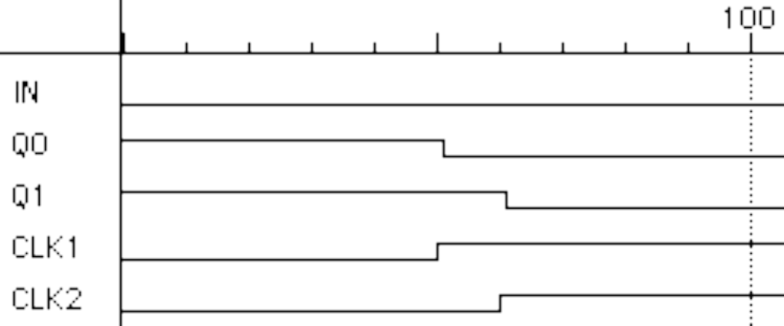
Clock skew
The problem
  correct behavior assumes next state of all storage elements
  determined by all storage elements at the same time
  this is difficult in high-performance systems because time for clock
  to arrive at flip-flop is comparable to delays through logic
  effect of skew on cascaded flip-flops:
100
In
Q0
Q1
CLK0
CLK1
CLK1 is a delayed
version of CLK0
original state: IN = 0, Q0 = 1, Q1 = 1
due to skew, next state becomes: Q0 = 0, Q1 = 0, and not Q0 = 0, Q1 = 1

Slide 30
Summary of latches and flip-flops
Development of D-FF
  level-sensitive used in custom integrated circuits
    can be made with 4 switches
  edge-triggered used in programmable logic devices
  good choice for data storage register
Historically J-K FF was popular but now never used
  similar to R-S but with 1-1 being used to toggle output (complement state)
  good in days of TTL/SSI (more complex input function: D = J Q’ + K’ Q
  not a good choice for PALs/PLAs as it requires 2 inputs
  can always be implemented using D-FF
Preset and clear inputs are highly desirable on flip-flops
  used at start-up or to reset system to a known state

Slide 31
Metastability and asynchronous inputs
Clocked synchronous circuits
  inputs, state, and outputs sampled or changed in relation to a
  common reference signal (called the clock)
  e.g., master/slave, edge-triggered
Asynchronous circuits
  inputs, state, and outputs sampled or changed independently of a
  common reference signal (glitches/hazards a major concern)
  e.g., R-S latch
Asynchronous inputs to synchronous circuits
  inputs can change at any time, will not meet setup/hold times
  dangerous, synchronous inputs are greatly preferred
  cannot be avoided (e.g., reset signal, memory wait, user input)

Slide 32
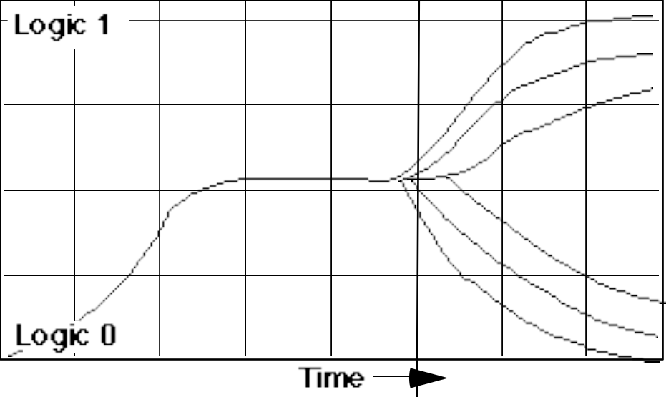
Synchronization failure
Occurs when FF input changes close to clock edge
  the FF may enter a metastable state – neither a logic 0 nor 1 –
  it may stay in this state an indefinite amount of time
  this is not likely in practice but has some probability
logic 1
logic 0
logic 1
logic 0
small, but non-zero probability
that the FF output will get stuck
in an in-between state
oscilloscope traces demonstrating
synchronizer failure and eventual
decay to steady state

Slide 33
Dealing with synchronization failure
Probability of failure can never be reduced to 0, but it can be reduced
  (1) slow down the system clock
  this gives the synchronizer more time to decay into a steady state;
  synchronizer failure becomes a big problem for very high speed systems
  (2) use fastest possible logic technology in the synchronizer
  this makes for a very sharp "peak" upon which to balance
  (3) cascade two synchronizers
  this effectively synchronizes twice (both would have to fail)
asynchronous
input
D
Q
Q
synchronized
input
D
Clk
synchronous system

Slide 34
Handling asynchronous inputs
Never allow asynchronous inputs to fan-out to more than one flip-flop
  synchronize as soon as possible and then treat as synchronous signal
Clocked
Synchronizer
Synchronous
System
Async
Q0
Async
D
Q
D
Q
Q0
Input
D
Q
Input
Clock
Clock
D
Q
Q1
D
Q
Q1
Clock
Clock

Slide 35
Handling asynchronous inputs (cont’d)
What can go wrong?
  input changes too close to clock edge (violating setup time constraint)
In
Q0
Q1
CLK
In is asynchronous and
fans out to D0 and D1
one FF catches the
signal, one does not
inconsistent state may
be reached!

Slide 36
Flip-flop features
Reset (set state to 0) – R
  synchronous: Dnew = R' • Dold (when next clock edge arrives)
  asynchronous: doesn't wait for clock, quick but dangerous
Preset or set (set state to 1) – S (or sometimes P)
  synchronous: Dnew = Dold + S (when next clock edge arrives)
  asynchronous: doesn't wait for clock, quick but dangerous
Both reset and preset
  Dnew = R' • Dold + S (set-dominant)
  Dnew = R' • Dold + R'S (reset-dominant)
Selective input capability (input enable or load) – LD or EN
  multiplexor at input: Dnew = LD' • Q + LD • Dold
  load may or may not override reset/set (usually R/S have priority)
Complementary outputs – Q and Q'

Slide 37
Registers
Collections of flip-flops with similar controls and logic
  stored values somehow related (for example, form binary value)
  share clock, reset, and set lines
  similar logic at each stage
Examples
  shift registers
  counters
OUT1
OUT2
OUT3
OUT4
"0"
R
S
R
S
R
S
R
S
D
Q
D
Q
D
Q
D
Q
CLK
IN1
IN2
IN3
IN4

Slide 38
Shift register
Holds samples of input
  store last 4 input values in sequence
  4-bit shift register:
OUT1
OUT2
OUT3
OUT4
IN
D
Q
D
Q
D
Q
D
Q
CLK

Slide 39
Universal shift register
Holds 4 values
  serial or parallel inputs
  serial or parallel outputs
  permits shift left or right
  shift in new values from left or right
output
clear sets the register contents
and output to 0
s1 and s0 determine the shift function
s0 s1 function
0 0 hold state
0 1 shift right
1 0 shift left
1 1 load new input
left_in
right_out
left_out
right_in
clear
s0
clock
s1
input

Slide 40
Design of universal shift register
clear s0 s1 new value
1 – – 0
0 0 0 output
0 0 1 output value of FF to left (shift right)
0 1 0 output value of FF to right (shift left)
0 1 1 input
Consider one of the four flip-flops
  new value at next clock cycle:
Nth cell
to N-1th
cell
to N+1th
cell
Q
D
CLK
CLEAR
0
1
2
3
s0 and s1
control mux
Q[N-1]
(left)
Q[N+1]
(right)
Input[N]

Slide 41
Shift register application
Parallel-to-serial conversion for serial transmission
parallel outputs
parallel inputs
serial transmission

Slide 42
Pattern recognizer
Combinational function of input samples
  in this case, recognizing the pattern 1001 on the single input signal
OUT
OUT1
OUT2
OUT3
OUT4
IN
D
Q
D
Q
D
Q
D
Q
CLK

Slide 43
Counters
Sequences through a fixed set of patterns
  in this case, 1000, 0100, 0010, 0001
  if one of the patterns is its initial state (by loading or set/reset)
OUT1
OUT2
OUT3
OUT4
IN
D
Q
D
Q
D
Q
D
Q
CLK

Slide 44
Activity
How does this counter work?
OUT1
OUT2
OUT3
OUT4
IN
D
Q
D
Q
D
Q
D
Q
CLK
Counts through the sequence: 1000, 1100, 1110, 1111, 0111, 0011, 0001, 0000
Known as Mobius (or Johnson) counter

Slide 45
Binary counter
Logic between registers (not just multiplexer)
  XOR decides when bit should be toggled
  always for low-order bit,
  only when first bit is true for second bit,
  and so on
OUT1
OUT2
OUT3
OUT4
D
Q
D
Q
D
Q
D
Q
CLK
"1"

Slide 46
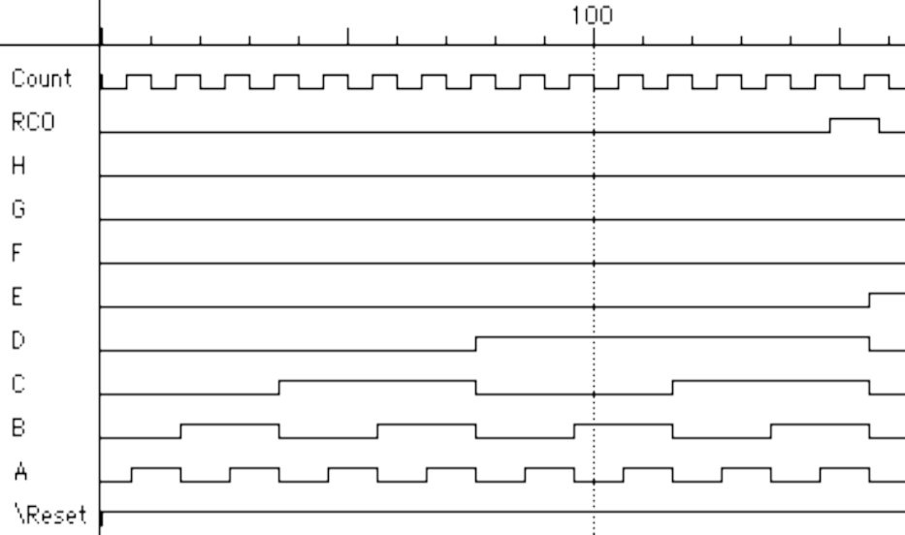
Four-bit binary synchronous up-counter
Standard component with many applications
  positive edge-triggered FFs w/ synchronous load and clear inputs
  parallel load data from D, C, B, A
  enable inputs: must be asserted to enable counting
  RCO: ripple-carry out used for cascading counters
    high when counter is in its highest state 1111
    implemented using an AND gate
EN
D
C
B
A
LOAD
CLK
CLR
RCO
QD
QC
QB
QA
(2) RCO goes high
(3) High order 4-bits
are incremented
(1) Low order 4-bits = 1111

Slide 47
Offset counters
Starting offset counters – use of synchronous load
  e.g., 0110, 0111, 1000, 1001,
  1010, 1011, 1100, 1101, 1111, 0110, . . .
Ending offset counter – comparator for ending value
  e.g., 0000, 0001, 0010, ..., 1100, 1101, 0000
Combinations of the above (start and stop value)
"1"
"0"
"1"
"1"
"0"
EN
D
C
B
A
LOAD
CLK
CLR
RCO
QD
QC
QB
QA
"0"
"1"
"0"
"0"
"0"
"0"
EN
D
C
B
A
LOAD
CLK
CLR
RCO
QD
QC
QB
QA

Slide 48
Hardware Description Languages and Sequential Logic
Flip-flops
  representation of clocks - timing of state changes
  asynchronous vs. synchronous
Shift registers
Simple counters

Slide 49
Flip-flop in Verilog
Use always block's sensitivity list to wait for clock edge
module dff (clk, d, q);
input clk, d;
output q;
reg q;
always @(posedge clk)
q = d;
endmodule

Slide 50
More Flip-flops
Synchronous/asynchronous reset/set
  single thread that waits for the clock
  three parallel threads – only one of which waits for the clock
Synchronous
Asynchronous
module dff (clk, s, r, d, q);
input clk, s, r, d;
output q;
reg q;
always @(posedge clk)
if (r) q = 1'b0;
else if (s) q = 1'b1;
else q = d;
endmodule
module dff (clk, s, r, d, q);
input clk, s, r, d;
output q;
reg q;
always @(posedge r)
q = 1'b0;
always @(posedge s)
q = 1'b1;
always @(posedge clk)
q = d;
endmodule

Slide 51
Incorrect Flip-flop in Verilog
Use always block's sensitivity list to wait for clock to change
module dff (clk, d, q);
input clk, d;
output q;
reg q;
always @(clk)
q = d;
endmodule
Not correct! Q will
change whenever the
clock changes, not
just on an edge.

Slide 52
Blocking and Non-Blocking Assignments
Blocking assignments (X=A)
  completes the assignment before continuing on to next statement
Non-blocking assignments (X<=A)
  completes in zero time and doesn’t change the value of the target until a blocking point (delay/wait) is encountered
Example: swap
always @(posedge CLK)
begin
temp = B;
B = A;
A = temp;
end
always @(posedge CLK)
begin
A <= B;
B <= A;
end

Slide 53
Register-transfer-level (RTL) Assignment
Non-blocking assignment is also known as an RTL assignment
  if used in an always block triggered by a clock edge
  all flip-flops change together
// B,C,D all get the value of A
always @(posedge clk)
begin
B = A;
C = B;
D = C;
end
// implements a shift register too
always @(posedge clk)
begin
B <= A;
C <= B;
D <= C;
end

Slide 54
Mobius Counter in Verilog
initial
begin
A = 1’b0;
B = 1’b0;
C = 1’b0;
D = 1’b0;
end
always @(posedge clk)
begin
A <= ~D;
B <= A;
C <= B;
D <= C;
end

Slide 55
Binary Counter in Verilog
module binary_counter (clk, c8, c4, c2, c1);
input clk;
output c8, c4, c2, c1;
reg [3:0] count;
initial begin
count = 0;
end
always @(posedge clk) begin
count = count + 4’b0001;
end
assign c8 = count[3];
assign c4 = count[2];
assign c2 = count[1];
assign c1 = count[0];
endmodule
module binary_counter (clk, c8, c4, c2, c1, rco);
input clk;
output c8, c4, c2, c1, rco;
reg [3:0] count;
reg rco;
initial begin . . . end
always @(posedge clk) begin . . . end
assign c8 = count[3];
assign c4 = count[2];
assign c2 = count[1];
assign c1 = count[0];
assign rco = (count == 4b’1111);
endmodule

Slide 56
Sequential logic summary
Fundamental building block of circuits with state
  latch and flip-flop
  R-S latch, R-S master/slave, D master/slave, edge-triggered D flip-flop
Timing methodologies
  use of clocks
  cascaded FFs work because propagation delays exceed hold times
  beware of clock skew
Asynchronous inputs and their dangers
  synchronizer failure: what it is and how to minimize its impact
Basic registers
  shift registers
  counters
Hardware description languages and sequential logic

