Slide 1
Combinational logic
Basic logic
  Boolean algebra, proofs by re-writing, proofs by perfect induction
  logic functions, truth tables, and switches
  NOT, AND, OR, NAND, NOR, XOR, . . ., minimal set
Logic realization
  two-level logic and canonical forms
  incompletely specified functions
Simplification
  uniting theorem
  grouping of terms in Boolean functions
Alternate representations of Boolean functions
  cubes
  Karnaugh maps

Slide 2
Possible logic functions of two variables
There are 16 possible functions of 2 input variables:
  in general, there are 2**(2**n) functions of n inputs
X
F
Y
        X Y 16 possible functions (F0–F15)
        0 0 0 0 0 0 0 0 0 0 1 1 1 1 1 1 1 1
        0 1 0 0 0 0 1 1 1 1 0 0 0 0 1 1 1 1
        1 0 0 0 1 1 0 0 1 1 0 0 1 1 0 0 1 1
        1 1 0 1 0 1 0 1 0 1 0 1 0 1 0 1 0 1
0
X
Y
not Y
not X
1
X and Y
X xor Y
X = Y
X nand Y
not (X and Y)
X or Y
X nor Y
not (X or Y)

Slide 3
Cost of different logic functions
Different functions are easier or harder to implement
  each has a cost associated with the number of switches needed
  0 (F0) and 1 (F15): require 0 switches, directly connect output to low/high
  X (F3) and Y (F5): require 0 switches, output is one of inputs
  X’ (F12) and Y’ (F10): require 2 switches for "inverter" or NOT-gate
  X nor Y (F4) and X nand Y (F14): require 4 switches
  X or Y (F7) and X and Y (F1): require 6 switches
  X = Y (F9) and X ⊕ Y (F6): require 16 switches
  thus, because NOT, NOR, and NAND are the cheapest they are the functions we implement the most in practice

Slide 4
Minimal set of functions
Can we implement all logic functions from NOT, NOR, and NAND?
  For example, implementing X and Y
  is the same as implementing not (X nand Y)
In fact, we can do it with only NOR or only NAND
  NOT is just a NAND or a NOR with both inputs tied together
  and NAND and NOR are "duals",
  that is, its easy to implement one using the other
But lets not move too fast . . .
  lets look at the mathematical foundation of logic
X Y X nor Y
0 0 1
1 1 0
X Y X nand Y
0 0 1
1 1 0
X nand Y ≡ not ( (not X) nor (not Y) )
X nor Y ≡ not ( (not X) nand (not Y) )

Slide 5
An algebraic structure
An algebraic structure consists of
  a set of elements B
  binary operations { + , • }
  and a unary operation { ’ }
  such that the following axioms hold:
1. the set B contains at least two elements: a, b
2. closure: a + b is in B a • b is in B
3. commutativity: a + b = b + a a • b = b • a
4. associativity: a + (b + c) = (a + b) + c a • (b • c) = (a • b) • c
5. identity: a + 0 = a a • 1 = a
6. distributivity: a + (b • c) = (a + b) • (a + c) a • (b + c) = (a • b) + (a • c)
7. complementarity: a + a’ = 1 a • a’ = 0

Slide 6
Boolean algebra
Boolean algebra
  B = {0, 1}
  variables
  + is logical OR, • is logical AND
  ’ is logical NOT
All algebraic axioms hold

Slide 7
Logic functions and Boolean algebra
Any logic function that can be expressed as a truth table can be written as an expression in Boolean algebra using the operators: ’, +, and •
X Y X • Y
0 0 0
0 1 0
1 0 0
1 1 1
X Y X’ X’ • Y
0 0 1 0
0 1 1 1
1 0 0 0
1 1 0 0
X Y X’ Y’ X • Y X’ • Y’ ( X • Y ) + ( X’ • Y’ )
0 0 1 1 0 1 1
0 1 1 0 0 0 0
1 0 0 1 0 0 0
1 1 0 0 1 0 1
( X • Y ) + ( X’ • Y’ ) ≡ X = Y
Boolean expression that is
true when the variables X
and Y have the same value
and false, otherwise
X, Y are Boolean algebra variables

Slide 8
Axioms and theorems of Boolean algebra
identity
1. X + 0 = X 1D. X • 1 = X
null
2. X + 1 = 1 2D. X • 0 = 0
idempotency:
3. X + X = X 3D. X • X = X
involution:
4. (X’)’ = X
complementarity:
5. X + X’ = 1 5D. X • X’ = 0
commutativity:
6. X + Y = Y + X 6D. X • Y = Y • X
associativity:
7. (X + Y) + Z = X + (Y + Z) 7D. (X • Y) • Z = X • (Y • Z)

Slide 9
Axioms and theorems of Boolean algebra (cont’d)
distributivity:
8. X • (Y + Z) = (X • Y) + (X • Z) 8D. X + (Y • Z) = (X + Y) • (X + Z)
uniting:
9. X • Y + X • Y’ = X 9D. (X + Y) • (X + Y’) = X
absorption:
10. X + X • Y = X 10D. X • (X + Y) = X
11. (X + Y’) • Y = X • Y 11D. (X • Y’) + Y = X + Y
factoring:
12. (X + Y) • (X’ + Z) = 12D. X • Y + X’ • Z =
X • Z + X’ • Y (X + Z) • (X’ + Y)
concensus:
13. (X • Y) + (Y • Z) + (X’ • Z) = 13D. (X + Y) • (Y + Z) • (X’ + Z) =
X • Y + X’ • Z (X + Y) • (X’ + Z)

Slide 10
Axioms and theorems of Boolean algebra (cont’d)
de Morgan’s:
14. (X + Y + ...)’ = X’ • Y’ • ... 14D. (X • Y • ...)’ = X’ + Y’ + ...
generalized de Morgan’s:
15. f’(X₁,X₂,...,X_{n},0,1,+,•) = f(X₁’,X₂’,...,X_{n}’,1,0,•,+)
establishes relationship between • and +

Slide 11
Axioms and theorems of Boolean algebra (cont’d)
Duality
  a dual of a Boolean expression is derived by replacing
  • by +, + by •, 0 by 1, and 1 by 0, and leaving variables unchanged
  any theorem that can be proven is thus also proven for its dual!
  a meta-theorem (a theorem about theorems)
duality:
16. X + Y + ... ⇔ X • Y • ...
generalized duality:
17. f (X₁,X₂,...,X_{n},0,1,+,•) ⇔ f(X₁,X₂,...,X_{n},1,0,•,+)
Different than deMorgan’s Law
  this is a statement about theorems
  this is not a way to manipulate (re-write) expressions

Slide 12
Proving theorems (rewriting)
Using the axioms of Boolean algebra:
  e.g., prove the theorem: X • Y + X • Y’ = X
  e.g., prove the theorem: X + X • Y = X
distributivity (8) X • Y + X • Y’ = X • (Y + Y’)
complementarity (5) X • (Y + Y’) = X • (1)
identity (1D) X • (1) = X ✓
identity (1D) X + X • Y = X • 1 + X • Y
distributivity (8) X • 1 + X • Y = X • (1 + Y)
identity (2) X • (1 + Y) = X • (1)
identity (1D) X • (1) = X ✓

Slide 13
Activity
Prove the following using the laws of Boolean algebra:
  (X • Y) + (Y • Z) + (X’ • Z) = X • Y + X’ • Z
(X • Y) + (Y • Z) + (X’ • Z)
identity (X • Y) + (1) • (Y • Z) + (X’ • Z)
complementarity (X • Y) + (X’ + X) • (Y • Z) + (X’ • Z)
distributivity (X • Y) + (X’ • Y • Z) + (X • Y • Z) + (X’ • Z)
commutativity (X • Y) + (X • Y • Z) + (X’ • Y • Z) + (X’ • Z)
factoring (X • Y) • (1 + Z) + (X’ • Z) • (1 + Y)
null (X • Y) • (1) + (X’ • Z) • (1)
identity (X • Y) + (X’ • Z) ✓

Slide 14
Proving theorems (perfect induction)
Using perfect induction (complete truth table):
  e.g., de Morgan’s:
(X + Y)’ = X’ • Y’
NOR is equivalent to AND
with inputs complemented
X Y X’ Y’ (X + Y)’ X’ • Y’
0 0 1 1
0 1 1 0
1 0 0 1
1 1 0 0
1
0
0
0
1
0
0
0
(X • Y)’ = X’ + Y’
NAND is equivalent to OR
with inputs complemented
X Y X’ Y’ (X • Y)’ X’ + Y’
0 0 1 1
0 1 1 0
1 0 0 1
1 1 0 0
1
1
1
0
1
1
1
0

Slide 15
A simple example: 1-bit binary adder
Cout
Cin
Inputs: A, B, Carry-in
Outputs: Sum, Carry-out
A A A A A
B B B B B
S S S S S
A
S
A B Cin Cout S
0 0 0
0 0 1
0 1 0
0 1 1
1 0 0
1 0 1
1 1 0
1 1 1
B
0
0
0
1
0
1
1
1
Cout
0
1
1
0
1
0
0
1
Cin
S = A’ B’ Cin + A’ B Cin’ + A B’ Cin’ + A B Cin
Cout = A’ B Cin + A B’ Cin + A B Cin’ + A B Cin

Slide 16
Apply the theorems to simplify expressions
The theorems of Boolean algebra can simplify Boolean expressions
  e.g., full adder’s carry-out function (same rules apply to any function)
Cout = A’ B Cin + A B’ Cin + A B Cin’ + A B Cin
= A’ B Cin + A B’ Cin + A B Cin’ + A B Cin + A B Cin
= A’ B Cin + A B Cin + A B’ Cin + A B Cin’ + A B Cin
= (A’ + A) B Cin + A B’ Cin + A B Cin’ + A B Cin
= (1) B Cin + A B’ Cin + A B Cin’ + A B Cin
= B Cin + A B’ Cin + A B Cin’ + A B Cin + A B Cin
= B Cin + A B’ Cin + A B Cin + A B Cin’ + A B Cin
= B Cin + A (B’ + B) Cin + A B Cin’ + A B Cin
= B Cin + A (1) Cin + A B Cin’ + A B Cin
= B Cin + A Cin + A B (Cin’ + Cin)
= B Cin + A Cin + A B (1)
= B Cin + A Cin + A B
adding extra terms creates new factoring opportunities

Slide 17
Activity
Fill in the truth-table for a circuit that checks that a 4-bit number is divisible by 2, 3, or 5
Write down Boolean expressions for By2, By3, and By5
X8 X4 X2 X1 By2 By3 By5
0 0 0 0 1 1 1
0 0 0 1 0 0 0
0 0 1 0 1 0 0
0 0 1 1 0 1 0

Slide 18
Activity
X8 X4 X2 X1 By2 By3 By5
0 0 0 0 1 1 1
0 0 0 1 0 0 0
0 0 1 0 1 0 0
0 0 1 1 0 1 0
0 1 0 0 1 0 0
0 1 0 1 0 0 1
0 1 1 0 1 1 0
0 1 1 1 0 0 0
1 0 0 0 1 0 0
1 0 0 1 0 1 0
1 0 1 0 1 0 1
1 0 1 1 0 0 0
1 1 0 0 1 1 0
1 1 0 1 0 0 0
1 1 1 0 1 0 0
1 1 1 1 0 1 1
By2 = X8’X4’X2’X1’ + X8’X4’X2X1’
+ X8’X4X2’X1’ + X8’X4X2X1’
+ X8X4’X2’X1’ + X8X4’X2X1’
+ X8X4X2’X1’ + X8X4X2X1’
= X1’
By3 = X8’X4’X2’X1’ + X8’X4’X2X1
+ X8’X4X2X1’ + X8X4’X2’X1
+ X8X4X2’X1’ + X8X4X2X1
By5 = X8’X4’X2’X1’ + X8’X4X2’X1
+ X8X4’X2X1’ + X8X4X2X1

Slide 19

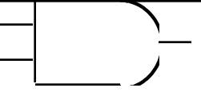

From Boolean expressions to logic gates
X Y
0 1
1 0
NOT X’ X ~X
AND X • Y XY X ∧ Y
OR X + Y X ∨ Y
X
Y
X Y Z
0 0 0
0 1 0
1 0 0
1 1 1
X
Y
Z
X Y Z
0 0 0
0 1 1
1 0 1
1 1 1
X
Z
Y

Slide 20
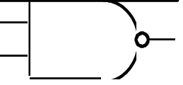
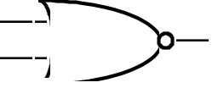


From Boolean expressions to logic gates (cont’d)
X Y Z
0 0 1
0 1 1
1 0 1
1 1 0
X
NAND
NOR
XOR
X ⊕ Y
XNOR
X = Y
Y
Z
X Y Z
0 0 1
0 1 0
1 0 0
1 1 0
X
Z
Y
X Y Z
0 0 0
0 1 1
1 0 1
1 1 0
X xor Y = X Y’ + X’ Y
X or Y but not both
("inequality", "difference")
X
Y
Z
X Y Z
0 0 1
0 1 0
1 0 0
1 1 1
X xnor Y = X Y + X’ Y’
X and Y are the same
("equality", "coincidence")
X
Y
Z

Slide 21
From Boolean expressions to logic gates (cont’d)
More than one way to map expressions to gates
  e.g., Z = A’ • B’ • (C + D) = (A’ • (B’ • (C + D)))
T2
T1
use of 3-input gate
A
Z
A
B
T1
B
Z
C
T2
C
D
D

Slide 22
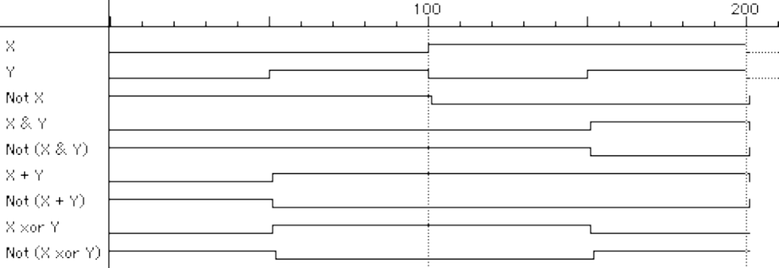
Waveform view of logic functions
Just a sideways truth table
  but note how edges don’t line up exactly
  it takes time for a gate to switch its output!
time
change in Y takes time to "propagate" through gates

Slide 23
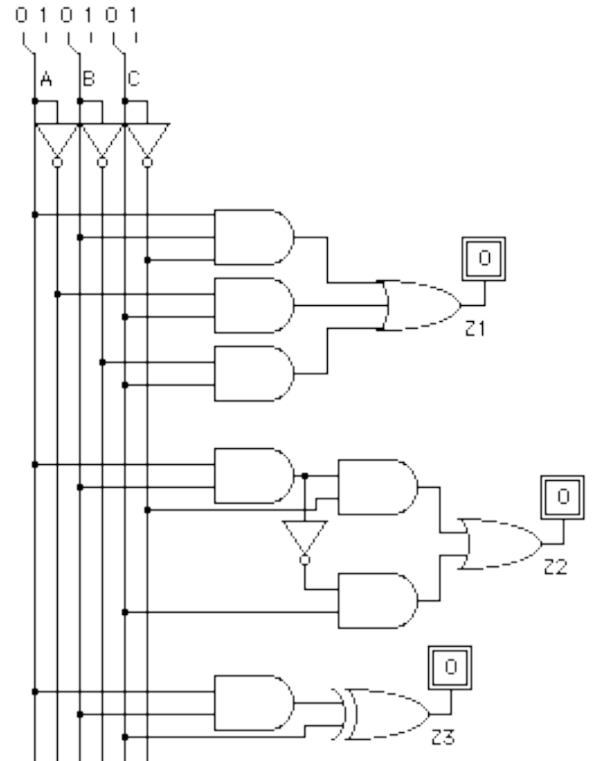
Choosing different realizations of a function
A B C Z
0 0 0 0
0 0 1 1
0 1 0 0
0 1 1 1
1 0 0 0
1 0 1 1
1 1 0 1
1 1 1 0
two-level realization
(we don’t count NOT gates)
multi-level realization
(gates with fewer inputs)
XOR gate (easier to draw
but costlier to build)

Slide 24
Which realization is best?
Reduce number of inputs
  literal: input variable (complemented or not)
    can approximate cost of logic gate as 2 transitors per literal
    why not count inverters?
  fewer literals means less transistors
    smaller circuits
  fewer inputs implies faster gates
    gates are smaller and thus also faster
  fan-ins (# of gate inputs) are limited in some technologies
Reduce number of gates
  fewer gates (and the packages they come in) means smaller circuits
    directly influences manufacturing costs

Slide 25
Which is the best realization? (cont’d)
Reduce number of levels of gates
  fewer level of gates implies reduced signal propagation delays
  minimum delay configuration typically requires more gates
    wider, less deep circuits
How do we explore tradeoffs between increased circuit delay and size?
  automated tools to generate different solutions
  logic minimization: reduce number of gates and complexity
  logic optimization: reduction while trading off against delay

Slide 26
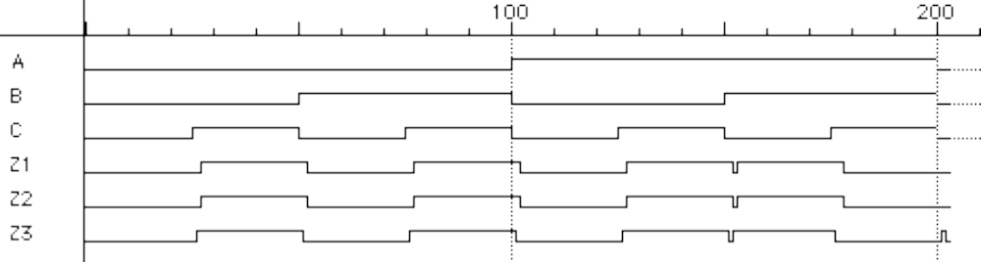
Are all realizations equivalent?
Under the same input stimuli, the three alternative implementations have
almost the same waveform behavior
  delays are different
  glitches (hazards) may arise – these could be bad, it depends
  variations due to differences in number of gate levels and structure
The three implementations are functionally equivalent

Slide 27
Implementing Boolean functions
Technology independent
  canonical forms
  two-level forms
  multi-level forms
Technology choices
  packages of a few gates
  regular logic
  two-level programmable logic
  multi-level programmable logic

Slide 28
Canonical forms
Truth table is the unique signature of a Boolean function
The same truth table can have many gate realizations
Canonical forms
  standard forms for a Boolean expression
  provides a unique algebraic signature

Slide 29
Sum-of-products canonical forms
Also known as disjunctive normal form
Also known as minterm expansion
F = 001 011 101 110 111
+ A’BC
+ AB’C
+ ABC’
F =
A’B’C
+ ABC
A B C F F’
0 0 0 0 1
0 0 1 1 0
0 1 0 0 1
0 1 1 1 0
1 0 0 0 1
1 0 1 1 0
1 1 0 1 0
1 1 1 1 0
F’ = A’B’C’ + A’BC’ + AB’C’

Slide 30
Sum-of-products canonical form (cont’d)
Product term (or minterm)
  ANDed product of literals – input combination for which output is true
  each variable appears exactly once, true or inverted (but not both)
A B C minterms
0 0 0 A’B’C’ m0
0 0 1 A’B’C m1
0 1 0 A’BC’ m2
0 1 1 A’BC m3
1 0 0 AB’C’ m4
1 0 1 AB’C m5
1 1 0 ABC’ m6
1 1 1 ABC m7
F in canonical form:
F(A, B, C) = Σm(1,3,5,6,7)
= m1 + m3 + m5 + m6 + m7
= A’B’C + A’BC + AB’C + ABC’ + ABC
canonical form ≠ minimal form
F(A, B, C) = A’B’C + A’BC + AB’C + ABC + ABC’
      = (A’B’ + A’B + AB’ + AB)C + ABC’
      = ((A’ + A)(B’ + B))C + ABC’
      = C + ABC’
      = ABC’ + C
= AB + C
short-hand notation for
minterms of 3 variables

Slide 31
Product-of-sums canonical form
Also known as conjunctive normal form
Also known as maxterm expansion
F = 000 010 100
F =
(A + B + C)
(A + B’ + C)
(A’ + B + C)
A B C F F’
0 0 0 0 1
0 0 1 1 0
0 1 0 0 1
0 1 1 1 0
1 0 0 0 1
1 0 1 1 0
1 1 0 1 0
1 1 1 1 0
F’ = (A + B + C’) (A + B’ + C’) (A’ + B + C’) (A’ + B’ + C) (A’ + B’ + C’)

Slide 32
Product-of-sums canonical form (cont’d)
Sum term (or maxterm)
  ORed sum of literals – input combination for which output is false
  each variable appears exactly once, true or inverted (but not both)
A B C maxterms
0 0 0 A+B+C M0
0 0 1 A+B+C’ M1
0 1 0 A+B’+C M2
0 1 1 A+B’+C’ M3
1 0 0 A’+B+C M4
1 0 1 A’+B+C’ M5
1 1 0 A’+B’+C M6
1 1 1 A’+B’+C’ M7
F in canonical form:
F(A, B, C) = ΠM(0,2,4)
= M0 • M2 • M4
= (A + B + C) (A + B’ + C) (A’ + B + C)
canonical form ≠ minimal form
F(A, B, C) = (A + B + C) (A + B’ + C) (A’ + B + C)
      = (A + B + C) (A + B’ + C)
      (A + B + C) (A’ + B + C)
      = (A + C) (B + C)
short-hand notation for
maxterms of 3 variables

Slide 33
S-o-P, P-o-S, and de Morgan’s theorem
Sum-of-products
  F’ = A’B’C’ + A’BC’ + AB’C’
Apply de Morgan’s
  (F’)’ = (A’B’C’ + A’BC’ + AB’C’)’
  F = (A + B + C) (A + B’ + C) (A’ + B + C)
Product-of-sums
  F’ = (A + B + C’) (A + B’ + C’) (A’ + B + C’) (A’ + B’ + C) (A’ + B’ + C’)
Apply de Morgan’s
  (F’)’ = ( (A + B + C’)(A + B’ + C’)(A’ + B + C’)(A’ + B’ + C)(A’ + B’ + C’) )’
  F = A’B’C + A’BC + AB’C + ABC’ + ABC

Slide 34
Four alternative two-level implementations of F = AB + C
A
B
canonical sum-of-products
minimized sum-of-products
canonical product-of-sums
minimized product-of-sums
F1
C
F2
F3
F4

Slide 35
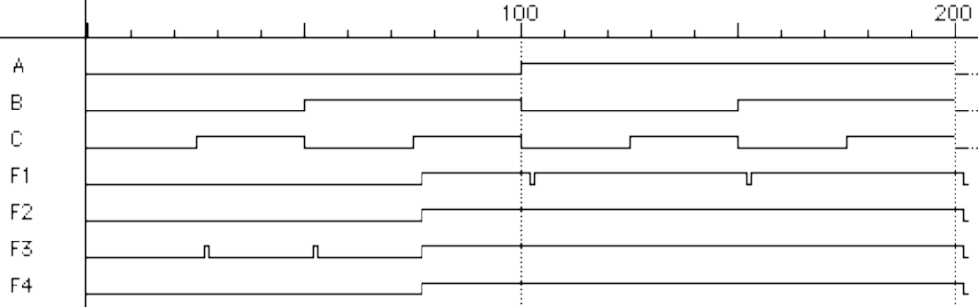
Waveforms for the four alternatives
Waveforms are essentially identical
  except for timing hazards (glitches)
  delays almost identical (modeled as a delay per level, not type of gate or number of inputs to gate)

Slide 36
Mapping between canonical forms
Minterm to maxterm conversion
  use maxterms whose indices do not appear in minterm expansion
  e.g., F(A,B,C) = Σm(1,3,5,6,7) = ΠM(0,2,4)
Maxterm to minterm conversion
  use minterms whose indices do not appear in maxterm expansion
  e.g., F(A,B,C) = ΠM(0,2,4) = Σm(1,3,5,6,7)
Minterm expansion of F to minterm expansion of F’
  use minterms whose indices do not appear
  e.g., F(A,B,C) = Σm(1,3,5,6,7) F’(A,B,C) = Σm(0,2,4)
Maxterm expansion of F to maxterm expansion of F’
  use maxterms whose indices do not appear
  e.g., F(A,B,C) = ΠM(0,2,4) F’(A,B,C) = ΠM(1,3,5,6,7)

Slide 37
Incompleteley specified functions
Example: binary coded decimal increment by 1
  BCD digits encode the decimal digits 0 – 9
  in the bit patterns 0000 – 1001
A B C D W X Y Z
0 0 0 0 0 0 0 1
0 0 0 1 0 0 1 0
0 0 1 0 0 0 1 1
0 0 1 1 0 1 0 0
0 1 0 0 0 1 0 1
0 1 0 1 0 1 1 0
0 1 1 0 0 1 1 1
0 1 1 1 1 0 0 0
1 0 0 0 1 0 0 1
1 0 0 1 0 0 0 0
1 0 1 0 X X X X
1 0 1 1 X X X X
1 1 0 0 X X X X
1 1 0 1 X X X X
1 1 1 0 X X X X
1 1 1 1 X X X X
off-set of W
on-set of W
don’t care (DC) set of W
these inputs patterns should
never be encountered in practice
– "don’t care" about associated
output values, can be exploited
in minimization

Slide 38
Notation for incompletely specified functions
Don’t cares and canonical forms
  so far, only represented on-set
  also represent don’t-care-set
  need two of the three sets (on-set, off-set, dc-set)
Canonical representations of the BCD increment by 1 function:
  Z = m0 + m2 + m4 + m6 + m8 + d10 + d11 + d12 + d13 + d14 + d15
  Z = Σ [ m(0,2,4,6,8) + d(10,11,12,13,14,15) ]
  Z = M1 • M3 • M5 • M7 • M9 • D10 • D11 • D12 • D13 • D14 • D15
  Z = Π [ M(1,3,5,7,9) • D(10,11,12,13,14,15) ]

Slide 39
Simplification of two-level combinational logic
Finding a minimal sum of products or product of sums realization
  exploit don’t care information in the process
Algebraic simplification
  not an algorithmic/systematic procedure
  how do you know when the minimum realization has been found?
Computer-aided design tools
  precise solutions require very long computation times, especially for
  functions with many inputs (> 10)
  heuristic methods employed – "educated guesses" to reduce amount of
  computation and yield good if not best solutions
Hand methods still relevant
  to understand automatic tools and their strengths and weaknesses
  ability to check results (on small examples)

Slide 40
The uniting theorem
Key tool to simplification: A (B’ + B) = A
Essence of simplification of two-level logic
  find two element subsets of the ON-set where only one variable changes its value – this single varying variable can be eliminated and a single product term used to represent both elements
F = A’B’+AB’ = (A’+A)B’ = B’
A B F
0 0 1
0 1 0
1 0 1
1 1 0
B has the same value in both on-set rows
– B remains
A has a different value in the two rows
– A is eliminated

Slide 41
Boolean cubes
Visual technique for indentifying when the uniting theorem
can be applied
n input variables = n-dimensional "cube"
01
11
0
1
Y
1-cube
2-cube
X
00
10
X
111
1111
0111
3-cube
4-cube
Y
101
Z
Y
000
Z
X
W
1000
0000
X

Slide 42
Mapping truth tables onto Boolean cubes
Uniting theorem combines two "faces" of a cube
into a larger "face"
Example:
two faces of size 0 (nodes)
combine into a face of size 1(line)
F
A B F
0 0 1
0 1 0
1 0 1
1 1 0
01
11
B
00
10
A
A varies within face, B does not
this face represents the literal B'
ON-set = solid nodes
OFF-set = empty nodes
DC-set = ×'d nodes

Slide 43
Three variable example
Binary full-adder carry-out logic
(A'+A)BCin
A B Cin Cout
0 0 0 0
0 0 1 0
0 1 0 0
0 1 1 1
1 0 0 0
1 0 1 1
1 1 0 1
1 1 1 1
AB(Cin'+Cin)
111
B
101
C
000
A(B+B')Cin
A
the on-set is completely covered by
the combination (OR) of the subcubes
of lower dimensionality - note that “111”
is covered three times
Cout = BCin+AB+ACin

Slide 44
Higher dimensional cubes
Sub-cubes of higher dimension than 2
F(A,B,C) = Σm(4,5,6,7)
on-set forms a square
i.e., a cube of dimension 2
represents an expression in one variable
i.e., 3 dimensions – 2 dimensions
011
111
110
010
B
001
C
101
A is asserted (true) and unchanged
B and C vary
000
A
100
This subcube represents the
literal A

Slide 45
m-dimensional cubes in a n-dimensional Boolean space
In a 3-cube (three variables):
  a 0-cube, i.e., a single node, yields a term in 3 literals
  a 1-cube, i.e., a line of two nodes, yields a term in 2 literals
  a 2-cube, i.e., a plane of four nodes, yields a term in 1 literal
  a 3-cube, i.e., a cube of eight nodes, yields a constant term "1"
In general,
  an m-subcube within an n-cube (m < n) yields a term
  with n – m literals

Slide 46
Karnaugh maps
Flat map of Boolean cube
  wrap–around at edges
  hard to draw and visualize for more than 4 dimensions
  virtually impossible for more than 6 dimensions
Alternative to truth-tables to help visualize adjacencies
  guide to applying the uniting theorem
  on-set elements with only one variable changing value are adjacent unlike the situation in a linear truth-table
A
A B F
0 0 1
0 1 0
1 0 1
1 1 0
B
0
1
1
1
0
0 2
1 3
1
0
0

Slide 47
Karnaugh maps (cont’d)
Numbering scheme based on Gray–code
  e.g., 00, 01, 11, 10
  only a single bit changes in code for adjacent map cells
AB
A
C
00
01
11
10
0
A
0 2
1 3
6 4
7 5
1
0 4
1 5
12 8
13 9
C
B
D
A
3 7
2 6
15 11
14 10
C
0 2
1 3
6 4
7 5
B
13 = 1101= ABC’D
C
B

Slide 48
Adjacencies in Karnaugh maps
Wrap from first to last column
Wrap top row to bottom row
011
111
A
110
000 010
001 011
110 100
111 101
010
C
B
001
C
101
B
000
100
A

Slide 49
Karnaugh map examples
F =
Cout =
f(A,B,C) = Σm(0,4,5,7)
A
1 1
0 0
B’
B
A
0 0
0 1
1 0
1 1
AB
+ ACin
+ BCin
Cin
A
B
1 0
0 0
0 1
1 1
obtain the
complement
of the function
by covering 0s
with subcubes
C
B
AC
+ B’C’
+ AB’

Slide 50
More Karnaugh map examples
A
0 0
0 0
1 1
1 1
G(A,B,C) =
A
C
B
A
1 0
0 0
0 1
1 1
F(A,B,C) = Σm(0,4,5,7)
= AC + B’C’
C
B
A
0 1
1 1
1 0
0 0
F' simply replace 1's with 0's and vice versa
F'(A,B,C) = Σ m(1,2,3,6)
= BC’ + A’C
C
B

Slide 51
Karnaugh map: 4-variable example
F(A,B,C,D) = Σm(0,2,3,5,6,7,8,10,11,14,15)
F =
C
+ A’BD
+ B’D’
A
1111
0111
1 0
0 1
0 1
0 0
D
C
1 1
1 1
1 1
1 1
D
C
A
1000
0000
B
B
find the smallest number of the largest possible
subcubes to cover the ON-set
(fewer terms with fewer inputs per term)

Slide 52
Karnaugh maps: don’t cares
f(A,B,C,D) = Σ m(1,3,5,7,9) + d(6,12,13)
  without don't cares
    f =
A’D
+ B’C’D
A
0 0
1 1
X 0
X 1
D
1 1
0 X
0 0
0 0
C
B

Slide 53
Karnaugh maps: don’t cares (cont’d)
f(A,B,C,D) = Σ m(1,3,5,7,9) + d(6,12,13)
  f = A'D + B'C'D without don't cares
  f = with don't cares
A'D
+ C'D
A
by using don't care as a "1"
a 2-cube can be formed
rather than a 1-cube to cover
this node
0 0
1 1
X 0
X 1
D
1 1
0 X
0 0
0 0
C
don't cares can be treated as
1s or 0s
depending on which is more
advantageous
B

Slide 54
Activity
Minimize the function F = Σ m(0, 2, 7, 8, 14, 15) + d(3, 6, 9, 12, 13)
A
A
1 0
0 0
X 1
X X
1 0
0 0
X 1
X X
F =
AC’ +
A’C +
D
BC +
D
AB +
X 1
1 X
1 0
1 0
X 1
1 X
1 0
1 0
C
C
A’B’D’ +
B’C’D’
B
A
B
1 0
0 0
X 1
X X
F = BC + A’B’D’ + B’C’D’
D
F = A’C + AB + B’C’D’
X 1
1 X
1 0
1 0
C
B

Slide 55
Combinational logic summary
Logic functions, truth tables, and switches
  NOT, AND, OR, NAND, NOR, XOR, . . ., minimal set
Axioms and theorems of Boolean algebra
  proofs by re-writing and perfect induction
Gate logic
  networks of Boolean functions and their time behavior
Canonical forms
  two-level and incompletely specified functions
Simplification
  a start at understanding two-level simplification
Later
  automation of simplification
  multi-level logic
  time behavior
  hardware description languages
  design case studies

