Slide 1
MIDTERM

Slide 2
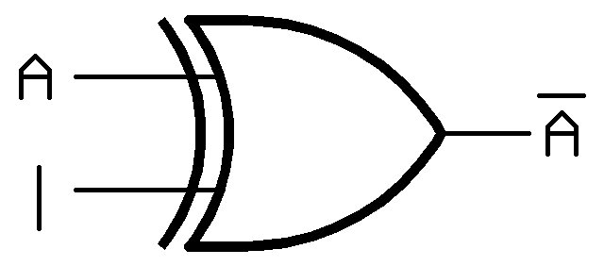
3, B) KEYWORD : NOT
XY | out
00 | 0
01 | 1
11 | 0
10 | 1

Slide 3
8, PROBLEM A
Input : X, Y
State output : A, B
Circuit output : Z

Slide 4
JA = XA + XY, KA = X’Y
 |  | A
X | Y | 0 |  | 1
0 | 0 | 0 | 0 | 0 | 0
0 | 1 | 0 | 1 | 0 | 1
1 | 1 | 1 | 0 | 1 | 0
1 | 0 | 0 | 0 | 1 | 0

Slide 5
JB = XA, KB = Y
 |  | A
X | Y | 0 |  | 1
0 | 0 | 0 | 0 | 0 | 0
0 | 1 | 0 | 1 | 0 | 1
1 | 1 | 0 | 1 | 1 | 1
1 | 0 | 0 | 0 | 1 | 0

Slide 6
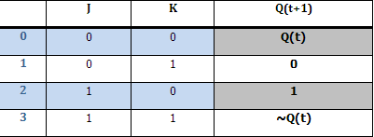
A+, B+, Z
 | AB
XY | 00 | 01 | 11 | 10
00 | 00/0 | 01/0 | 11/0 | 10/0
01 | 00/0 | 00/0 | 00/0 | 00/0
11 | 10/0 | 10/0 | 10/0 | 11/1
10 | 00/0 | 01/0 | 11/0 | 11/0
*** Z = YB

Slide 7
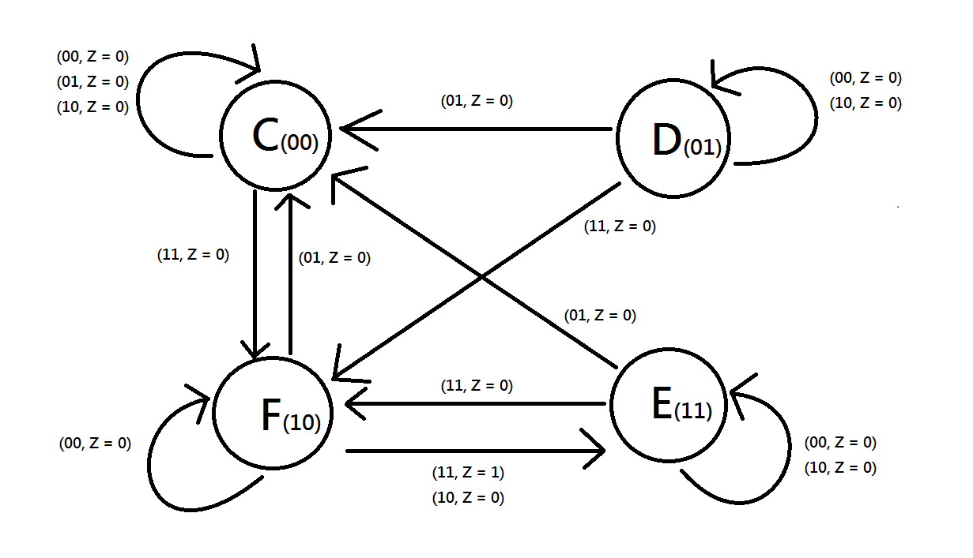
B).

