Slide 1

CarFinder
CarFinder
“One-shot click-to-buy AI”
Co-Founders: Noble Manaye & Mike Pham

Slide 2
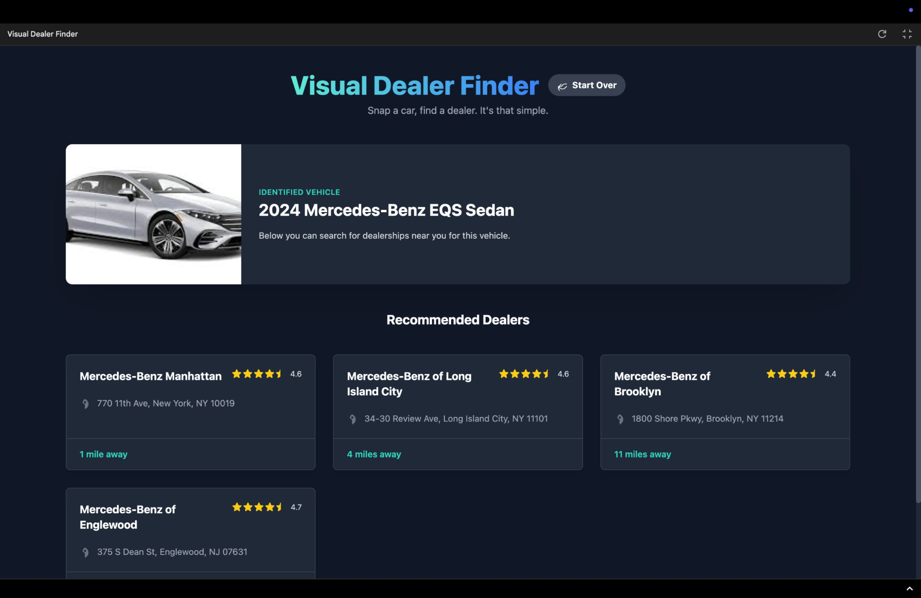
App’s Function
Receives images of the car and then gives you the price and where to buy.

Slide 3
Architecture
Multimodal
binarization
User’s Car Picture
Gemma 3-4B
Web scraping
recommendations

Slide 4
Future Implementation
Scraping robots.txt
More Advanced Error Checking

Slide 5



Full Name
Title
Full Name
Title
Full Name
Title
Team
Landscape
Opportunities
Timeline
Write a brief bio of this team member. Include their background, expertise, and project responsibilities.
Write a brief bio of this team member. Include their background, expertise, and project responsibilities.
Write a brief bio of this team member. Include their background, expertise, and project responsibilities.

