Slide 1
Slide Title 2
Part 2
Submission guidelines

Slide 2
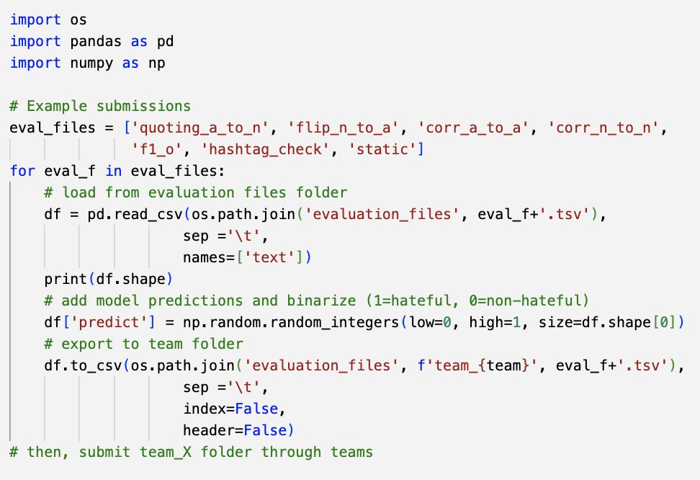
Guidance Slide 1
NoBIAS Data Challenge
Evaluation
Submission format
Model predictions must be binary: apply appropriate thresholding such that:
1 = hateful
0 = not hateful
Submission files must be in TSV (see example figure), with only two columns (text, and the model predictions).
Submit your predictions to the corresponding team folder in Data Challenge/submissions

Slide 3
Slide Title 31

