Slide 1
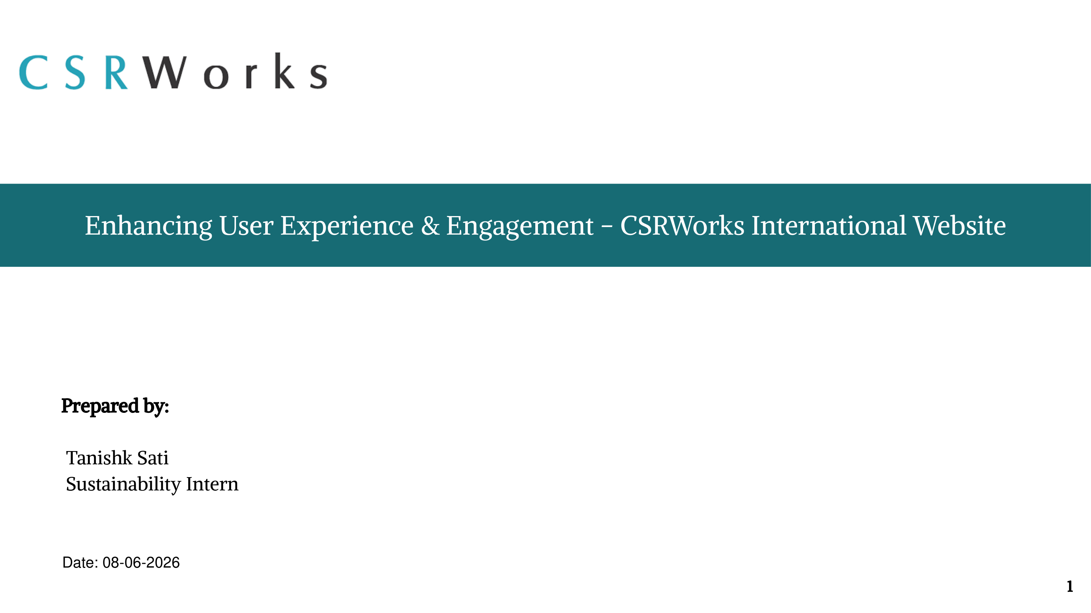

Slide 2
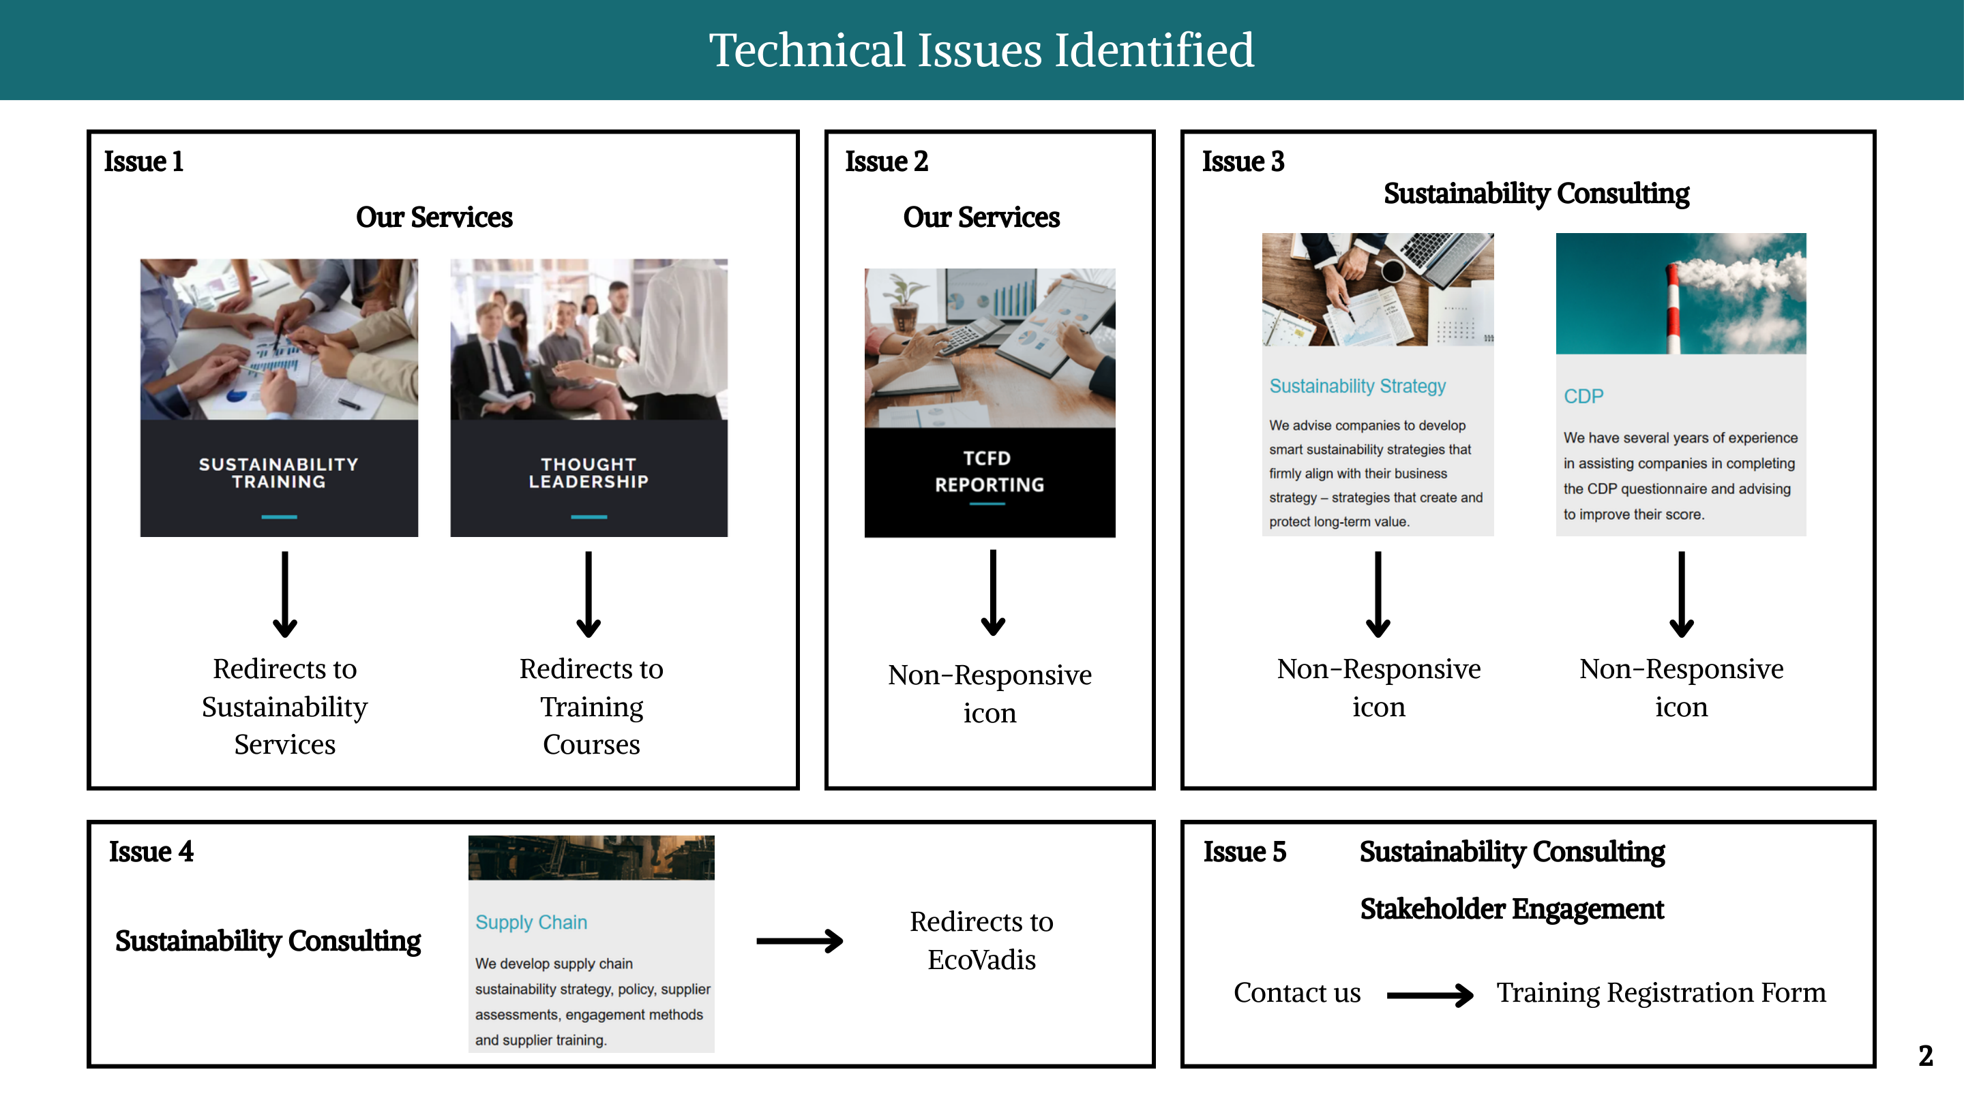

Slide 3
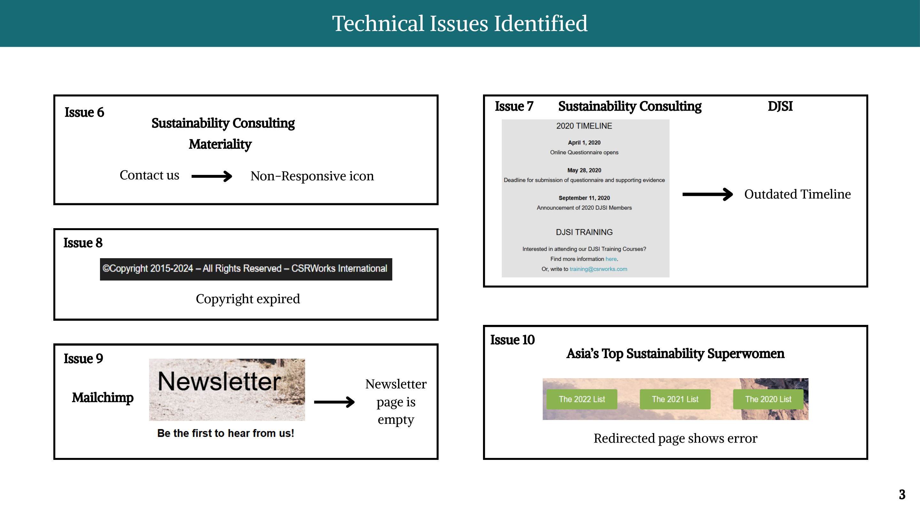

Slide 4
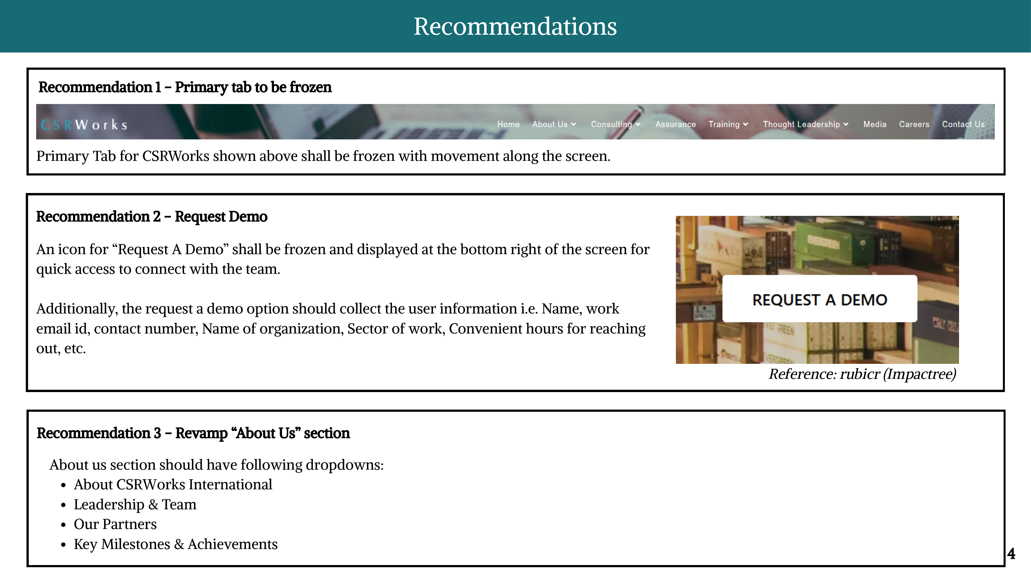

Slide 5
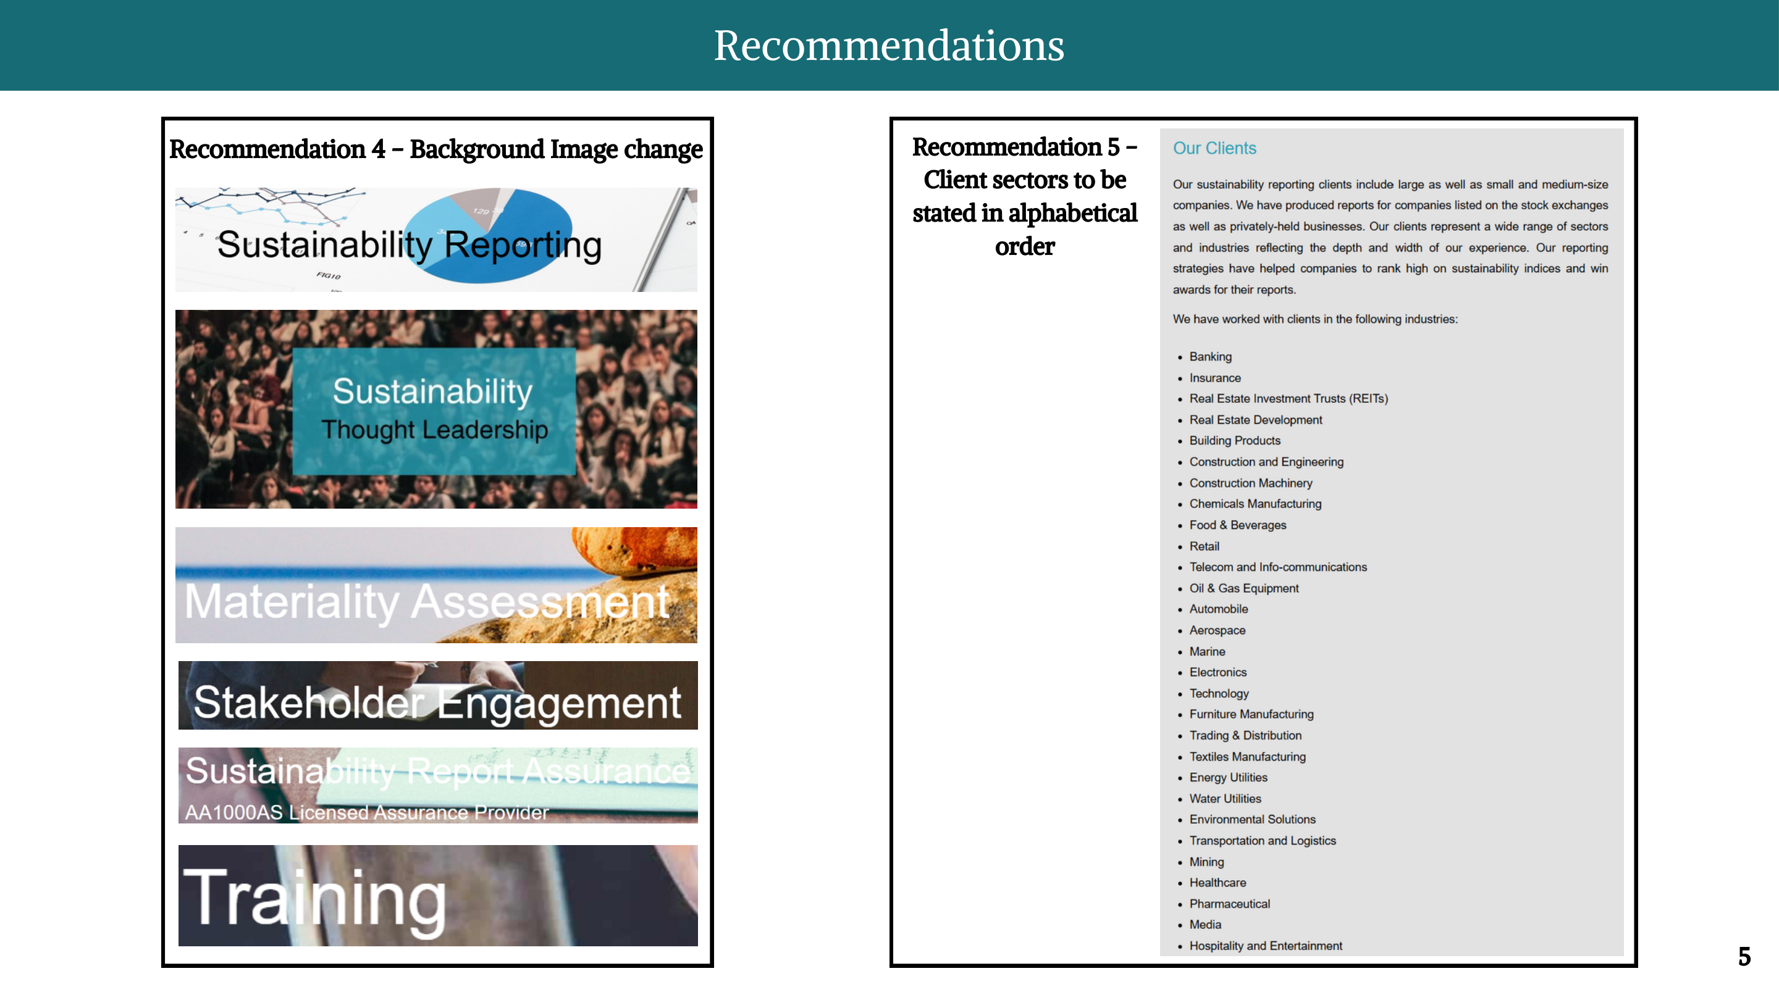

Slide 6
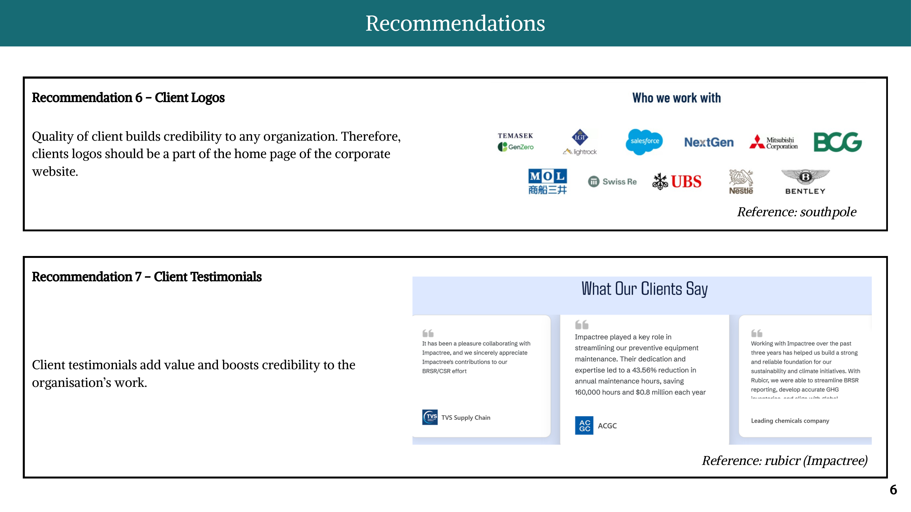

Slide 7
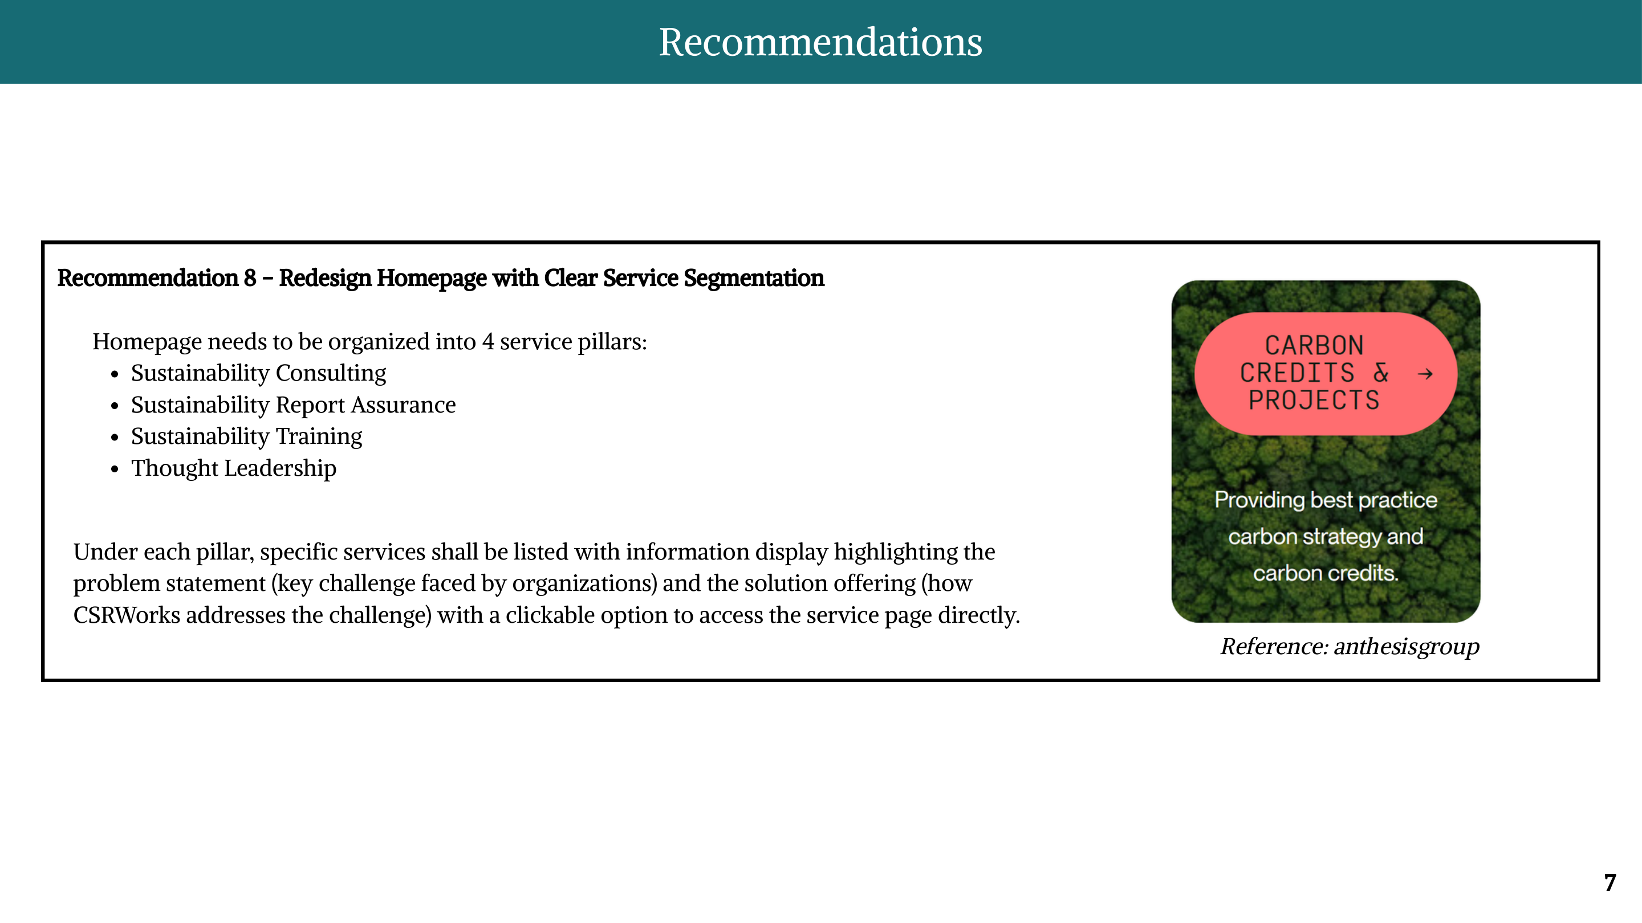

Slide 8
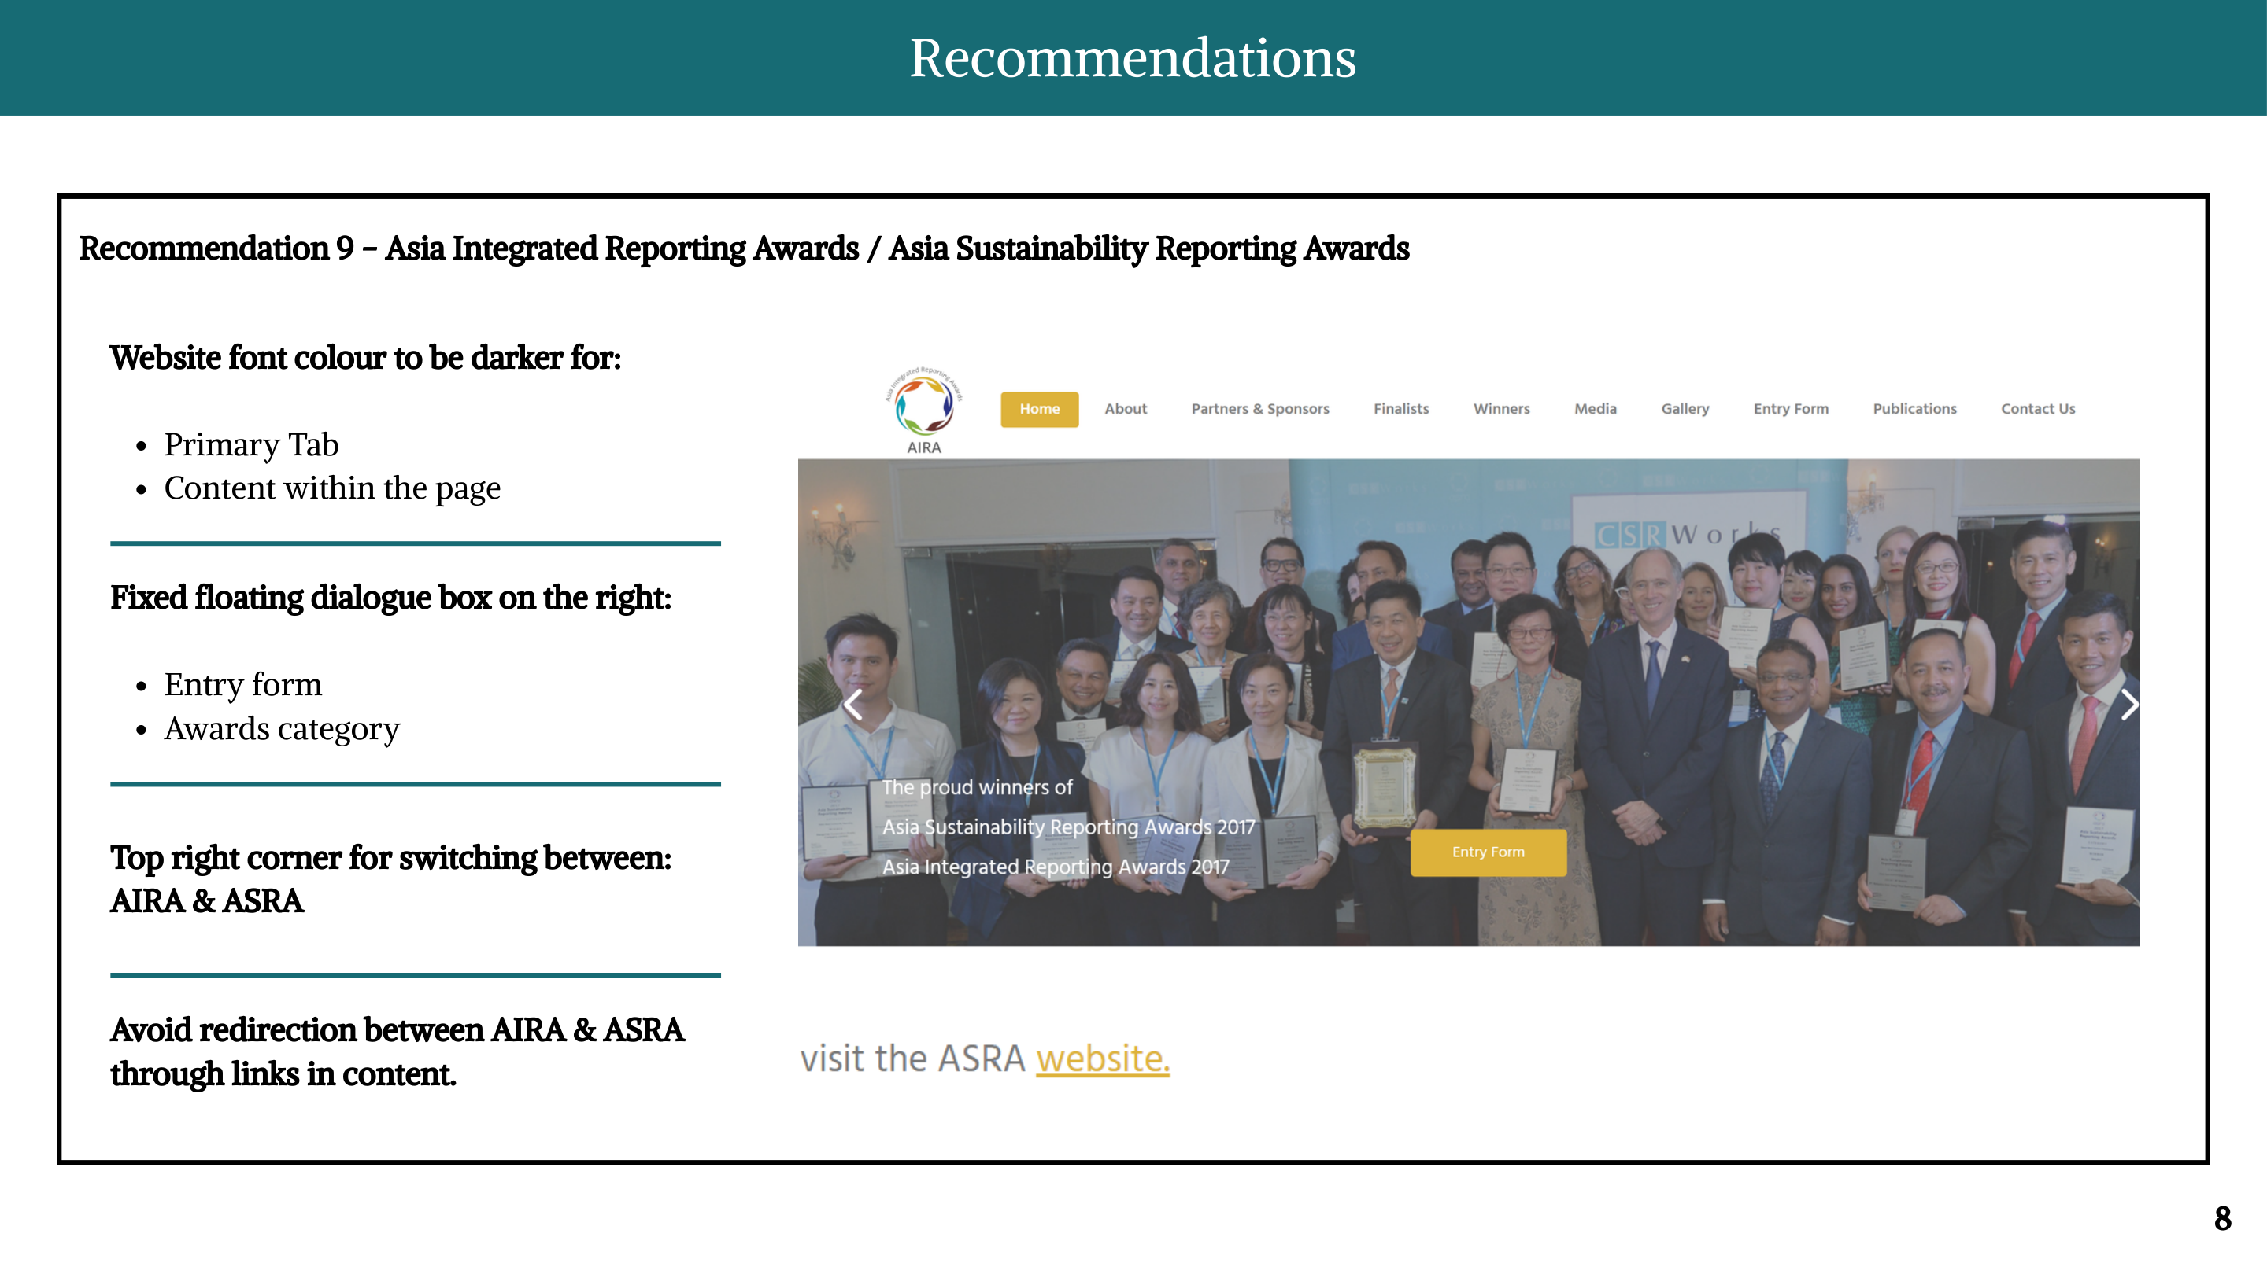

Slide 9
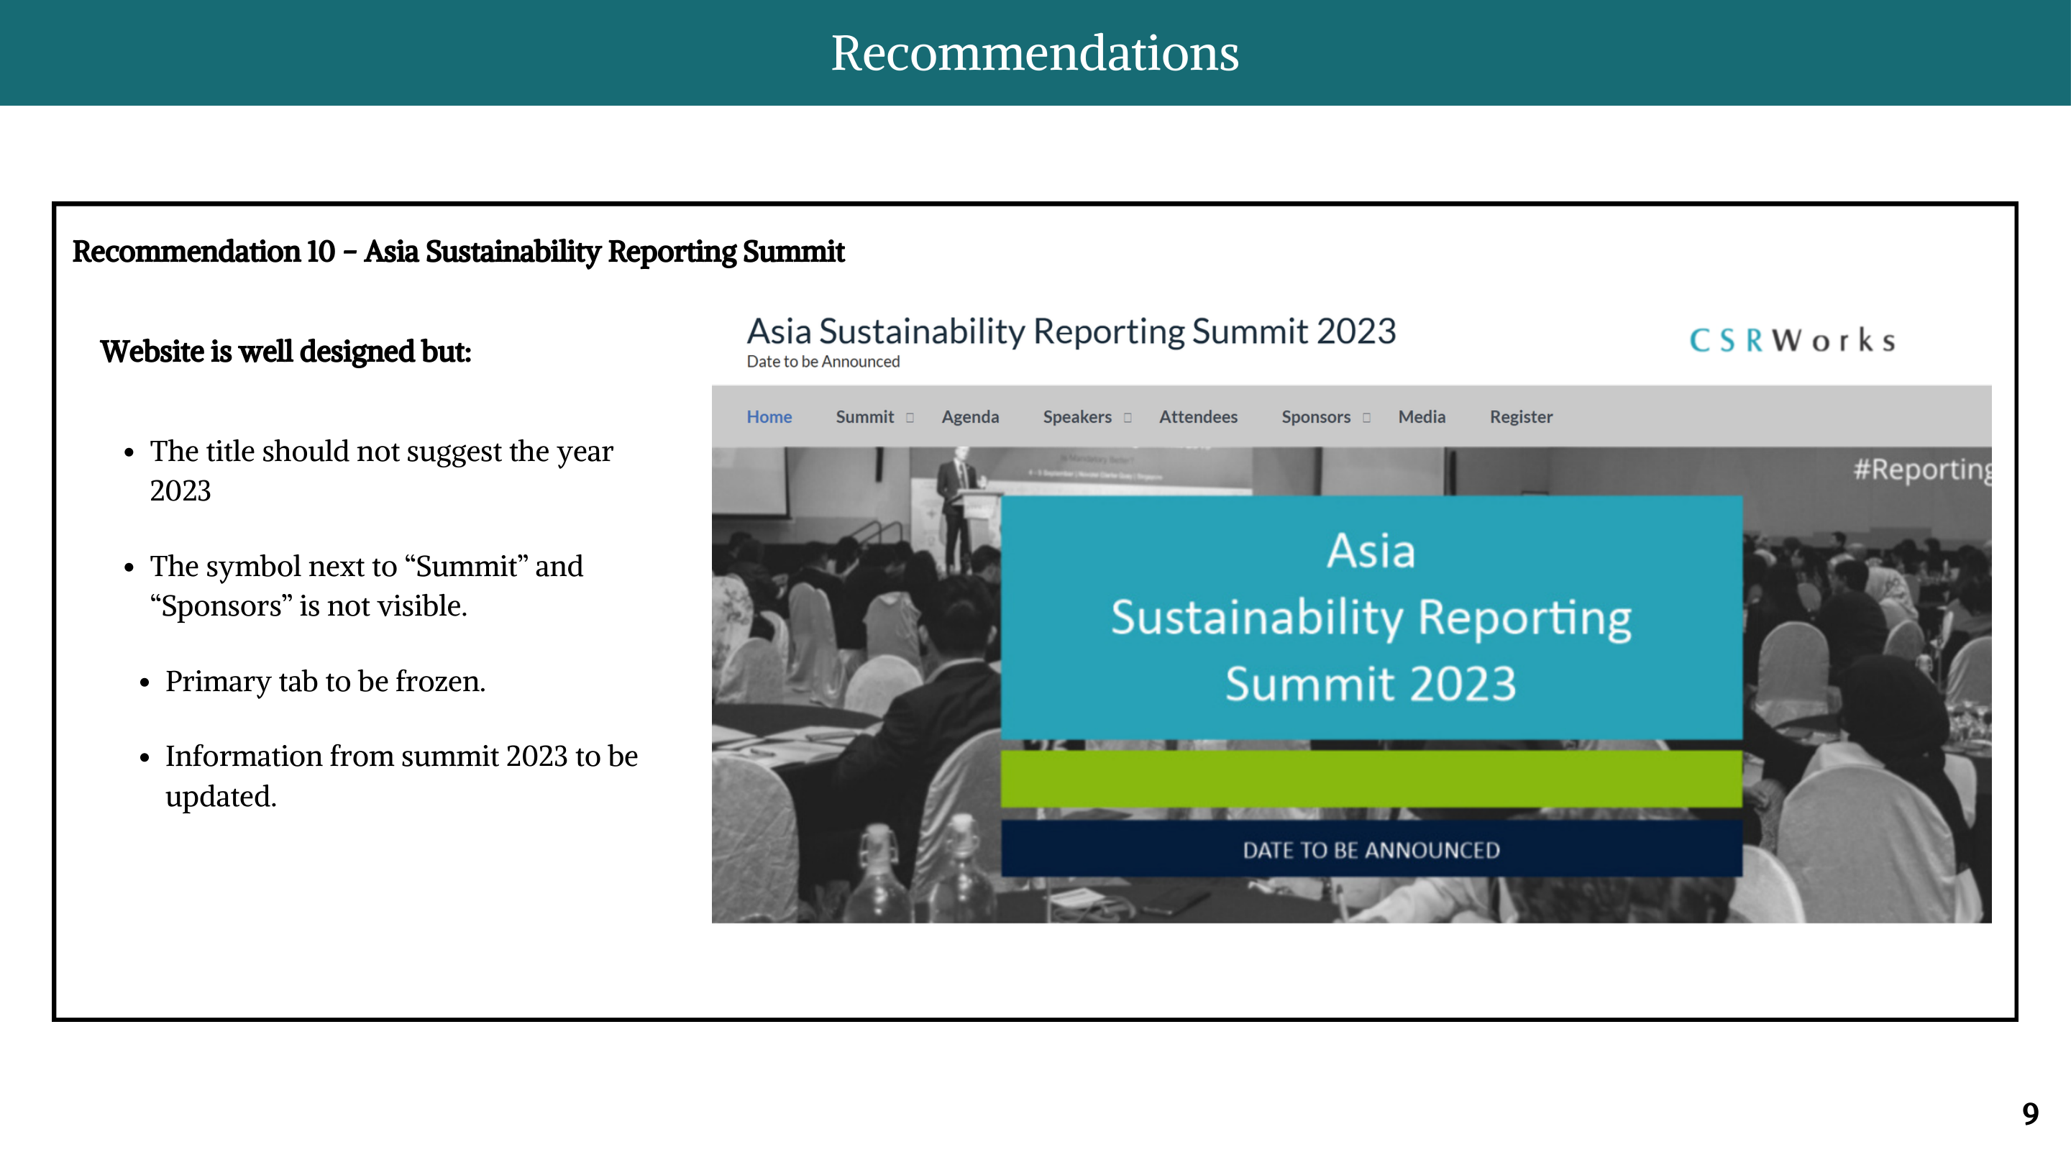

Slide 10
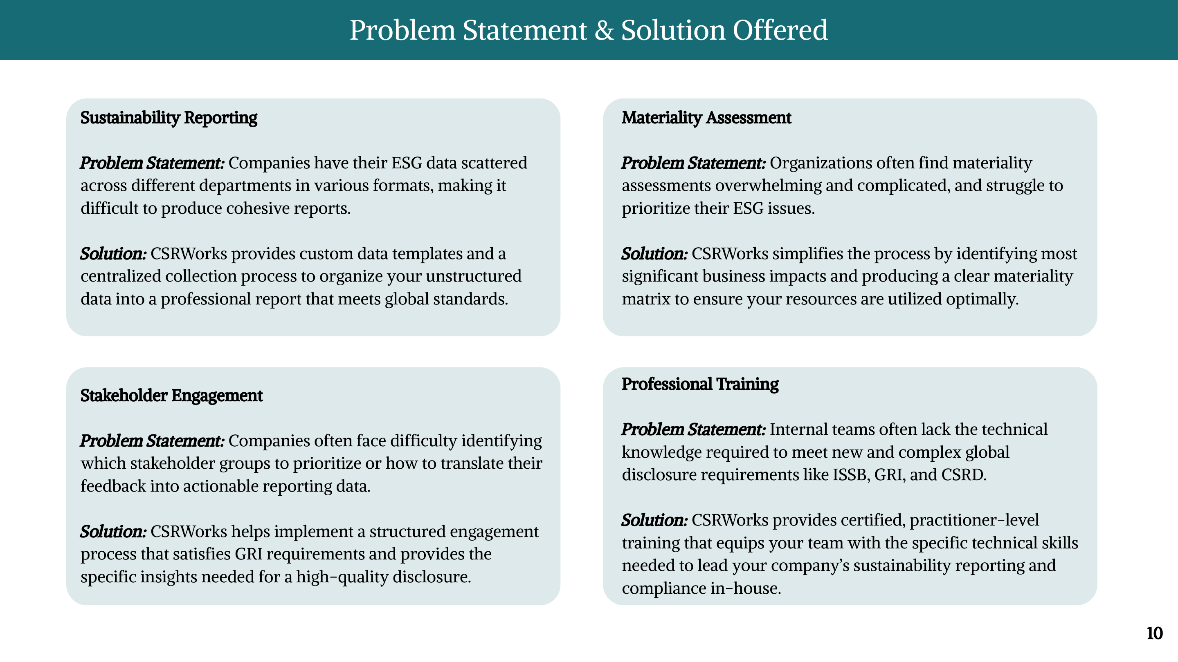

Slide 11
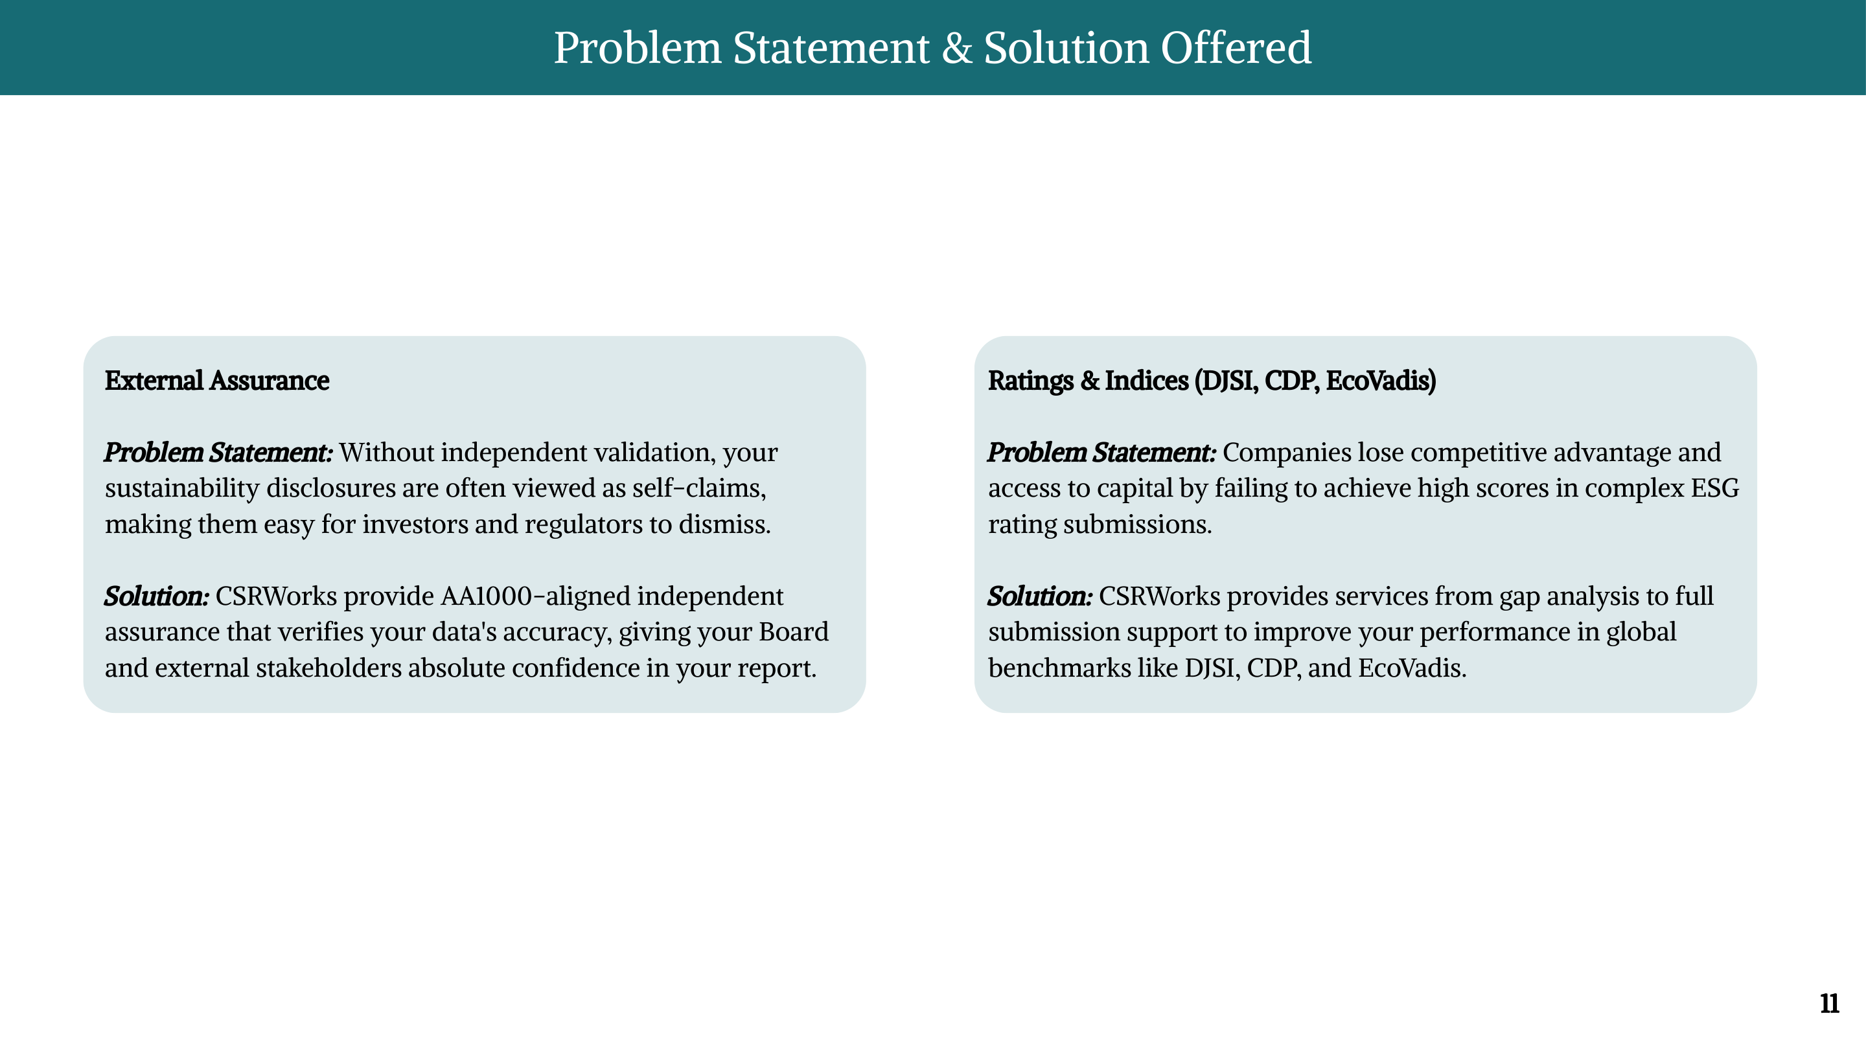

Slide 12
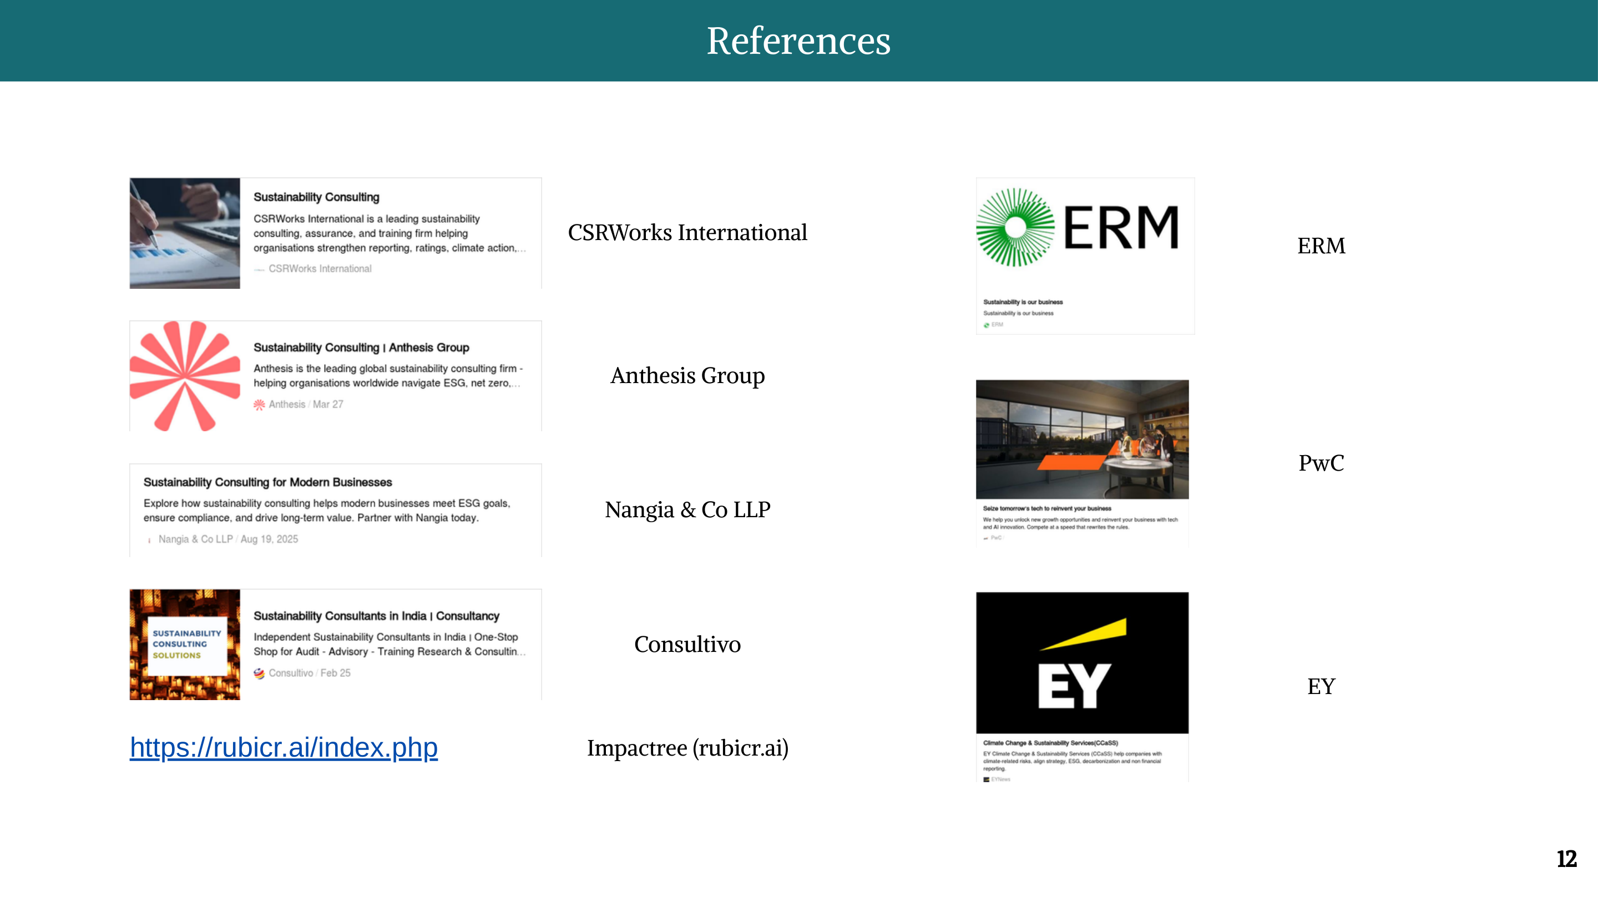

Slide 13
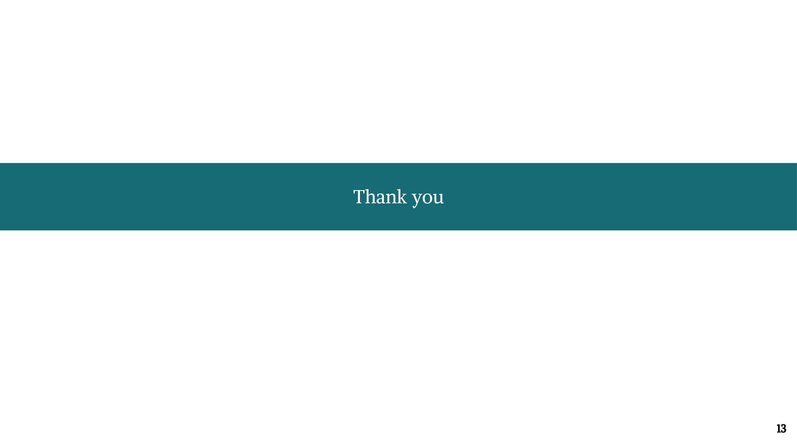

Slide 14

SUSTAINABILITY CERTIFICATIONS
& COALITIONS
Presented by: Tanishk Sati
CSRWorks International
1 / 21

Slide 15
ISO 45001
OHSAS 18001
Global
UK/Global
Occupational
Health & Safety
NEBOSH IGC
OSHA VPP
UK
USA
ANSI Z10
CSA Z1000
USA
Canada
Global OHS standards including new Western-nation certifications
SABS OHSAS
JISHA
South Africa
Japan
KOSHA OSHMS
DOSH OSHMS
Korea
Malaysia
See the Annexure for full detail tables →
2 / 21

Slide 16
Occupational Health & Safety
OHS CERTIFICATIONS
Global Standards
Western Nations
Asian Standards
ISO 45001:2018 - the gold standard for OHS management systems worldwide
OSHA VPP (USA) - Voluntary Protection Program, cooperative OSHA scheme
JISHA (Japan) - Japan Industrial Safety & Health Association certification
OHSAS 18001 - legacy standard, now superseded by ISO 45001
SABS OHSAS (South Africa) - aligned with OHSAS 18001 / ISO 45001
KOSHA OSHMS (South Korea) - Korea OHS management system
NEBOSH IGC - globally recognized individual qualification
DOSH OSHMS (Malaysia) - Malaysia Dept. of Occupational Safety & Health
Full process details and certified companies → See Annexure A (Slide 14)
3/ 21

Slide 17
ISO/IEC 27001
SOC 2
Global
USA
Cybersecurity &
Info Security
FedRAMP
CMMC
🇺🇸 USA (Cloud/Govt)
USA (Defense)
NIST CSF
ISMS-P
USA (Framework)
Korea
Global certifications across USA, Europe, Asia & international frameworks
CSA STAR
Common Criteria
Global (Cloud)
International
Cyber Essentials
UK
See the Annexure for full detail tables →
4/ 21

Slide 18
Cybersecurity & Information Security
CERTIFICATIONS
USA - Government & Defense
▸ FedRAMP
▸ CMMC
▸ NIST CSF
Cloud services used by US federal agencies. 3rd-party assessment org (3PAO) audit + ATO.
Cybersecurity Maturity Model Certification for US DoD contractors. Levels 1–3. Required for defense contracts.
Framework (not a cert), but companies self-attest or get 3rd-party assessment. Basis for many US regs.
Global - Finance & Cloud
▸ CSA STAR
▸ Common Criteria (ISO 15408)
Cloud Security Alliance – Security Trust Assurance and Risk. Level 1 (self-assessment) to Level 3 (continuous).
International IT security evaluation standard. Government and enterprise ICT products.
Previously Researched
▸ ISO/IEC 27001
▸ SOC 2 (AICPA)
▸ Cyber Essentials (UK)
▸ ISMS-P (Korea)
ISMS global standard; 3-yr cert + annual surveillance
KISA; mandatory for large Korean ICT companies
SaaS/cloud service providers; Type I & II audit reports
UK NCSC-backed; mandatory for UK govt contracts
5 / 21
Full process details → See Annexure B (Slide 15)

Slide 19
Americas
Europe
LEED, WELL, Living Building Challenge, BOMA 360
BREEAM, DGNB (Germany), HQE (France), MINERGIE (Switzerland)
Green Building
Certifications
Middle East & Africa
South & SE Asia
Estidama (UAE), Green Star SA, EDGE
GRIHA, IGBC (India), Green Mark (SG), GBI (MY), LOTUS (VN)
Global coverage: Americas, Europe, Middle East, Africa, Asia-Pacific
East Asia
Global / IFC
CASBEE (JP), GBCS (KR), China 3-Star Green Building
EDGE (IFC) - emerging markets worldwide
See the Annexure for full detail tables →
6 / 21

Slide 20
Green Building Certifications - World Coverage
GLOBAL MAP
Europe
BREEAM, DGNB
HQE, MINERGIE
North America
LEED, WELL, LBC
BOMA 360
East Asia
CASBEE, GBCS
China 3-Star
Middle East
Estidama
EDGE
South Asia
GRIHA, IGBC
EDGE
Africa
Green Star SA
EDGE
SE Asia
Green Mark, GBI
LOTUS
South America
LEED, EDGE, BREEAM
Oceania
Green Star
(Australia)
REGIONS WITH ACTIVE GREEN BUILDING CERTIFICATIONS
Americas
Europe
Middle East
Africa
South Asia
SE Asia
East Asia
Oceania
7/ 21

Slide 21
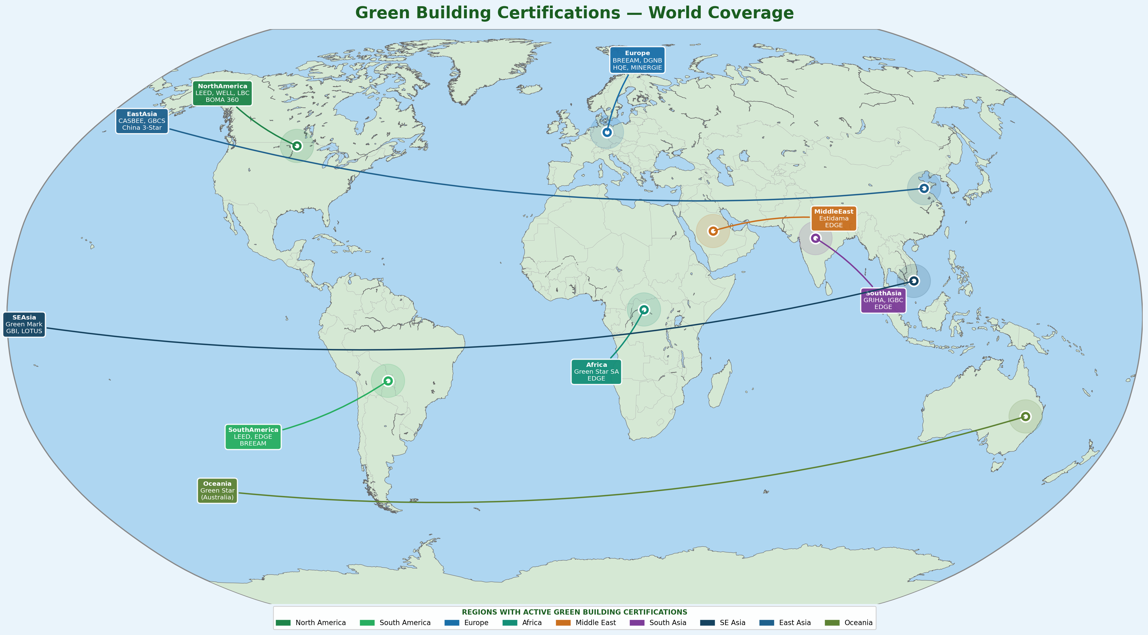
CSRWorks International

Slide 22
Green Building - Global Certifications at a Glance
NEW ADDITIONS ★
: WELL Building Standard
: Living Building Challenge
IWBI, USA | Global
ILFI, USA | Global
Focuses on human health & wellness in buildings. 10 concepts. 100+ countries.
Most rigorous standard - net-zero energy/water/waste. Petal or full certification.
: DGNB (German Sustainable Building Council)
: HQE (Haute Qualité Environnementale)
DGNB, Germany | Europe (also Middle East)
France / Francophone countries
Lifecycle performance-based. Used across EU and exported to Middle East.
French national green building standard; 14 targets across 4 themes.
: MINERGIE
: Estidama (Pearl Rating)
MINERGIE Association, Switzerland | Switzerland / DACH Region
Abu Dhabi Urban Planning Council, UAE | UAE / Middle East
Energy efficiency focus; MINERGIE, MINERGIE-P (Passive House), MINERGIE-A (Net-Zero).
1–5 Pearl rating. Mandatory for Abu Dhabi developments from 1 Pearl onwards.
: Green Star SA
: BOMA 360
Green Building Council South Africa (GBCSA) | South Africa / Africa
BOMA International, USA | USA / Canada
Aligned with Green Building Council Australia's Green Star system. 4–6 Star ratings.
Building Operations Management standard for existing commercial buildings.
Full process details → See Annexure C (Slides 16-17)
8 / 21

Slide 23
SmartWay
SBTi
Sustainable Procurement + Environment
Climate / GHG Targets
UN Global Compact
RE100
Sustainability
Coalitions &
Endorsements
Broad ESG - 10 Principles
Renewable Energy
RBA
Equator Principles
Supply Chain / Labor
Finance / Environmental Risk
Criteria-based review: Environment, Labor, Ethics, Procurement - incl. SmartWay
Ellen MacArthur Foundation
WBCSD
Circular Economy
Broad Sustainability
See the Annexure for full detail tables →
9 / 21

Slide 24
Sustainability Coalitions - Criteria Coverage
SMARTWAY
SmartWay Transport Partnership
Environment
U.S. Environmental Protection Agency (EPA) | USA + Canada + Mexico
SBTi · RE100· SmartWay
Cross-sectoral - all industries with freight transport (retail, manufacturing, 3PL, logistics)
Signatory/Partner membership published on EPA SmartWay website
Required Actions: Annual data submission (fuel use, miles travelled, cargo ton-miles); EPA-verified benchmarking
Addresses Sustainable Procurement: companies require freight carriers to be SmartWay partners
Labor & Human Rights
Environment criteria: reduces GHG, NOx and PM emissions from freight supply chains
UN Global Compact · RBA · Equator Principles · Better Work · amfori BSCI
Ethics & Transparency: public performance scoring; annual public report
Sustainable Procurement
Ethics
SmartWay · RBA · Equator Principles · Ellen MacArthur Fdn
UN Global Compact · RBA · SmartWay · WBCSD
Full coalition tables → See Annexure D (Slides 18-19)
10 / 21

Slide 25
Key Coalitions at a Glance
ENDORSEMENTS & COALITIONS
SBTi
UN Global Compact
RE100
11,000+
companies
20,000+
companies
400+
companies
1.5°C-aligned science-based targets. Validated by SBTi team.
10 Principles on HR, Labour, Env, Anti-Corruption.
Commit to 100% renewable electricity by target year.
RBA
SmartWay
Ellen MacArthur Foundation
400+
members
3,500+
partners
500+
partners
Electronics/ICT supply chain labor & ethics code.
EPA freight emissions reduction. Annual data reporting.
Circular economy commitment and co-design.
11 / 21

Slide 26
Thank You
Annexure with full data tables follows on the next slides →
12 / 21

Slide 27
Annexure Guide
Annexure A
OHS Certifications (Full Detail)
Annexure B
Cybersecurity Certifications (Full Detail)
Slide 14
ISO 45001, OHSAS, NEBOSH, OSHA VPP, ANSI Z10, CSA Z1000, SABS, JISHA, KOSHA, DOSH - 10 certifications
Slide 15
ISO 27001, SOC 2, FedRAMP, CMMC, NIST CSF, CSA STAR, Common Criteria, Cyber Essentials, ISMS-P - 10 certifications
Annexure C1
Green Building: Americas / Europe / ME / Africa
Annexure C2
Green Building: Asia-Pacific (Full Detail)
Slide 16
LEED, WELL, LBC, BOMA 360, BREEAM, DGNB, HQE, MINERGIE, Estidama, Green Star SA - 10 certifications
Slide 17
Green Mark, GBI, GRIHA, IGBC, EDGE, LOTUS, CASBEE, GBCS, China 3-Star - 9 certifications
Annexure D1
Coalitions: Climate, Energy & SmartWay
Annexure D2
Coalitions: ESG, Supply Chain, Finance & Circular
Slide 18
SBTi, ACT, RE100, EP100, EV100, SmartWay
Slide 19
UNGC, WBCSD, RBA, Ellen MacArthur, Equator Principles
Annexure E
Coalition Criteria Coverage Matrix
Annexure F
Other Certifications
Slide 20
Env / Labor & HR / Ethics / Sustainable Procurement mapping across major coalitions incl. SmartWay
Slide 21
Forest (FSC/RSPO), ISO Environmental, Social (SA8000/B Corp/Fair Trade), Carbon (PAS 2060/VCS), Textiles (GOTS/OEKO-TEX)
13 / 21

Slide 28
ANNEXURE
Annexure A - OHS Certifications
Certification | Governing Org | Region | Industry? | Eligibility | Process (Summary) | Example Companies
ISO 45001:2018 | ISO (Global) | Global | No – All industries | Any org worldwide | Gap analysis → EMS docs → Internal audit → Stage 1+2 CB audit → 3-yr cert + annual surveillance | Unilever, Siemens, Toyota, Tata Steel, Samsung SDI
OHSAS 18001 (legacy) | BSI / CBs | UK/Global | No – All industries | Any org; now migrating to ISO 45001 | Risk assessment → Policy → Internal audit → CB audit. Superseded by ISO 45001 | BP, Shell, Ford, Honeywell, Hyundai Heavy Ind.
NEBOSH IGC | NEBOSH, UK | UK (global) | No – All (specialized tracks) | Individual EHS professionals | Register → IG1+IG2 units → Open-book exam → Practical assessment → Certificate | Aramco, Balfour Beatty, Jacobs Eng, Mott MacDonald
OSHA VPP | OSHA, US Dept of Labor | USA | No – All US industries | US worksites with strong OHS programs wanting cooperative partnership | Apply to OSHA → Site evaluation by OSHA team → Approval as Star/Merit/Developmental participant → Annual re-evaluation | 3M, DuPont, Procter & Gamble, ExxonMobil, Honeywell
SABS OHSAS | South African Bureau of Standards (SABS) | South Africa | No – All industries in SA | South African companies seeking OHS management system certification | Apply to SABS or accredited CB → Gap analysis → Implementation → Internal audit → On-site certification audit → Annual surveillance | Sasol, Anglo American, MTN Group, Eskom, Transnet
JISHA | Japan Industrial Safety & Health Assn | Japan | No – All (mfg, chemicals, construction) | Japanese companies or Japan operations | Apply to JISHA → Documentation review → On-site audit → Certificate → Surveillance | Toyota, Nippon Steel, Mitsubishi Chemical, Kawasaki Heavy
KOSHA OSHMS | Korea OHS Agency (KOSHA) | South Korea | No – All (mfg, construction, chemicals) | Korean companies or Korea operations | Apply to KOSHA → Self-assessment → Doc review → On-site audit → 3-yr cert + annual surveillance | POSCO, Hyundai Motor, Samsung Electronics, LG Chem, SK Hynix
DOSH OSHMS | DOSH Malaysia | Malaysia | No – All industries | Companies operating in Malaysia | Adopt MS 1722 → Implement OSHMS → Internal audit → DOSH/CB audit → Certificate | Petronas, Sime Darby, Tenaga Nasional, Top Glove
14 / 21

Slide 29
ANNEXURE
Annexure B - Cybersecurity & Information Security (Full Detail)
Certification | Governing Org | Region | Industry? | Eligibility | Process (Summary) | Example Companies
ISO/IEC 27001:2022 | ISO / IEC | Global | No – All (esp. IT, finance, healthcare) | Any org handling sensitive information | ISMS scope → Risk assessment → Controls → Internal audit → Stage 1+2 CB audit → 3-yr cert | Microsoft, Accenture, Infosys, HSBC, NTT Data, Fujitsu
SOC 2 Type I & II | AICPA, USA | USA (globally recognized) | Yes – SaaS, cloud service providers | Service orgs processing customer data | Define scope & Trust Service Criteria → Readiness → CPA firm audit → Type I or II report issued | Salesforce, Dropbox, AWS, Zoom, HubSpot, Freshworks
FedRAMP | GSA / NIST, USA | USA (federal cloud services) | Yes – Cloud service providers serving US federal agencies | Cloud service providers (CSPs) seeking to serve US federal govt | CSP initiates with Agency → 3PAO assessment → ATO from Agency or JAB P-ATO → Continuous monitoring | AWS GovCloud, Microsoft Azure Govt, Google Cloud, Palantir
CMMC | US Dept of Defense (DoD) | USA (defense supply chain) | Yes – DoD contractors and subcontractors | Any company in US DoD supply chain handling CUI | Self-assess (Level 1) or C3PAO 3rd-party assessment (Level 2+) → DoD contract requirement → Annual affirmation | Lockheed Martin, Raytheon, General Dynamics, BAE Systems, SAIC
NIST CSF | NIST, USA | USA (internationally adopted) | No – All industries (voluntary framework) | Any organization seeking structured cybersecurity risk management | Adopt NIST CSF core functions (Identify/Protect/Detect/Respond/Recover) → Self-assess or 3rd-party assessment → Tiered maturity | US federal agencies, major banks, energy utilities; internationally adopted
CSA STAR | Cloud Security Alliance (CSA) | Global (cloud-focused) | Yes – Cloud service providers and cloud users | Any cloud service provider or enterprise user | Level 1: CAIQ self-assessment → Level 2: STAR Certification (ISO 27001 + cloud controls) → Level 3: Continuous monitoring | Google Cloud, AWS, Microsoft Azure, Alibaba Cloud, IBM Cloud
Common Criteria (ISO 15408) | National agencies (CCRA mutual recognition); ISO 15408 | International (29 CCRA member countries) | Yes – IT security products (hardware, software, firmware) | IT product manufacturers seeking security evaluation | Develop Security Target (ST) → Testing by CCTL lab → Validation by national scheme → EAL1–EAL7 rating | Microsoft (Windows), Cisco, Juniper, Samsung (mobile), Thales
Cyber Essentials / Plus (UK) | NCSC, UK | UK | No – All UK orgs; mandatory for UK govt contracts | UK-registered organizations | Self-assessment questionnaire → Submit to NCSC-approved CB → Vuln scan (Plus) → Annual cert | BT Group, Rolls-Royce, BAE Systems, QinetiQ
ISMS-P (Korea) | KISA, Ministry of Science & ICT | South Korea | No – All; mandatory for large Korean ICT companies | Korean companies >1,000 employees or >10B KRW in ICT/online services | Apply to KISA → Doc review → On-site audit → ISMS-P cert (3-yr) + annual surveillance | Kakao, Naver, Samsung SDS, SK Telecom, Lotte IT
15 / 21

Slide 30
ANNEXURE
Annexure C1 - Green Building: Americas, Europe & Middle East/Africa
Certification | Governing Org | Region | Industry? | Eligibility | Process (Summary) | Example Companies
LEED | USGBC, USA | USA/Global (185+ countries) | Yes – Construction, real estate, building ops | Building owners/developers new or existing | Register on LEED Online → Doc compliance → GBCI review → Certified/Silver/Gold/Platinum → 5-yr recert | Apple Park, Empire State Bldg, Goldman Sachs HQ, Infosys campuses (IN)
WELL Building Standard | IWBI (Intl WELL Building Institute), USA | Global (100+ countries) | Yes – Buildings, interiors, communities | Building owners, developers, employers in any sector | Register with IWBI → Design + operational documentation → GBCI on-site performance testing → Verified rating → 3-yr recert | Amazon HQ2, JPMorgan Chase NY, Nike WHQ, Capital One, Deloitte
Living Building Challenge | ILFI (Intl Living Future Institute), USA | Global (primarily North America, Europe, Australia) | Yes – All building types; net-zero focus | Building owners/developers committed to highest sustainability performance | Register with ILFI → 12-month post-occupancy performance period → Documentation of 20 Imperatives → 3rd-party audit → Petal or Full Certification | Bullitt Center (Seattle), Eden Project (UK), Brock Environmental Center (USA)
BOMA 360 | BOMA International, USA | USA / Canada (expanding internationally) | Yes – Commercial real estate / office buildings | Property owners and managers of existing commercial buildings | Apply on BOMA360.org → Submit documentation (operations, emergency, sustainability) → BOMA evaluation → Designation valid 3 yrs | Empire State Building, Brookfield Properties, Cushman & Wakefield, JLL portfolios
BREEAM | Building Research Establishment, UK | UK/Europe/Global (80+ countries) | Yes – Construction, real estate, infrastructure | New/existing buildings, communities, infrastructure projects | Register with licensed BREEAM assessor → Design-stage assessment → Post-construction assessment → Pass/Good/Very Good/Excellent/Outstanding | Unilever HQ (UK), Canary Wharf, Prologis, HSBC Dubai
DGNB | German Sustainable Building Council (DGNB) | Germany / Europe / Middle East | Yes – Buildings and districts in Europe & beyond | Building owners/developers in Germany and internationally | Engage DGNB auditor → Assessment across 6 themes (ENV, ECO, SOC, TEC, PRO, LOC) → DGNB Precertificate (design) → DGNB Certificate (completion) → Bronze/Silver/Gold/Platinum | Volkswagen AutoCity, Deutsche Telekom HQ, Stuttgart Airport T3
HQE | Certivéa (subsidiary of CSTB), France | France / Francophone countries | Yes – Buildings in France and Francophone markets | Building owners/developers seeking French green building certification | Apply to Certivéa → Assessment against 14 HQE targets across 4 themes (Eco-Site, Eco-Construction, Eco-Management, Comfort) → Pass/Good/Very Good/Exceptional | La Défense offices (Paris), Bordeaux Métropole Areana, Lyon Confluence
MINERGIE | MINERGIE Association, Switzerland | Switzerland / DACH region | Yes – Buildings in Switzerland and DACH | Building owners/developers in Switzerland; can be referenced internationally | Apply to MINERGIE → Energy performance calculation → 3rd-party audit → MINERGIE / MINERGIE-P (Passive) / MINERGIE-A (Net-Zero) label → Periodic re-audit | Swiss parliament offices, ETH Zurich buildings, SBB railway stations
Estidama Pearl Rating | Abu Dhabi Urban Planning Council (UPC), UAE | UAE / Middle East | Yes – Buildings and communities in Abu Dhabi, UAE | Building developers in Abu Dhabi; 1 Pearl minimum mandatory for all developments | Apply to UPC → Design submission → Pearl Design Rating (PDR) → Post-construction Pearl Construction Rating (PCR) → 1–5 Pearl rating | Masdar City (Abu Dhabi), Cleveland Clinic Abu Dhabi, Khalifa University
Green Star SA | Green Building Council South Africa (GBCSA) | South Africa / Sub-Saharan Africa | Yes – Buildings in South Africa and region | Building owners/developers seeking SA green building certification | Register with GBCSA → Engage Green Star Accredited Professional → Design review → Post-construction assessment → 4, 5, or 6 Star rating | Growthpoint Properties, Redefine Properties, Nedbank HQ, Investec
16 / 21

Slide 31
ANNEXURE
Annexure C2 - Green Building: South/SE Asia & East Asia (Full Detail)
Certification | Governing Org | Region | Industry? | Eligibility | Process (Summary) | Example Companies
Green Mark (Singapore) | BCA, Singapore | Singapore (reference in ASEAN) | Yes – Buildings in Singapore | Building owners/developers/contractors in Singapore | Register with BCA → Design assessment vs Green Mark criteria → On-site inspection → Certified/GoldPLUS/Platinum → 3-yr recert for existing | CapitaLand, Keppel Land, City Developments (CDL), Sunway (MY)
Green Building Index (GBI) | GBI Accreditation Panel, Malaysia | Malaysia | Yes – Buildings in Malaysia | Building owners/developers in Malaysia | Engage GBI facilitator → Submit design docs → Provisional GBI rating → Post-construction assessment → Certified/Silver/Gold/Platinum | IOI Properties, Gamuda, Sime Darby Property, YTL Land, UEM Sunrise
GRIHA (India) | TERI & MNRE, India | India | Yes – Buildings in India | Building owners/developers in India | Register with GRIHA Council → 3rd-party evaluator → Assessment vs 24 criteria → 1–5 Star rating → Provisional then Final award | TERI Retreat (Delhi), MNRE HQ, IIT Delhi, NTPC offices, Infosys campuses
IGBC (India) | Indian Green Building Council (IGBC), CII | India | Yes – Buildings in India | Building owners, developers, architects in India | Register on IGBC portal → Design-stage docs → IGBC assessment → On-site verification → Certified/Silver/Gold/Platinum | Infosys, Wipro, HCL campuses, DLF, Prestige Group, Godrej Properties
EDGE (IFC) | IFC, World Bank Group | Global (emerging markets: IN, ID, PH, VN, BD) | Yes – Buildings in emerging markets | Building developers in emerging market countries | Register on EDGE App → Model 20% savings in energy/water/embodied energy → EDGE-licensed auditor → EDGE Certified/Advanced/Zero Carbon | Godrej Properties (IN), BRAC (BD), Aboitiz Land (PH), Ciputra Group (ID)
LOTUS (Vietnam) | VGBC, Vietnam | Vietnam | Yes – Buildings in Vietnam | Building owners/developers of new and existing buildings in Vietnam | Register with VGBC → LOTUS-accredited professional → Assessment vs LOTUS criteria → Certified/Silver/Gold/Platinum | CapitaLand Vietnam, Vingroup, Gamuda Land Vietnam, Lotte Center Hanoi
CASBEE (Japan) | IBEC, Japan | Japan | Yes – Buildings in Japan | Building owners/developers in Japan | Engage CASBEE evaluator → Q (quality) and L (load) evaluated → BEE score → Class C/B-/B+/A/S → Submit to local govt | Mori Building, Tokyu Corp, Sumitomo Realty, Obayashi Corp
GBCS (South Korea) | MOLIT, South Korea | South Korea | Yes – Buildings in South Korea | Building owners/developers in South Korea | Apply to 1 of 6 authorized CBs → Doc review (energy, water, materials, ecology, indoor env) → On-site inspection → Certified/Good/Excellent/Best | Samsung C&T, Lotte E&C, Hyundai E&C, Korea LH Corp
China 3-Star Green Building | MOHURD, China | China | Yes – Buildings in China | Building owners/developers in China | Apply to provincial/municipal evaluation agency → Assessment vs GB/T 50378 → Site inspection → 1-star/2-star/3-star | China Resources Land, Vanke, Country Garden, CIFI Holdings, CSCEC
17 / 21

Slide 32
ANNEXURE
Annexure D1 - Sustainability Coalitions: Climate, Energy & Mobility
Coalition | Founded By | Key Supporters | Countries | Sector Specific? | How to Join / Process
SBTi | CDP, UN Global Compact, WRI, WWF (2015) | 11,000+ companies: Microsoft, Amazon, Apple, Unilever, Walmart | 70+ countries | No – All sectors (pathway per sector) | 1. Commitment letter on sbti.org 2. Develop 1.5°C-aligned targets 3. Submit for SBTi validation 4. Annual public reporting. Fee: revenue-based
ACT | CDP, ADEME & WBA | EDF, Renault, Michelin; co-funders: Climate-KIC, EU LIFE | France → expanding EU & global | No – All (sector methodologies) | 1. Visit act-initiative.org 2. Engage approved ACT assessor 3. Provide company data 4. Assessor evaluates alignment 5. Score: 0–5 stars
RE100 | The Climate Group & CDP (2014) | Apple, Google, Microsoft, IKEA, BMW, Nike – 400+ cos | 50+ countries | No – All with significant electricity use | 1. Apply at there100.org 2. Confirm electricity demand eligibility 3. Commit to 100% renewables by target year 4. Annual reporting via CDP
EP100 | Climate Group & Alliance to Save Energy (2016) | Signify, Schneider, Tata Group, Mahindra, JLL – 130+ cos | 35+ countries | No – All with significant energy use | 1. Apply at theclimategroup.org/EP100 2. Confirm eligibility 3. Commit to double energy productivity by 2030 4. Annual reporting via CDP
EV100 | The Climate Group (2017) | LeasePlan, IKEA, Heathrow, Unilever, Uber, BT – 130+ cos | 40+ countries | No – Any org with vehicle fleets | 1. Apply at theclimategroup.org/EV100 2. Commit to fleet EV transition by 2030 3. Annual reporting via CDP
SmartWay | US EPA (est. 2004) | 3,500+ Shipper/Carrier/Logistics Partners: Walmart, UPS, FedEx, Target, Home Depot, Amazon, Schneider National | USA, Canada, Mexico | No – All industries with freight transport | 1. Apply at epa.gov/smartway 2. Sign SmartWay Partnership Agreement 3. Submit annual data (fuel, miles, cargo ton-miles) 4. EPA verifies performance 5. Published membership + SmartWay logo use
18 / 21

Slide 33
ANNEXURE
Annexure D2 - Coalitions: ESG, Supply Chain, Finance & Circular Economy
Coalition | Founded By | Key Supporters | Countries | Sector Specific? | How to Join / Process
UN Global Compact | United Nations (Kofi Annan, 2000) | 20,000+ companies: Accenture, Nestlé, Unilever, L'Oréal, ABB | 160+ countries | No – All sectors | 1. CEO sends Letter of Commitment to UN SG 2. First COP within 2 years 3. Annual reporting on 10 Principles. Criteria: Labour Rights (Prin.3-6), Environment (Prin.7-9), Anti-Corruption (Prin.10)
WBCSD | Stephan Schmidheiny & 50 business leaders (1995) | 200+ companies: Unilever, Nestlé, BASF, Microsoft, Allianz, Walmart | 35+ countries | No – All (focus: large multinationals) | 1. Apply at wbcsd.org/membership 2. Submit application 3. Board review 4. Sign WBCSD charter 5. Annual membership fee
RBA | Cisco, HP, IBM, Intel, Seagate (as EICC, 2004) | Apple, Samsung, Dell, Microsoft, Toyota, BMW, Foxconn – 400+ members | 100+ countries | Yes – Electronics/ICT; expanded to automotive & retail | 1. Apply at responsiblebusiness.org 2. Eligibility review 3. Sign RBA Code of Conduct 4. Complete SAQ 5. VAP audit if required. Criteria: Labor, Health & Safety, Environment, Ethics, Management System
Ellen MacArthur Foundation | Dame Ellen MacArthur, Rob Mackenzie (UK, 2010) | Google, Apple, Renault, Philips, Unilever, H&M, Nike, IKEA – 500+ partners | 50+ countries | No – All (focus: mfg, consumer goods, fashion, food) | 1. Visit ellenmacarthurfoundation.org/network 2. Apply as Global/Network/Govt/Education partner 3. Align strategy with circular economy principles 4. Annual partnership fee for businesses
Equator Principles | ABN AMRO, Barclays, Citigroup, Credit Suisse + 7 banks (2003) | 120+ financial institutions: IFC, MUFG, Standard Chartered, BBVA, BNP Paribas | 37+ countries | Yes – Financial institutions financing large infrastructure projects ($10M+ threshold) | 1. Review EP4 framework 2. Board-level commitment 3. Integrate into credit risk assessment 4. Approved by EP Association Steering Committee 5. Annual reporting. Criteria: Environmental, Social risk management
19 / 21

Slide 34
ANNEXURE
Annexure E - Coalition Criteria Coverage Matrix
Coalition / Initiative | Environment | Labor & Human Rights | Ethics | Sustainable Procurement | Membership Type | Published?
SmartWay (EPA) | ✔ GHG & NOx reduction; fuel efficiency benchmarking | ✔ Carrier working conditions referenced in Shipper guidance | ✔ Annual data accuracy; EPA verification; public scoring | ✔ Shippers require carriers to be SmartWay partners | Partner (Shipper/Carrier/Logistics) | ✔ Published on EPA website
UN Global Compact | ✔ Prin.7–9: precautionary principle, env responsibility | ✔ Prin.3–6: freedom of association, no forced/child labour | ✔ Prin.10: anti-corruption | ✔ Sustainable procurement encouraged in COP reporting | Signatory (any org) | ✔ UNGC website
SBTi | ✔ Science-based emissions targets aligned to 1.5°C | - (not a labor standard) | ✔ Transparent target validation & annual reporting | ✔ Scope 3 supplier targets required for full value chain | Committed / Approved | ✔ SBTi website
RBA | ✔ Environmental management code | ✔ Labor (working hours, wages, no forced/child labor) | ✔ Business Ethics code (anti-corruption, IP, privacy) | ✔ CoC applies to supply chain; SAQ + VAP audit | Member / Participant | ✔ RBA website
Equator Principles | ✔ Environmental impact assessment required | ✔ Labor standards per IFC Performance Standards | ✔ Stakeholder engagement; grievance mechanisms | ✔ Environmental & social due diligence required | Signatory (EPFI) | ✔ EP website
UN Global Compact (UNGC) | ✔ Environment (Prin.7–9) | ✔ Labour (Prin.3–6) | ✔ Anti-Corruption (Prin.10) | ✔ Procurement aligned via supply chain COP | Signatory | ✔ UNGC website
Ellen MacArthur Foundation | ✔ Circular economy; eliminate waste; regenerate nature | - (focus on systems, not labor standards directly) | ✔ Transparent reporting via annual progress | ✔ Circular procurement principles promoted | Global/Network Partner | ✔ EMF website
20 / 21

Slide 35
ANNEXURE
Annexure F - Other Certifications
Certification | Governing Org | Region | Industry? | Eligibility | Process (Summary) | Example Companies
FSC – Forest Mgmt & CoC | Forest Stewardship Council | Global (incl. Indonesia, Malaysia, China, India) | Yes – Forestry, timber, paper, packaging | Forest managers/owners; downstream CoC | Contact FSC CB → Pre-assessment → Audit vs FSC-STD → 5-yr cert + annual surveillance | IKEA, Kimberly-Clark, Tetra Pak, Mondi, Marubeni (JP)
RSPO – Palm Oil | RSPO, Kuala Lumpur | Global (focus: Indonesia & Malaysia) | Yes – Palm oil production and supply chain | Palm oil growers, millers, traders, processors, manufacturers | Join RSPO → Adopt P&C → Audit by RSPO CB → 5-yr cert + annual surveillance | Sime Darby, IOI Corp, Musim Mas, Wilmar, Nestlé, Unilever
ISO 14001:2015 | ISO | Global | No – All industries | Any org globally | Env. review → EMS policy → Implementation → Internal audit → Mgmt review → Stage 1+2 CB audit → 3-yr cert | Apple, BMW, Samsung, Sony, Toyota, Tata Group, Infosys, Reliance
ISO 50001:2018 | ISO | Global | No – All | Any org with significant energy use | Energy baseline → EnMS → Targets → Action plans → Internal audit → Stage 1+2 CB audit → 3-yr cert | Volkswagen, Schneider Electric, POSCO, Tata Steel, CLP Group (HK)
SA8000 | Social Accountability Intl (SAI), NY | Global (strong in S. Asia, SE Asia, China) | No – All (common: mfg, textiles, food) | Any organization globally | Gap assessment → Corrective actions → Audit by SAAS-accredited CB → 3-yr cert + semi-annual surveillance | Marks & Spencer, H&M, Bosch, Adidas (BD suppliers), Gap, Hanesbrands
B Corp Certification | B Lab (global) | Global (Asia: India, Japan, Korea, Singapore) | No – All sectors | For-profit companies scoring ≥80/200 on B Impact Assessment | Complete BIA → Score ≥80 → Documentation verification → Legal requirement → 3-yr recert | Patagonia, Ben & Jerry's, Danone NA, The Body Shop, Natura
PAS 2060 – Carbon Neutrality | BSI Group, UK | UK/Global (used in Japan, Korea, Singapore) | No – All industries | Any org or product declaring carbon neutrality | Define scope → Measure GHG → Reduction plan → Offset with verified credits → 3rd-party verification → Annual re-verification | Fujitsu, Hitachi, Kia Motors, Cathay Pacific, Bain Capital
VCS / Verra | Verra, Washington DC | Global (projects in India, China, SE Asia) | No – GHG reduction/removal projects | Project developers and companies purchasing VCUs | Submit project description → Validation by VVB → Verra review → Monitoring → VCU issuance → Retire VCUs for offset claim | Microsoft, Delta Air Lines, Shell, Mitsubishi Corp as buyers
GOTS – Organic Textile Standard | GOTS, Germany | Global (supply chain: India, Bangladesh, China, Turkey) | Yes – Textile processing, mfg, trading of organic fibers | Textile processors, manufacturers, traders | Apply to GOTS-approved CB → Doc review + facility inspection → Annual cert + traceability tracking | Patagonia, H&M (select lines); spinners: Pratibha Syntex, Arvind (IN)
OEKO-TEX Standard 100 | OEKO-TEX Association, Zurich | Global (factories: China, Bangladesh, India, Pakistan) | Yes – Textiles at all production stages | Manufacturers at every textile production stage | Apply to OEKO-TEX institute → Product testing in accredited lab → Annual cert per article number | H&M, Zara (Inditex), IKEA, Decathlon, Li-Ning (CN), Shahi Exports (IN)
21 / 21

