Slide 1
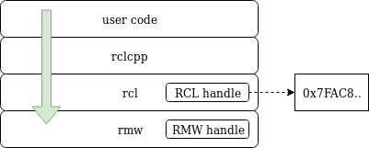
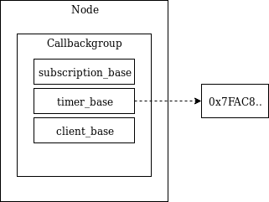
User code level (pseudo)
main() {
executor executor;
auto node = create_node;
auto subscriber1= node->create_subscription;
auto publisher1 = node->create_publisher;
auto timer1 = node->create_wall_timer(1s , publisher1);
executor.add_node(node);
executor.spin();
}

Slide 2
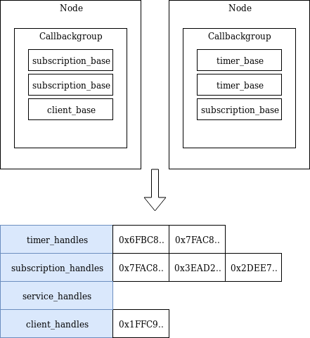
Collect entities
Weak ptrs to nodes get added to the executor then:
Executor walks through all
Nodes
Callback-groups
Timers
Subscriptions
Services
Clients
to collect RCL handles and store them

Slide 3
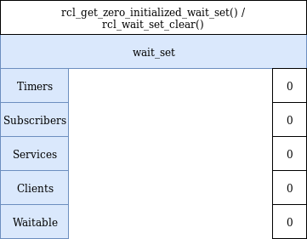
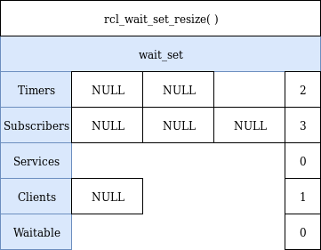
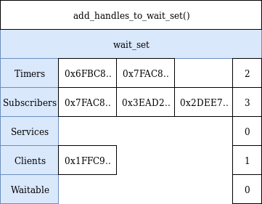
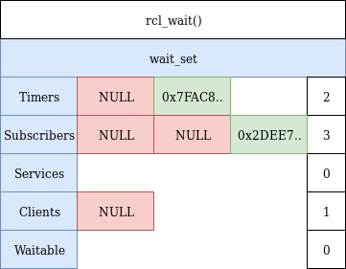
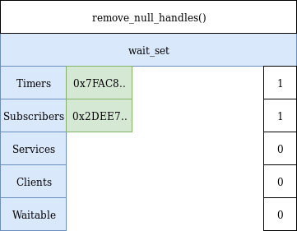
Creating a wait_set
A wait_set contains references to everything that potentially needs to be executed

Slide 4
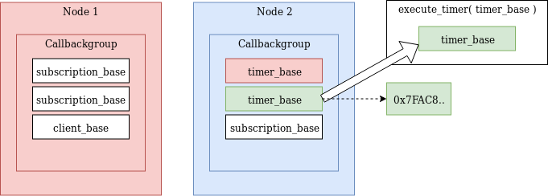
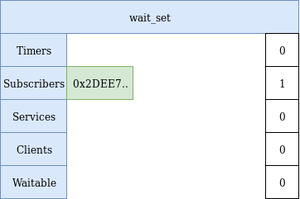
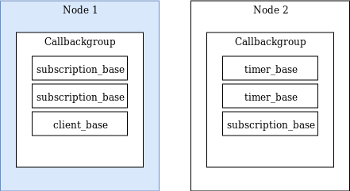
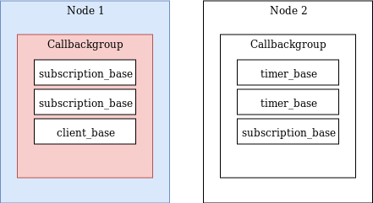
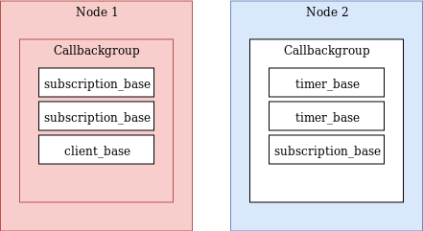
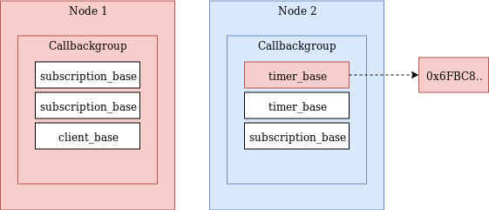
Executing an executable
Need a "base" that has a handle in the wait_set
get_next_ready_executable walks through timers, subscriptions, services and clients to find the first thing that is ready
Makes system dynamic but consumes a lot of CPU

Slide 5
Proposed solution
Assume system to be static
Collect entities once
Build the wait-set once
Don’t walk the tree to find executables
Instead:
Create a struct of bases that relates directly to the wait-set
if ready to execute -> execute
else skip it

Slide 6
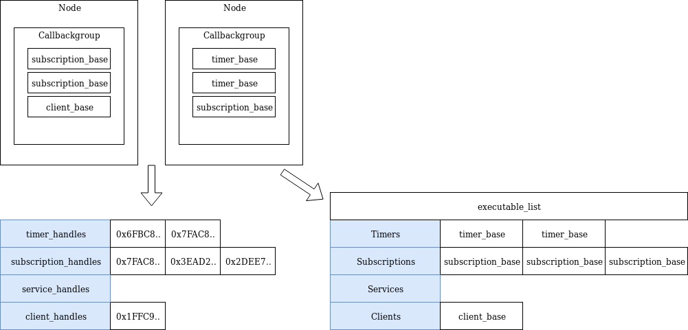
Static Executor - Implementation

Slide 7
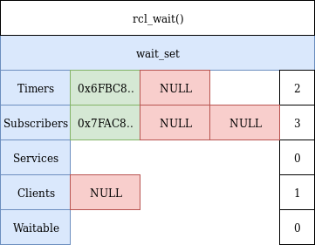
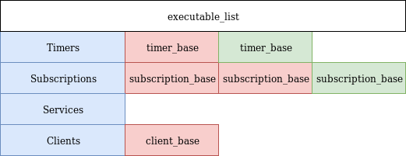
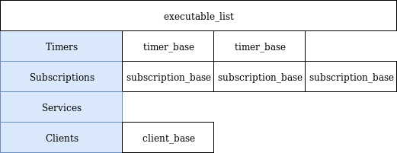
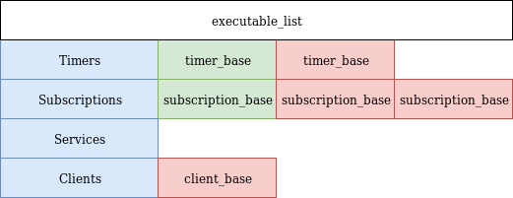
Static Executor - Implementation

Slide 8
Next Steps
Add event triggers to static executor
Improve scheduling (Bosch)
Priority
RT safe
Working on a PR https://github.com/ros2/rclcpp/pull/873
Implement community proposed changes
Get PR approved / assist in design of proper executor (share our information / data)

Slide 9
Thank you

