Slide 1
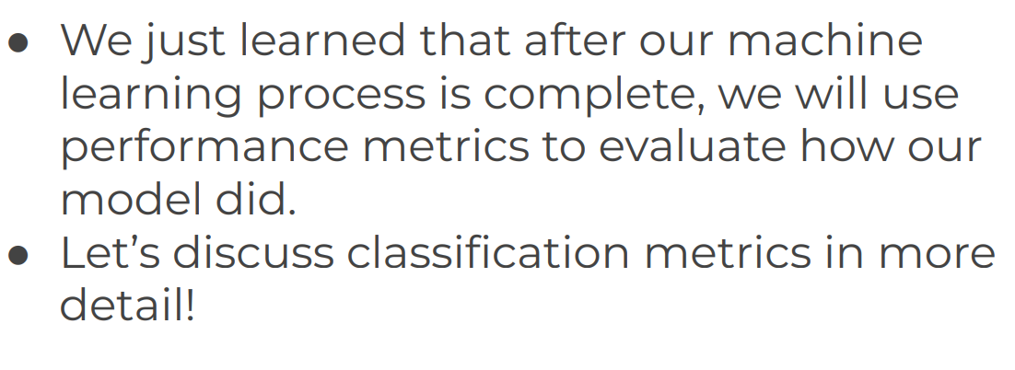
Evaluating Performance - Classification Error Metrics

Slide 2
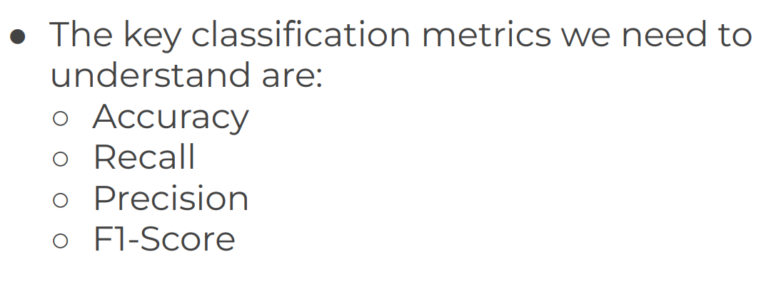
Evaluating Performance of Classification Error Metrics

Slide 3
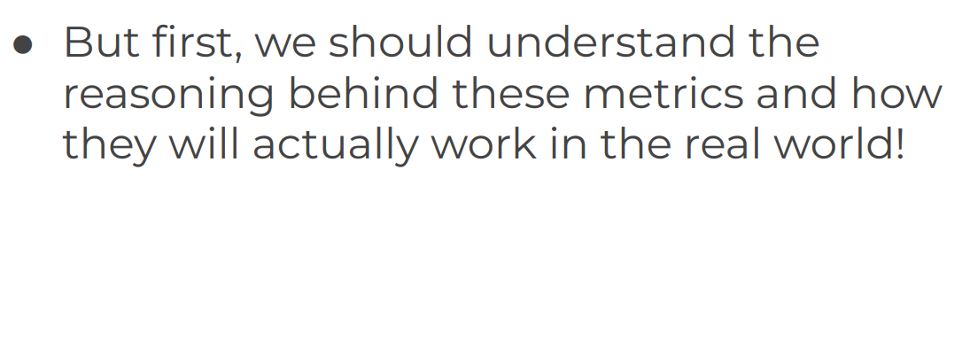
Evaluating Performance of Classification Error Metrics

Slide 4
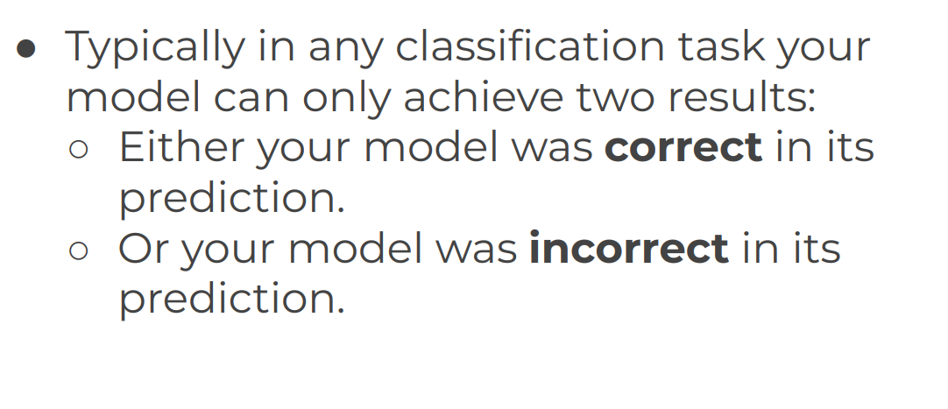
Evaluating Performance of Classification Error Metrics

Slide 5
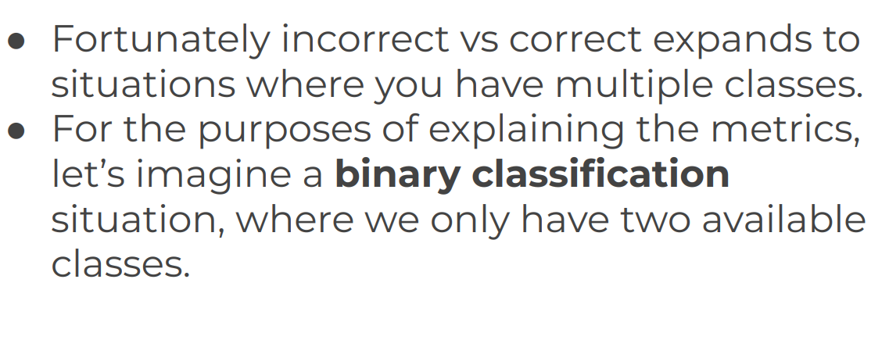
Evaluating Performance of Classification Error Metrics

Slide 6
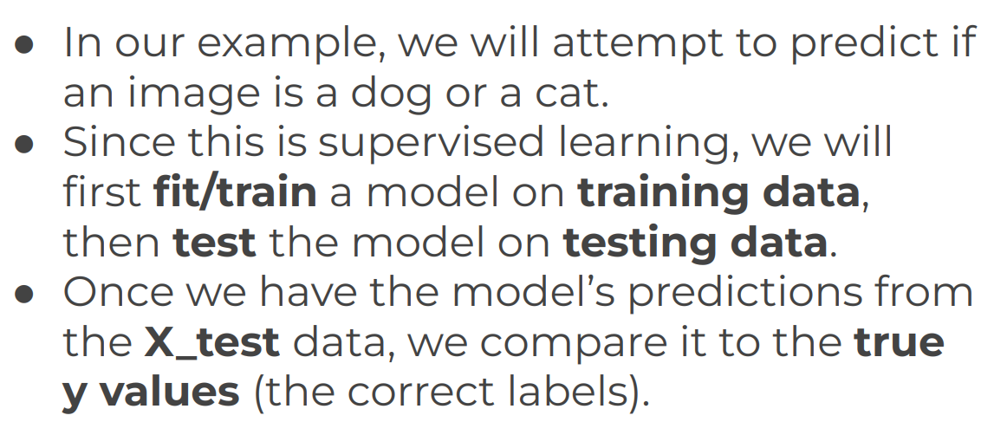
Evaluating Performance of Classification Error Metrics

Slide 7
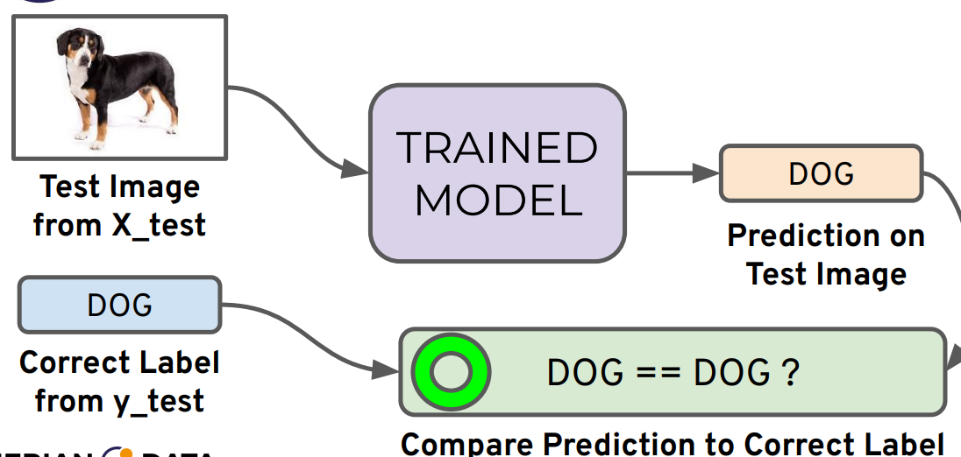
Evaluating Performance of Classification Error Metrics

Slide 8
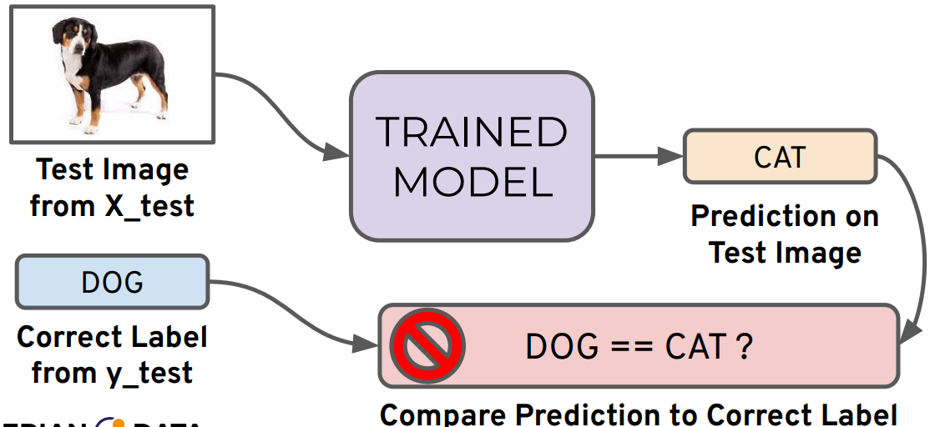
Evaluating Performance of Classification Error Metrics

Slide 9
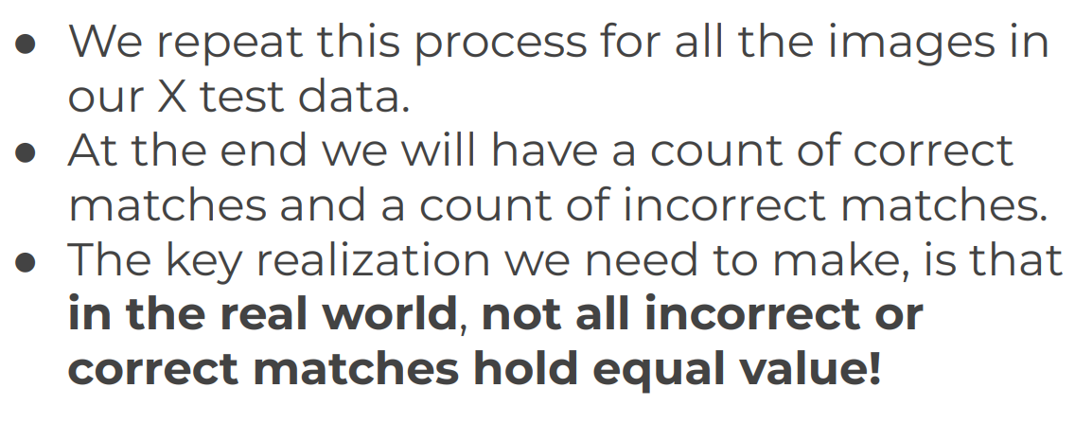
Evaluating Performance of Classification Error Metrics

Slide 10
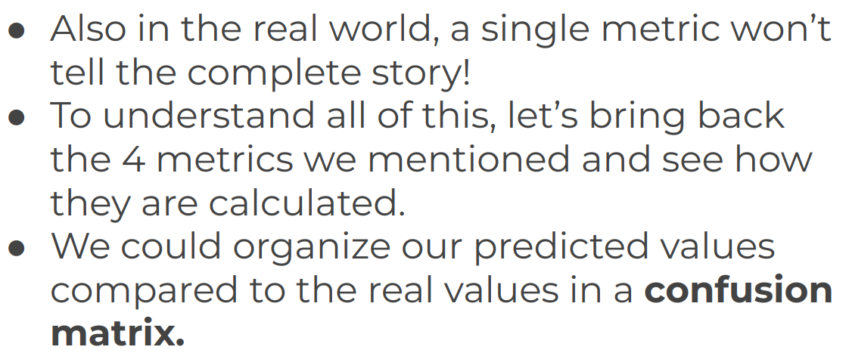
Evaluating Performance of Classification Error Metrics

Slide 11
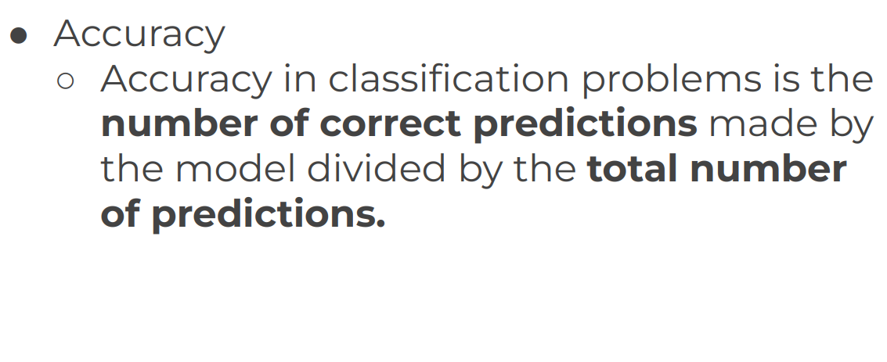
Evaluating Performance of Classification Error Metrics

Slide 12
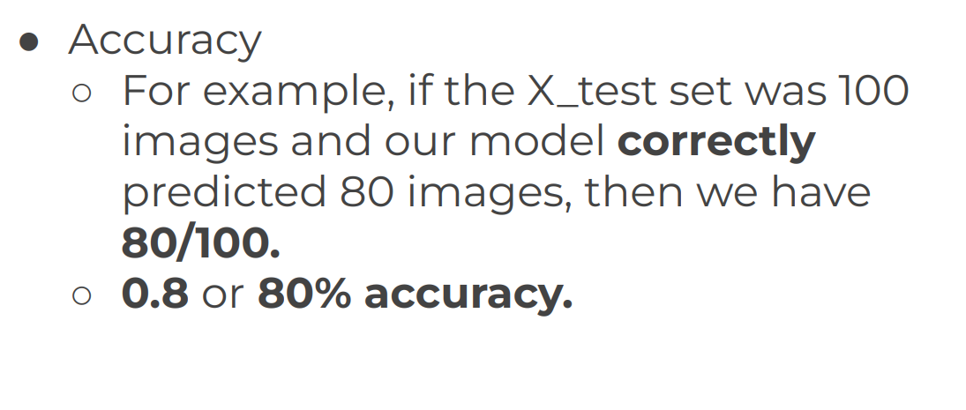
Evaluating Performance of Classification Error Metrics

Slide 13
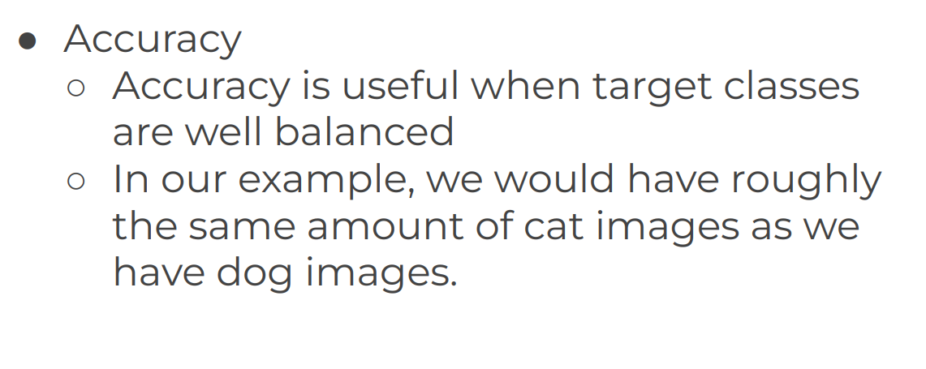
Evaluating Performance of Classification Error Metrics

Slide 14
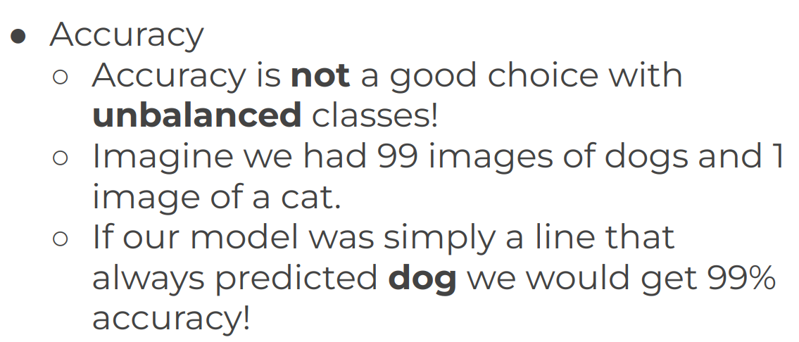
Evaluating Performance of Classification Error Metrics

Slide 15
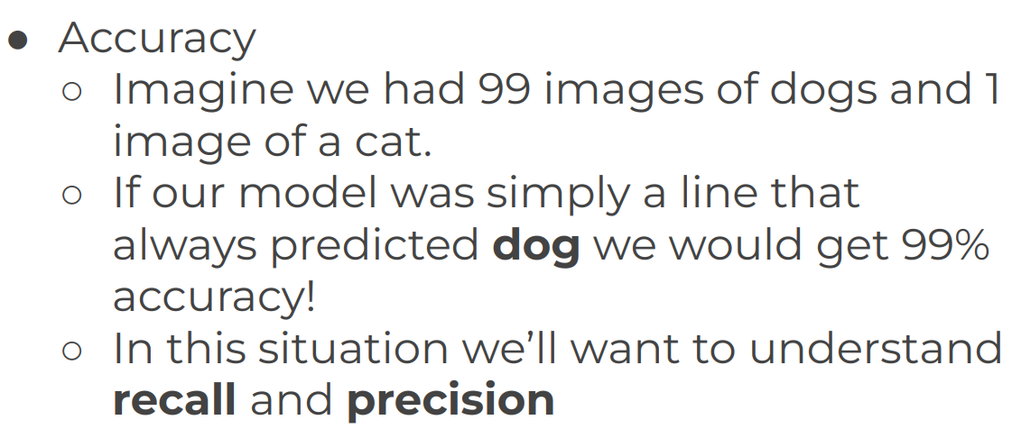
Evaluating Performance of Classification Error Metrics

Slide 16
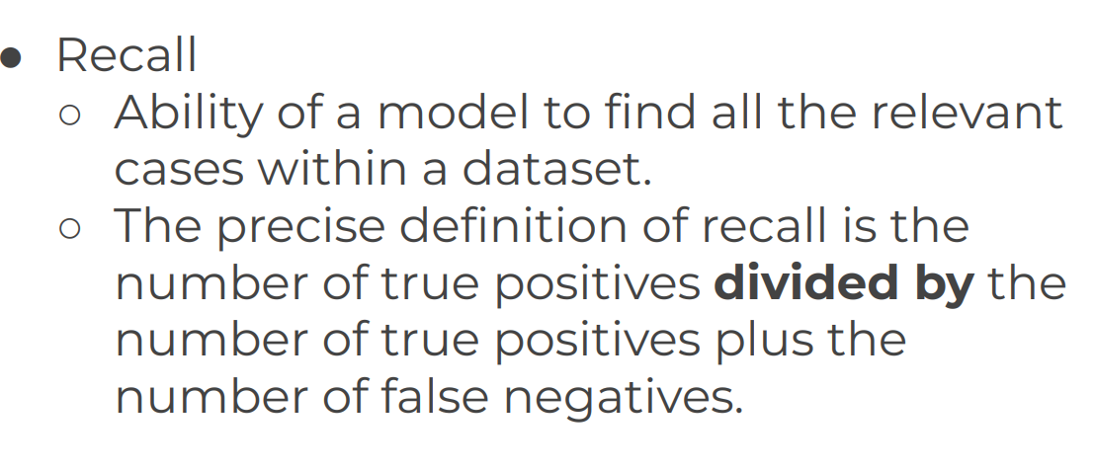
Evaluating Performance of Classification Error Metrics

Slide 17
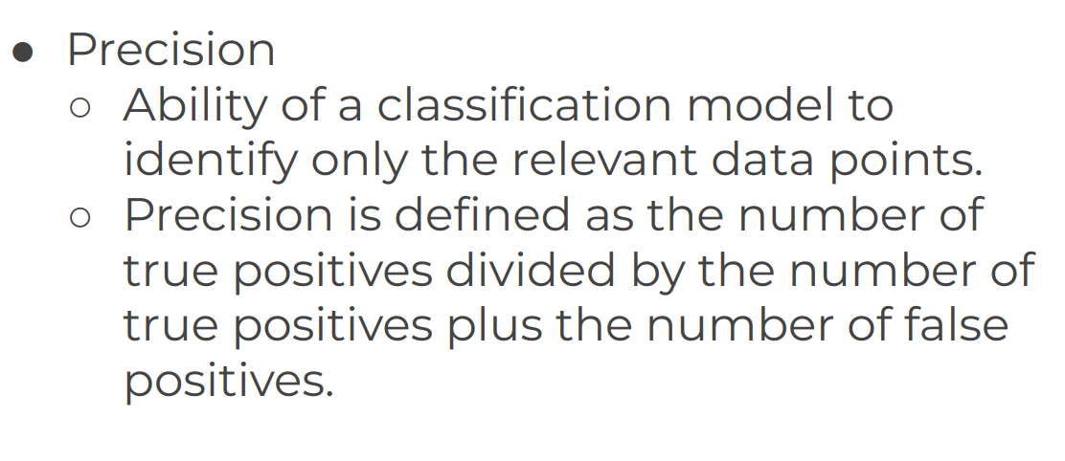
Evaluating Performance of Classification Error Metrics

Slide 18
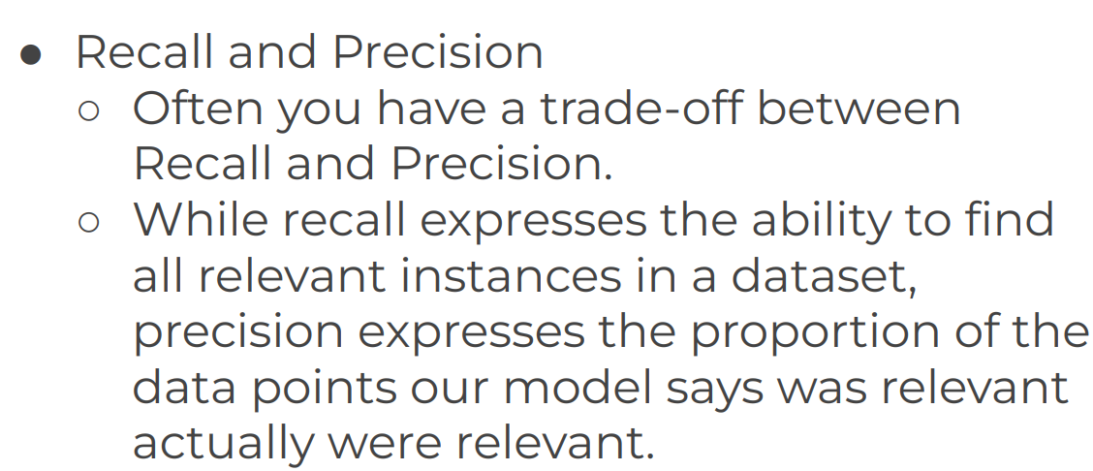
Evaluating Performance of Classification Error Metrics

Slide 19
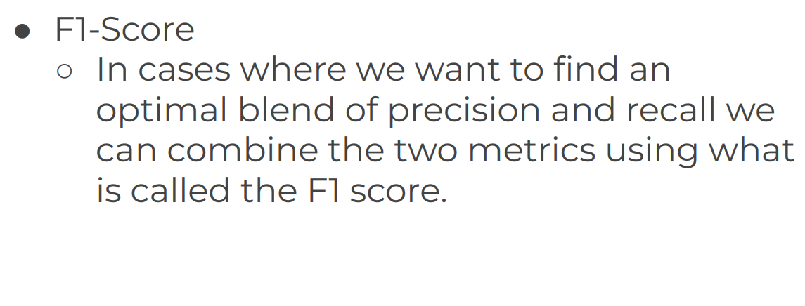
Evaluating Performance of Classification Error Metrics

Slide 20
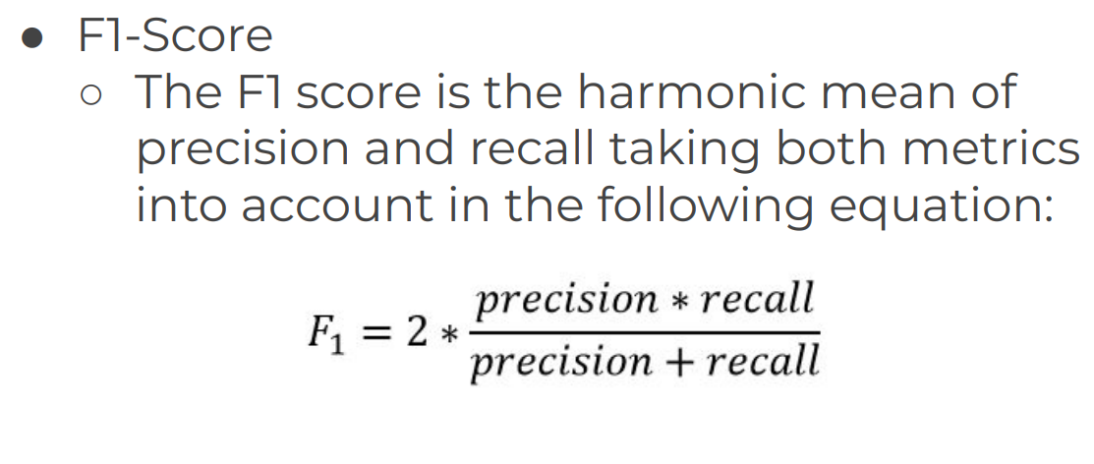
Evaluating Performance of Classification Error Metrics

Slide 21
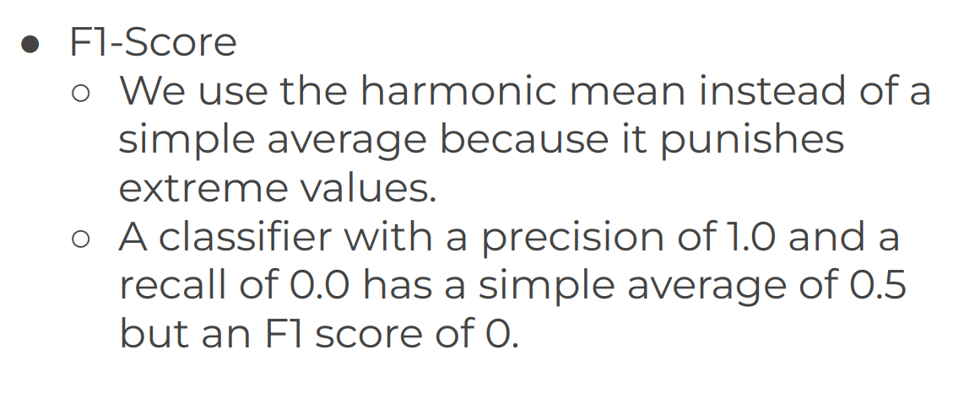
Evaluating Performance of Classification Error Metrics

Slide 22
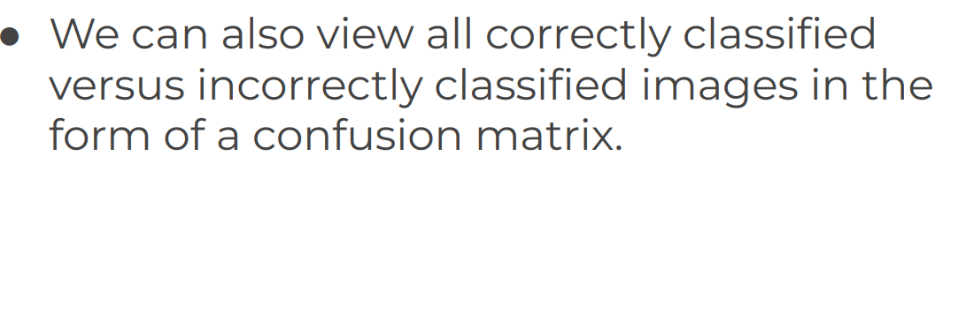
Evaluating Performance of Classification Error Metrics

Slide 23
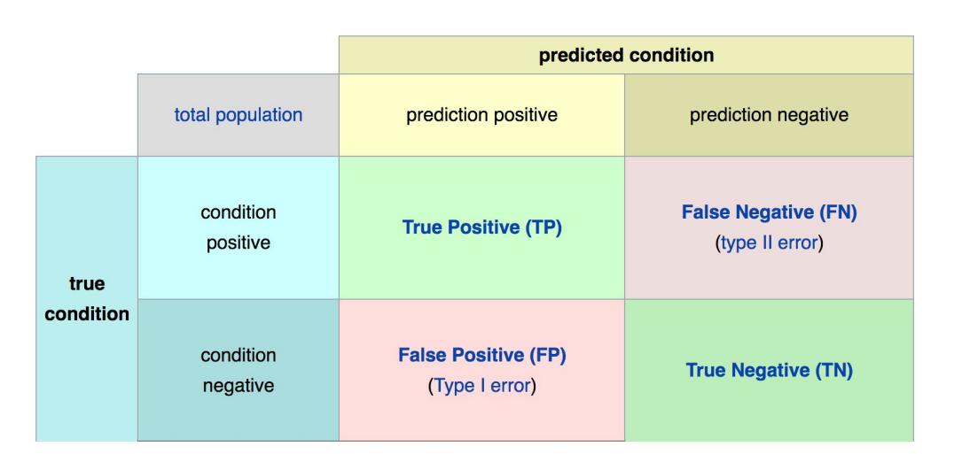
Evaluating Performance of Classification Error Metrics

Slide 24
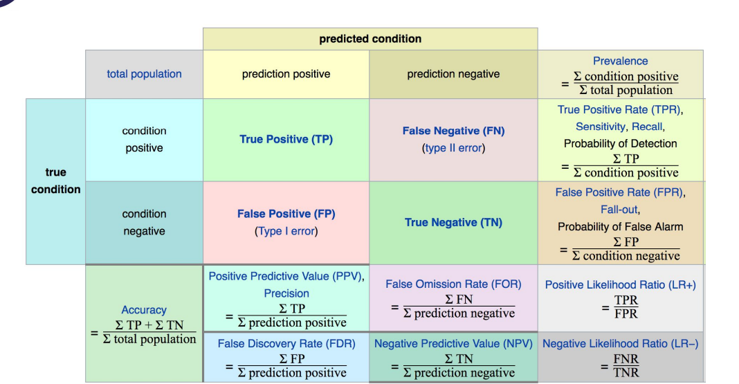
Evaluating Performance of Classification Error Metrics

Slide 25
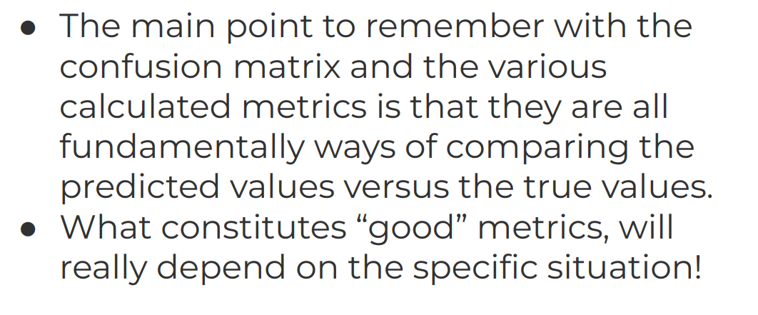
Evaluating Performance of Classification Error Metrics

Slide 26
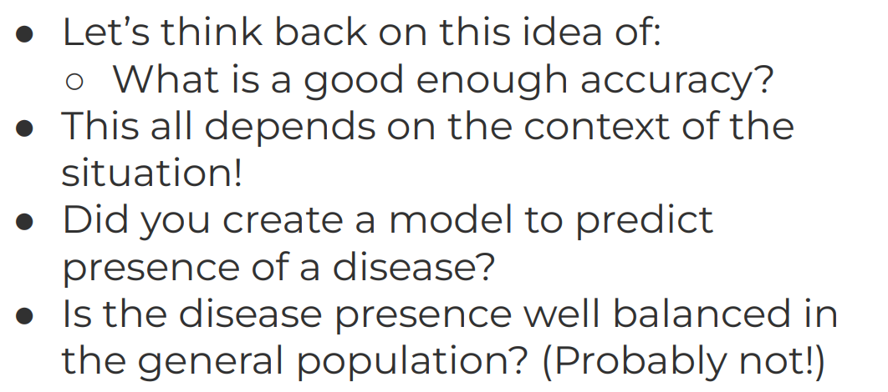
Evaluating Performance of Classification Error Metrics

Slide 27
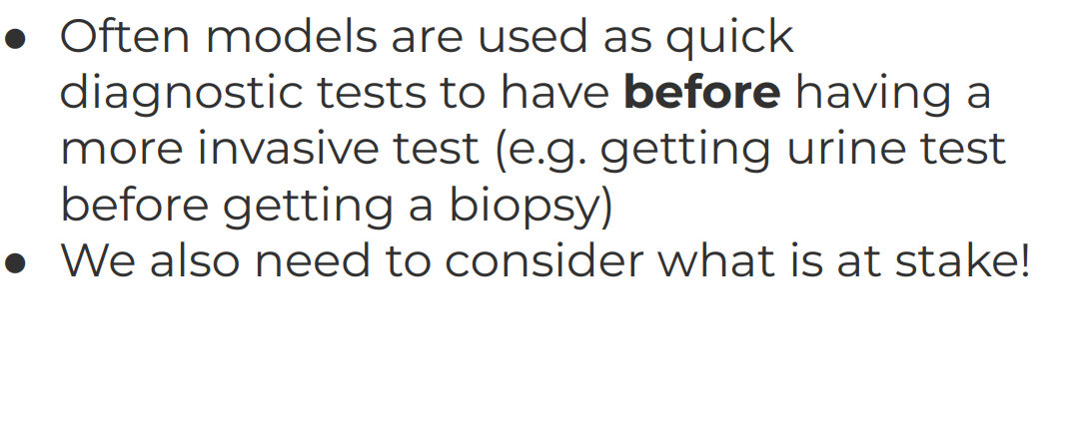
Evaluating Performance of Classification Error Metrics

Slide 28
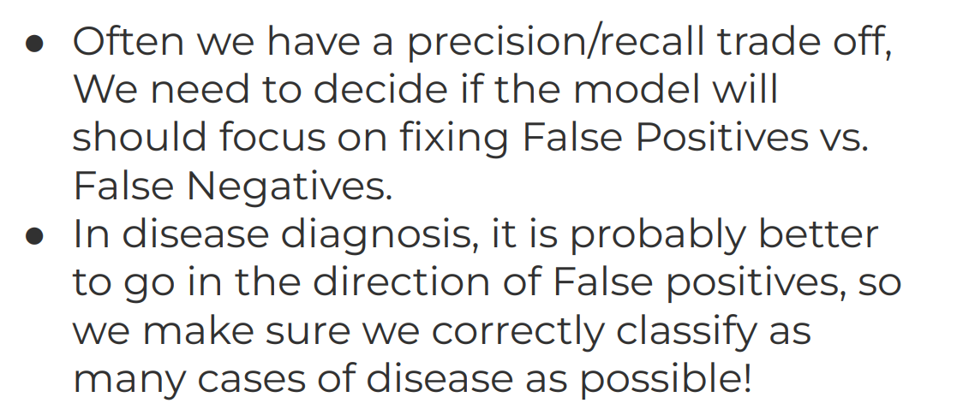
Evaluating Performance of Classification Error Metrics

Slide 29
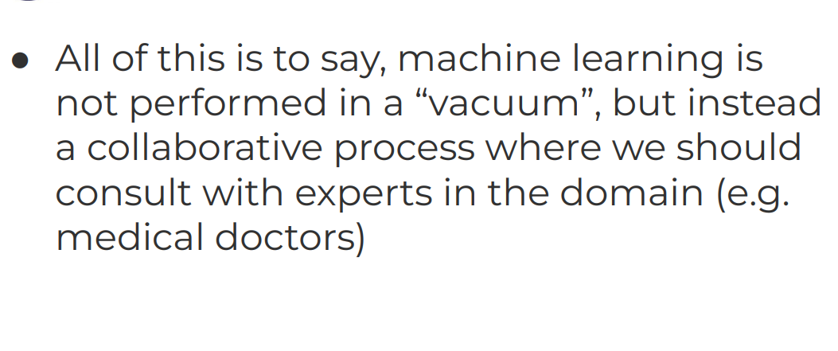
Evaluating Performance of Classification Error Metrics

