Slide 1
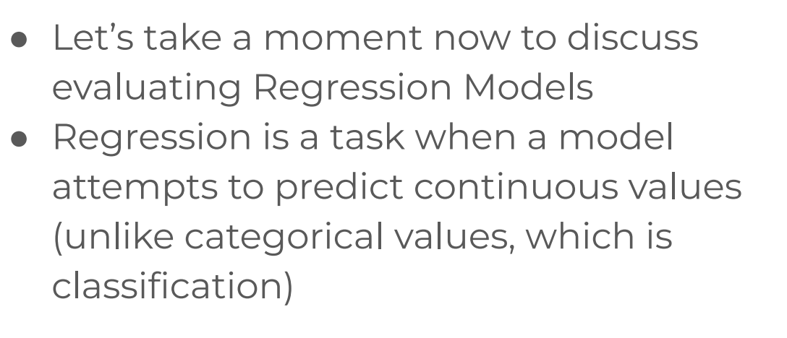
Evaluating Performance - Regression Error Metrics

Slide 2
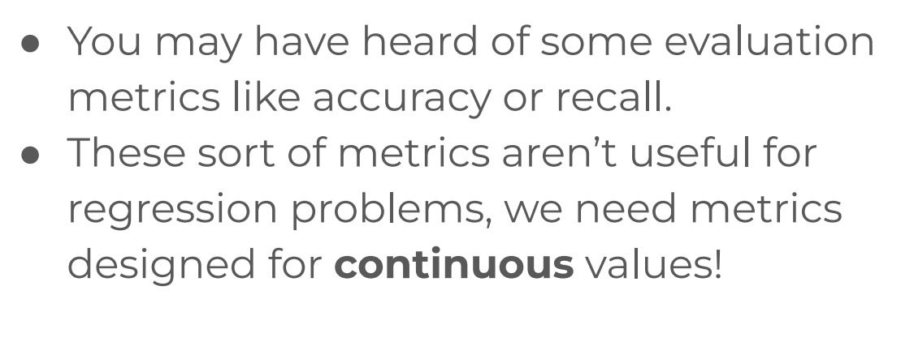
Evaluating Performance - Regression Error Metrics

Slide 3
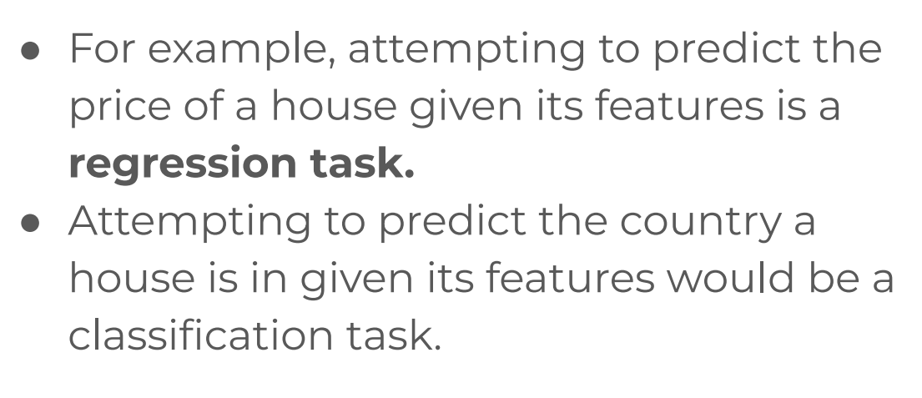
Evaluating Performance - Regression Error Metrics

Slide 4
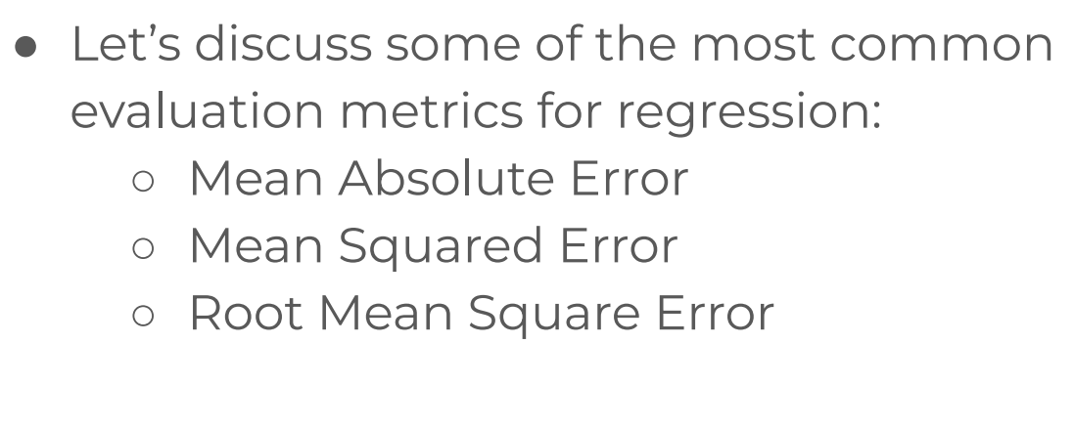
Evaluating Performance - Regression Error Metrics

Slide 5
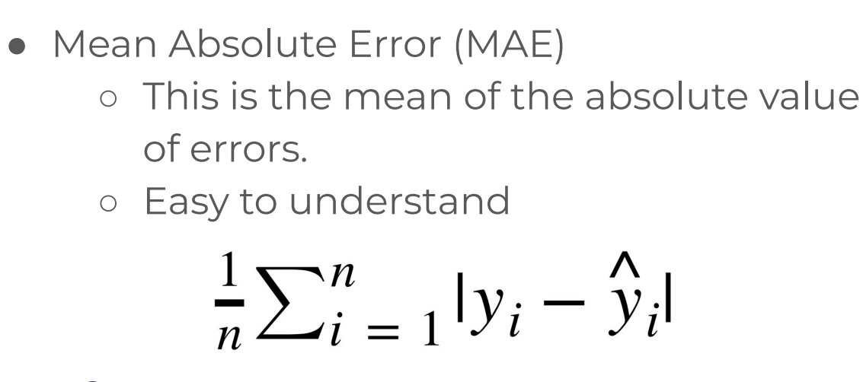
Evaluating Performance - Regression Error Metrics

Slide 6
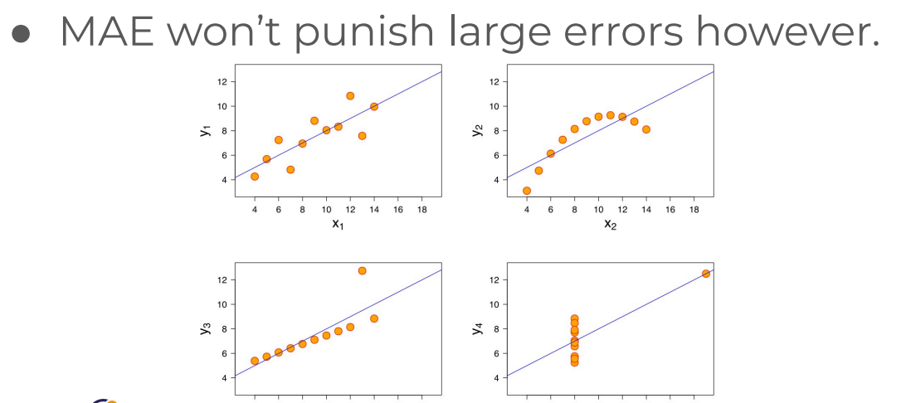
Evaluating Performance - Regression Error Metrics

Slide 7
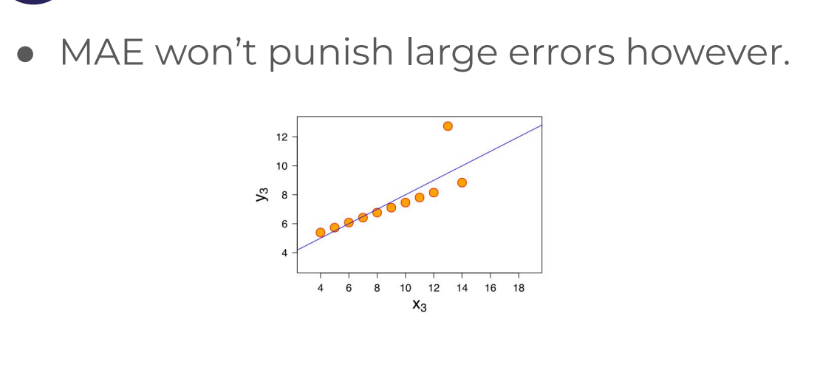
Evaluating Performance - Regression Error Metrics

Slide 8
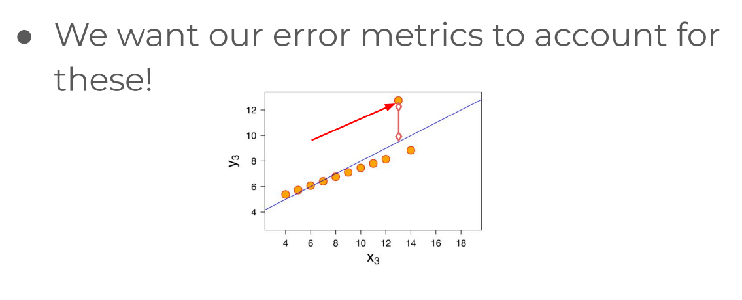
Evaluating Performance - Regression Error Metrics

Slide 9
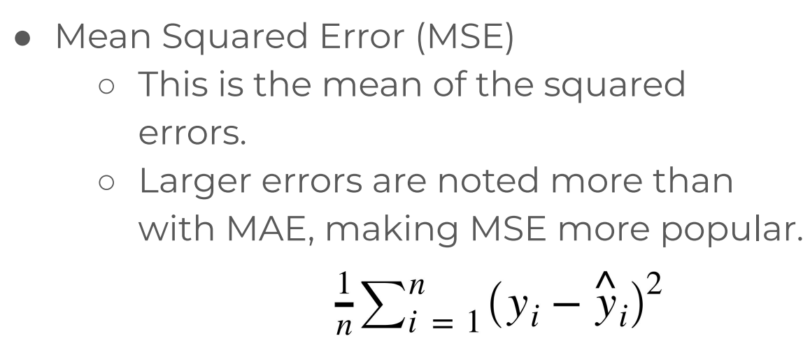
Evaluating Performance - Regression Error Metrics

Slide 10
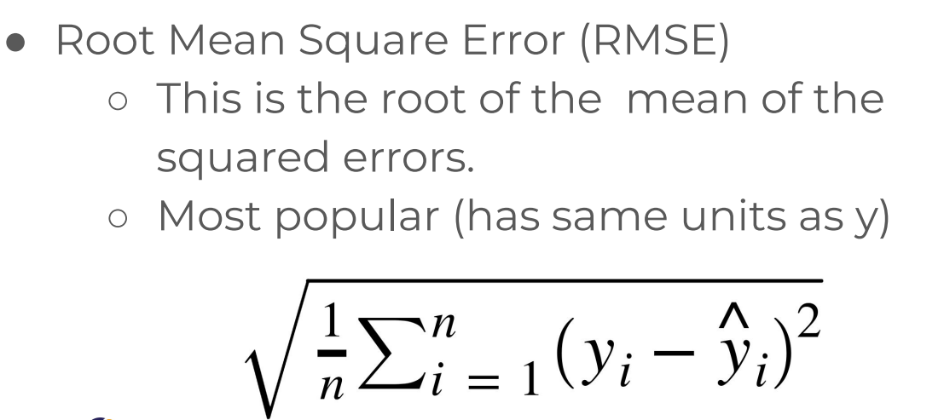
Evaluating Performance - Regression Error Metrics

Slide 11
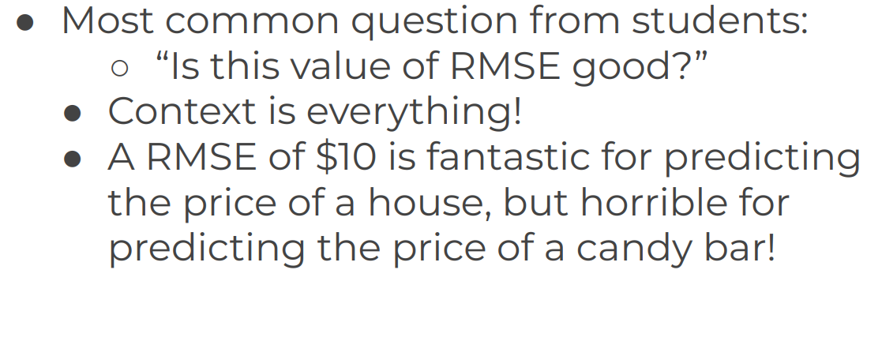
Evaluating Performance - Regression Error Metrics

Slide 12
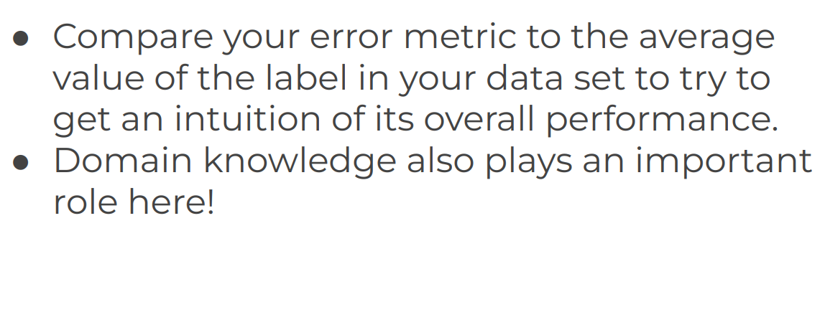
Evaluating Performance - Regression Error Metrics

Slide 13
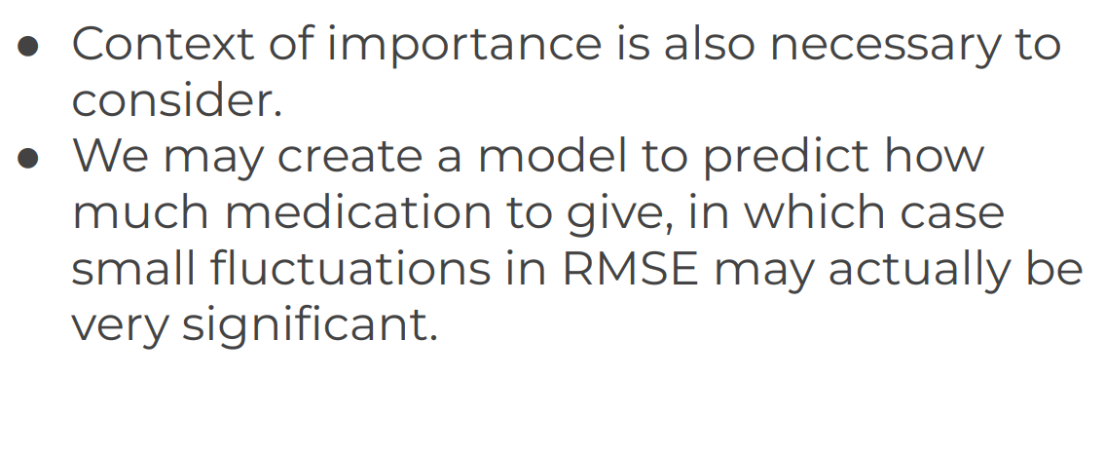
Evaluating Performance - Regression Error Metrics

Slide 14
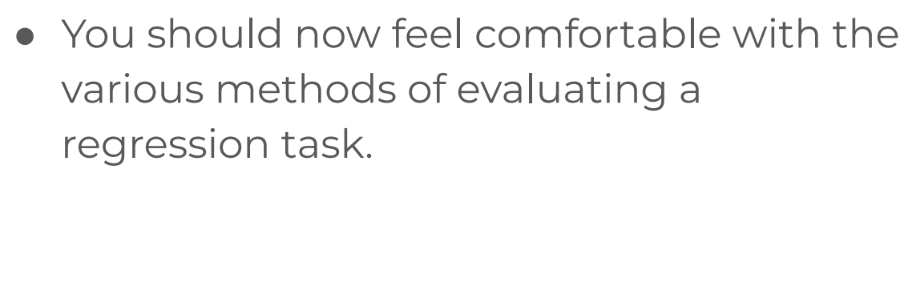
Evaluating Performance - Regression Error Metrics

