Slide 1
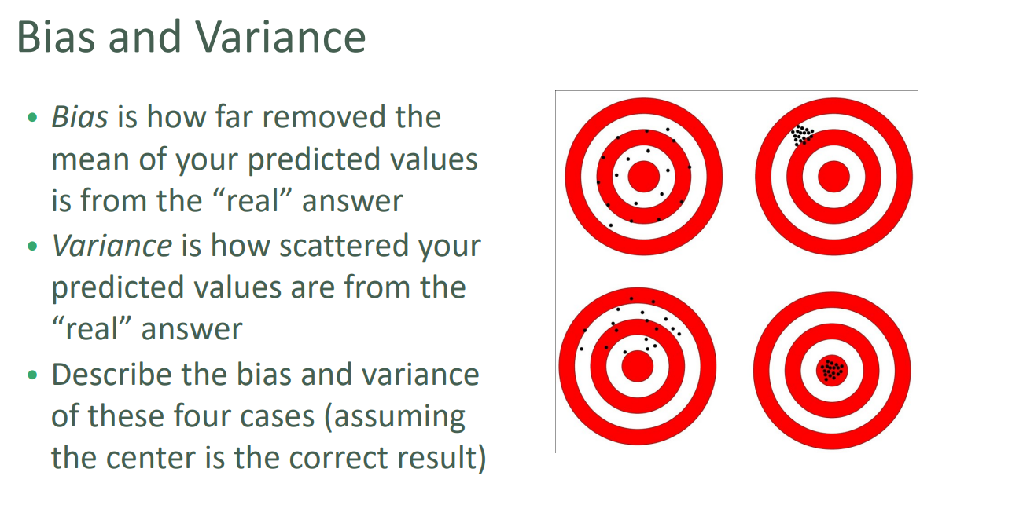
Bias Variance Trade Off

Slide 2
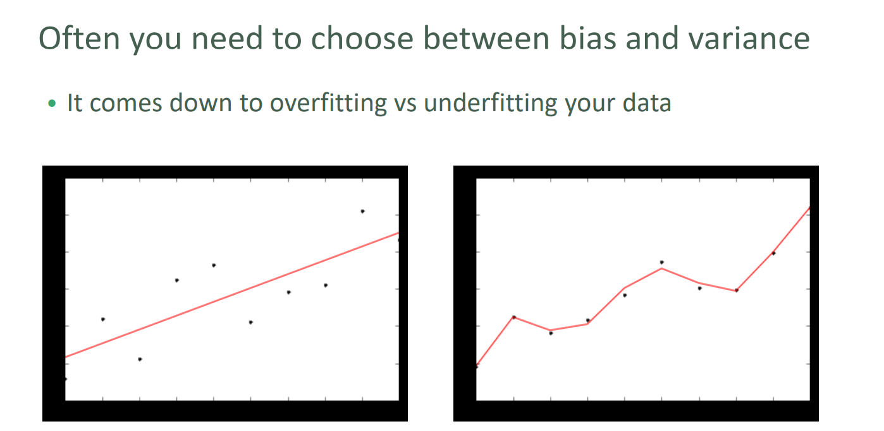
Bias Variance Trade Off

Slide 3
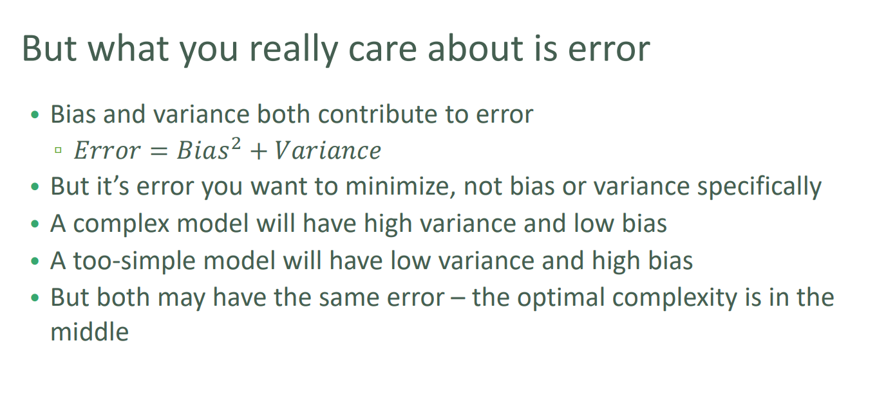
Bias Variance Trade Off

