Slide 1

Evaluating Performance
CLASSIFICATION

Slide 2
Model Evaluation
We just learned that after our machine learning process is complete, we will use performance metrics to evaluate how our model did.
Let’s discuss classification metrics in more detail!

Slide 3
Model Evaluation
The key classification metrics we need to understand are:
Accuracy
Recall
Precision
F1-Score

Slide 4
Model Evaluation
But first, we should understand the reasoning behind these metrics and how they will actually work in the real world!

Slide 5
Model Evaluation
Typically in any classification task your model can only achieve two results:
Either your model was correct in its prediction.
Or your model was incorrect in its prediction.

Slide 6
Model Evaluation
Fortunately incorrect vs correct expands to situations where you have multiple classes.
For the purposes of explaining the metrics, let’s imagine a binary classification situation, where we only have two available classes.

Slide 7
Model Evaluation
In our example, we will attempt to predict if an image is a dog or a cat.
Since this is supervised learning, we will first fit/train a model on training data, then test the model on testing data.
Once we have the model’s predictions from the X_test data, we compare it to the true y values (the correct labels).

Slide 8
Model Evaluation
TRAINED
MODEL

Slide 9
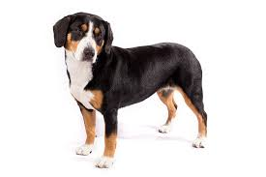
Model Evaluation
TRAINED
MODEL
Test Image
from X_test

Slide 10
Model Evaluation
TRAINED
MODEL
Test Image
from X_test
DOG
Correct Label
from y_test

Slide 11
Model Evaluation
TRAINED
MODEL
Test Image
from X_test
DOG
Prediction on
Test Image
DOG
Correct Label
from y_test

Slide 12
Model Evaluation
TRAINED
MODEL
Test Image
from X_test
DOG
Prediction on
Test Image
DOG
Correct Label
from y_test
DOG == DOG ?
Compare Prediction to Correct Label

Slide 13
Model Evaluation
TRAINED
MODEL
Test Image
from X_test
CAT
Prediction on
Test Image
DOG
Correct Label
from y_test
DOG == CAT ?
Compare Prediction to Correct Label

Slide 14
Model Evaluation
We repeat this process for all the images in our X test data.
At the end we will have a count of correct matches and a count of incorrect matches.
The key realization we need to make, is that in the real world, not all incorrect or correct matches hold equal value!

Slide 15
Model Evaluation
Also in the real world, a single metric won’t tell the complete story!
To understand all of this, let’s bring back the 4 metrics we mentioned and see how they are calculated.
We could organize our predicted values compared to the real values in a confusion matrix.

Slide 16
Model Evaluation
Accuracy
Accuracy in classification problems is the number of correct predictions made by the model divided by the total number of predictions.

Slide 17
Model Evaluation
Accuracy
For example, if the X_test set was 100 images and our model correctly predicted 80 images, then we have 80/100.
0.8 or 80% accuracy.

Slide 18
Model Evaluation
Accuracy
Accuracy is useful when target classes are well balanced
In our example, we would have roughly the same amount of cat images as we have dog images.

Slide 19
Model Evaluation
Accuracy
Accuracy is not a good choice with unbalanced classes!
Imagine we had 99 images of dogs and 1 image of a cat.
If our model was simply a line that always predicted dog we would get 99% accuracy!

Slide 20
Model Evaluation
Accuracy
Imagine we had 99 images of dogs and 1 image of a cat.
If our model was simply a line that always predicted dog we would get 99% accuracy!
In this situation we’ll want to understand recall and precision

Slide 21
Model Evaluation
Recall
Ability of a model to find all the relevant cases within a dataset.
The precise definition of recall is the number of true positives divided by the number of true positives plus the number of false negatives.

Slide 22
Model Evaluation
Precision
Ability of a classification model to identify only the relevant data points.
Precision is defined as the number of true positives divided by the number of true positives plus the number of false positives.

Slide 23
Model Evaluation
Recall and Precision
Often you have a trade-off between Recall and Precision.
While recall expresses the ability to find all relevant instances in a dataset, precision expresses the proportion of the data points our model says was relevant actually were relevant.

Slide 24
Model Evaluation
F1-Score
In cases where we want to find an optimal blend of precision and recall we can combine the two metrics using what is called the F1 score.

Slide 25
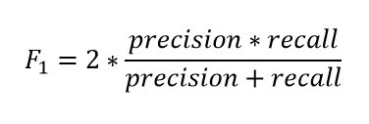
Model Evaluation
F1-Score
The F1 score is the harmonic mean of precision and recall taking both metrics into account in the following equation:

Slide 26
Model Evaluation
F1-Score
We use the harmonic mean instead of a simple average because it punishes extreme values.
A classifier with a precision of 1.0 and a recall of 0.0 has a simple average of 0.5 but an F1 score of 0.

Slide 27
Model Evaluation
We can also view all correctly classified versus incorrectly classified images in the form of a confusion matrix.

Slide 28
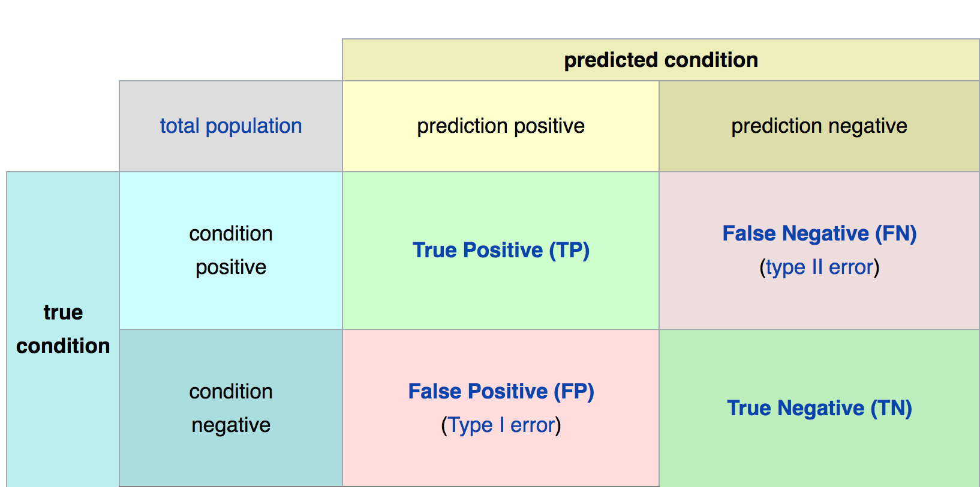
Confusion Matrix
Math &
Statistics
Machine Learning
DS
Software
Research
Domain
Knowledge

Slide 29
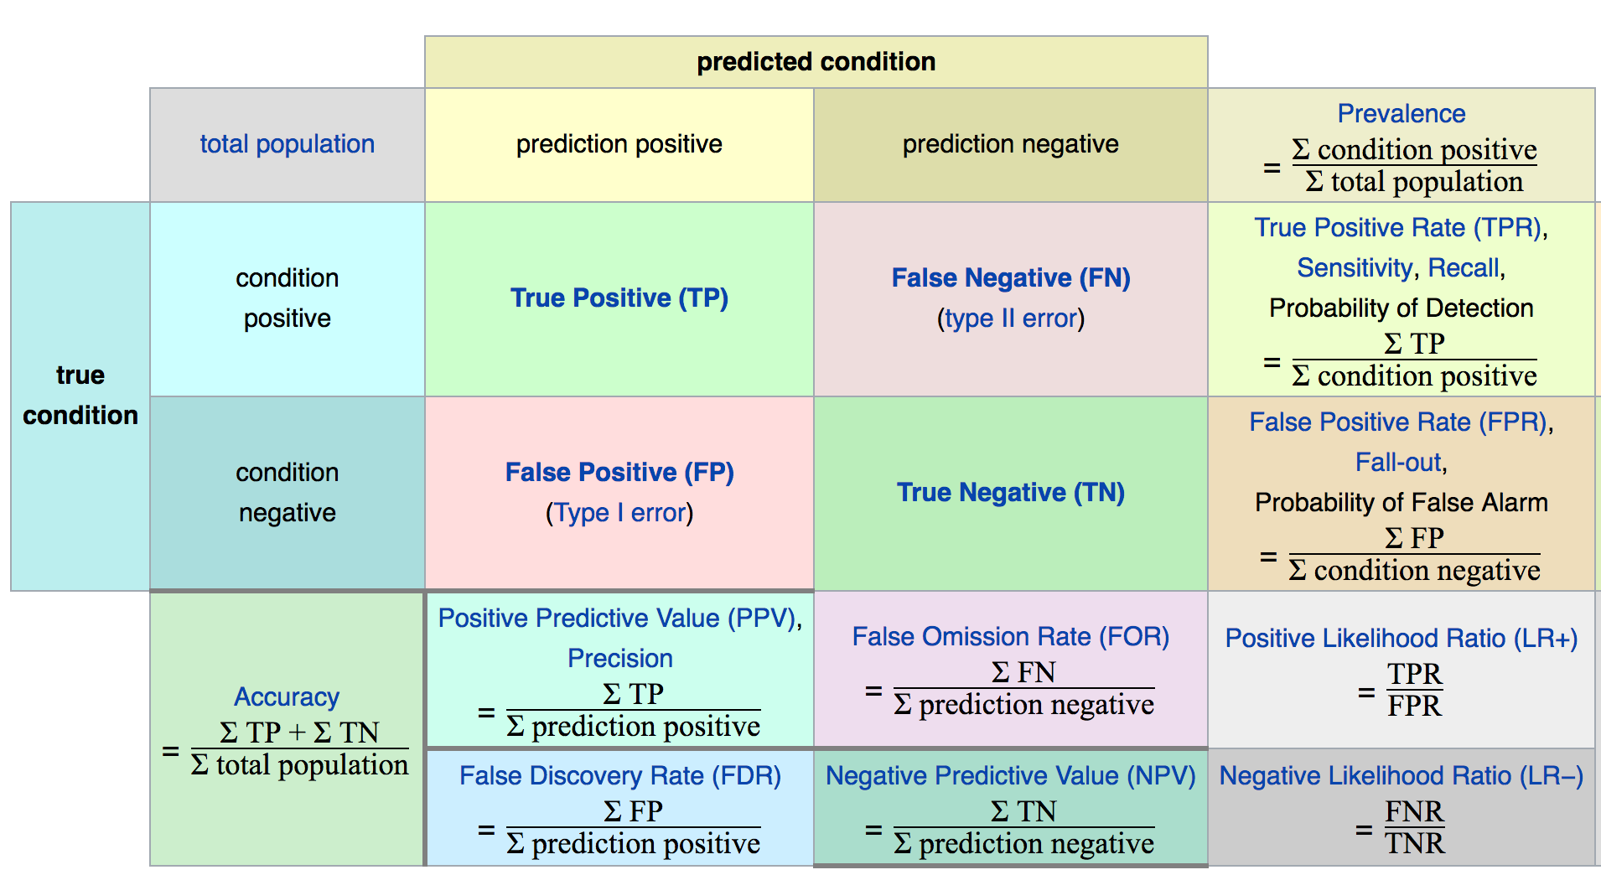
Confusion Matrix
Math &
Statistics
Machine Learning
DS
Software
Research
Domain
Knowledge

Slide 30
Model Evaluation
The main point to remember with the confusion matrix and the various calculated metrics is that they are all fundamentally ways of comparing the predicted values versus the true values.
What constitutes “good” metrics, will really depend on the specific situation!
Math &
Statistics
Machine Learning
DS
Software
Research
Domain
Knowledge

Slide 31
Model Evaluation
Still confused on the confusion matrix?
No problem! Check out the Wikipedia page for it, it has a really good diagram with all the formulas for all the metrics.
Throughout the training, we’ll usually just print out metrics (e.g. accuracy).
Math &
Statistics
Machine Learning
DS
Software
Research
Domain
Knowledge

Slide 32
Model Evaluation
Let’s think back on this idea of:
What is a good enough accuracy?
This all depends on the context of the situation!
Did you create a model to predict presence of a disease?
Is the disease presence well balanced in the general population? (Probably not!)
Math &
Statistics
Machine Learning
DS
Software
Research
Domain
Knowledge

Slide 33
Model Evaluation
Often models are used as quick diagnostic tests to have before having a more invasive test (e.g. getting urine test before getting a biopsy)
We also need to consider what is at stake!
Math &
Statistics
Machine Learning
DS
Software
Research
Domain
Knowledge

Slide 34
Model Evaluation
Often we have a precision/recall trade off, We need to decide if the model will should focus on fixing False Positives vs. False Negatives.
In disease diagnosis, it is probably better to go in the direction of False positives, so we make sure we correctly classify as many cases of disease as possible!
Math &
Statistics
Machine Learning
DS
Software
Research
Domain
Knowledge

Slide 35
Model Evaluation
All of this is to say, machine learning is not performed in a “vacuum”, but instead a collaborative process where we should consult with experts in the domain (e.g. medical doctors)
Math &
Statistics
Machine Learning
DS
Software
Research
Domain
Knowledge

