Slide 1
Evaluating Performance
REGRESSION

Slide 2
Evaluating Regression
Let’s take a moment now to discuss evaluating Regression Models
Regression is a task when a model attempts to predict continuous values (unlike categorical values, which is classification)

Slide 3
Evaluating Regression
You may have heard of some evaluation metrics like accuracy or recall.
These sort of metrics aren’t useful for regression problems, we need metrics designed for continuous values!

Slide 4
Evaluating Regression
For example, attempting to predict the price of a house given its features is a regression task.
Attempting to predict the country a house is in given its features would be a classification task.

Slide 5
Evaluating Regression
Let’s discuss some of the most common evaluation metrics for regression:
Mean Absolute Error
Mean Squared Error
Root Mean Square Error

Slide 6
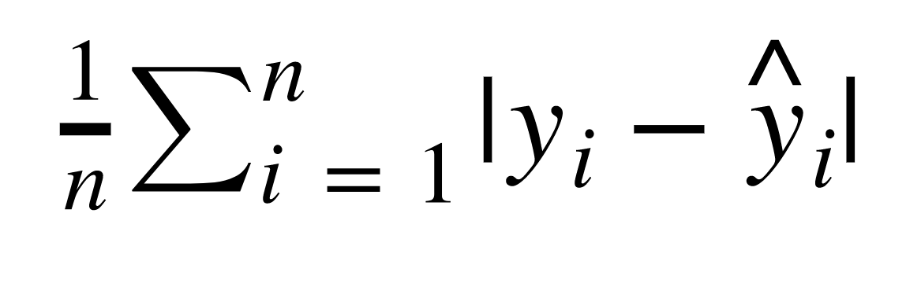
Evaluating Regression
Mean Absolute Error (MAE)
This is the mean of the absolute value of errors.
Easy to understand

Slide 7
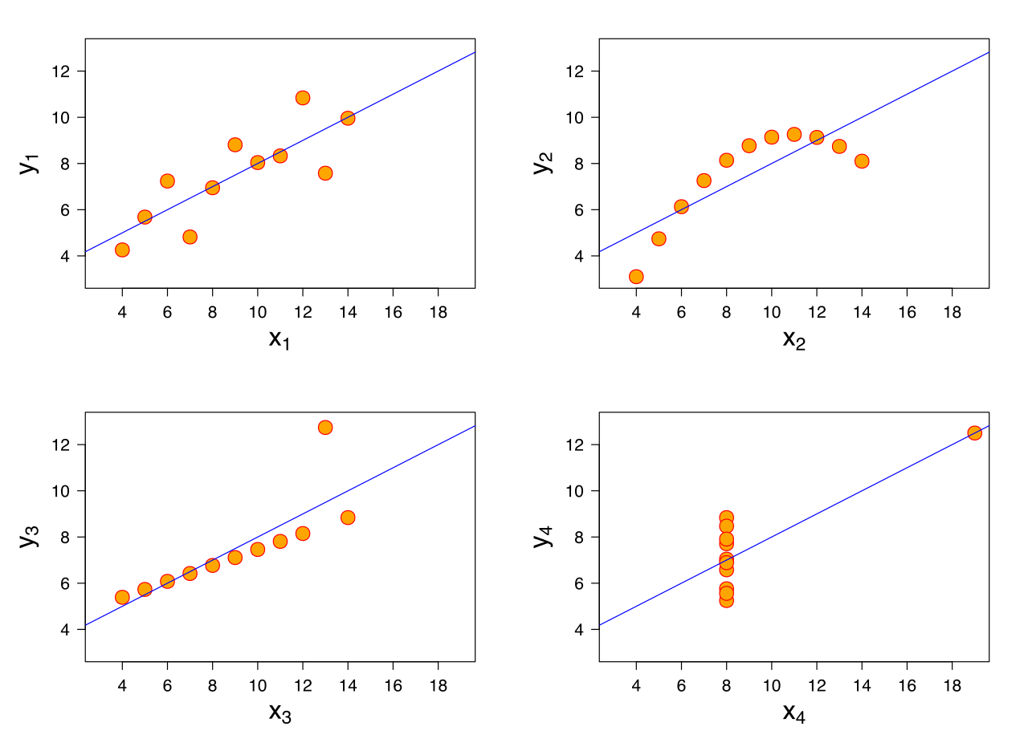
Evaluating Regression
MAE won’t punish large errors however.

Slide 8
Evaluating Regression
MAE won’t punish large errors however.

Slide 9
Evaluating Regression
We want our error metrics to account for these!

Slide 10
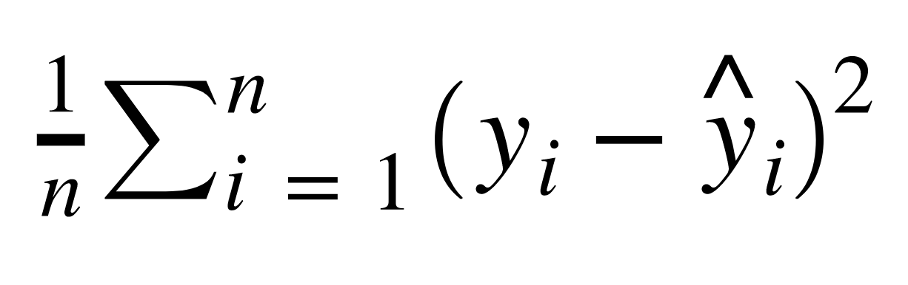
Evaluating Regression
Mean Squared Error (MSE)
This is the mean of the squared errors.
Larger errors are noted more than with MAE, making MSE more popular.

Slide 11
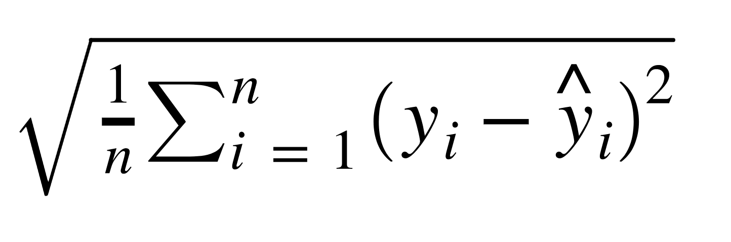
Evaluating Regression
Root Mean Square Error (RMSE)
This is the root of the mean of the squared errors.
Most popular (has same units as y)

Slide 12
Machine Learning
Most common question from students:
“Is this value of RMSE good?”
Context is everything!
A RMSE of $10 is fantastic for predicting the price of a house, but horrible for predicting the price of a candy bar!

Slide 13
Machine Learning
Compare your error metric to the average value of the label in your data set to try to get an intuition of its overall performance.
Domain knowledge also plays an important role here!

Slide 14
Machine Learning
Context of importance is also necessary to consider.
We may create a model to predict how much medication to give, in which case small fluctuations in RMSE may actually be very significant.

