Slide 1
Machine Learning
with Python

Slide 2
Scikit Learn
We will be using the Scikit Learn package.
It’s the most popular machine learning package for Python and has a lot of algorithms built-in!

Slide 3
Scikit Learn
You’ll need to install it using:
conda install scikit-learn
or
pip install scikit-learn

Slide 4
Scikit Learn
Let’s talk about the basic structure of how to use Scikit Learn!
First, a quick review of the machine learning process.

Slide 5
Machine Learning Process
Test
Data
Model
Training &
Building
Data
Acquisition
Data
Cleaning
Model
Testing
Model
Deployment

Slide 6
Scikit Learn
Now let’s go over an example of the process to use SciKit Learn.
Don’t worry about memorizing any of this, we’ll get plenty of practice and review when we actually start coding in subsequent lectures!

Slide 7
Scikit Learn
Every algorithm is exposed in scikit-learn via an ''Estimator''
First you’ll import the model, the general form is:
from sklearn.family import Model
For example:
from sklearn.linear_model import LinearRegression

Slide 8
Scikit Learn
Estimator parameters: All the parameters of an estimator can be set when it is instantiated, and have suitable default values.
You can use Shift+tab in jupyter to check the possible parameters.

Slide 9
Scikit Learn
For example:
model = LinearRegression(normalize=True)
print(model)
LinearRegression(copy_X=True, fit_intercept=True, normalize=True)

Slide 10
Scikit Learn
Once you have your model created with your parameters, it is time to fit your model on some data!
But remember, we should split this data into a training set and a test set.

Slide 11
Scikit Learn
>>> import numpy as np >>> from sklearn.model_selection import train_test_split >>> X, y = np.arange(10).reshape((5, 2)), range(5) >>> X array([[0, 1], [2, 3], [4, 5], [6, 7], [8, 9]]) >>> list(y) [0, 1, 2, 3, 4]

Slide 12
Scikit Learn
>>> X_train, X_test, y_train, y_test = train_test_split(X, y,test_size=0.3) >>> X_train array([[4, 5], [0, 1], [6, 7]]) >>> y_train [2, 0, 3] >>> X_test array([[2, 3], [8, 9]]) >>> y_test [1, 4]

Slide 13
Scikit Learn
Now that we have split the data, we can train/fit our model on the training data.
This is done through the model.fit() method:
model.fit(X_train,y_train)

Slide 14
Scikit Learn
Now the model has been fit and trained on the training data.
The model is ready to predict labels or values on the test set!

Slide 15
Scikit Learn
We get predicted values using the predict method:
predictions = model.predict(X_test)

Slide 16
Scikit Learn
We can then evaluate our model by comparing our predictions to the correct values.
The evaluation method depends on what sort of machine learning algorithm we are using (e.g. Regression,Classification, Clustering, etc.)

Slide 17
Scikit Learn
Scikit-learn strives to have a uniform interface across all methods, and we'll see examples of these below.
Given a scikit-learn estimator object named model, the following methods are available...

Slide 18
Scikit Learn
Available in all Estimators
model.fit() : fit training data.
For supervised learning applications, this accepts two arguments: the data X and the labels y (e.g. model.fit(X, y)).
For unsupervised learning applications, this accepts only a single argument, the data X (e.g. model.fit(X)).

Slide 19
Scikit Learn
Available in supervised estimators
model.predict() : given a trained model, predict the label of a new set of data. This method accepts one argument, the new data X_new (e.g. model.predict(X_new)), and returns the learned label for each object in the array.

Slide 20
Scikit Learn
Available in supervised estimators
model.predict_proba() : For classification problems, some estimators also provide this method, which returns the probability that a new observation has each categorical label. In this case, the label with the highest probability is returned by model.predict().

Slide 21
Scikit Learn
Available in supervised estimators
model.score() : for classification or regression problems, most estimators implement a score method. Scores are between 0 and 1, with a larger score indicating a better fit.

Slide 22
Scikit Learn
Available in unsupervised estimators
model.predict() : predict labels in clustering algorithms.

Slide 23
Scikit Learn
Available in unsupervised estimators
model.transform() : given an unsupervised model, transform new data into the new basis. This also accepts one argument X_new, and returns the new representation of the data based on the unsupervised model.

Slide 24
Scikit Learn
Available in unsupervised estimators
model.fit_transform() : some estimators implement this method, which more efficiently performs a fit and a transform on the same input data.

Slide 25
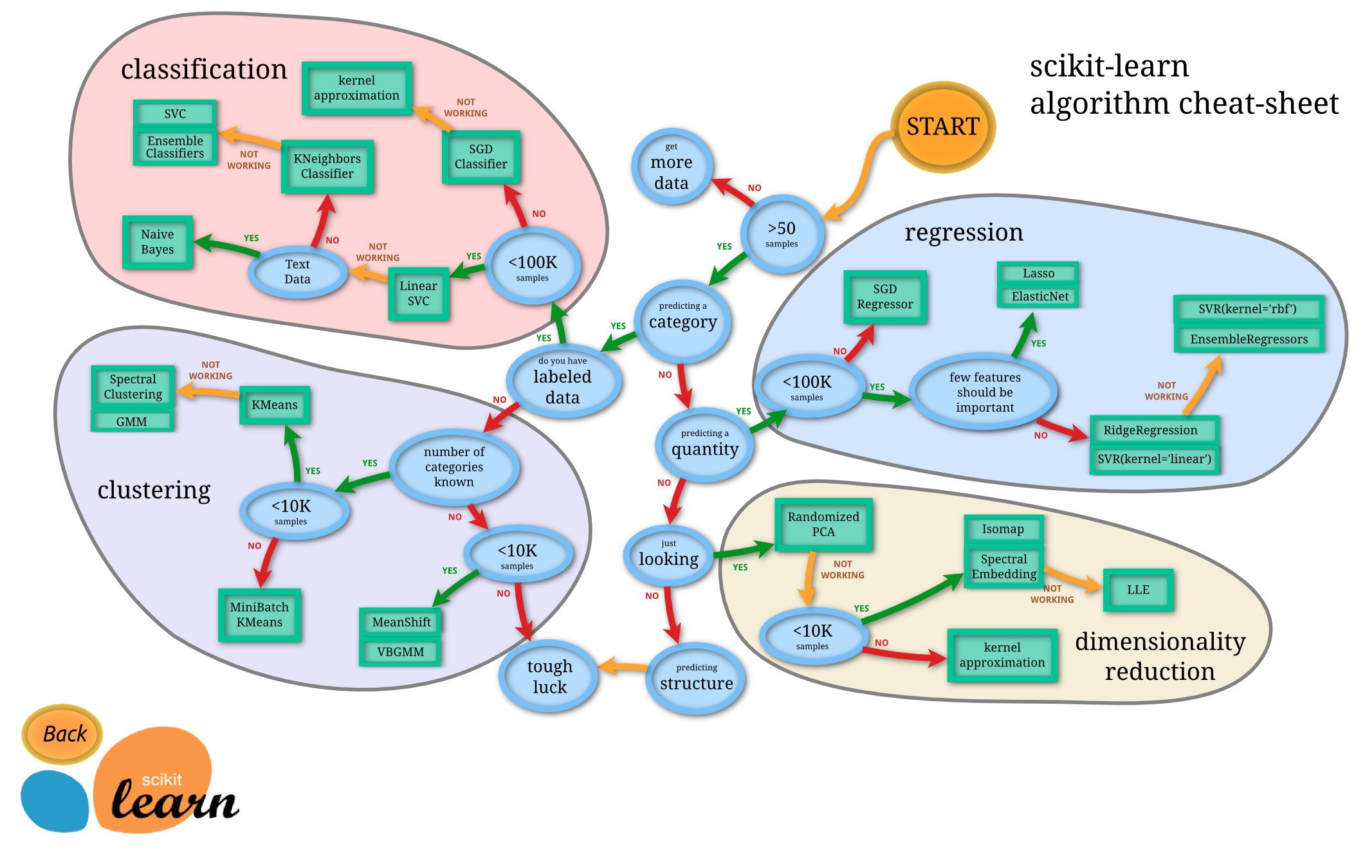
Choosing an Algorithm

