Slide 1
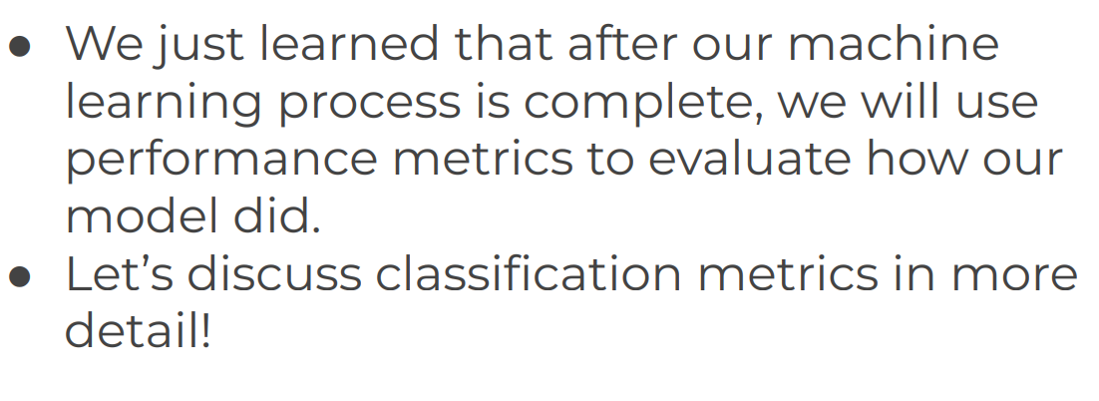
Evaluating Performance of Classification Error Metrics

Slide 2
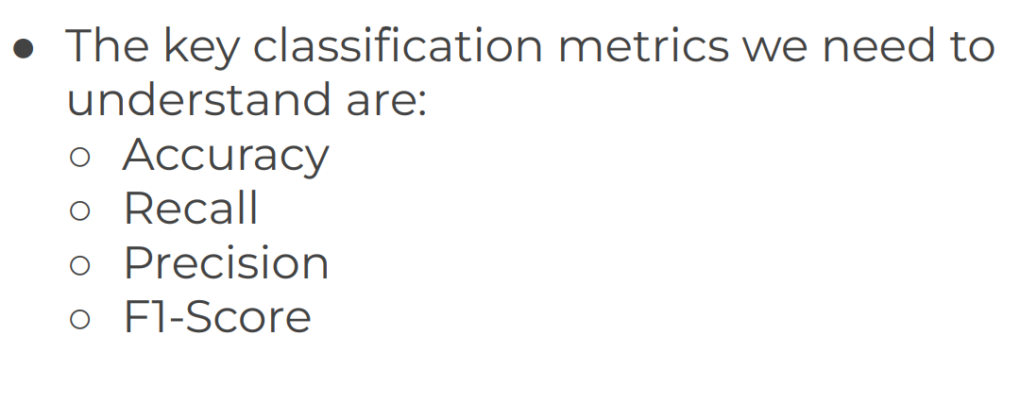
Evaluating Performance of Classification Error Metrics

Slide 3
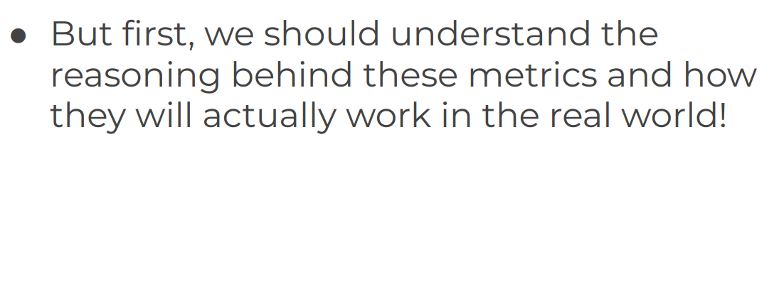
Evaluating Performance of Classification Error Metrics

Slide 4
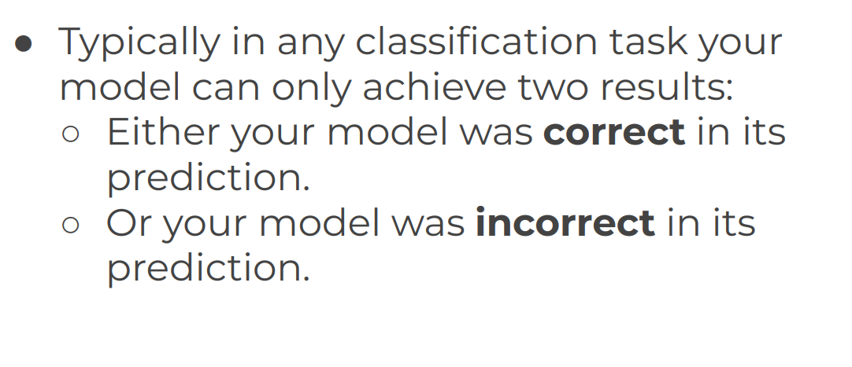
Evaluating Performance of Classification Error Metrics

Slide 5
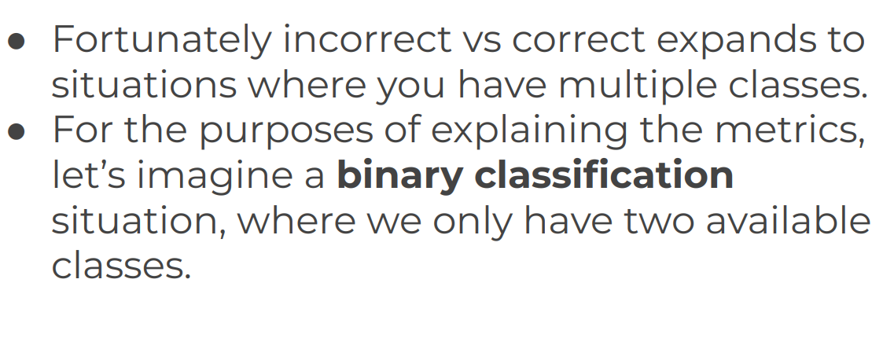
Evaluating Performance of Classification Error Metrics

Slide 6
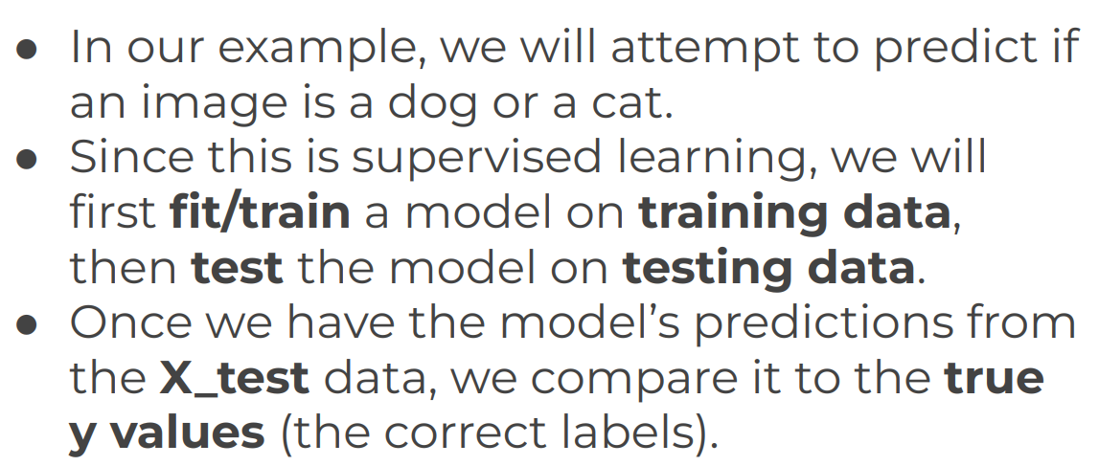
Evaluating Performance of Classification Error Metrics

